Slide 1
WRF—Week3
Benchmark case test
MIC version test
Cluster of 10 (160 processes)

Slide 2
Benchmark case

Slide 3
Purpose for the benchmark
Demonstrate computational performance and scaling of the WRF model on target architectures.
Ignores I/O and initialization costs.
Provide a means for comparing the performance of different architectures and for comparing WRF computational performance and scaling with other models.
Notes:
Demonstrate computational performance and scaling of the WRF model on
target architectures. This is a measure of integration speed and,
unless otherwise noted for a specific case, ignores I/O and
initialization costs. The benchmarks are intended to provide a means
for comparing the performance of different architectures and for
comparing WRF computational performance and scaling with other models.

Slide 4
Definitions
Performance is model speed, ignoring I/O and initialization cost, directly measured as the average cost per time step over a representative period of model integration, and is presented as normalized floating-point rate and as simulation speed;
Includes all different types of time-step in the proportions they will occur for any length simulation;
Provides a number of sequences of the complete set of time steps to reasonably represent performance variability stemming from varying state of the atmosphere being simulated and operational variability of the computer system itself.

Slide 5
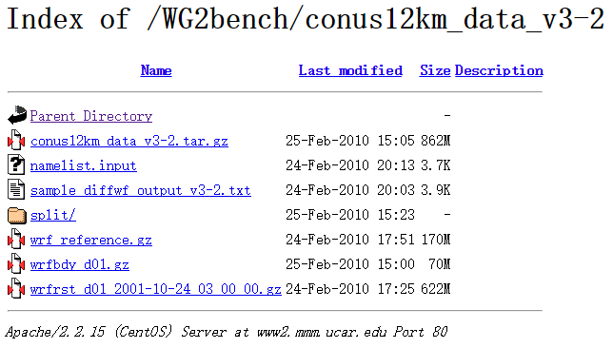
Case files (restarting case)
http://www2.mmm.ucar.edu/WG2bench/conus12km_data_v3-2/

Slide 6
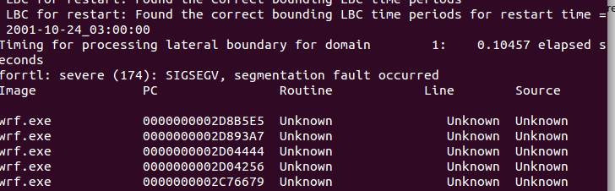
Problems
Stack limitation:
Ulimit –s unlimited
Small number of processes (Over 20GB Mem):
Cluster Environments

Slide 7
MPI with 32 processes test
-data-limit: Specify the limitation of the amount of collected data. (Default 500MB)
amplxe-cl -collect hotspots -r report-1 -data-limit 2000 mpirun -np 32 ./wrf.exe
Hyper-Threading: 16+16
Relatively poor performance

Slide 8
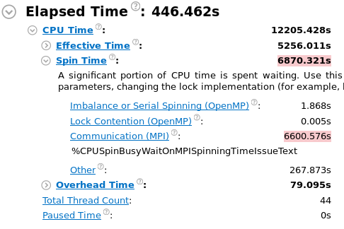
Results

Slide 9
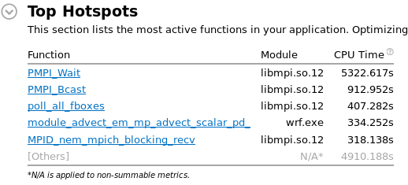
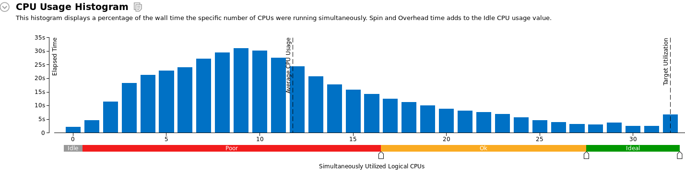

Slide 10
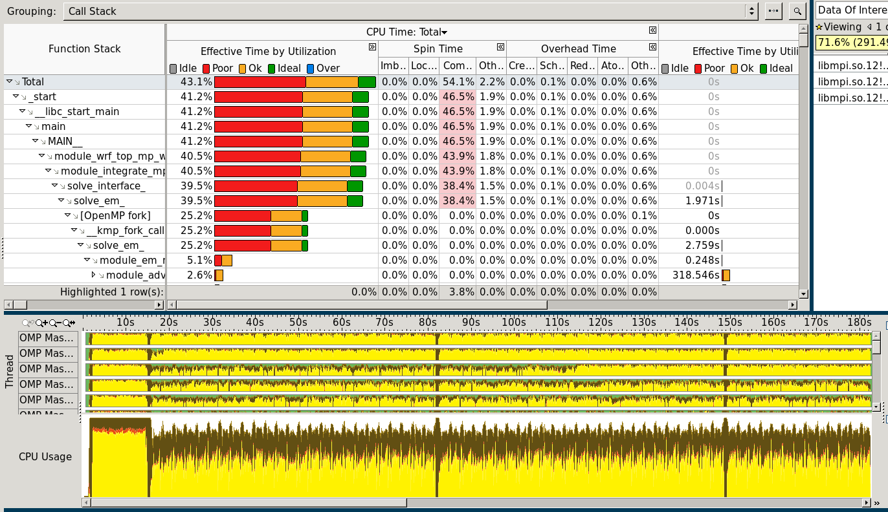
Top-down Tree

Slide 11
time.sh:
grep 'Timing for main' rsl.error.0000 | tail -149 | awk '{print $9}' | awk -f stats.awk
stats.awk:
BEGIN{ a = 0.0 ; i = 0 ; max = -999999999 ; min = 9999999999 }
{
i ++
a += $1
if ( $1 > max ) max = $1
if ( $1 < min ) min = $1
}
END{ printf("---\n%10s %8d\n%10s %15f\n%10s %15f\n%10s %15f\n%10s %15f\n%10s %15f\n","items:",i,"max:",max,"min:",min,"sum:",a,"mean:",a/(i*1.0),"mean/max:",(a/(i*1.0))/max) }

Slide 12
MIC compiling flags
./configure --prefix=/public/home/hppa2015/WRF/netcdf CPPFLAGS=-DpgiFortran CXX=icpc CC=icc F77=ifort NM=nm --disable-cxx --host=x86_64-k1om-linux --build=x86_64-unknown-linux
make CFLAGS=-mmic FCLAGS=-mmic LDFLAGS=-mmic

Slide 13
Xeon phi 5100
$ ./time.sh 5m20.479s
---
items: 149
max: 45.953620
min: 0.808580
sum: 179.043030
mean: 1.201631
mean/max: 0.026149
CPU:3:24.54
$ ./time.sh
---
items: 149
max: 29.788480
min: 0.988430
sum: 183.111730
mean: 1.228938
mean/max: 0.041255

Slide 14
Cluster of 10
---
items: 149
max: 29.666910
min: 0.110330
sum: 55.841360
mean: 0.374774
mean/max: 0.012633

