Slide 1
WRF Week5
Library Optimization: MKL
Global Case

Slide 2
Library Optimization
Using MKL

Slide 3
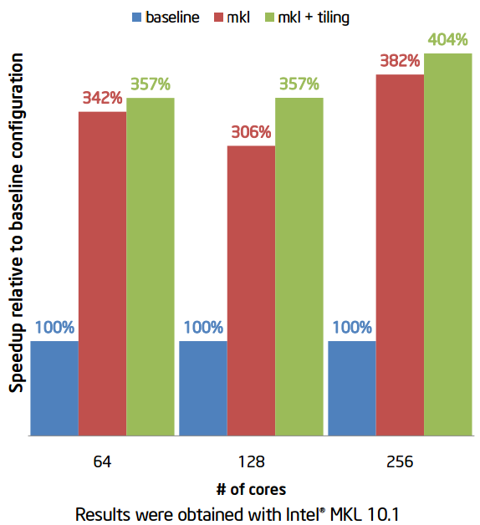
Improving performance of Global WRF by using Intel® Math Kernel Library (Intel® MKL)

Slide 4
Explanations
Filtering is done using FFT and, by default, WRF uses fftpack5 FFT library developed in NCAR in mid-90’s and not tuned for modern processors
Replacing calls to fftpack5 with calls to Intel® MKL DFTI improved simulation performance > 3x despite additional overhead caused by pre- and post-processing of data that was required to match FFT definition used by fftpack5
Polarfft: WRF planetary/global simulations use FFT to filter out noise in polar areas.

Slide 5
Global Case
WPS Preprocessing

Slide 6
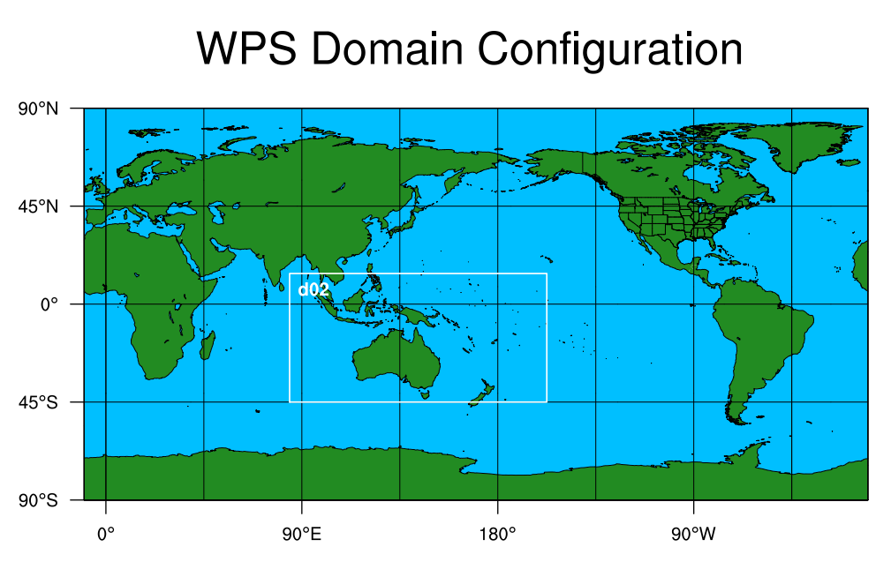
Global Project

Slide 7
Problems and Next
Clusters and Cases

Slide 8
Problems
Clusters：Error with Vtune
MKL
Namelist
Global Case configuration:

Slide 9
Next
Global Case
Cluster
MKL

