Slide 1
WRF week7
Compiling Options
Code Modifications

Slide 2
Compiling Options
Different options trials

Slide 3
Relative Compiling Options
-ip/ip0: Enable single-/multi-file interprocedural optimizations.
-IPF_fp_relaxed: Enable use of faster but slightly less accurate algorithms for math functions.
-mp: Restricts optimizations to maintain floating-point precision and disable some optimizations that affect floating-point accuracy.
-ftz: Flush denormal results to zero. (-O3 default)
-mP3OPT_ecg_mm_fp_ld_latency: Enable to set floating-point load latency. (Default: 11, for better instruction schedule)
-unroll0: Disable unrolling the loops in the file.

Slide 4
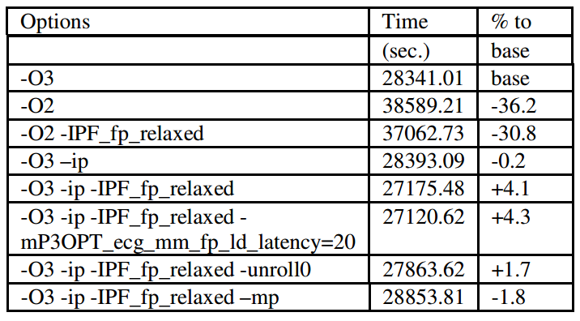
Results
Effects of different compiling options on performance

Slide 5
Code Modifcation
Compiler Directives

Slide 6
Compiling Directvies
!DIR$ LOOP_COUNT(N): Tell the compiler the expected trip count of the loop is N. (Loop unrolling heuristics)
!DIR$ DISTRIBUTE POINT: Specifies place where the loop should be divided into two loops. (Cache Locality)
!DIR$ [NO]UNROLL(N): Specifies the loop unrolling factor that the user believes is better than that used by compiler automatically.

Slide 7
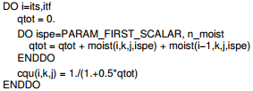

Specific Modification
File: module_big_step_utilities_em.F:
Modified to:
Speedup: 9%

Slide 8

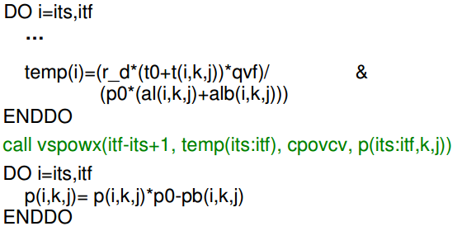
Specific Modification
File: module_big_step_utilities_em.F
Modified to MKL:
Speedup: 4.5%

Slide 9
Specific Modification
File: module_map_etanew.F
Arrays reordering: Row-major To column-major
Speedup: 5.5%

Slide 10
Next
Further improvements
GPU

