Slide 1


SoftCell: Scalable and Flexible Cellular Core Network Architecture
Xin Jin
Princeton University
Joint work with Li Erran Li, Laurent Vanbever, and Jennifer Rexford
Notes:
Hello, everyone. Thanks for attending this talk. Today’s cellular core networks are remarkably brittle and expensive. In this talk, I’ll present a new architecture that makes cellular core network scalable and flexible.

Slide 2
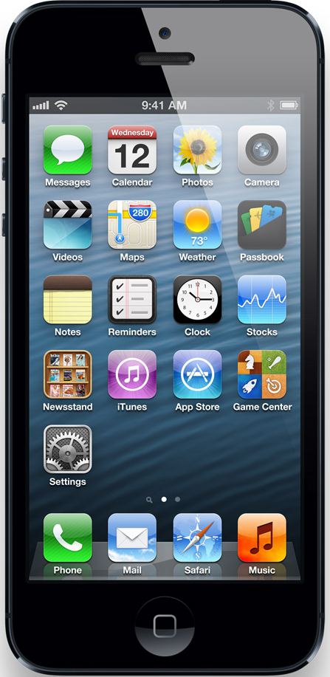
Cellular Core Network Architecture
Base Station (BS)
Serving Gateway
Packet Data Network Gateway
User Equipment (UE)
Serving Gateway
Internet
access
core
Notes:
This figure shows the architecture of today’s cellular core networks. User equipment connect to base stations via radio channels.
Base stations connect to the Internet via the cellular core network. There are two main components in the cellular core network, serving gateway and packet data network gateway.

Slide 3
Cellular core networks are not flexible
Most functionalities are implemented at
Packet Data Network Gateway
Content filtering, application identification,
stateful firewall, lawful intercept, …
This is not flexible
Packet Data Network Gateway
Combine functionality from different vendors
Easy to add new functionality
Only expand capacity for bottlenecked functionality
Notes:
Most functionalities are implemented at the packet gateway today, including application identification, content filtering, monitoring and billing, and so on.
It is not flexible because carriers cannot combine functionality from different vendors.
It is also not easy to add new functionality because vendors have to integrate the functionality with other functionalities that might have already exist for more than 10 years.
It is also no possible to only expand capacity for bottlenecked functionality. Carriers have to buy a new equipment in order to expand the capacity.

Slide 4
Cellular core networks are not scalable
A lot of processing and state!
Base Station
Serving Gateway
Packet Data Network Gateway
User Equipment
Serving Gateway
Internet
access
core
Notes:
With so many functionalities centralized at the packet gateway, it has to do a lot of processing at high speed keep state for each flow.
The serving gateway serves as the mobility anchor for hundreds of thousands of devices. It also has to do a lot of processing and state.
Such a centralized data plane design has performance bottlenecks in these few points.

Slide 5

Cellular core networks are not cost-effective
Capex & Opex
Base Station
Serving Gateway
Packet Data Network Gateway
User Equipment
Serving Gateway
Internet
access
core
Notes:
It is also not cheap to build such a network.
It can cost as much as millions of dollar to buy a single box.
This is only the capital cost, not to mention the operational cost.
As shown in a recent report, the unit revenue decreases much faster than the unit cost.
So the current solution is not sustainable.

Slide 6

Can we make cellular core networks like data center networks?
✔ Flexible
✔ Scalable
✔ Cost-Effective
Notes:
On the other hand, data center networks have solved similar problems.
Can we make cellular core networks like data center networks? Flexible, scalable, and cost effective.

Slide 7
Can we make cellular core networks like data center networks?
Yes! With SoftCell!
✔ Flexible
✔ Scalable
✔ Cost-Effective
Notes:
Yes! With SoftCell.

Slide 8


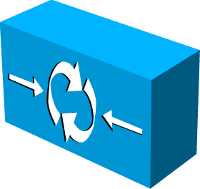
SoftCell Overview
Commodity hardware
No change
No change
+ SoftCell software
Controller
Internet
Notes:
It makes no change no user equipment, the radio access technology, or the Internet.
It only replaces the core network with commodity switches and middleboxes, controlled by a logically centralized controller.
Data Plane:
Switch: connectivity, traffic steering
Middlebox: various network services
~mix-match, combine functionality from different vendors
~easy to add new functionality
~up-/down-scale
~cheap
Control Plane:
Logically centralized controller, centralized control, rather than distributed protocol (hard to reason, debug, trouble shooting)
~Easy to manage
~Easy to change

Slide 9





subscriber attributes + application type ➔ an ordered list of middleboxes
Challenge: Scalable Support of
Fine-Grained Service Policies
Service Policy:
Content Filter <-> Firewall
Normal Customer
Parental Control
Normal Customer
Firewall
Government Customer
IPS <-> Firewall
Web Accelerator <-> Customized Firewall
“Gold Plan” Customer
Web Traffic
Notes:
The first part is a service policy, which predicts on application type like whether the traffic is video traffic and subscriber attributes like whether the traffic goes to a gold plan customer.
Traffic that matches the predict will be directed to an ordered sequence of middleboxes.

Slide 10
subscriber attributes + application type ➔ an ordered list of middleboxes
Challenge: Scalable Support of
Fine-Grained Service Policies
Service Policy:
Notes:
The first part is a service policy, which predicts on application type like whether the traffic is video traffic and subscriber attributes like whether the traffic goes to a gold plan customer.
Traffic that matches the predict will be directed to an ordered sequence of middleboxes.

Slide 11
Challenge: Scalable Support of Fine-Grained Service Policies
Packet Classification: decide which service policy to be applied to a flow and tag flows
How to classify millions of flows?
Traffic Steering: generate switch rules to implement paths for service policy
How to implement million of paths?
Notes:
The main challenge to solve the problem is scalability.
First, we have to do packet classification. Given a flow, we have to decide which service policy to be applied to a flow. The challenge is how to classify millions of flows?
Second, we have to generate switch rules to implement paths given by traffic management policy. As switches have limited flow table size, how to implement millions of paths in switches is a big challenge.
Now let’s me tell you how to do packet classification in a scalable way.

Slide 12
“North south” Traffic Pattern
Too expensive to do packet classification at Gateway Edge!
Internet
~1 million UEs
~10 million flows
~400 Gbps – 2 Tbps
Access Edge
~1K UEs
~10K flows
~1 – 10 Gbps
Gateway Edge
Low traffic volume
Small number of active flows
High traffic volume
Huge number of active flows
Notes:
The dominant traffic in cellular core networks is “north south” traffic.
Traffic can enter the network both from the access edge and the gateway edge.
At the access edge, each base station handles around 1 thousand devices.
It operates at relatively low link speed.
However, the gateway edge aggregates traffic for around 1 million devices.
So it operates at a very high link speed and handles a huge number of flows.
Apparently, it is too expensive to do packet classification at the gateway edge.

Slide 13
“North south” Traffic Pattern
Internet
~1 million UEs
~10 million flows
~400 Gbps – 2 Tbps
Access Edge
~1K UEs
~10K flows
~1 – 10 Gbps
Gateway Edge
Opportunity: Traffic initiated from the access edge!
Notes:
The dominant traffic in cellular core networks is “north south” traffic.
Traffic can enter the network both from the access edge and the gateway edge.
At the access edge, each base station handles around 1 thousand devices.
It operates at relatively low link speed.
However, the gateway edge aggregates traffic for around 1 million devices.
So it operates at a very high link speed and handles a huge number of flows.
Apparently, it is too expensive to do packet classification at the gateway edge.

Slide 14


Asymmetric Edge: Packet Classification
Internet
Access Edge
Gateway Edge
Packet Classification
software
Simple Forwarding
hardware
Encode classification results in srcIP and srcPort
Classification results are piggybacked in dstIP and dstPort
Notes:
However, there is also opportunities.
In cellular core networks, most traffic is initiated from mobile devices entering the access edge.
So we leverage this characteristic and adopt an asymmetric edge design.
We do packet classification when traffic enter the network at the access edge and encode classification results in packet header.
Then when traffic returns from the Internet, the gateway edge only needs to do forwarding as classification results are implicitly piggybacked in packet header.

Slide 15
Challenge: Scalable Support of Fine-Grained Service Policies
Packet Classification: decide which service policy to be applied to a flow and tag flows
How to classify millions of flows?
Traffic Steering: generate switch rules to implement paths for service policy
How to implement million of paths?
Notes:
8min
The main challenge to solve the problem is scalability.
First, we have to do packet classification. Given a flow, we have to decide which service policy to be applied to a flow. The challenge is how to classify millions of flows?
Second, we have to generate switch rules to implement paths given by traffic management policy. As switches have limited flow table size, how to implement millions of paths in switches is a big challenge.
Now let’s me tell you how to do packet classification in a scalable way.

Slide 16
Traffic Steering
Steering traffic through different sequences of middlebox instances
Difficult to configure with traditional layer-2 or layer-3 routing
[PLayer’08] use packet classifiers, large flow table
What about use a tag to encode a path?
Aggregate traffic of the same path
Suppose 1000 service policy clauses, 1000 base stations
May result in 1 million paths, need 1 million tags
Limited switch flow tables: ~1K – 4K TCAM, ~16K – 64K L2/Eth
Solution: multi-dimensional aggregation

Slide 17
Multi-Dimensional Aggregation
Use multi-dimensional tags rather than flat tags
Exploit locality in the network
Selectively match on one or multiple dimensions
Supported by TCAM in today’s switches
Policy Tag
BS ID
UE ID
Aggregate flows that share a common policy (even across UEs and BSs)
Aggregate flows going to the same (group of) base stations
Aggregate flows going to the same UE
Notes:
The basic idea is to use multi-dimensional tags rather than flat tags.
We aggregate in three dimensions, policy tag, BS ID and UE ID.
Policy tag aggregate flows that share a common policy, even across devices or base stations.
BS ID aggregates flows going to the same base station.
UE ID aggregates flows going to the same device. This is especially useful in UE handoff.
Multi-dimensional tags allow us to exploit locality in the network.
And we can selectively match on one or multiple dimensions in order to further reduce flow table size.

Slide 18
Multi-Dimensional Aggregation
Use multi-dimensional tags rather than flat tags
Exploit locality in the network
Selectively match on one or multiple dimensions
Supported by TCAM in today’s switches
Policy Tag
BS ID
UE ID
Aggregate flows that share a common policy (even across UEs and BSs)
Aggregate flows going to the same (group of) base stations
Aggregate flows going to the same UE
Notes:
Don’t use flat tags

Slide 19
Route to different MBs with policy tag
Example service policy clause:
Traffic of this policy is pushed tag1
Normal Customer
Parental Control
Content Filter
Firewall
SW 1
SW 2
SW 3
Match | Action
tag1 | Forward to Filter
Match | Action
tag1 | Forward to Firewall

Slide 20
Multi-Dimensional Aggregation
Use multi-dimensional tags rather than flat tags
Exploit locality in the network
Selectively match on one or multiple dimensions
Supported by TCAM in today’s switches
Policy Tag
BS ID
UE ID
Aggregate flows that share a common policy (even across UEs and BSs)
Aggregate flows going to the same (group of) base stations
Aggregate flows going to the same UE
Notes:
Don’t use flat tags

Slide 21
Location-Based Hierarchical IP Address
BS 1
BS 2
BS 3
BS 4

Slide 22
Location-Based Hierarchical IP Address
BS ID: an IP prefix assigned to each base station
BS 1
10.0.0.0/16
BS ID
BS 2
10.1.0.0/16
10.1.0.7
UE ID
BS 3
10.2.0.0/16
192.168.0.5
UE ID: an IP suffix unique under the BS ID
BS 4
10.3.0.0/16

Slide 23
Route to different BSs with BS ID
Forward to base station with prefix matching
Can aggregate nearby BS IDs
BS 1
10.0.0.0/16
SW 1
SW 2
SW 3
BS 2
SW 4
10.1.0.0/16
Match | Action
10.0.0.0/16 | Forward to BS 1
10.1.0.0/16 | Forward to BS 2
Match | Action
10.0.0.0/15 | Forward to Switch 3

Slide 24
Multi-Dimensional Aggregation
Use multi-dimensional tags rather than flat tags
Exploit locality in the network
Selectively match on one or multiple dimensions
Supported by TCAM in today’s switches
Policy Tag
BS ID
UE ID
Aggregate flows that share a common policy (even across UEs and BSs)
Aggregate flows going to the same (group of) base stations
Aggregate flows going to the same UE
Notes:
Don’t use flat tags

Slide 25
Multi-Dimensional Aggregation
Use multi-dimensional tags rather than flat tags
Exploit locality in the network
Selectively match on one or multiple dimensions
Supported by TCAM in today’s switches
Policy Tag
BS ID
UE ID
Aggregate flows that share a common policy (even across UEs and BSs)
Aggregate flows going to the same (group of) base stations
Aggregate flows going to the same UE
Notes:
Don’t use flat tags

Slide 26
Policy Consistency
UE Mobility: frequent, unplanned
Policy consistency:
Ongoing flows traverse the same sequence of middlebox instances, even in the presence of UE mobility
Crucial for stateful middleboxes, e.g., stateful firewall

Slide 27
Policy Consistency
An ongoing flow traverses stateful Firewall 1 before handoff
Use 10.0.0.7 (old IP under BS1), go via the old path
New flow can go via stateful Firewall 2
Use 10.1.0.11 (new IP under BS2), go via the new path
Firewall 1
Old Path
BS 1: 10.0.0.0/16
New Path
10.0.0.7
Old flow
Handoff
192.168.0.5
BS 2: 10.1.0.0/16
10.1.0.11
Old Flow
10.0.0.7
New Flow
192.168.0.5
New Flow
10.1.0.11
Firewall 2

Slide 28
Multi-Dimensional Identifier Encoding
Encode multi-dimensional identifiers to source IP and source port
Return traffic from the Internet:
Identifiers are implicitly piggybacked in destination IP and destination port
Commodity chipsets (e.g., Broadcom) can wildcard on these bits
Policy Tag
BS ID
UE ID
Encode
Src IP
BS ID
UE ID
Src Port
Tag
Flow ID
Notes:
Don’t use flat tags
note that each UE has (say) 10 flows, so there is plenty of space in the TCP/UDP port number for the tag. even if all ten flows go to the same external service, you'd still have a ton of bits left to store the tag.
somewhere you should mention that, although OpenFlow 1.0 only does prefix matching on IP addresses and TCP/UDP port numbers, today's commodity chipsets (e.g., BroadCom Trident chipset) can wildcard on any of those bits, and as such is not limited to prefix matching.

Slide 29
Scalable Data Plane Summary
Packet classification
Encoding results to packet headers
Traffic steering
Selectively multi-dimensional aggregation
Simple forwarding
Based on encoded multi-dimensional tags
Steering Fabric

Slide 30
SoftCell: Scalable and Flexible Cellular Core Network Architecture
Scalable Data Plane
Asymmetric Edge: Packet Classification
Core: Multi-Dimensional Aggregation
Scalable Control Plane
Hierarchical Controller
Notes:
14min

Slide 31
Control Plane Load
Packet classification
Handle every flow
Frequent switch update
Multi-dimensional aggregation
Handle every policy path
Infrequent switch update
Internet
Notes:
Finally, let’s take a look at the control plane load.
The access edge does packet classification.
So it has to handle every flow.
The switches are updated very frequently.
In the core, it only needs to setup up policy paths.
So the switches are updated less frequently.
Handling all these switch update in one controller can overwhelm the controller.

Slide 32
Hierarchical Controller
Local agent (LA) at each base station
Offload packet classification to local agents
Controller
LA
LA
LA
Internet
LA
Notes:
So we adopt a hierarchical controller design.
We introduce a local agent at each base station and offload packet classification to local agents, in order to scale the control plane.

Slide 33
Implementation
Service Policy
Packet
Classification
Multi-Dimensional
Aggregation
Subscriber
Attributes
Topology
Controller (Floodlight)
Packet Classifiers
~10 ms to calculate one path. Can pre-compute.
~2 million requests/sec
Packet
Classification
Switch Rules
For Path Implementation
Local Agent (Floodlight)
~2 K – 500 K requests/sec
Switch Rules For Header Rewriting
Notes:
16min

Slide 34
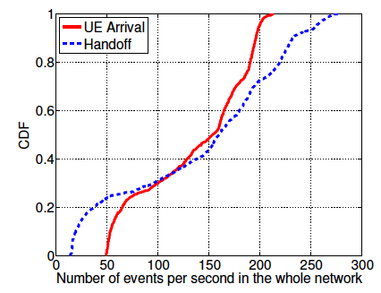
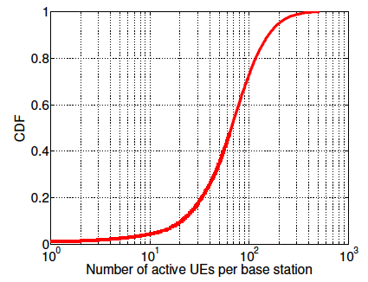
Network Wide (Controller Load)
Evaluation: LTE workload characteristics
Per Base Station (Local Agent Load)
99.999th percentile
214 UE arrivals/s
280 handoffs/s
514 active UEs
Easily handled by our prototype controller
(Compare with micro benchmark results in previous slide)
Notes:
http://tinyurl.com/cz279q5
http://www.openflow.org/wk/index.php/Controller_Performance_Comparisons

Slide 35
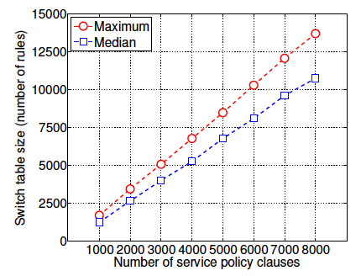
Evaluation: Data plane scalability
13.7 K rules
for 8 K service policy clauses
1.7 K rules
for 1 K service policy clauses
Commodity switches can handle several K service policy clauses

Slide 36
Conclusion
SoftCell uses commodity switches and middleboxes to build flexible cellular core networks
SoftCell achieves scalability with
Asymmetric Edge Design for Packet Classification
Data Plane
Multi-dimensional Aggregation for Traffic Steering
Control Plane
Hierarchical Controller Design
Notes:
In conclusion, CellSDN uses commodity switches and middleboxes to build flexible and cost-effective cellular core networks.
It supports fine-grained service policies and traffic management policies.
It achieves scalability with asymmetric edge design, multi-dimensional aggregation and hierarchical controller.

Slide 37

Thanks!

Slide 38
Related Work
Cellular network architecture:
[OpenRoads’10]: slice the network to enable multiple carriers
[Ericsson’12]: GTP tunnel support in OpenFlow
Traffic Steering/Service Chaining:
[PLayer’08]: use off-path MBs to make it more flexible
NFV (Network Function Virtualization): virtualize network functions/services, supported by many carriers and vendors
No previous works present a scalable architecture that supports fined-grained policies

