Slide 1


SoftCell: Scalable and Flexible Cellular Core Network Architecture
Xin Jin
Princeton University
Joint work with Li Erran Li, Laurent Vanbever, and Jennifer Rexford

Slide 2

Cellular Core Network Architecture
Base Station (BS)
Serving Gateway
Packet Data Network Gateway
User Equipment (UE)
Serving Gateway
Internet
access
core

Slide 3
Cellular core networks are not flexible
Most functionalities are implemented at
Packet Data Network Gateway
Content filtering, application identification,
stateful firewall, lawful intercept, …
This is not flexible
Packet Data Network Gateway
Combine functionality from different vendors
Easy to add new functionality
Only expand capacity for bottlenecked functionality

Slide 4
Cellular core networks are not scalable
A lot of processing and state!
Base Station
Serving Gateway
Packet Data Network Gateway
User Equipment
Serving Gateway
Internet
access
core

Slide 5

Cellular core networks are not cost-effective
Capex & Opex
Base Station
Serving Gateway
Packet Data Network Gateway
User Equipment
Serving Gateway
Internet
access
core

Slide 6

Can we make cellular core networks like data center networks?
✔ Flexible
✔ Scalable
✔ Cost-Effective

Slide 7
Can we make cellular core networks like data center networks?
Yes! With SoftCell!
✔ Flexible
✔ Scalable
✔ Cost-Effective

Slide 8


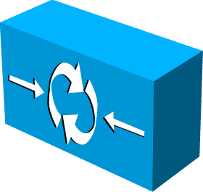
SoftCell Overview
Commodity hardware
No change
No change
+ SoftCell software
Controller
Internet

Slide 9





subscriber attributes + application type ➔ an ordered list of middleboxes
Challenge: Scalable Support of
Fine-Grained Service Policies
Service Policy:
Content Filter <-> Firewall
Normal Customer
Parental Control
Normal Customer
Firewall
Government Customer
IPS <-> Firewall
Web Accelerator <-> Customized Firewall
“Gold Plan” Customer
Web Traffic

Slide 10
subscriber attributes + application type ➔ an ordered list of middleboxes
Challenge: Scalable Support of
Fine-Grained Service Policies
Service Policy:

Slide 11
Challenge: Scalable Support of Fine-Grained Service Policies
Packet Classification: decide which service policy to be applied to a flow and tag flows
How to classify millions of flows?
Traffic Steering: generate switch rules to implement paths for service policy
How to implement million of paths?

Slide 12
“North south” Traffic Pattern
Too expensive to do packet classification at Gateway Edge!
Internet
~1 million UEs
~10 million flows
~400 Gbps – 2 Tbps
Access Edge
~1K UEs
~10K flows
~1 – 10 Gbps
Gateway Edge
Low traffic volume
Small number of active flows
High traffic volume
Huge number of active flows

Slide 13
“North south” Traffic Pattern
Internet
~1 million UEs
~10 million flows
~400 Gbps – 2 Tbps
Access Edge
~1K UEs
~10K flows
~1 – 10 Gbps
Gateway Edge
Opportunity: Traffic initiated from the access edge!

Slide 14


Asymmetric Edge: Packet Classification
Internet
Access Edge
Gateway Edge
Packet Classification
software
Simple Forwarding
hardware
Encode classification results in srcIP and srcPort
Classification results are piggybacked in dstIP and dstPort

Slide 15
Challenge: Scalable Support of Fine-Grained Service Policies
Packet Classification: decide which service policy to be applied to a flow and tag flows
How to classify millions of flows?
Traffic Steering: generate switch rules to implement paths for service policy
How to implement million of paths?

Slide 16
Traffic Steering
Steering traffic through different sequences of middlebox instances
Difficult to configure with traditional layer-2 or layer-3 routing
[PLayer’08] use packet classifiers, large flow table
What about use a tag to encode a path?
Aggregate traffic of the same path
Suppose 1000 service policy clauses, 1000 base stations
May result in 1 million paths, need 1 million tags
Limited switch flow tables: ~1K – 4K TCAM, ~16K – 64K L2/Eth
Solution: multi-dimensional aggregation

Slide 17
Multi-Dimensional Aggregation
Use multi-dimensional tags rather than flat tags
Exploit locality in the network
Selectively match on one or multiple dimensions
Supported by TCAM in today’s switches
Policy Tag
BS ID
UE ID
Aggregate flows that share a common policy (even across UEs and BSs)
Aggregate flows going to the same (group of) base stations
Aggregate flows going to the same UE

Slide 18
Multi-Dimensional Aggregation
Use multi-dimensional tags rather than flat tags
Exploit locality in the network
Selectively match on one or multiple dimensions
Supported by TCAM in today’s switches
Policy Tag
BS ID
UE ID
Aggregate flows that share a common policy (even across UEs and BSs)
Aggregate flows going to the same (group of) base stations
Aggregate flows going to the same UE

Slide 19
Route to different MBs with policy tag
Example service policy clause:
Traffic of this policy is pushed tag1
Normal Customer
Parental Control
Content Filter
Firewall
SW 1
SW 2
SW 3
Match | Action
tag1 | Forward to Filter
Match | Action
tag1 | Forward to Firewall

Slide 20
Multi-Dimensional Aggregation
Use multi-dimensional tags rather than flat tags
Exploit locality in the network
Selectively match on one or multiple dimensions
Supported by TCAM in today’s switches
Policy Tag
BS ID
UE ID
Aggregate flows that share a common policy (even across UEs and BSs)
Aggregate flows going to the same (group of) base stations
Aggregate flows going to the same UE

Slide 21
Location-Based Hierarchical IP Address
BS 1
BS 2
BS 3
BS 4

Slide 22
Location-Based Hierarchical IP Address
BS ID: an IP prefix assigned to each base station
BS 1
10.0.0.0/16
BS ID
BS 2
10.1.0.0/16
10.1.0.7
UE ID
BS 3
10.2.0.0/16
192.168.0.5
UE ID: an IP suffix unique under the BS ID
BS 4
10.3.0.0/16

Slide 23
Route to different BSs with BS ID
Forward to base station with prefix matching
Can aggregate nearby BS IDs
BS 1
10.0.0.0/16
SW 1
SW 2
SW 3
BS 2
SW 4
10.1.0.0/16
Match | Action
10.0.0.0/16 | Forward to BS 1
10.1.0.0/16 | Forward to BS 2
Match | Action
10.0.0.0/15 | Forward to Switch 3

Slide 24
Multi-Dimensional Aggregation
Use multi-dimensional tags rather than flat tags
Exploit locality in the network
Selectively match on one or multiple dimensions
Supported by TCAM in today’s switches
Policy Tag
BS ID
UE ID
Aggregate flows that share a common policy (even across UEs and BSs)
Aggregate flows going to the same (group of) base stations
Aggregate flows going to the same UE

Slide 25
Multi-Dimensional Aggregation
Use multi-dimensional tags rather than flat tags
Exploit locality in the network
Selectively match on one or multiple dimensions
Supported by TCAM in today’s switches
Policy Tag
BS ID
UE ID
Aggregate flows that share a common policy (even across UEs and BSs)
Aggregate flows going to the same (group of) base stations
Aggregate flows going to the same UE

Slide 26
Policy Consistency
UE Mobility: frequent, unplanned
Policy consistency:
Ongoing flows traverse the same sequence of middlebox instances, even in the presence of UE mobility
Crucial for stateful middleboxes, e.g., stateful firewall

Slide 27
Policy Consistency
An ongoing flow traverses stateful Firewall 1 before handoff
Use 10.0.0.7 (old IP under BS1), go via the old path
New flow can go via stateful Firewall 2
Use 10.1.0.11 (new IP under BS2), go via the new path
Firewall 1
Old Path
BS 1: 10.0.0.0/16
New Path
10.0.0.7
Old flow
Handoff
192.168.0.5
BS 2: 10.1.0.0/16
10.1.0.11
Old Flow
10.0.0.7
New Flow
192.168.0.5
New Flow
10.1.0.11
Firewall 2

Slide 28
Multi-Dimensional Identifier Encoding
Encode multi-dimensional identifiers to source IP and source port
Return traffic from the Internet:
Identifiers are implicitly piggybacked in destination IP and destination port
Commodity chipsets (e.g., Broadcom) can wildcard on these bits
Policy Tag
BS ID
UE ID
Encode
Src IP
BS ID
UE ID
Src Port
Tag
Flow ID

Slide 29
Scalable Data Plane Summary
Packet classification
Encoding results to packet headers
Traffic steering
Selectively multi-dimensional aggregation
Simple forwarding
Based on encoded multi-dimensional tags
Steering Fabric

Slide 30
SoftCell: Scalable and Flexible Cellular Core Network Architecture
Scalable Data Plane
Asymmetric Edge: Packet Classification
Core: Multi-Dimensional Aggregation
Scalable Control Plane
Hierarchical Controller

Slide 31
Control Plane Load
Packet classification
Handle every flow
Frequent switch update
Multi-dimensional aggregation
Handle every policy path
Infrequent switch update
Internet

Slide 32
Hierarchical Controller
Local agent (LA) at each base station
Offload packet classification to local agents
Controller
LA
LA
LA
Internet
LA

Slide 33
Implementation
Service Policy
Packet
Classification
Multi-Dimensional
Aggregation
Subscriber
Attributes
Topology
Controller (Floodlight)
Packet Classifiers
~10 ms to calculate one path. Can pre-compute.
~2 million requests/sec
Packet
Classification
Switch Rules
For Path Implementation
Local Agent (Floodlight)
~2 K – 500 K requests/sec
Switch Rules For Header Rewriting

Slide 34
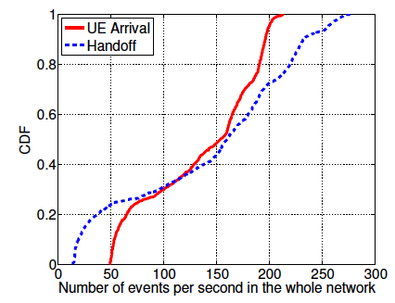
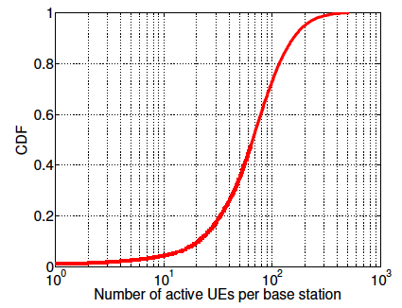
Network Wide (Controller Load)
Evaluation: LTE workload characteristics
Per Base Station (Local Agent Load)
99.999th percentile
214 UE arrivals/s
280 handoffs/s
514 active UEs
Easily handled by our prototype controller
(Compare with micro benchmark results in previous slide)

Slide 35
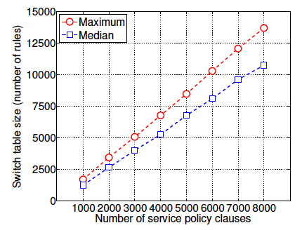
Evaluation: Data plane scalability
13.7 K rules
for 8 K service policy clauses
1.7 K rules
for 1 K service policy clauses
Commodity switches can handle several K service policy clauses

Slide 36
Conclusion
SoftCell uses commodity switches and middleboxes to build flexible cellular core networks
SoftCell achieves scalability with
Asymmetric Edge Design for Packet Classification
Data Plane
Multi-dimensional Aggregation for Traffic Steering
Control Plane
Hierarchical Controller Design

Slide 37

Thanks!

Slide 38
Related Work
Cellular network architecture:
[OpenRoads’10]: slice the network to enable multiple carriers
[Ericsson’12]: GTP tunnel support in OpenFlow
Traffic Steering/Service Chaining:
[PLayer’08]: use off-path MBs to make it more flexible
NFV (Network Function Virtualization): virtualize network functions/services, supported by many carriers and vendors
No previous works present a scalable architecture that supports fined-grained policies

