Slide 1
Evaluation on Movie Classification
of Popular list from Rotten Romatoes

Slide 2
1. Introduction
Rotten Tomatoes is a review-aggregation website for film and television in the U.S.
Rotten Tomatoes has its own ranking system of movies, with three tiers: Certified Fresh, Fresh, and Rotten.
The project is going to evaluate on the classification among the fundamental scores of each movie, that are:
Audience Sentiment (Binary, negative or positive)
Audience Score (Numeric, 0 to 100)
Critics Sentiment (Binary, negative or positive)
Critics Score (Numeric, 0 to 100)
Our target class is Critic Score, and our conditions are the rest.

Slide 3
Project Steps
Crawler
We implemented a crawler to crawl information from the rotten tomatoes’ website;
The crawler crawls the top 100 + movies;
Evaluation
We develop the evaluation algorithm using python;
Uses entropy & information gain as the measurement of purity;
Conclusion
We then derives a sequence of dividing conditions based on its purity;
We may get extra information.

Slide 4
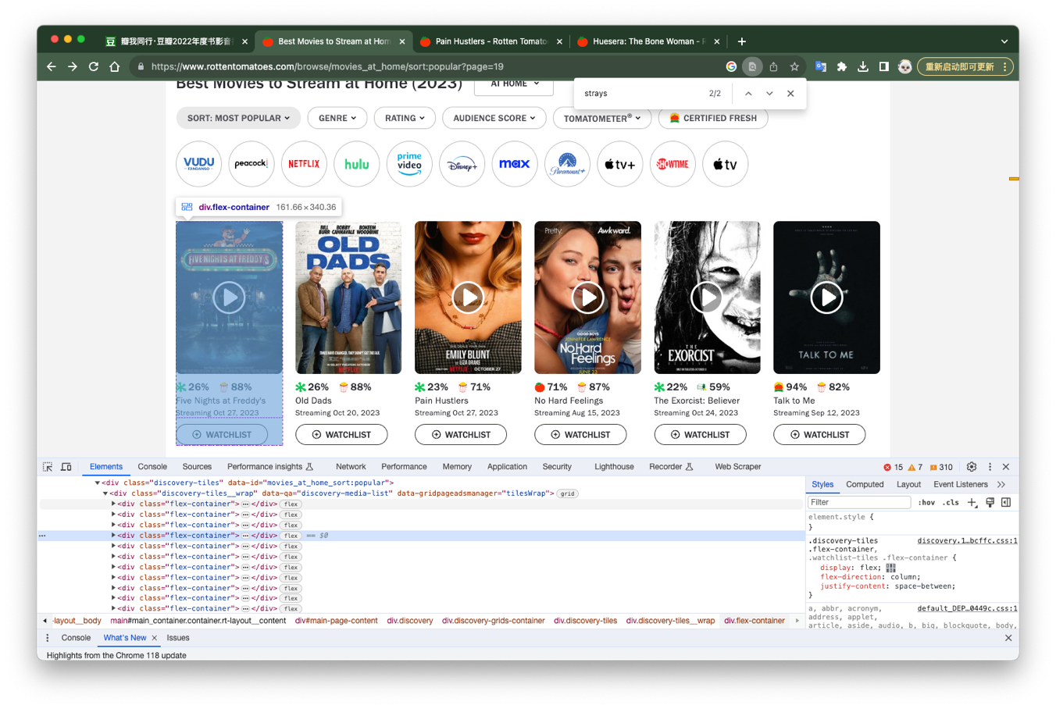
2. Crawler Part

Slide 5
2. Crawler Part
2.1 Analyze the page structure
The collection of movie items is represented by a list of <div> container.
What to do: Find all of them, whose class is “flex-container”.

Slide 6
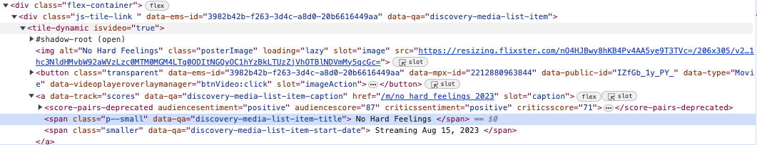
2. Crawler Part
2.1.1 Movie Title and Stream Time
Movie Title is stored in the <span> tag with class “p-small”. Since <span> was under the <div> movie item, we easily extract it by xpath.
Problems:
The title we obtain in fact has some spaces and enters, so we eliminate them using regular expression.
Meanwhile, we get some false elements. Hence, we filter out those elements whose title is none type.
__get_movies__.py
movie_title = score_container.xpath(".//span[@class='p--small']/text()").get() # Guardian method. Don't get useless message if movie_title is None: continue movie_title = re.sub(r"\n|\s","", movie_title)

Slide 7
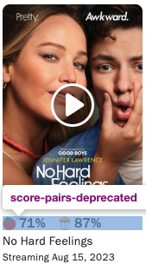
2. Crawler Part

Slide 8
2. Crawler Part
2.1.2 Scores and sentiments
The four measurements lies in the <score-pairs-depricated> tag.
This tag represents the score pair bar UI on the card view of a movie.
The four items within the tag is our required data:
We first extract <score-pairs-deprecated> as root, then extract its items one by one.
__get_movies__.py
# Overall score container evaluation_scores = score_container.xpath(".//score-pairs-deprecated") # Four important scores aud_sentiment = evaluation_scores.xpath("@audiencesentiment").get() aud_score = evaluation_scores.xpath("@audiencescore").get() critics_sentiment = evaluation_scores.xpath("@criticssentiment").get() critics_score = evaluation_scores.xpath("@criticsscore").get()

Slide 9
2. Crawler Part
2.2 Store the extracted data into an Excel file
__get_movies__.py
# Processing data # Change negative/positive to binary expressions, which is a lot easier to cope with bin_aud_sentiment = 0 if aud_sentiment == 'negative' else 1 bin_critics_sentiment = 0 if critics_sentiment == 'negative' else 1 data = { "title": movie_title, "stream_time": stream_time, 'link': score_link, "audience score": aud_score, "critics score": critics_score, "audience sentiment": bin_aud_sentiment, "critics sentiment": bin_critics_sentiment, } # Store the data in a new Excel file self.start_urls.append("https://www.rottentomatoes.com/" + data['link']) if self.custom_settings['SAVE_DATA']: __save_data__.save_data_to_excel(data)

Slide 10
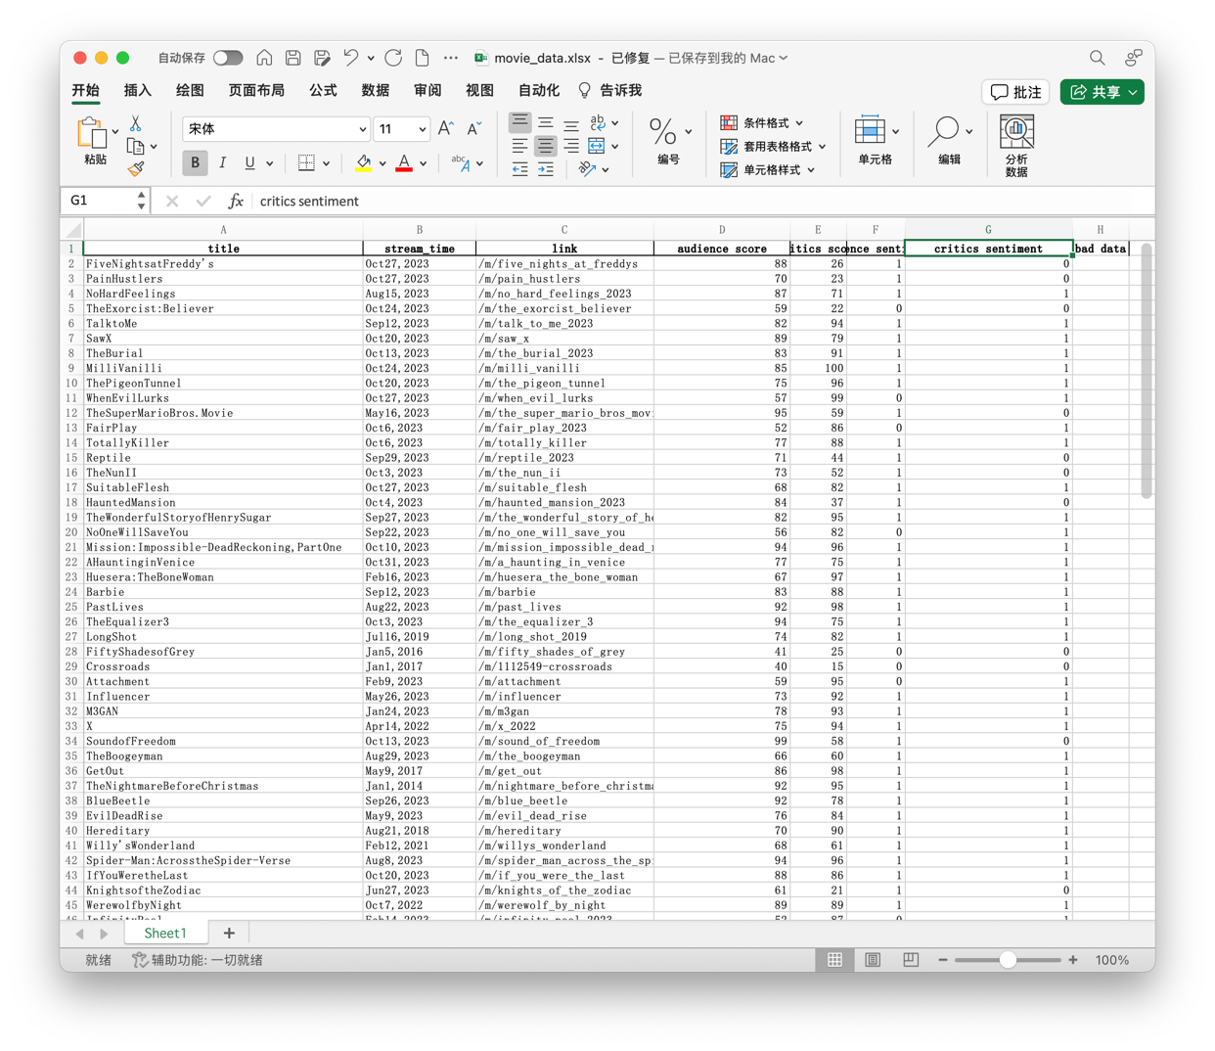
2. Crawler Part
2.2 Store the extracted data into an Excel file

Slide 11
3. Evaluation Algorithms
First 10 rows of data:
title | audience score | critics score | audience sentiment | critics sentiment
FiveNightsatFreddy's | 88 | 26 | 1 | 0
PainHustlers | 70 | 23 | 1 | 0
NoHardFeelings | 87 | 71 | 1 | 1
TheExorcist:Believer | 59 | 22 | 0 | 0
TalktoMe | 82 | 94 | 1 | 1
SawX | 89 | 79 | 1 | 1
TheBurial | 83 | 91 | 1 | 1
MilliVanilli | 85 | 100 | 1 | 1
ThePigeonTunnel | 75 | 96 | 1 | 1
WhenEvilLurks | 57 | 99 | 0 | 1
… | … | … | … | …
Due to large amount of data, use python to calculate entropy rather than manually.
Use Audience Score, Critics Score, Audience Sentiment to classify into Critics Sentiment.

Slide 12
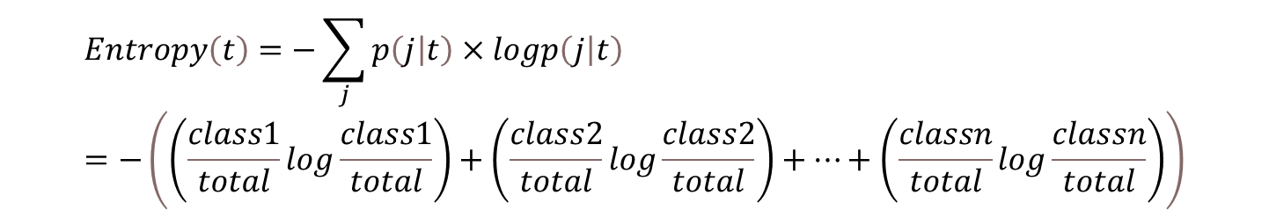
3. Evaluation Algorithms
3.1.2 get_entropy() Function
Since the evaluation process involves abundant calculations of entropy, a generic get_entropy() function is needed.
Entropy of a node:
We have only two target classes: critics_sentiment negative or positive. Therefore, the get_entropy() function can take only two inputs.
$$Entropy\left(t\right)=−\sum_{j}{p\left(j | t\right)×logp\left(j | t\right)}=−\left(\left(\frac{class1}{total}log\frac{class1}{total}\right)+\left(\frac{class2}{total}log\frac{class2}{total}\right)+…+\left(\frac{classn}{total}log\frac{classn}{total}\right)\right)$$

Slide 13
3. Evaluation Algorithms
3.1.2 get_entropy() Function
__get_movies__.py
# Processing data def get_entropy(a, b): total = a + b # Deal with divide by 0 problem a_ratio = a / total b_ratio = b / total # Deal with divide by 0 problem a_log_a = a_ratio * math.log10(a_ratio) if a_ratio != 0 else 0 b_log_b = b_ratio * math.log10(b_ratio) if b_ratio != 0 else 0 # Finally, calculate the entropy..... entropy = (-1) * (a_log_a + b_log_b) return entropy

Slide 14
3. Evaluation Algorithms
3.2 Binary Analysis
__get_movies__.py
# Processing data def get_entropy(a, b): total = a + b # Deal with divide by 0 problem a_ratio = a / total b_ratio = b / total # Deal with divide by 0 problem a_log_a = a_ratio * math.log10(a_ratio) if a_ratio != 0 else 0 b_log_b = b_ratio * math.log10(b_ratio) if b_ratio != 0 else 0 # Finally, calculate the entropy..... entropy = (-1) * (a_log_a + b_log_b) return entropy

