Slide 1
Implementation of Name Entity Recognition System and its Evaluation
Group 28
Huang Yanzhen | DC126732
Che Zirui | DC127901

Slide 2
Introduction: To build a MaxEnt Model
Feature Selection
Select proper and precise features that can best help to distinguish a word entity from “others” and “name”.
Feature Weighting
Use the training methods to assign each feature an importance weight for further prediction.
Model Evaluation
The assigned values of weights determines the behavior of the model. The model predicts each word entity with the observed features and weights.
1
2
3
Notes:
There are three essential steps to build a maxent model.
First, we need to select observable features with respects to each data points.
Then, we will weight the features using machine learning for the purpose of discriminating the classes.
Lastly, we will evaluate the performance of the model, and see how the feature selected goes for doing

Slide 3



Feature Selection
Frontend-Server Model
Evaluations and Demo
Notes:
There are three essential sections of our presentation:
Feature Selection,
Frontend-Server Model, and
Evaluations and Demo.

Slide 4
Feature Selection
Notes:
First, Feature Selection.

Slide 5
/ Feature Selection
8 custom features + 3 baseline features
Johnson
MacArthur
D.
…
January
Tuesday
China
She
Attributive Clause
Start of Sentence
Positional Status
Internal Pattern Features
Library Features
Contextual Features
Internal
Analyzes word patterns
Assumes that some specific pattern could distinguish names
Semi-Internal
Base on the experiences
Assumes that a word that is in some class is likely or not likely to be classified as a name
External
Base on the contextual environment
Assumes that a word that has certain contextual environment is likely or not likely to be a name
Notes:
Besides 3 baseline features, we have 8 custom features.
These features are divided into three essential classes:
Internal Pattern Features,
Library Features, and
Contextual Features.
Each feature could be either positive or negative. Positive features indicates a likelihood to names, while negative features indicates an unlikelihood to names.

Slide 6
/ Feature Selection / Internal Pattern Features
Feature Name |  | Description | Explanation | Match Examples
Positive Patterns | p_cap_low | Start with Capital Letter, and the rest of the letters are lowercase. There may be: - A prime after the first letter; - A second cap letter in the third or forth letter’s space. | In English, names always start with a capital letter. There are some special styles that is quite unique in names. | Jonathan, Jason MacArthur, McDonald O’Brien
 | p_cap_period | A single capital letter followed by a period. | In English, this pattern in most circumstances represent human name initials. | Donald J. Trump George W. Bush
Negative Patterns | p_noun_like | A word that has an ending like a noun. Specifically: -tion, -ment, -ness, -ship, -hood, -age, -ance, -ence | These suffixes are used to derive a noun from an adjective or adverb. These derivations are less likely to be names compared to other nouns. | movement, action, correctness, membership, likelihood, usage, allowance
Johnson
MacArthur
D.
…
Internal Pattern Features
Internal
Analyzes word patterns
Assumes that some specific pattern could distinguish names
Notes:
First, Internal Pattern Features.
Internal Pattern Features analyse word patterns.
It assumes that some specific pattern could help to distinguish person names from other words.
Capital-Low, a word starts with a capital letter and the following letters are lowercase. Some special cases are included.
Capital-Period, person name initials in English.
Noun-like, a negative feature that indicates a word is probably a noun. These nouns have certain patterns because they are transformed from a word with another form. For example, the word “transformation” is derived from the verb “transform”, and the “T I O N” in the suffix is the evidence of these transformations. These nouns are highly likely not to be a name.

Slide 7
/ Feature Selection / Libraries for Library Features
Libraries |  | Python Package Name | Examples
Positive Library | Useful Names | nltk.corpus.names | James, Jonathan, …
Negative Libraries | Week Names | self-defined | Tuesday, Wednesday, Thursday, …
 | Month Names | self-defined | January, February, March, April, …
 | Country Names | geonamescache.countries | China, Japan, United States, …
 | City Names | geonamescache.cities | London, Zhuhai, Hong Kong, Macau, …
 | Stopwords | nltk.corpus.stopwords | He, She, is, that, …
January
Tuesday
China
She
Library Features
Semi-Internal
Base on the experiences
Assumes that a word that is in some class is likely or not likely to be classified as a name
Notes:
Library Features.
Library Features analyses word based on the experience.
It assumes that a word is highly likely to be a name, when it belongs to some certain corpuses, and it is highly likely NOT to be a name when it belongs to some other corpuses.
The name corpus is the only positive library.
Week Names, Month Names, Country Names, City Names and Stopwords are highly likely not to be a person.

Slide 8
/ Feature Selection / Contextual Features
Feature Name |  | Description | Explanation
Positive Context | is_start_of_sentence | A word being at the start of a sentence. - This word has position of 0. - This word is after a concrete period. | It is highly likely that a word entity that fits the pattern of a name defined before is the start of the sentence.
 | is_target_of_clause | Is the target of the restricted attributive clause. | We often refer someone with addition informations using restricted attributive clause. For instance: Jane, who was my friend, went to the park. This clause puts high probability to the target entity that it is a name.
 | is_after_status | Is after the social status in English, like Mr., Ms. | It is very common to put names after social statuses.
Attributive Clause
Start of Sentence
Positional Status
Contextual Features
External
Base on the contextual environment
Assumes that a word that has certain contextual environment is likely or not likely to be a name
Notes:
Contextual Features.
Contextual Features analyses the environment in which the word entity is in. It is more grammar based.
It assumes that a word with certain contextual environment is likely to be a name, and vise versa.
A name is highly likely be at the start of the sentence
A name is highly likely to be the target of a restricted attributive clause,
A name is highly likely to be after a social status, like “Mr.” or “Ms.”

Slide 9
/ Feature Selection / Contextual Features / Clause
Attributive Clause Examples
Donald J. Trump, who was a former US president, was a successful business man.
Michael Rosen, whose son died before him, wrote We’re Going on a Bear Hunt.
Clause Form
<Entity>, who/whose <verb-phrase>.
Attributive Clause
Start of Sentence
Positional Status
Contextual Features
External
Base on the contextual environment
Assumes that a word that has certain contextual environment is likely or not likely to be a name
Highly Likely to be a name!
Notes:
An attributive clause helps to specify details.
For example, Donald J. Trump, who was a former US president, or
Michael Rosen, whose son died before him, etc.
There are specific clauses to specify details about people. Thus, this kind of clause can be a great feature for recognizing person names.

Slide 10
/ Feature Selection / Improvements / Branch Reduction
Feature Name |  | Description
Negative Internal Pattern Features | p_name_prefix | Social Status
 | p_possessive_like | Possessive case of a pronoun.
 | p_country_abbrev_like | Abbreviation of country names. Like U.K. or U.S.
 | p_num_slash | A set of numeric descriptions. For instance, 12-20
 | is_posessive | Is before the entity “’s”.
Feature Name |  | Description
Negative Contextual Features | is_around_first | Social Status
 | is_last_word | Last word in sentence
 | is_after_name_prefix | After social statuses, like Mr., Ms.
 | is_posessive | Is before the entity “’s”.
 | is_after_verb | A verb is after it.
Notes:
To prevent overfitting, we eliminated some negative features (including IPF and CF) that regulates the model too much.

Slide 11






/ Feature Selection / Improvements / Merge Library Features
w $∈$ names
is_in_name
Library Features were dispersed at first
That is, one library matches to one feature
However, again, we don’t want to tell the model too much about “what not to do”, instead of what to do.
w $∈$ Months
is_month
w $∈$ Week
is_week
w $∈$ Country
is_country
w $∈$ City
is_city
w $∈$ StopWords
is_stopwords
Notes:
Moreover, we would like to merge some library features.

Slide 12
/ Feature Selection / Improvements / Merge Library Features
w $∈$ names
is_in_name
Library Features were dispersed at first
That is, one library matches to one feature
However, again, we don’t want to tell the model too much about “what not to do”, instead of what to do.
Therefore, these features are merged into one.
w $∈$ Months
w $∈$ Week
w $∈$ Country
is_not_likely_name
w $∈$ City
w $∈$ StopWords

Slide 13
Frontend-Server Model
Notes:
Next, the web application.

Slide 14
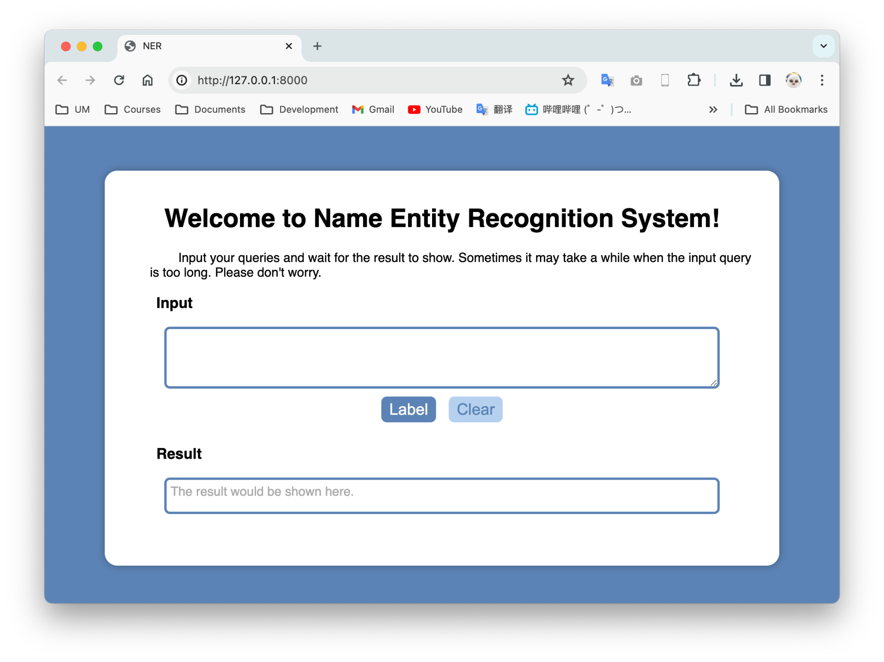

/ Frontend-Server Model
Frontend Framework
HTML + CSS + JS
Backend Framework
Django + Python
Notes:
We use plain HTML + CSS + JS as our frontend framework, and Django as a backend framework.

Slide 15
/ Frontend-Server Model / Frontend Framework
HTML + CSS:
Structure & Style of website.
JavaScript:
Defines how the input query is submitted to the backend (XMLHTTPRequest, etc).
Define how the response from the server is handled.
Frontend Framework
HTML + CSS + JS
Notes:
HTML and CSS are used for styling the website.
Javascript is used to send asynchronous messages to the server, and fetch the response asynchronously.

Slide 16
/ Frontend-Server Model / Backend Framework
Django: Model-Template-View Framework
View: Defines how the backend respond to the frontend, facing some specific requests.
In this case:
The predicted query of the MaxEnt Model is the response from the backend.
The backend responds the frontend in JSON format.
Backend Framework
Django + Python
Notes:
Django is a Model-Template-View Framework.
A view defines how the backend respond to the frontend when it is faced some specific requests.
In this case, we want the backend to pass the processed input query, that is the tagged query, to the front-end.

Slide 17
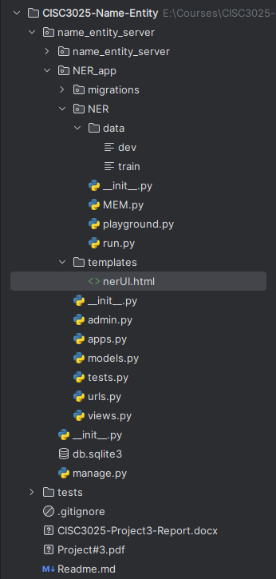

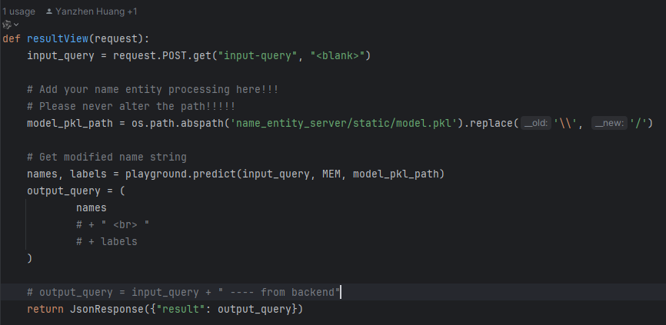
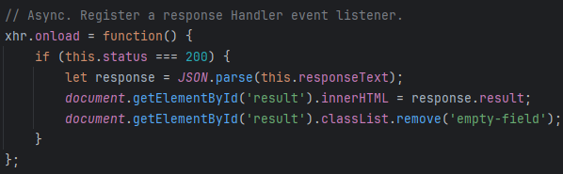
/ Frontend-Server Model / Backend Framework
1
2
Backend Framework
Django + Python
Invoke Model
3
Notes:
This is a peak view of the code.

Slide 18
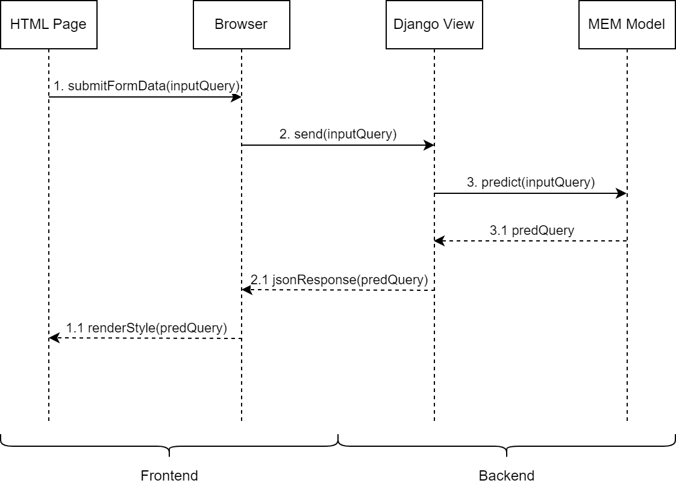
/ Frontend-Server Model / Backend Framework
Frontend Framework
HTML + CSS + JS
Backend Framework
Django + Python
Notes:
This is the UML of the cooperation of Front-end and Backend.

Slide 19
Evaluations and Demo

Slide 20
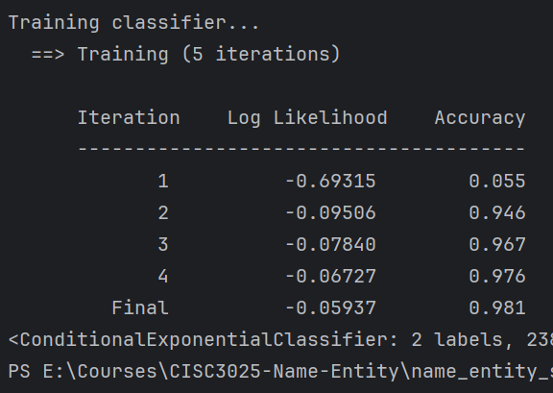
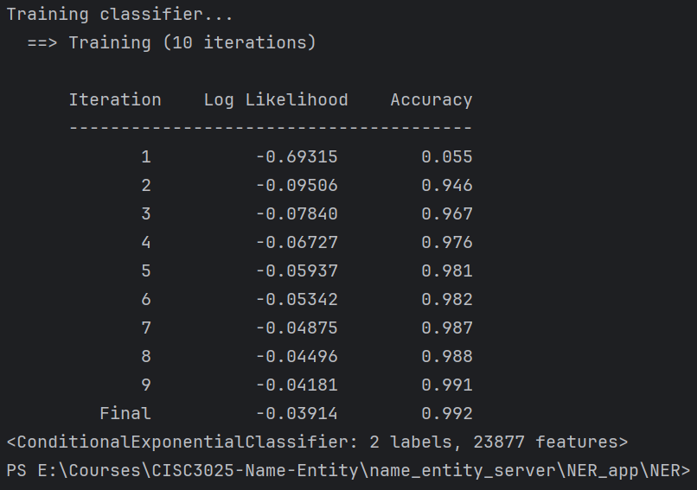
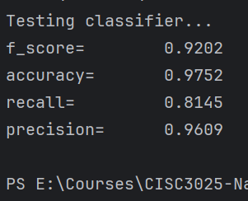
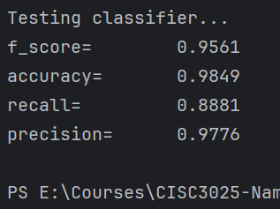
/ Evaluations and Demo / Training & Testing Results
5 Iterations
10 Iterations

Slide 21
/ Evaluations and Demo / Ideas
Too much Training:
Helps to improve F-Score, especially recall
However, causes over-fitting.
Dis-encourage innovation.
Synonym: You can’t make a child successful by regulating him too much.

Slide 22
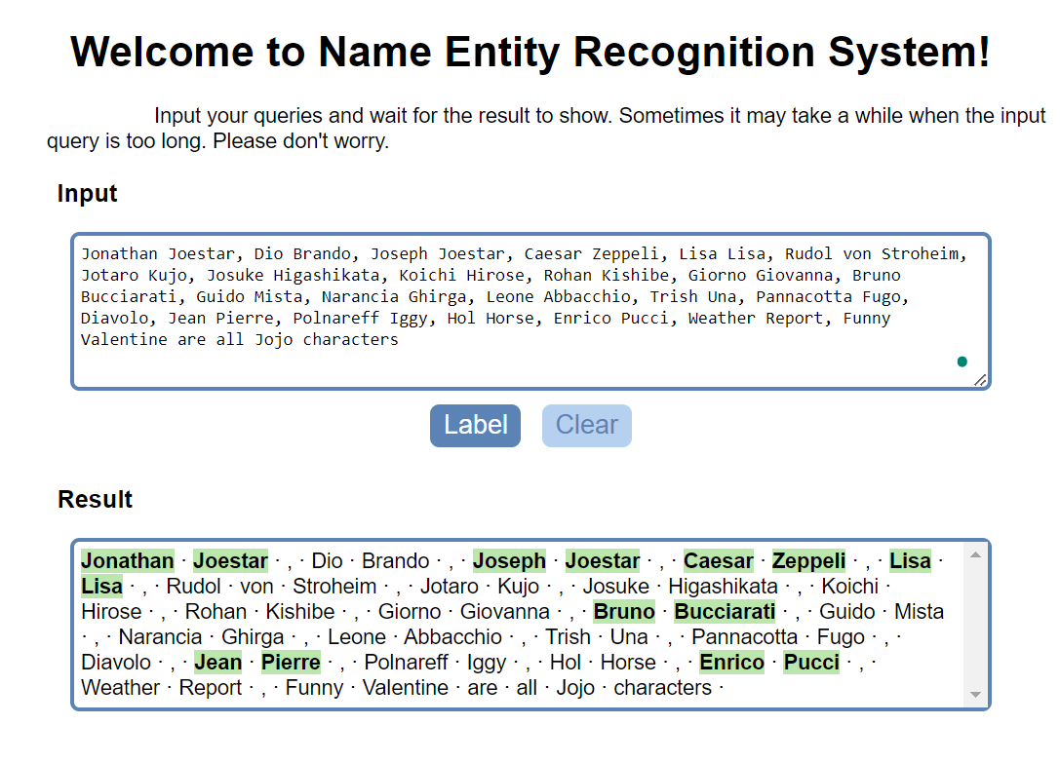
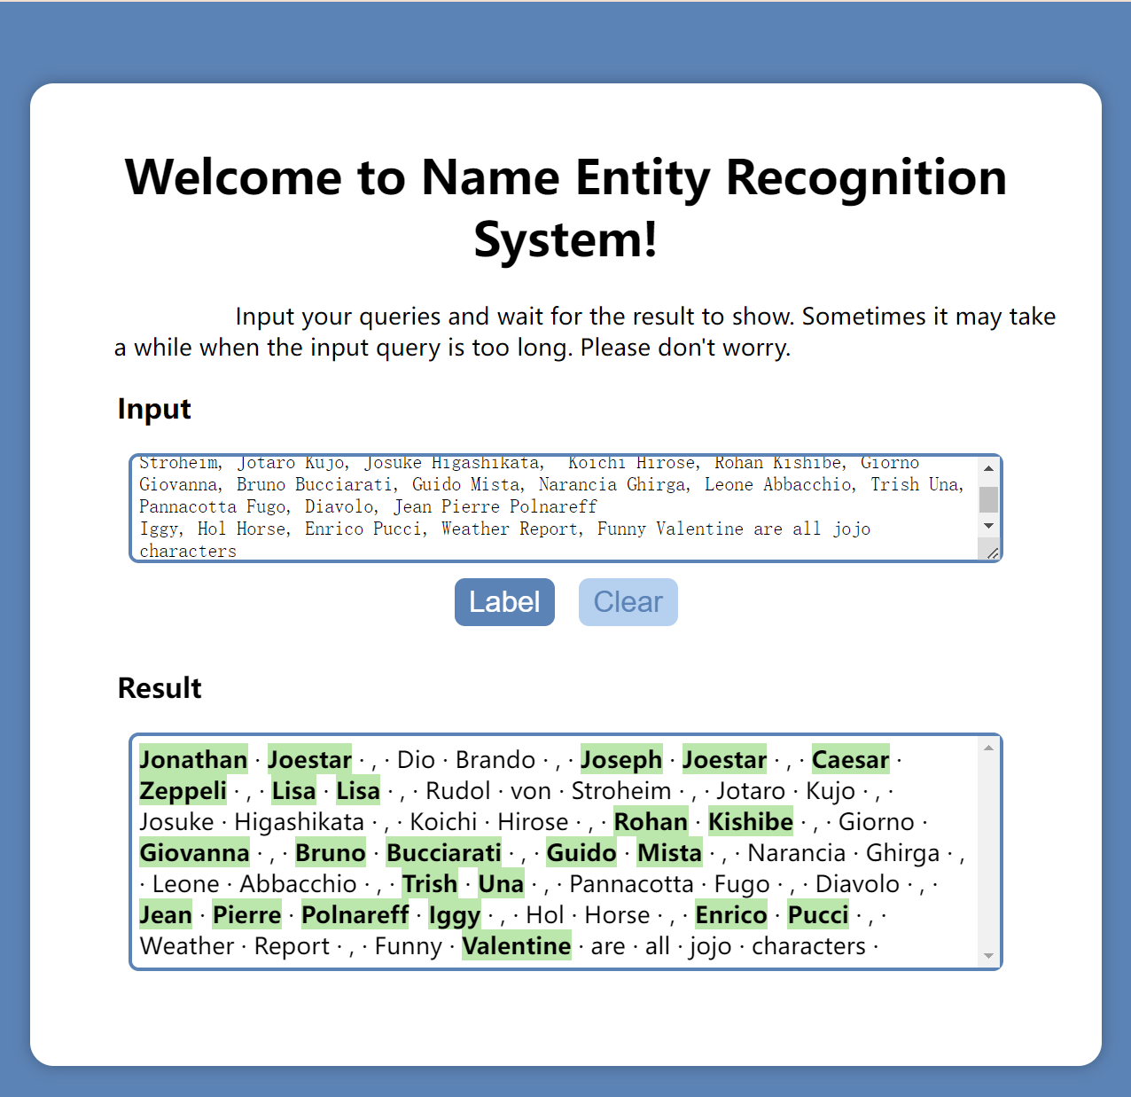
/ Evaluations and Demo / Performance Difference
Model’s performance on JOJO movie names: Including English, Japanese, Italian, Greeks, …
5 Iterations
10 Iterations

Slide 23
/ Evaluations and Demo / Live Demo
Live Demo

Slide 24
Thanks for Listening!

