Slide 1
Implementation of Name Entity Recognition System and its Evaluation
Group 28
Huang Yanzhen | DC126732
Che Zirui | DC127901
Notes:
There are three essential steps to build a maxent model.
First, we need to select observatble features with respects to each data points.
Then, we will weight the features using machine learning for discriminating the classes.
Lastly, we will evaluate the performance of the model, and see how the feature selected goes for doing

Slide 2
Introduction: To build a MaxEnt Model
Feature Selection
Select proper and precise features that can best help to distinguish a word entity from “others” and “name”.
Feature Weighting
Use the training methods to assign each feature an importance weight for further prediction.
Model Evaluation
The assigned values of weights determines the behavior of the model. The model predicts each word entity with the observed features and weights.
1
2
3

Slide 3



Feature Selection
Frontend-Server Model
Evaluations and Demo

Slide 4
Feature Selection

Slide 5
/ Feature Selection
8 custom features + 3 baseline features
Johnson
MacArthur
D.
…
January
Tuesday
China
She
Attributive Clause
Start of Sentence
Positional Status
Internal Pattern Features
Library Features
Contextual Features
Internal
Analyzes word patterns
Assumes that some specific pattern could distinguish names
Semi-Internal
Base on the experiences
Assumes that a word that is in some class is likely or not likely to be classified as a name
External
Base on the contextual environment
Assumes that a word that has certain contextual environment is likely or not likely to be a name

Slide 6
/ Feature Selection / Internal Pattern Features
Feature Name |  | Description | Explanation | Match Examples
Positive Patterns | p_cap_low | Start with Capital Letter, and the rest of the letters are lowercase. There may be: - A prime after the first letter; - A second cap letter in the third or forth letter’s space. | In English, names always start with a capital letter. There are some special styles that is quite unique in names. | Jonathan, Jason MacArthur, McDonald O’Brien
 | p_cap_period | A single capital letter followed by a period. | In English, this pattern in most circumstances represent human name initials. | Donald J. Trump George W. Bush
Negative Patterns | p_noun_like | A word that has an ending like a noun. Specifically: -tion, -ment, -ness, -ship, -hood, -age, -ance, -ence | These suffixes are used to derive a noun from an adjective or adverb. These derivations are less likely to be names compared to other nouns. | movement, action, correctness, membership, likelihood, usage, allowance
Johnson
MacArthur
D.
…
Internal Pattern Features
Internal
Analyzes word patterns
Assumes that some specific pattern could distinguish names

Slide 7
/ Feature Selection / Library Features
Libraries |  | Python Package Name | Examples
Positive Library | Useful Names | nltk.corpus.names | James, Jonathan, …
Negative Libraries | Week Names | self-defined | Tuesday, Wednesday, Thursday, …
 | Month Names | self-defined | January, February, March, April, …
 | Country Names | geonamescache.countries | China, Japan, United States, …
 | City Names | geonamescache.cities | London, Zhuhai, Hong Kong, Macau, …
 | Stopwords | nltk.corpus.stopwords | He, She, is, that, …
January
Tuesday
China
She
Library Features
Semi-Internal
Base on the experiences
Assumes that a word that is in some class is likely or not likely to be classified as a name

Slide 8
/ Feature Selection / Contextual Features
Feature Name |  | Description | Explanation
Positive Context | is_start_of_sentence | A word being at the start of a sentence. - This word has position of 0. - This word is after a concrete period. | It is highly likely that a word entity that fits the pattern of a name defined before is the start of the sentence.
 | is_target_of_clause | Is the target of the restricted attributive clause. | We often refer someone with addition informations using restricted attributive clause. For instance: Jane, who was my friend, went to the park. This clause puts high probability to the target entity that it is a name.
 | is_after_status | Is after the social status in English, like Mr., Ms. | It is very common to put names after social statuses.
Attributive Clause
Start of Sentence
Positional Status
Contextual Features
External
Base on the contextual environment
Assumes that a word that has certain contextual environment is likely or not likely to be a name

Slide 9
/ Feature Selection / Contextual Features / Clause
Attributive Clause Examples
Donald J. Trump, who was a former US president, was a successful business man.
Michael Rosen, whose son died before him, wrote We’re Going on a Bear Hunt.
Clause Form
<Entity>, who/whose <verb-phrase>.
Attributive Clause
Start of Sentence
Positional Status
Contextual Features
External
Base on the contextual environment
Assumes that a word that has certain contextual environment is likely or not likely to be a name
Highly Likely to be a name!

Slide 10
/ Feature Selection / Improvements / Eliminate Features
Feature Name |  | Description
Negative Internal Pattern Features | p_name_prefix | Social Status
 | p_possessive_like | Possessive case of a pronoun.
 | p_country_abbrev_like | Abbreviation of country names. Like U.K. or U.S.
 | p_num_slash | A set of numeric descriptions. For instance, 12-20
 | is_posessive | Is before the entity “’s”.
Feature Name |  | Description
Negative Contextual Features | is_around_first | Social Status
 | is_last_word | Last word in sentence
 | is_after_name_prefix | After social statuses, like Mr., Ms.
 | is_posessive | Is before the entity “’s”.
 | is_after_verb | A verb is after it.

Slide 11






/ Feature Selection / Improvements / Merge Library Features
w $∈$ names
is_in_name
Library Features were dispersed at first
That is, one library matches to one feature
However, again, we don’t want to tell the model too much about “what not to do”, instead of what to do.
Therefore, these features are merged into one.
w $∈$ Months
is_month
w $∈$ Week
is_week
w $∈$ Country
is_country
w $∈$ City
is_city
w $∈$ StopWords
is_stopwords

Slide 12
/ Feature Selection / Improvements / Merge Library Features
w $∈$ names
is_in_name
Library Features were dispersed at first
That is, one library matches to one feature
However, again, we don’t want to tell the model too much about “what not to do”, instead of what to do.
Therefore, these features are merged into one.
w $∈$ Months
w $∈$ Week
w $∈$ Country
is_not_likely_name
w $∈$ City
w $∈$ StopWords

Slide 13
Frontend-Server Model

Slide 14
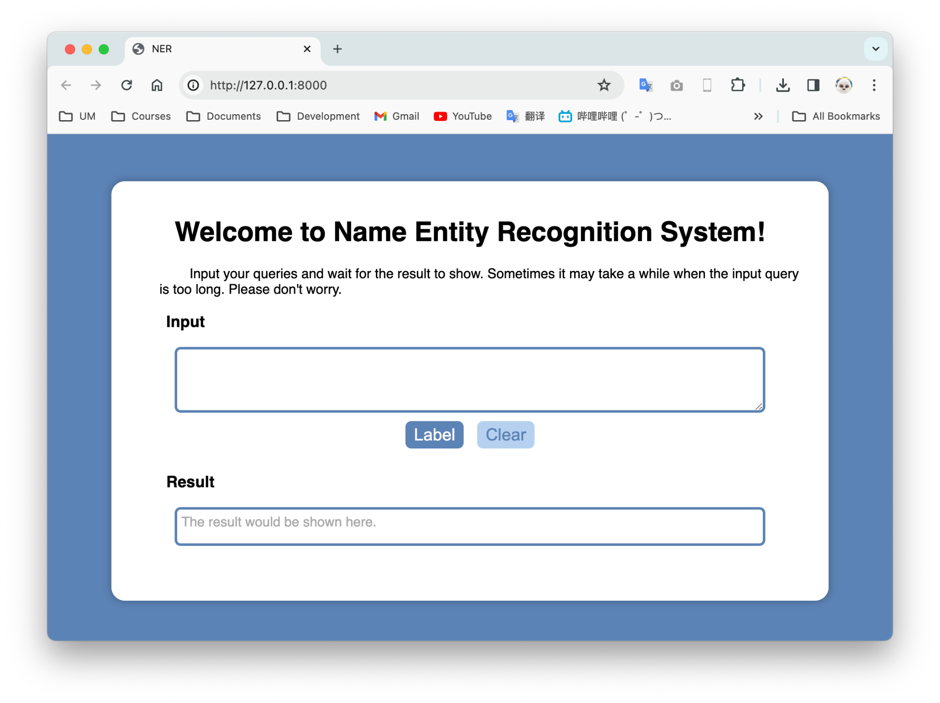

/ Frontend-Server Model
Frontend Framework
HTML + CSS + JS
Backend Framework
Django + Python

Slide 15
/ Frontend-Server Model / Frontend Framework
HTML + CSS:
Structure & Style of website.
JavaScript:
Defines how the input query is submitted to the backend (XMLHTTPRequest, etc).
Define how the response from the server is handled.
Frontend Framework
HTML + CSS + JS

Slide 16
/ Frontend-Server Model / Backend Framework
Django: Model-Template-View Framework
View: Defines how the backend respond to the frontend, facing some specific requests.
In this case:
The predicted query of the MaxEnt Model is the response from the backend.
The backend responds the frontend in JSON format.
Backend Framework
Django + Python

Slide 17
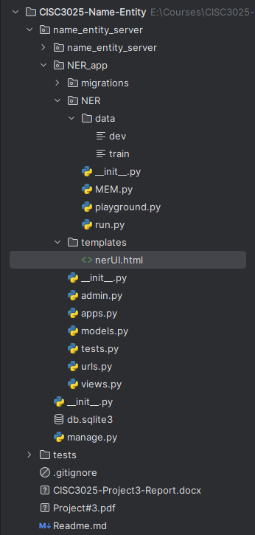

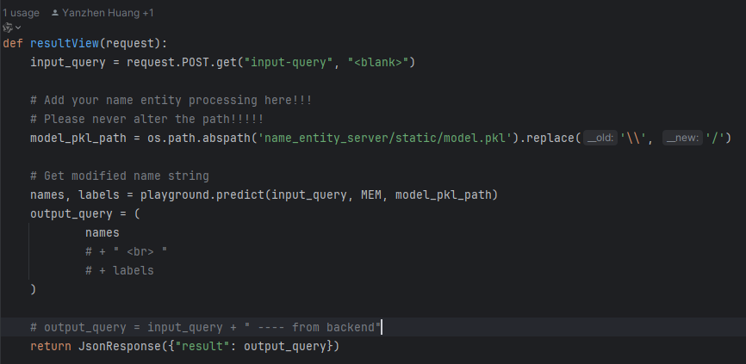
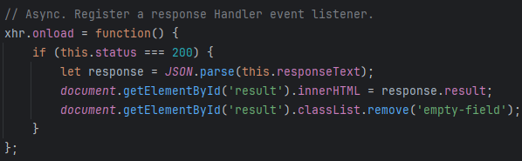
/ Frontend-Server Model / Backend Framework
1
2
Backend Framework
Django + Python
Invoke Model
3

Slide 18
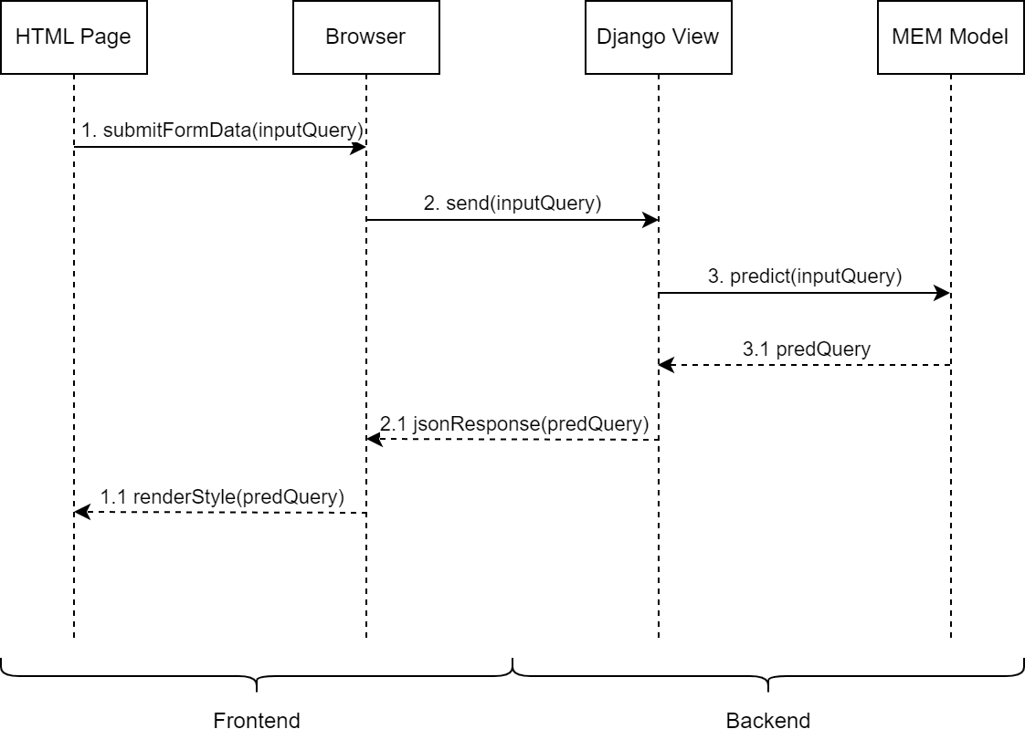
/ Frontend-Server Model / Backend Framework
Backend Framework
Django + Python

Slide 19
Evaluations and Demo

Slide 20
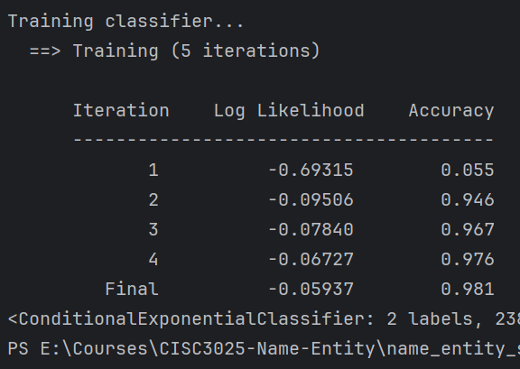
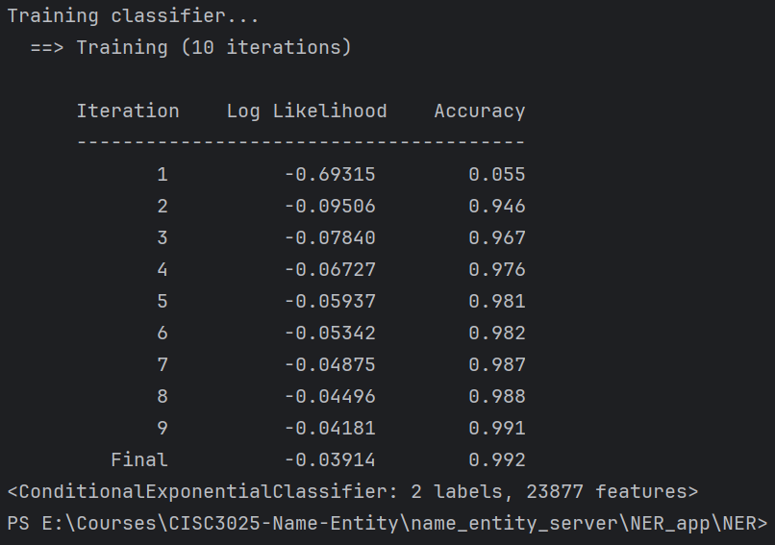
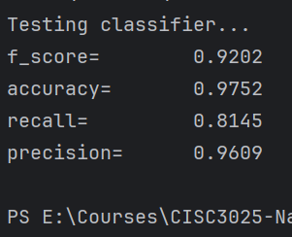
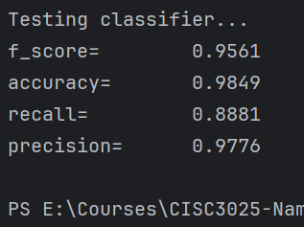
/ Evaluations and Demo / Training & Testing Results
5 Iterations
10 Iterations

Slide 21
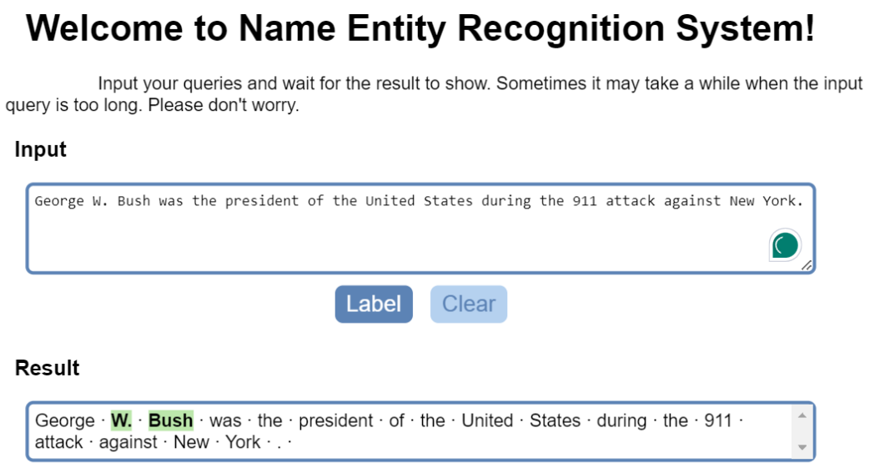
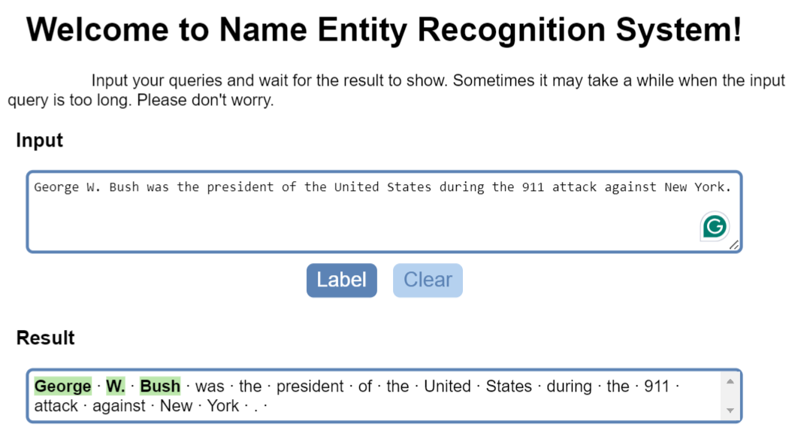
/ Evaluations and Demo / Performance Difference
5 Iterations
10 Iterations

Slide 22
/ Evaluations and Demo / Eliminate Features
Too much Negative Internal Pattern Features.
Helps to improve F-Score, especially recall
However, causes over-fitting.
Disencourage innovation.
Synonym: You can’t make a child successful by regulating him too much.

Slide 23
/ Evaluations and Demo /
Live Demo

Slide 24
Thanks for Listening!

