Slide 1
Gomoku
By Yanzhou Huang

Slide 2
Description
Gomoku is a board game.
Winner is the first player to get an unbroken row of five stones.
The black stones goes first.
Swap2 rule.
Gomoku swap2 rule
- The first player puts 2 black and 1 white stones anywhere on the board. - The second player has 3 options: - stay with white, - swap, - put 2 more stones and let the opponent choose the colour

Slide 3
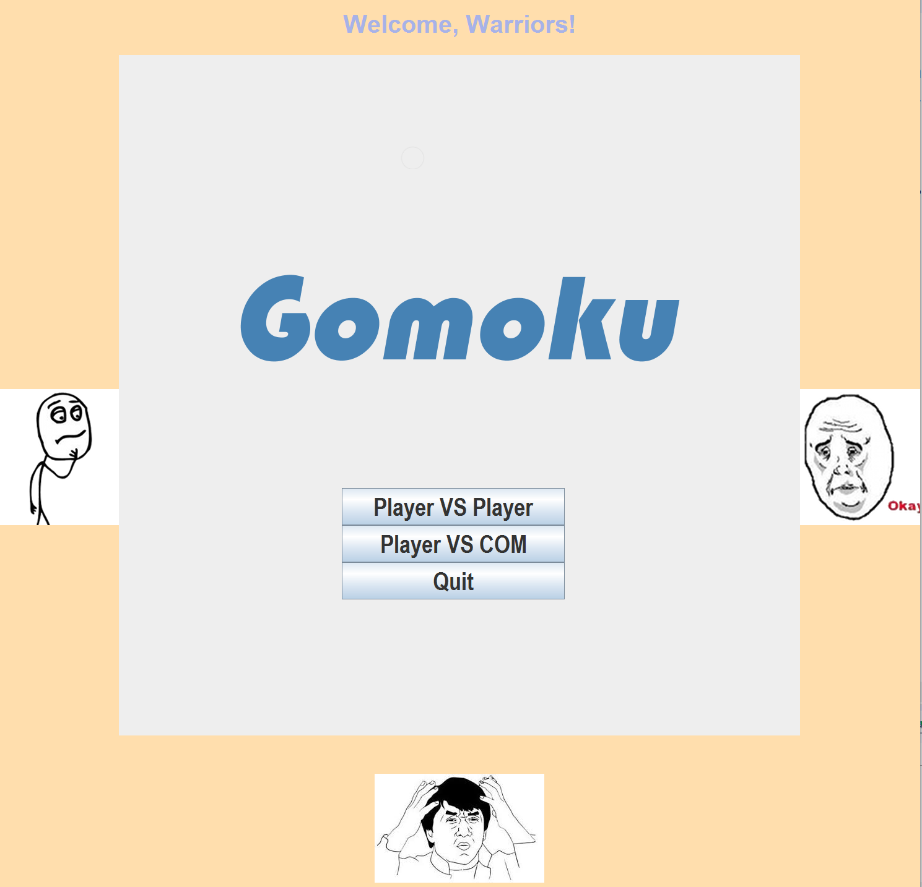
Game Mechanics
User can choose player vs player and player vs com.

Slide 4
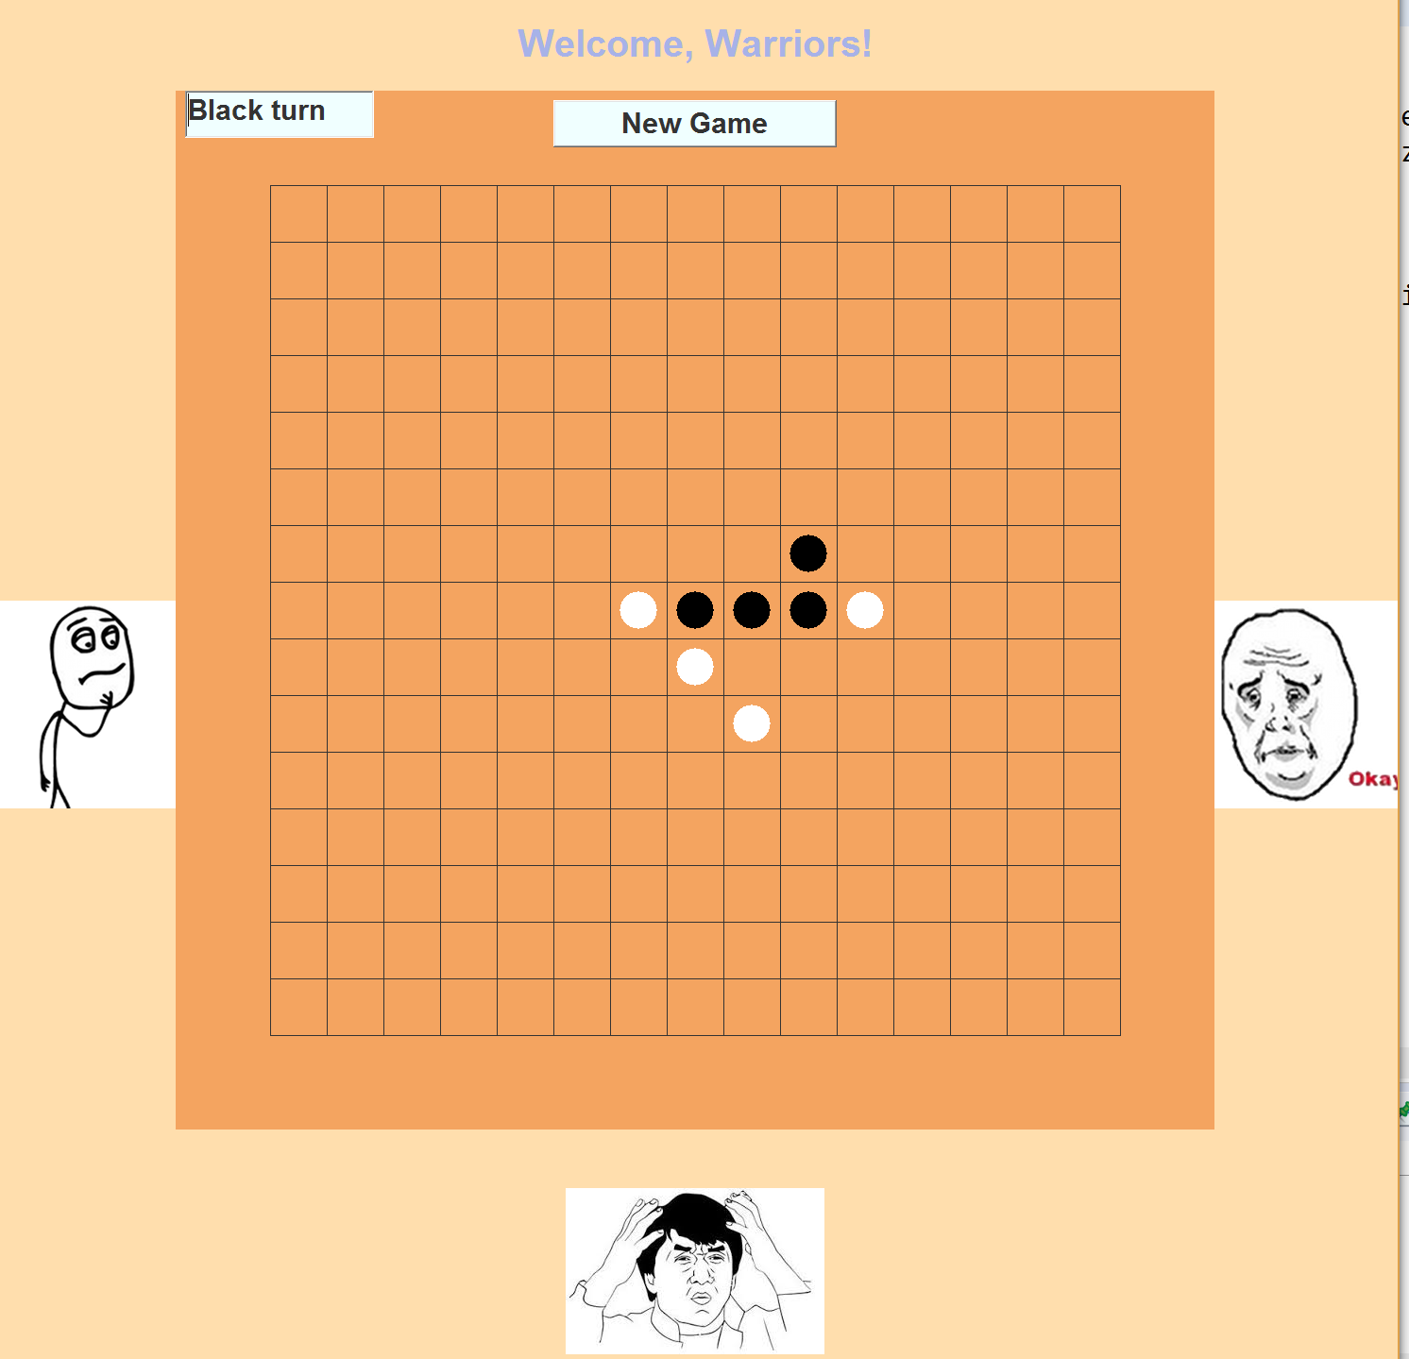
Game Mechanics
New Game Button on the top of the board, player can start a new game at any time.

Slide 5
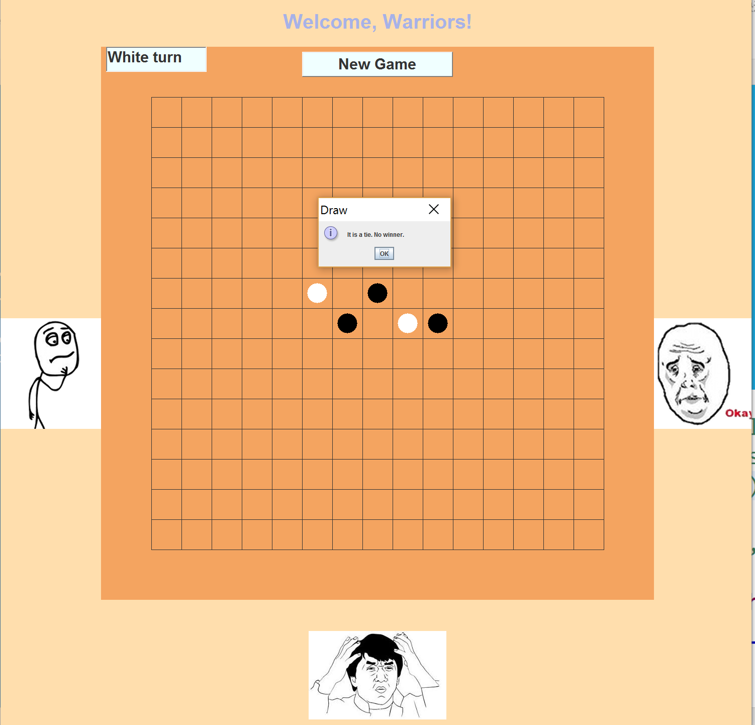
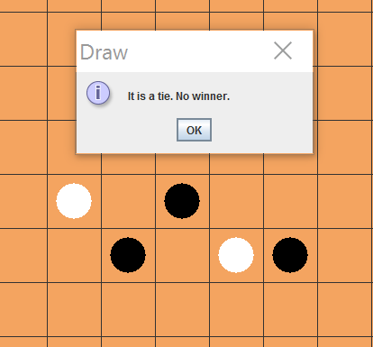
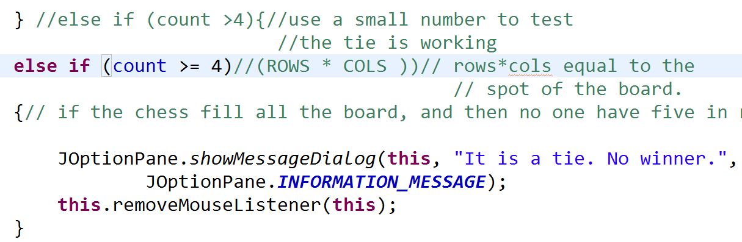
Game Mechanics
“count” record the numbers of stones on the board, if counts reaches rows*col, then a game is a tie.

Slide 6
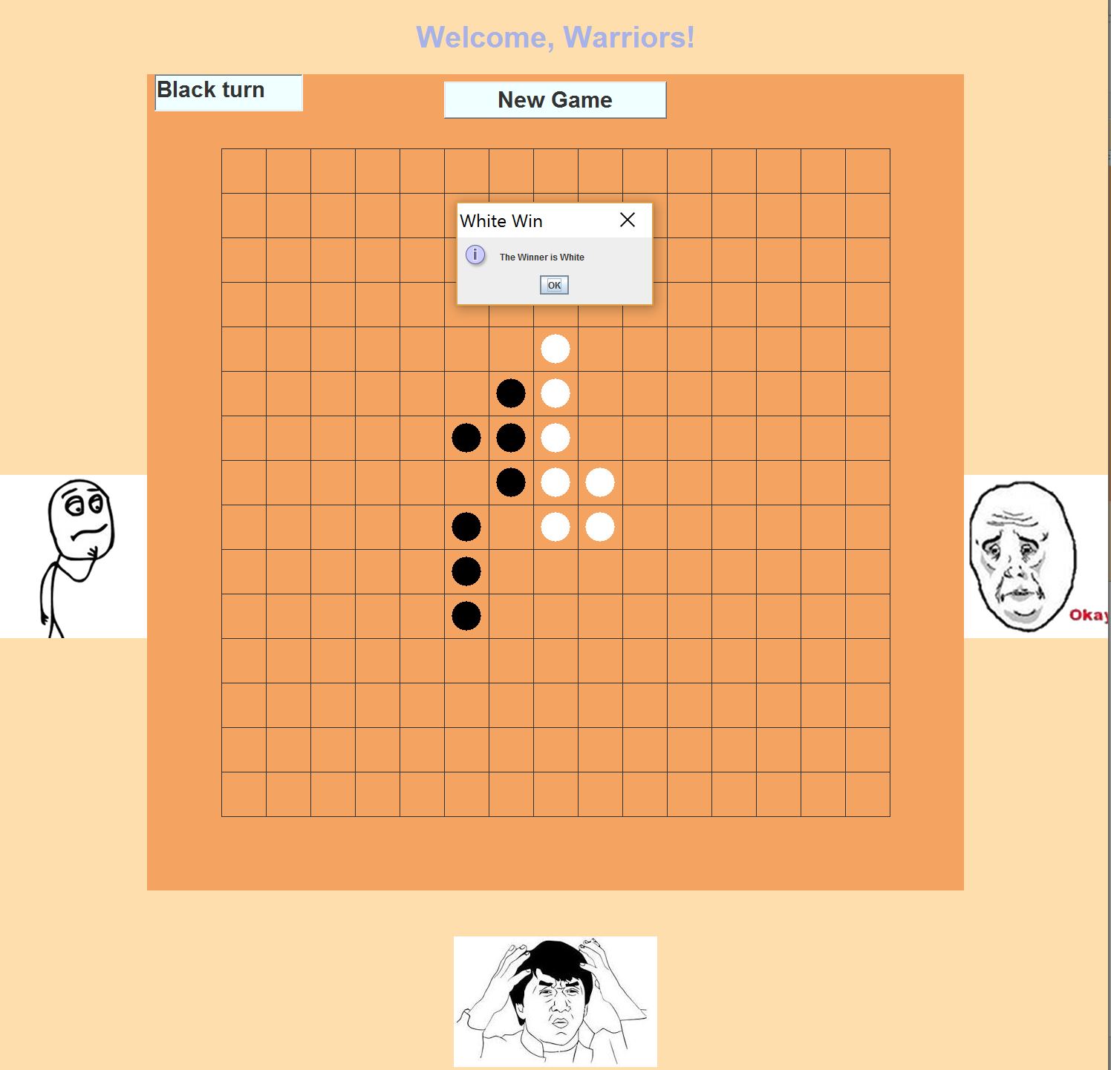
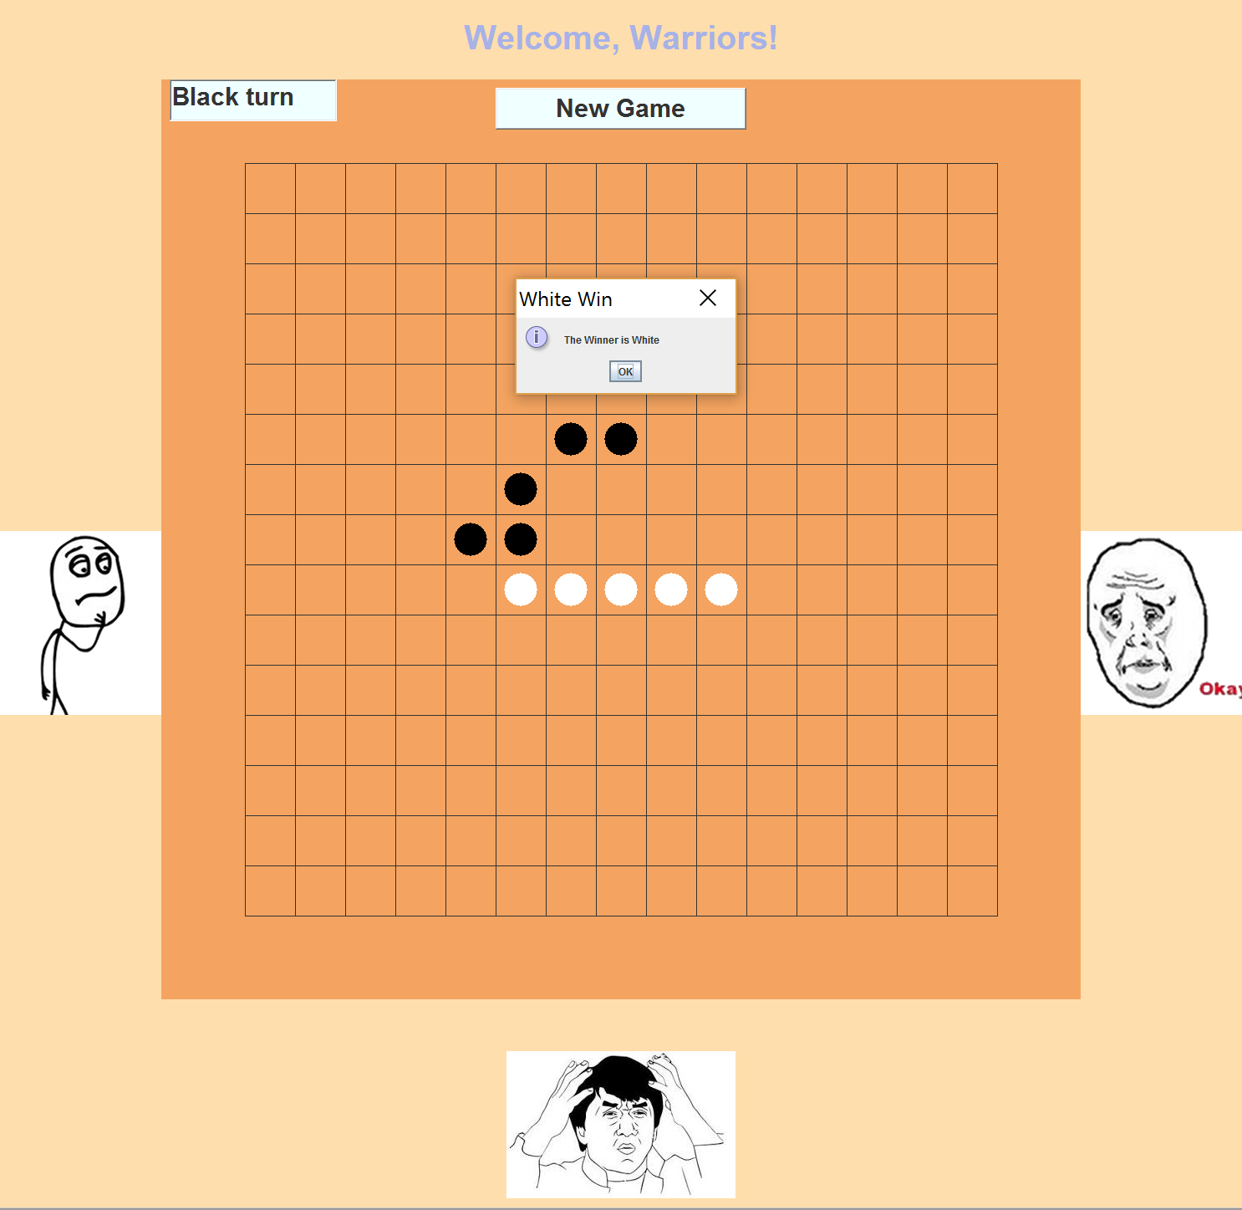
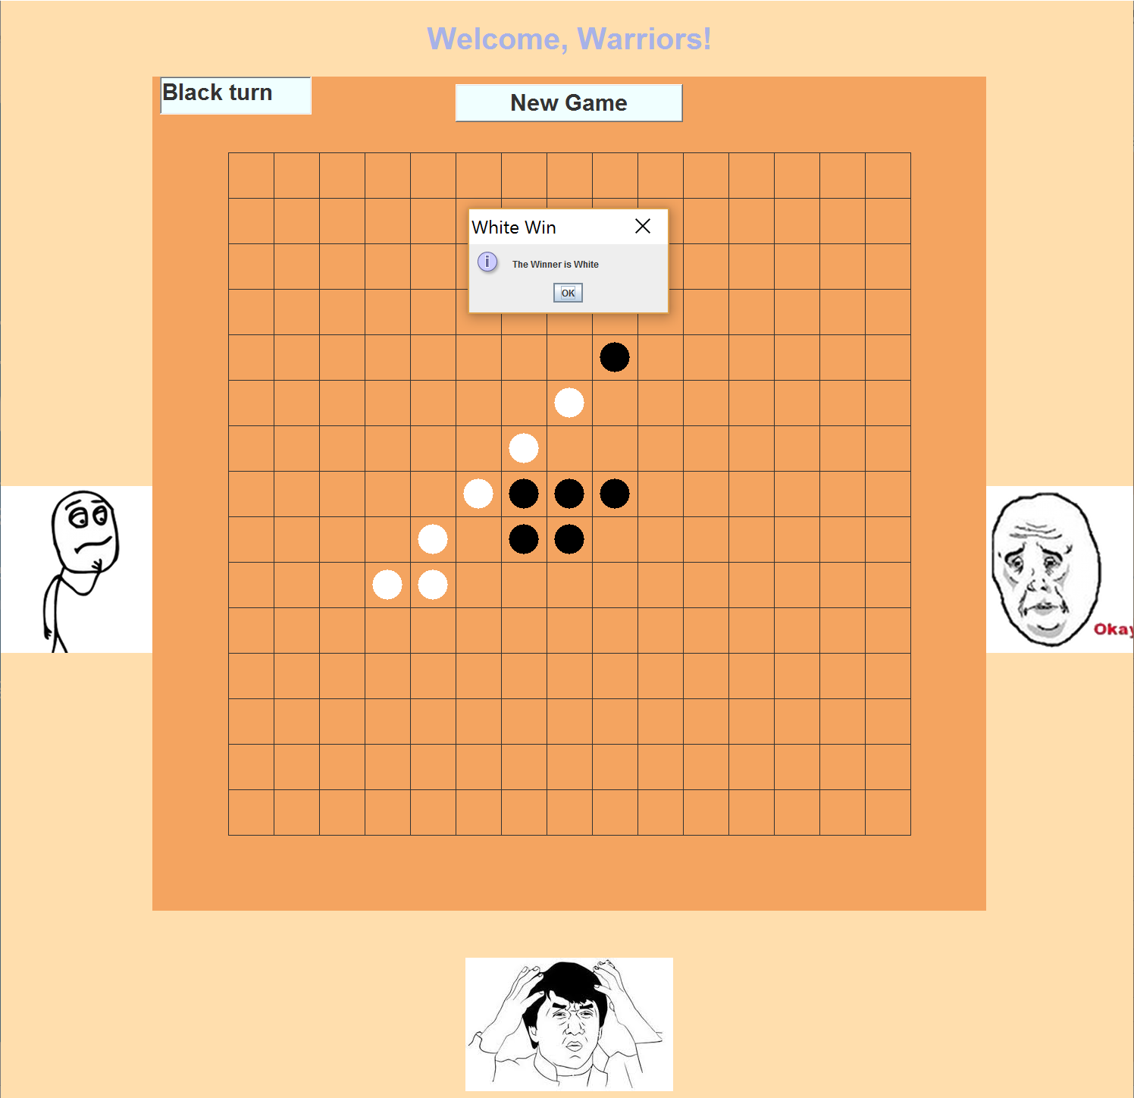
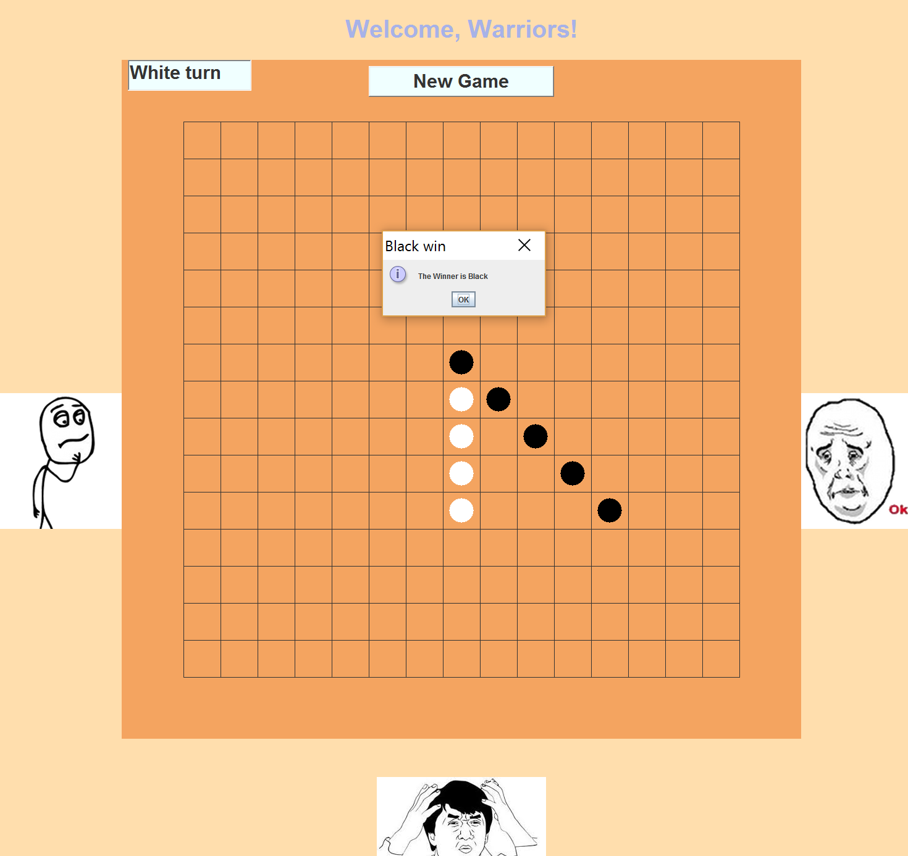
Game Mechanics
Game is win, if get an unbroken row of 5 stone.
Uses 4 loops to count the number of connected stones in each direction -----horizontally, vertically, or two
diagonally

Slide 7
AI
Block opponent
Try to get the winning placement
Search
Search for a place and calculate the rank
Each rank defined the difference action

