Slide 1
Chinese Culture Days
Missouri Botanical Garden Summer 2011
Elia Ahmed
Geography 1001, UMSL

Slide 2
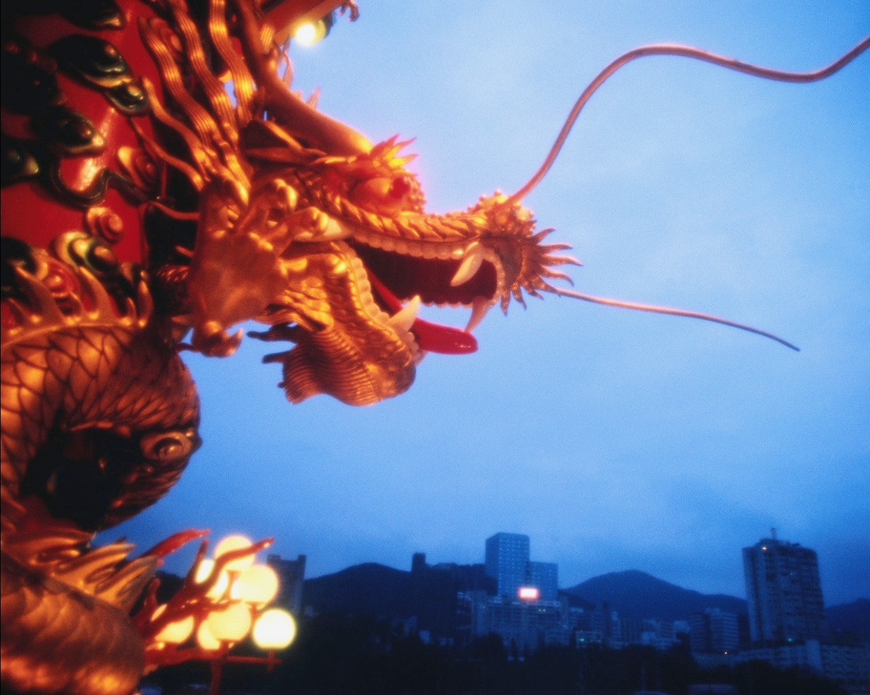
Dragon Symbol Used in opening of ceremony

Slide 3
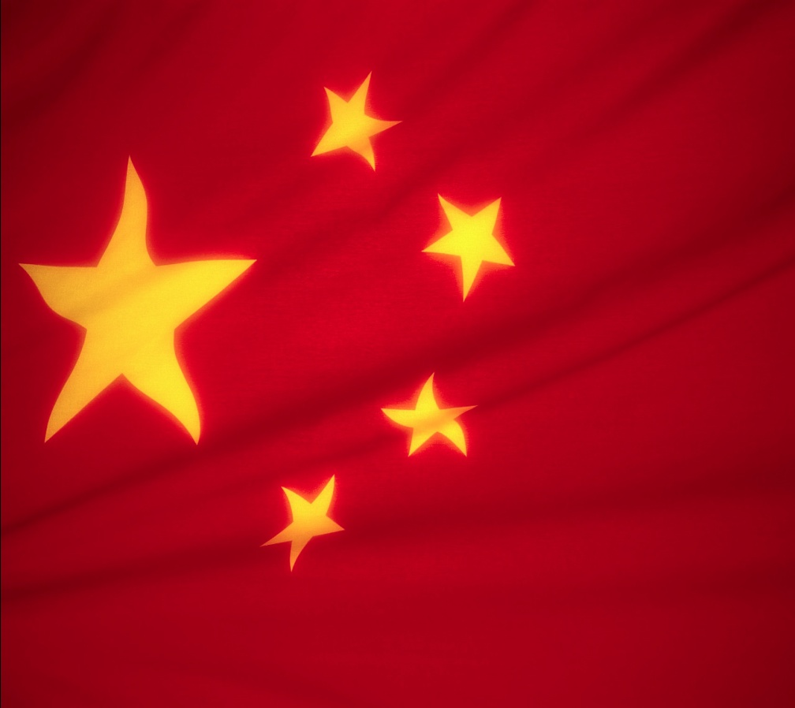
Chinese Flag
Red is the color of luck.

Slide 4
Chinese Arts
Creative Chinese Arts include:
Porcelain
Silk making
Painting and Calligraphy
Culinary Arts

Slide 5
Foods
Because of the wide range of climates in this vast country, there are varying products food in different regions of China. In northern China, where the climate is colder, the main crop is wheat, so breads and noodles are the main staples. In southern China, where the climate is warmer and wetter, rice is easily grown and is the main staple.
Vegetables are the next consumed foods. They are often eaten fresh, or pickled and salted countless ways as a means of preserving them for the winter months.

Slide 6
Traditional Recipes
Fried Rice
2 cups cooked rice
1 egg beaten
2 scallions, chopped
1 tbsp of soy sauce
Cucumber Salad
2 cucumbers, halved and sliced
2-3 tsp. Soy sauce
1 tsp. vinegar
1/2 tsp. sesame oil
Pinch of salt

Slide 7
Foods
Meat is eaten in small quantities and is often used to flavor the food with which it is cooked.
Fruits are eaten as snacks and served as dessert.
Soups are the first course in the south, as well as the last course in the north.

Slide 8
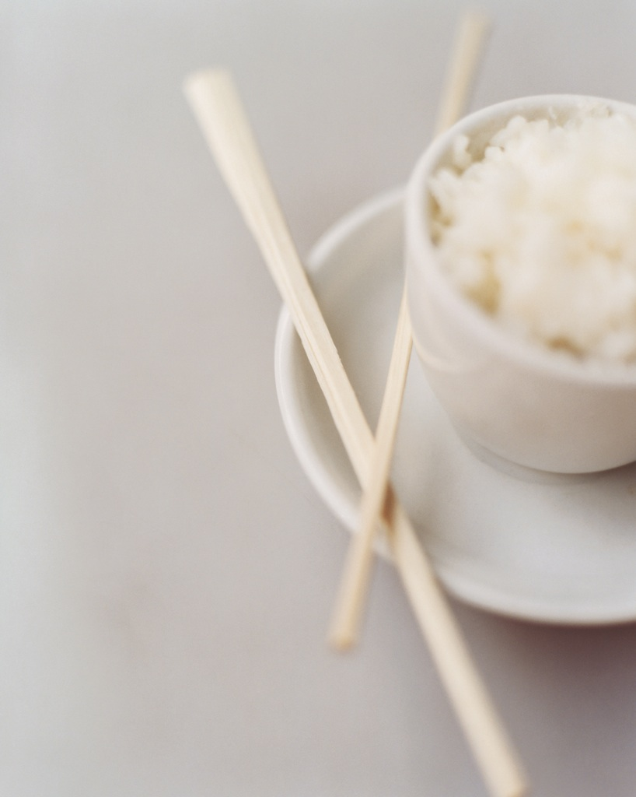
Rice Bowl

Slide 9
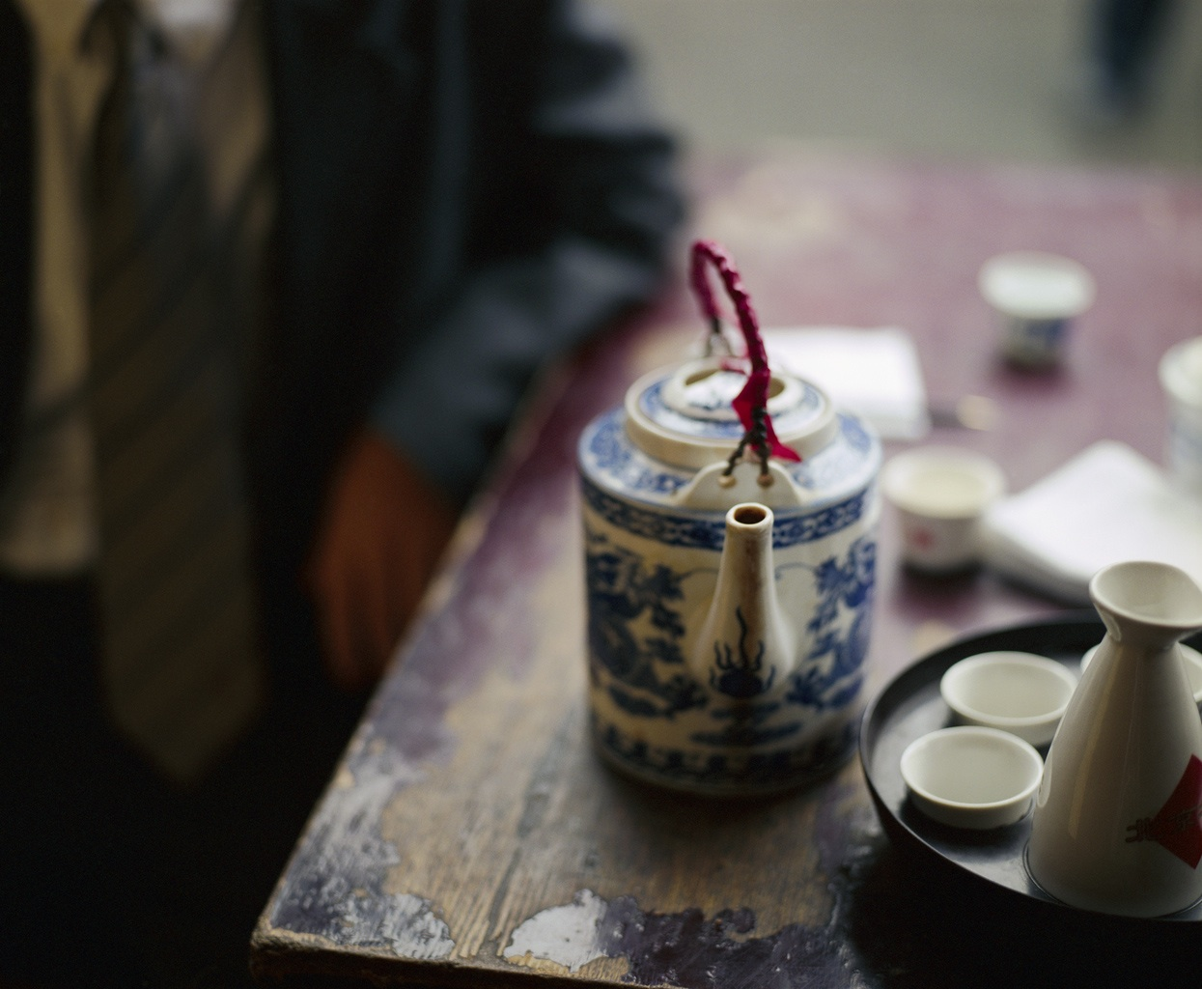
Chinese Tea

Slide 10
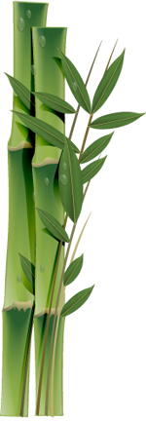
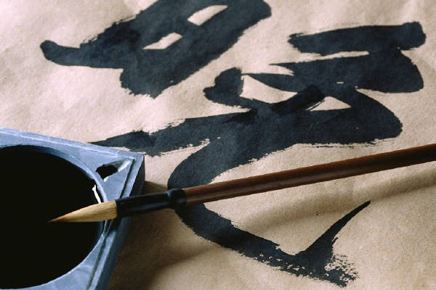
Calligraphy

Slide 11
Painting and Calligraphy
Painting and calligraphy are considered the two greatest artistic achievements of the Chinese.
The Chinese written language is made up of pictographs, pictures of ideas and things, so it is fitting that both paintings and the “pictures” or Chinese characters are created with brush and ink.
Artists painting names of children in Chinese calligraphy. Very organic brushstrokes.

Slide 12
Chinese Learning Experience
I learned of the many various rituals of the Chinese whom are have many festivals throughout the year to honor their ancestors, the moon, poets and the New Year.
Red is considered to be a lucky color and thought to bring happiness and money. It is the main color of the Chinese flag. During Chinese New Year, everyone wears red.
The Chinese do not use an alphabet as we do to produce sounds of their language.
Instead, each Chinese word is called a character, and each character represents an idea or object.

Slide 13
Observations
Some differences I noticed where the use of animal symbols to celebrate festivals, the art of brushstrokes, the fresh ingredients used in cooking, the elaborate costumes, the ceremonial dances, and the honoring of your ancestors with gifts to spirit houses.

Slide 14
Observations cont.
As someone whom enjoys the arts, I enjoy watching creative people creative art forms.
I believe that Western society has lost touch with many creative, organic processes.
I believe the Chinese people are very creative and artistic. Their art is sensitive in nature.
The family unit is important. Having a spirit house to honor your dead ancestors daily with cut flowers and fruit, as you must appease your ancestors and they will bring you luck.
Many superstitions in the Chinese culture, as opposed to the West.

Slide 15
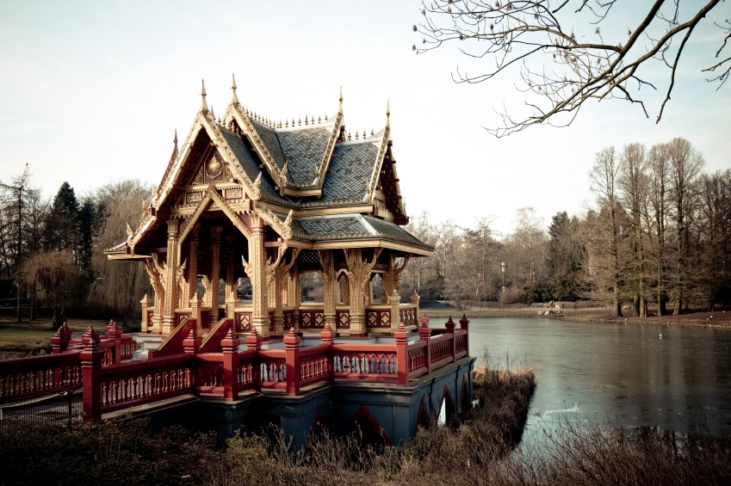
Pagoda

Slide 16
Borrowing from the Chinese
I think that Western society should look
the East on how to show respect for nature and the elderly. Love that the Chinese honor their deceased ancestors. Respectfulness for elders and doing for elders.
The Chinese people cook everyday with fresh ingredients and rice is their stable diet. Western people cook dinners from frozen prepared bags and cardboard instant boxes. There is a lack of fresh ingredients in the diets of Western people. Fruit is a dessert in China. Western people hardly eat any fresh ingredients daily.

Slide 17
What the East could learn from the West
As the event mainly focused on the arts,
I pondered over this for awhile.
I would like to see Chinese fusion in the art forms. Western artists have borrowed techniques and ideas from all across the globe. I would like to see young Chinese artists fuse the old Chinese traditional art forms with new art forms. For example, Chinese fusion cuisine.

