Slide 1
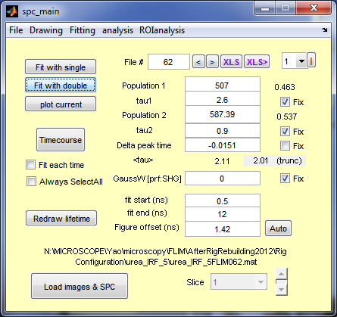
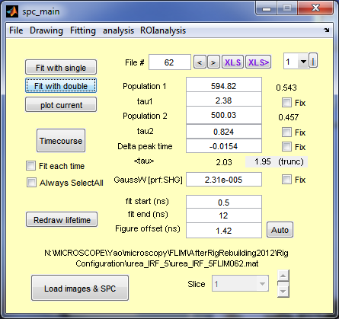
Manual fit
Automatic fit
64 channel
Prf=20120512top
True distribution
Tau1 2.6
Tau2 0.9
P1=p2=0.5
Simulated Data
SS=10^4 photons
No afterpulse
No Dark Count
No autofluorescence
Conclusion
Automatic fit is not as good as forced manual fit (forced lifetimes): why?

Slide 2
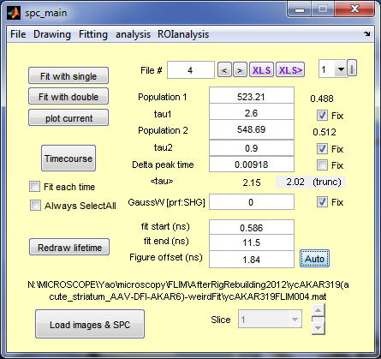
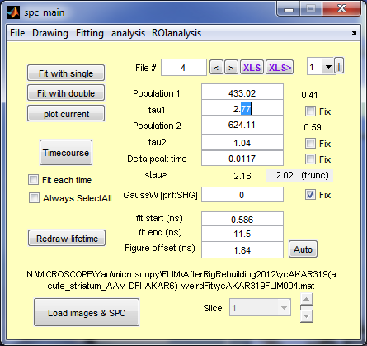
Manual fit
Automatic fit
64 channel
Prf=20120512top
True distribution
Tau1 2.6
Tau2 0.9
P1=p2=0.5
Simulated Data
SS=10^4 photons
No afterpulse
No Dark Count
No autofluorescence
After changing what to minimize in the program (by changing weights)
Conclusion
It is minimizing chi2; note that reduced chi2 got larger because of more free parameters.

Slide 3
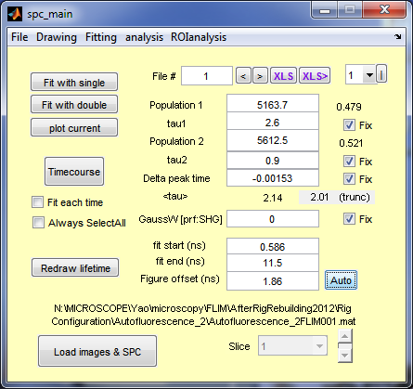
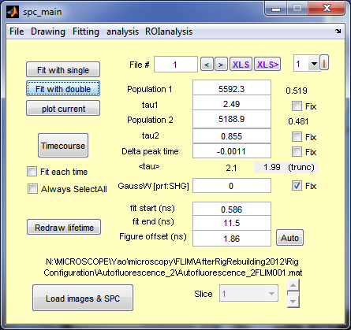
Manual fit
Automatic fit
64 channel
Prf=20120512top
True distribution
Tau1 2.6
Tau2 0.9
P1=p2=0.5
Simulated Data
SS=10^5 photons
No afterpulse
No Dark Count
No autofluorescence
Conclusion
More photons->More accurate fit.

Slide 4
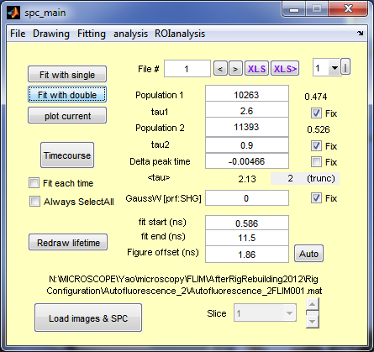

Manual fit
Automatic fit
64 channel
Prf=20120512top
True distribution
Tau1 2.6
Tau2 0.9
P1=p2=0.5
Simulated Data
SS=2*10^5 photons
No afterpulse
No Dark Count
No autofluorescence
Conclusion
Automatic fit is now better than manual fit. Accuracy similar to 10^5.

Slide 5


Manual fit
Automatic fit
64 channel
Prf=20120512top
True distribution
Tau1 2.6
Tau2 0.9
P1=p2=0.5
Simulated Data
SS=2*10^5 photons
No afterpulse
Dark Count 3000 (600/s)
No autofluorescence
Conclusion
Similar to no dark count.

Slide 6


Manual fit
Automatic fit
64 channel
Prf=20120512top
True distribution
Tau1 2.6
Tau2 0.9
P1=p2=0.5
Simulated Data
SS=2*10^5 photons
1% afterpulse
Dark Count 3000 (600/s)
Added autofluorescence
(Based on 20 frames
40% power, 10X, 30um
below surface)
Conclusion
Autofluorescence makes the fit a lot worse, but the proportion is more accurate with the forced manual fit. Note how the average lifetime changed with and without autofluorescence.

Slide 7
Manual fit
Automatic fit
64 channel
Prf=20120512top
True distribution
Tau1 2.6
Tau2 0.9
P1=p2=0.5
Simulated Data
SS=2*10^5 photons
1% afterpulse
Dark Count 3000 (600/s)
Added autofluorescence
(Based on 20 frames
40% power, 10X, 30um
below surface)
Conclusion
Autofluorescence makes the fit a lot worse, but the proportion is more accurate with the forced manual fit. Note how the average lifetime changed with and without autofluorescence.

Slide 8

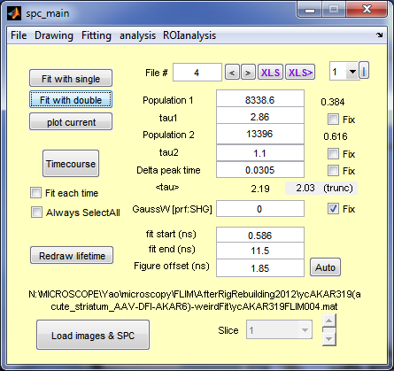
Manual fit
Automatic fit
64 channel
Prf=20120512top
True distribution
Tau1 2.6
Tau2 0.9
P1=p2=0.5
Simulated Data
SS=2*10^5 photons
1% afterpulse
Dark Count 3000 (600/s)
Included autofluorescence after convolution with prf
Conclusion
This is much better than convolution after addition of autofluorescence; and it makes sense too!
Forced fit is much closer to the true distribution, and the average lifetime is closer to the value without autofluorescence when you use forced fit.

Slide 10
How many photons are necessary?
Assumed distribution:
Tau1=2.1ns, tau2=0.7ns
Start: p1=60%, p2=40%
End: p1=20%, p2=80%.
Sample size (from signal)=
10000, 50000, 80000, 200000, 400000.
64 channel
Prf=20120512top
1% afterpulse
Dark Count 3000 (600/s)
Added autofluorescence (Based on 20 frames, 40% power, 10X, 30um below surface)

Slide 11
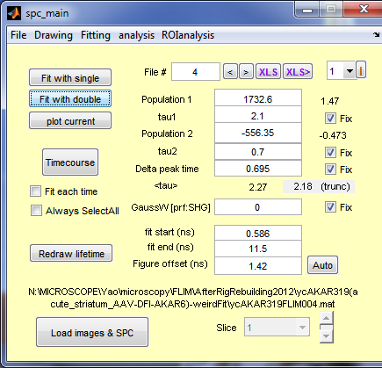
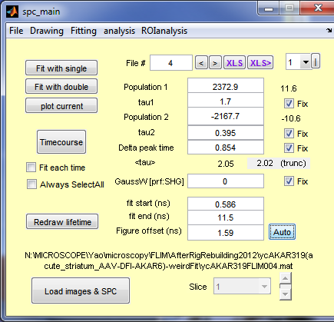
SS=10000
P1/p2=0.6/0.4
Manual fit
Automatic fit
Note:
Awful fitting

Slide 12
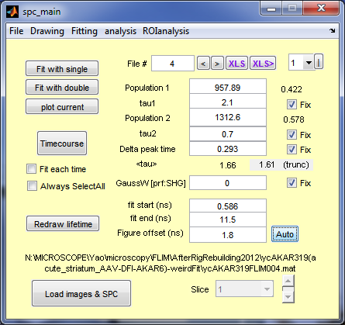
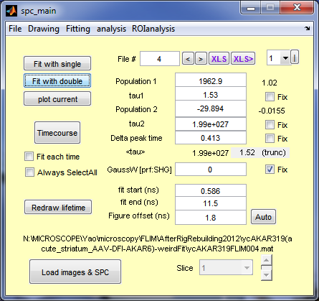
SS=10000
P1/p2=0.2/0.8
Manual fit
Automatic fit
Note:
Awful fitting

Slide 13
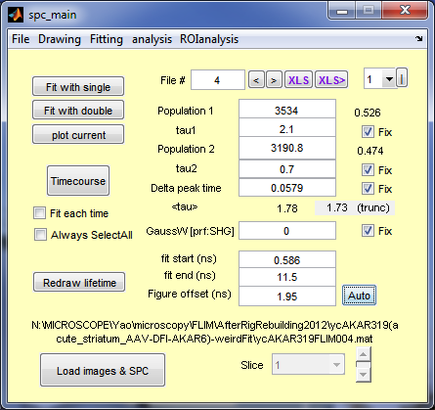

SS=50000
P1/p2=0.6/0.4
Manual fit
Automatic fit
Note:
Much better than 10000 photons

Slide 14
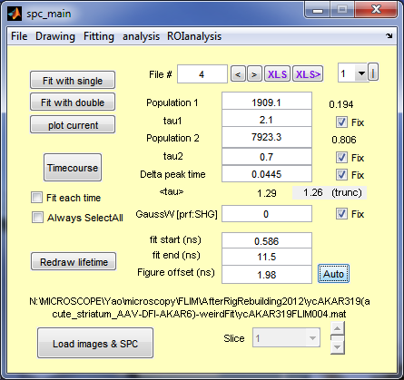
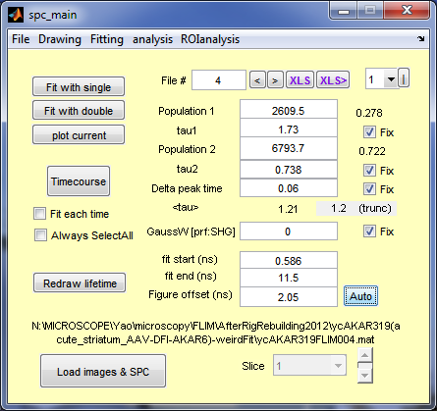
SS=50000
P1/p2=0.2/0.8
Manual fit
Automatic fit
Note:
Much better than 10000 photons

Slide 15
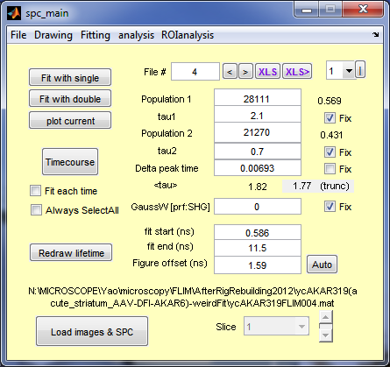

SS=400000
P1/p2=0.6/0.4
Manual fit
Automatic fit
Note:
Much nicer fitting than lower photon counts, problematic near starting point.

Slide 16
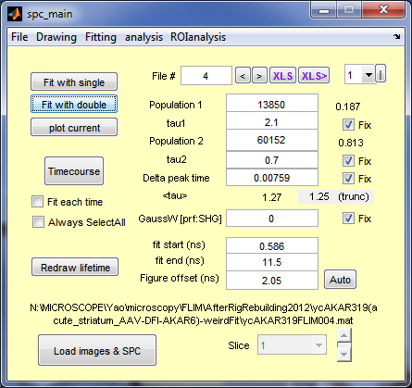

SS=400000
P1/p2=0.2/0.8
Manual fit
Automatic fit
Note:
Much nicer fitting than lower photon counts, problematic near starting point.

