Slide 1

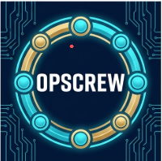

Team OpsCrew
Expense exception plans with human confirmation
Captain: sundaylee3100-ljl (GitHub)
Theme: Future of Work & Enterprise Productivity
Precloud review draft / 11 October 2026
Notes:
Captain public legal name and teammate names await owner confirmation. GitHub handle is an alias.
https://aibuildercup.com/themes.html
PROVENANCE.md: blank Google AI Studio Build origin. Logo supplied by owner as Gemini-generated.

Slide 2
Brief about the idea
OpsCrew helps operations staff turn a synthetic expense exception into a supported handling plan.
Gemini extracts facts, proposes steps, then reviews the proposal in a separate call. Fixed policy checks constrain each stage.
A person reviews the current plan and explicitly confirms a case. The app reads the saved record independently before showing success.
The prototype covers one synthetic USD policy. It creates handling records and performs no reimbursement or payment.
OpsCrew / Precloud review / 2
Notes:
https://aibuildercup.com/themes.html
SCOPE.md
docs/POLICY_AND_CONTRACTS.md

Slide 3
Opportunities and proposed value
Problem: staff must reconcile intake text, missing receipts and policy thresholds before deciding what to request next.
Proposed difference: OpsCrew binds the plan to supported facts and exact policy clauses, then stores the person's confirmation with that version.
Design value: input edits invalidate old plans. Contradictions and unsupported citations block case creation.
Expected impact: clearer exception triage and fewer unsupported actions. Actual staff time savings and customer adoption remain unmeasured.
OpsCrew / Precloud review / 3
Notes:
SCOPE.md
docs/POLICY_AND_CONTRACTS.md
docs/EVALUATION_PROTOCOL.md

Slide 4
Features offered by the solution
Synthetic presets and original text citations make intake decisions inspectable.
Facts, Planner and Reviewer outputs expose disagreements and exact policy evidence.
Firebase visitor identity, owned history and version-bound confirmation protect each person's handling records.
Atomic writes, idempotent recovery and independent readback prevent duplicate or unverified success. Shared quotas bound model traffic.
OpsCrew / Precloud review / 4
Notes:
docs/acceptance/S03-confirmation-and-cases.md
docs/PRECLOUD_BACKEND.md

Slide 5
Process flow and confirmation
Synthetic intake
Gemini facts
Planner + Reviewer
Saved record readback
Human confirmation
Fixed policy checks
Missing evidence produces a request plan. Contradictions block progression.
Editing intake requires a new analysis and a new confirmation.
OpsCrew / Precloud review / 5
Notes:
src/domain/workflow.ts
docs/S3_CONFIRMATION_CASES.md
docs/PRECLOUD_BACKEND.md

Slide 6
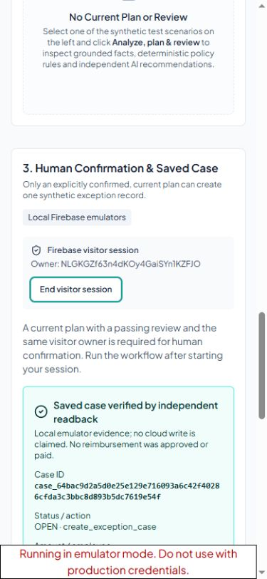
Interface and narrow-screen review
Observed local browser behavior
Explicit confirmation remains separate from the AI review.
Saved history survives a page reload with the same visitor identity.
The 390 px viewport had no horizontal overflow. Keyboard focus was visible.
Screenshot: local Auth/Firestore emulators and injected model output, 10 October. Public cloud behavior awaits acceptance.
OpsCrew / Precloud review / 6
Notes:
docs/acceptance/S03-confirmation-and-cases.md
docs/acceptance/S03-emulator-ui-mobile-2026-10-10.png

Slide 7
Architecture of the proposed cloud deployment
Browser
English React interface
Cloud Run
Node API + validators
Gemini API
Facts / plan / review
Firebase Auth
Verified visitor identity
Firestore
Plans / cases / quotas
Secret Manager
Server credential only
The server verifies ownership and mediates every business write. Browser Firestore access is denied. Cloud deployment remains the next team gate.
OpsCrew / Precloud review / 7
Notes:
docs/CLOUD_TEAMMATE_HANDOFF.md
docs/PRECLOUD_DEPLOYMENT.md
server/firebase-runtime.ts

Slide 8
Technologies used in the solution
Component | Role
Google AI Studio Build | Fresh application origin on 7 October
Gemini 3.1 Flash-Lite | Facts, separately prompted Planner and Reviewer
Node 24 / React / TypeScript | API, explicit review interface and fixed validators
Firebase Auth + Firestore | Visitor ownership, atomic records and shared quotas
Cloud Run + Secret Manager | Planned public runtime and server-only credential
Local extensions are disclosed. No code from the earlier non-Google prototype entered this repository.
OpsCrew / Precloud review / 8
Notes:
PROVENANCE.md
aistudio-export-2026-10-07/package-lock.json
docs/PRECLOUD_DEPLOYMENT.md

Slide 9
Implementation cost and traffic controls
Team management target: USD 40. Billing alerts and application quotas cannot guarantee a monetary spending cap.
Default model limits: 2 concurrent runs globally, 1 per visitor. Each visitor has 2 runs per minute and 12 per UTC day.
Global limits: 6 runs per minute and 60 per UTC day. Each workflow reserves up to 6 provider attempts. Unknown usage receives no refund.
Record tokens, elapsed time and failures from real runs. Historical live failures have unknown usage and billed cost. Verify actual cloud pricing before activation.
OpsCrew / Precloud review / 9
Notes:
docs/DELIVERY_WORKBOARD.md
docs/PRECLOUD_BACKEND.md
docs/EVALUATION_PROTOCOL.md

Slide 10
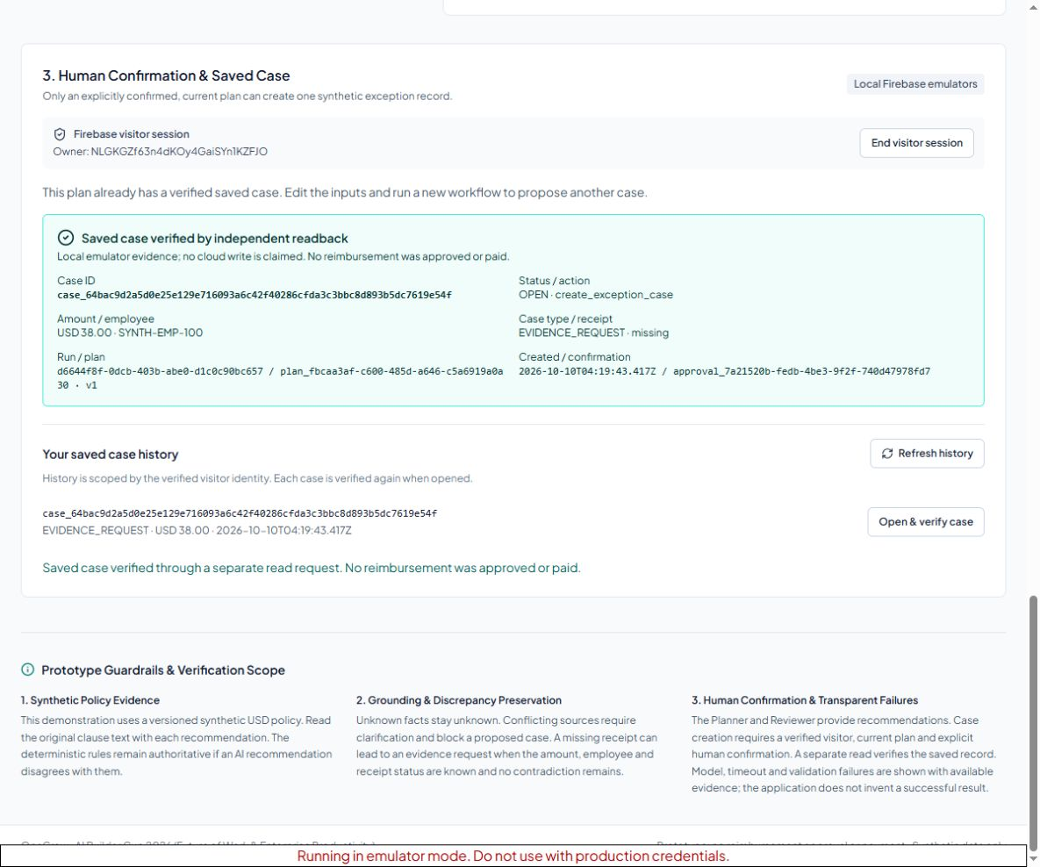
Snapshots of the prototype
Synthetic USD 38
missing-receipt example
The plan requests a receipt.
A person confirms the handling record. The API then independently reads the saved case.
No payment occurs.
Local emulators + injected models.
10 October 2026
OpsCrew / Precloud review / 10
Notes:
docs/acceptance/S03-confirmation-and-cases.md
docs/acceptance/S03-emulator-ui-desktop-2026-10-10.png

Slide 11
Performance report and evidence boundaries
Evidence | Result | Method
Offline engineering | 216 / 216 | Policy / HTTP / UI regressions
Auth + Firestore | 27 / 27 | Real local emulators, injected models
Public semantic cases | 12 / 12 | Injected models, MemoryCaseStore
High-risk repeats | 12 / 12 | 4 predefined public cases, each 3 runs
Fault / recovery | 6 / 6 | Injected failures and lost responses
Production packaging | 9 HTTP + 12 artifact groups | Pruned native runtime, no Docker daemon
Current local Gemini: 3 public branches passed after proxy repair. Three earlier failures remain recorded. Cloud stability and independent held-out acceptance remain pending.
OpsCrew / Precloud review / 11
Notes:
docs/acceptance/PRECLOUD-validation-metrics-2026-10-11.json
docs/PRECLOUD_EVALUATION.md
docs/acceptance/S02-captured-result-revalidation-2026-10-10.json

Slide 12
Additional details and future development
Next acceptance: deploy the frozen release to Cloud Run with real Firebase identity, Firestore and a server-only Gemini secret.
The teammate seals eight independent cases before first evaluation. Retain every attempt and run the main demo successfully three times in sequence.
Then record the real cloud flow, publish the product and sub-three-minute English video, and replace the draft proposal's pending link statuses.
After evaluation, consider broader policies and staff timing studies. Production reimbursement integrations require a separate design and authorization.
OpsCrew / Precloud review / 12
Notes:
docs/CLOUD_TEAMMATE_HANDOFF.md
docs/EVALUATION_PROTOCOL.md
SUBMISSION_CHECKLIST.md

Slide 13
Repository, demo and final product links
Public GitHub repository
github.com/sundaylee3100-ljl/AI-Builder-Cup-2026-OpsCrew
Public demo video: pending final cloud recording
Final product URL: pending teammate cloud deployment
This proposal is a precloud review draft. The team must add working public links and verify anonymous access before contest submission.
OpsCrew / Precloud review / 13
Notes:
https://github.com/sundaylee3100-ljl/AI-Builder-Cup-2026-OpsCrew
SUBMISSION_CHECKLIST.md
submission/RECORDING_PLAN.md

