Slide 1





Mecanum-wheeled Autonomous Tracking Robot
Thesis Proposal
项目组长
姚康晨
项目成员
金振宇 王明睿 赵禺赫 罗子轩
汇报日期
2026.3.14
Trace Rover Team

Slide 2
Contract
Project Background and Topic Selection
Structure
Control
Electronic
Vision
Software
Budget
Summary

Slide 3
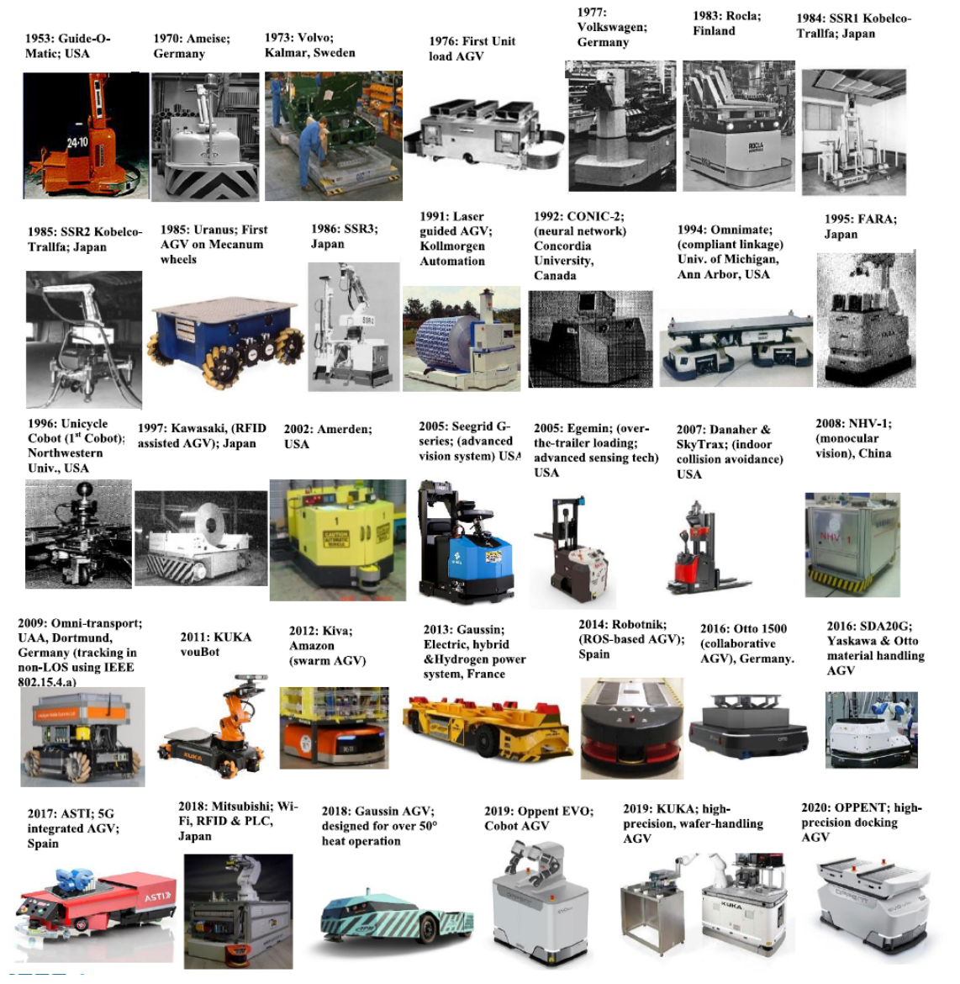
Project Background and Topic Selection
Market Background & Industry Needs
The demand for agile maneuvering has surged, while traditional chassis have encountered bottlenecks.
Macro Demand: In complex scenarios such as intelligent manufacturing, warehouse logistics, and disaster area reconnaissance, robots need to shuttle and track targets with high precision in narrow, unstructured spaces.
Existing problems: Traditional differential-drive chassis suffer from large turning radius and limited maneuverability. Existing omnidirectional Mecanum-wheel chassis improve mobility, but severe vibration and slippage often occur in practice due to rigid contact.
Industry Needs: There is an urgent need for a mobile platform with both extreme maneuverability and high all-terrain stability to serve as a reliable carrier for visual tracking and robotic arm operation.

Slide 4
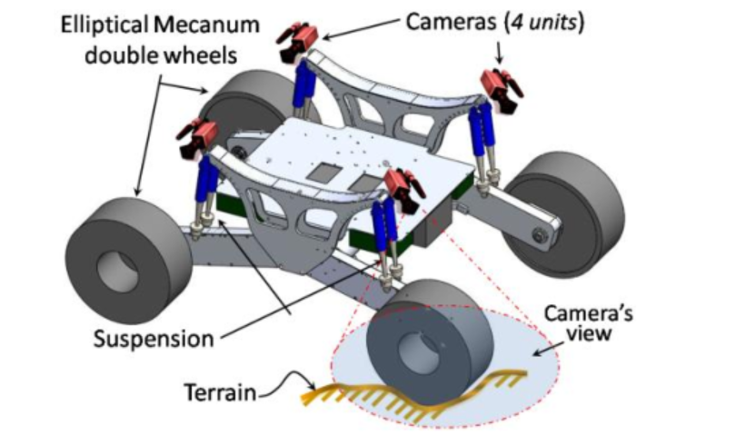
Project Background and Topic Selection
Literature Review & Technical Pain Points
Technical Pain Points
Chassis Vibration and Lack of Suspension: Intermittent contact of Mecanum wheel rollers causes periodic vibration, and systems without independent suspension lose grip on uneven roads (Ref. 1, 2).
Nonlinear Slip and Trajectory Drift: Skidding makes ideal kinematic matrices ineffective for accurate dead reckoning, and traditional single closed-loop PID easily leads to trajectory deviation in high-speed response (Ref. 3, 4).
Separation of Computing Power and Control: Fragmented "upper computer + lower controller" solutions lack bottom-level high-density integration, resulting in system delay between sensor fusion and motor response (Ref. 5).
Reference
1. Oh, S. et al. (2021). "Vibration Reduction Control of Omnidirectional Mobile Robot with Lift Mechanism." IEEE International Conference on Control, Automation and Systems (ICCAS).
2. Chen, Y. et al. (2024). "Systematic Review of Mecanum and Omni Wheel Technologies for Motor Impairments." MDPI Applied Sciences.
3. Wang, H. et al. (2019). "Trajectory tracking for omnidirectional mecanum robot with longitudinal slipping." MATEC Web of Conferences.
4. Li, X. et al. (2018). "Highly Maneuverable Ground Reconnaissance Robot Based on Machine Learning." IEEE International Conference on Robotics and Biomimetics (ROBIO).
5. Zhang, M. et al. (2020). "Design of Inspection Robot for Spherical Tank Based on Mecanum Wheel." IEEE International Conference on Mechatronics and Automation (ICMA).

Slide 5
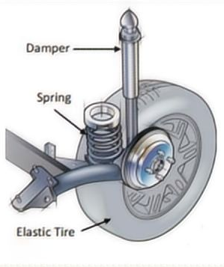
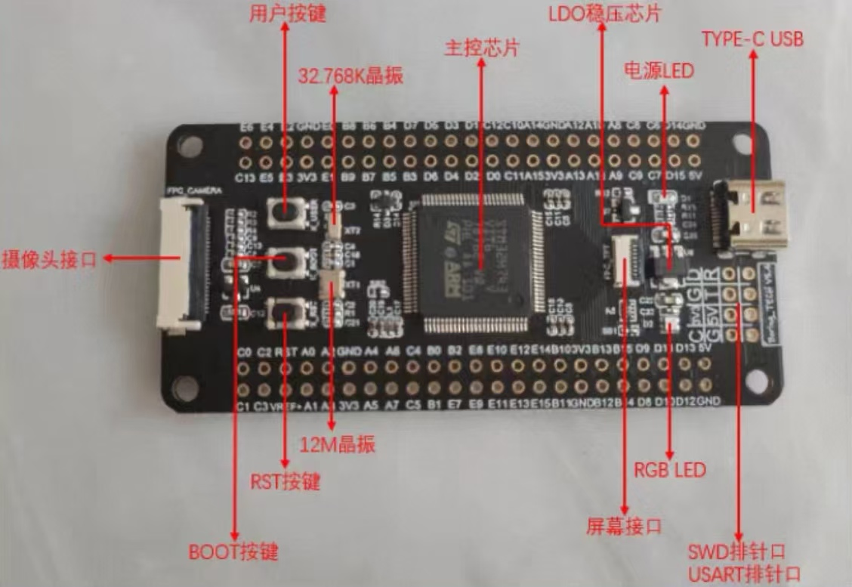
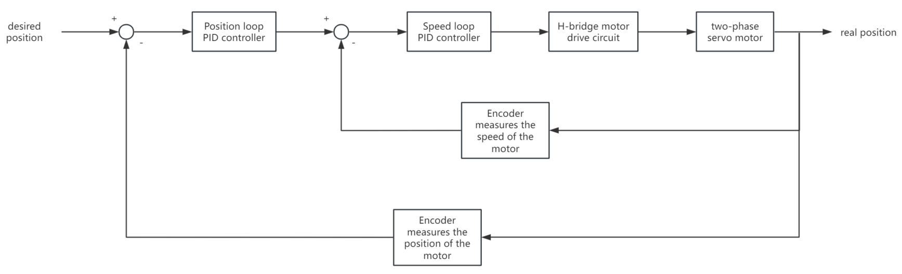
Project Background and Topic Selection
Our Work
We are not "assembling" a small car, but building a highly coupled complex robot system from scratch.
System Closed-Loop:
Mechanical Layer: Passive compliance for road adaptability via independent spring-damper suspension.
Hardware Layer: STM32H7 550MHz core for extreme space compression and ultra-low latency at the bottom board level.
Control & Perception Layer: Cascade PID motor closed-loop + encoder dead reckoning + ultrasonic polar radar + YOLO visual tracking. Data of each subsystem is deeply fused at high frequency, with every part affecting the whole system.

Slide 6
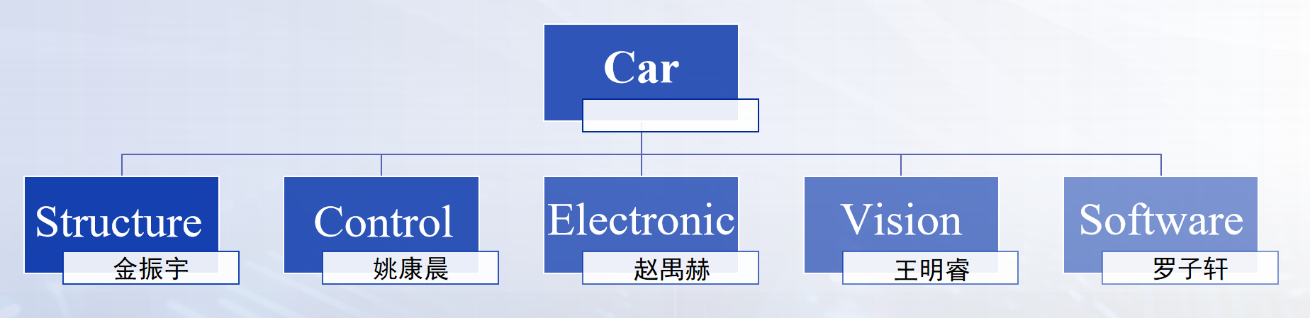
Project Background and Topic Selection
Objectives
Design and verify a highly stable omnidirectional mobile platform with a modular hierarchical architecture, low center of gravity, and a 2-DOF tracking gimbal.
Challenges
Parameter Matching and Tuning of Independent Suspension System in Narrow Space.
Multi-Motor Cooperative Closed-Loop and Dead Reckoning Error Handling of Mecanum Wheel Chassis.
Efficient Data Communication and Task Scheduling of Heterogeneous Software and Hardware Systems.
Task Division

Slide 7
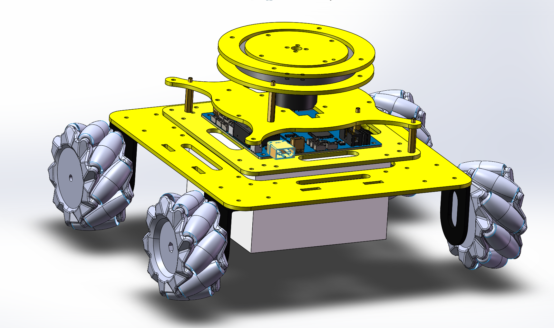
Structure
Core objective
Design and build a modular, high-stability, lightweight Mecanum-wheel mobile platform integrated with a 2-DOF gimbal to provide a reliable motion and execution carrier for tracking robots.
Overall Structural Design
Modular Layered Architecture:
Segregates the chassis, control circuits, and tracking pan-tilt layers.
Ensures streamlined hardware debugging and scalable future expansion.
Optimized Spatial Layout:
Features a low center of gravity by placing batteries and heavy masses at the base, maximizing kinematic stability.
Ample upper-layer spacing ensures optimal heat dissipation for the control boards.

Slide 8
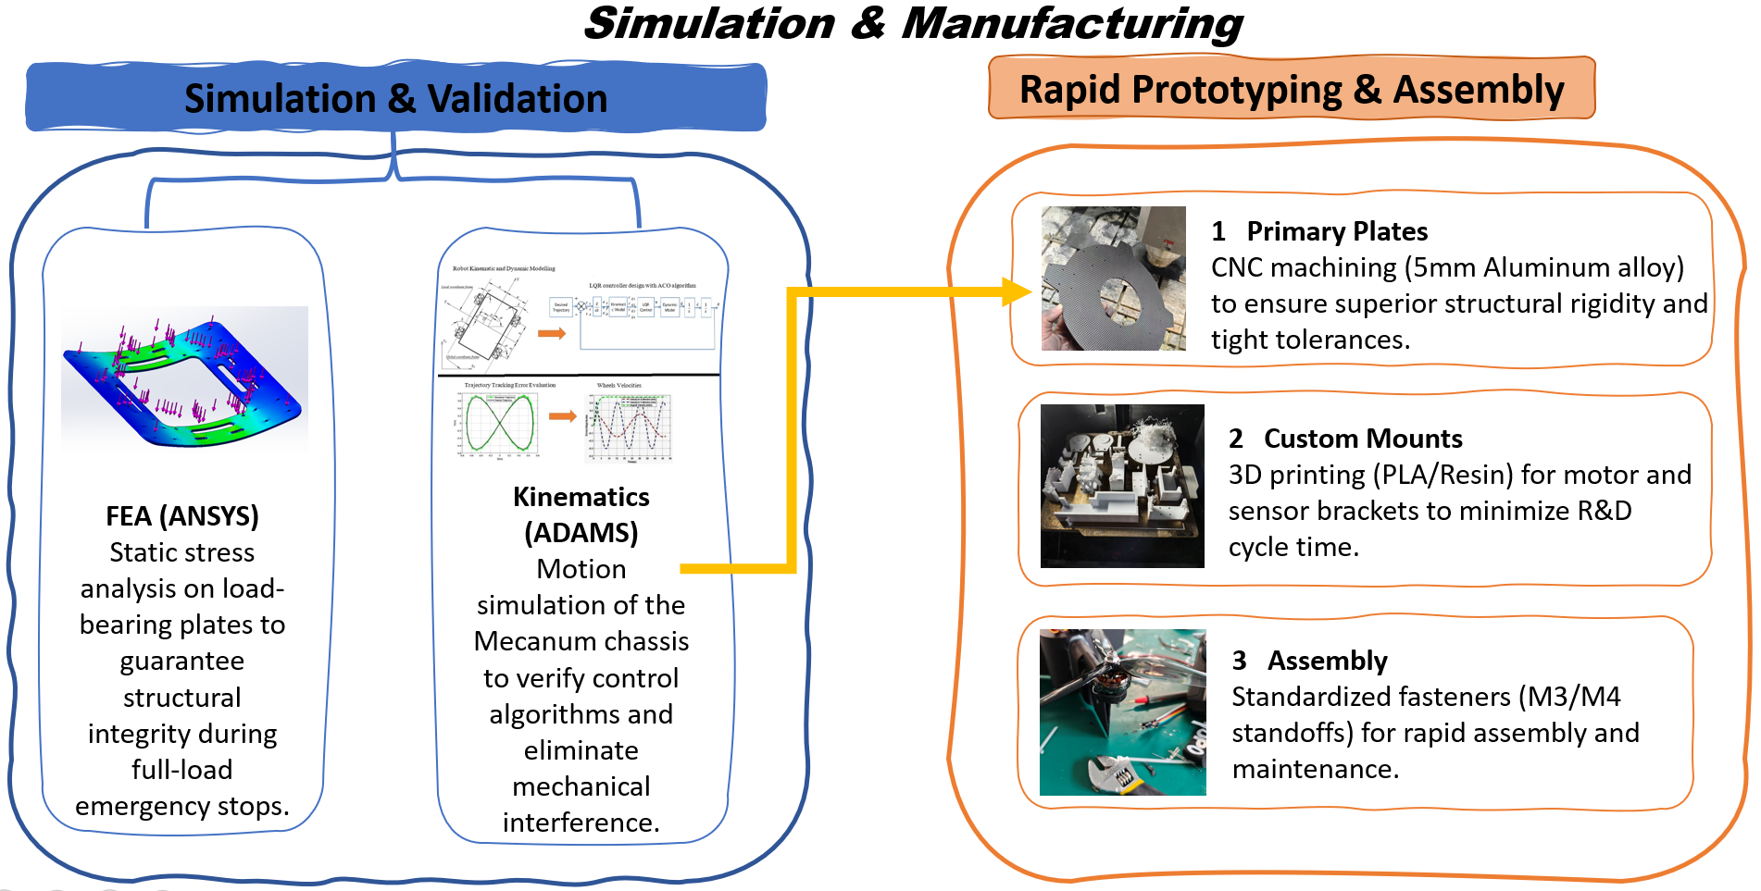
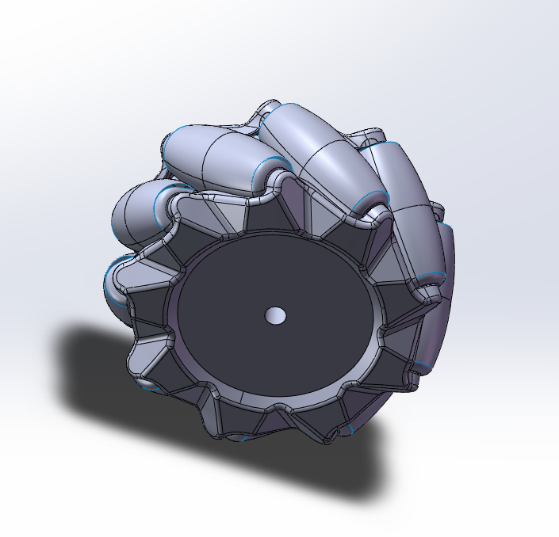

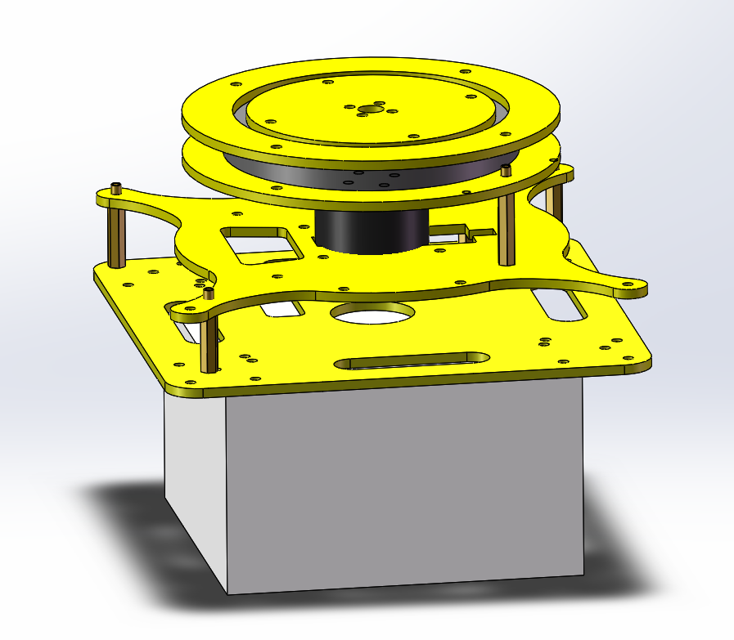


Structure
Core Mechanical Modules
Omnidirectional Chassis
Adopt Mecanum wheels to achieve zero-radius turning and meet real-time tracking requirements.
Design independent spring-damper suspension for each wheel to solve the problem of simultaneous four-wheel contact and improve adaptability on uneven roads.
Theoretical modeling and parameter optimization
Dynamic Modeling: We model the suspension as a quarter-car linear spring-damper system. The equation of motion is defined as:
2-DOF Tracking Pan-Tilt
Lightweight disc structure, driven by dual servos, achieves fast and omnidirectional target locking.
(Where m is quarter-mass, c is damping coefficient, k is spring stiffness).
Parameter Optimization: To prevent chassis resonance and optimize target-tracking stability, we calculate the natural frequency ωn and select springs to achieve an underdamped response:
Stiffness Selection: Based on a max payload of Wmax and desired deflection δmax, the required stiffness is determined by:

Slide 9
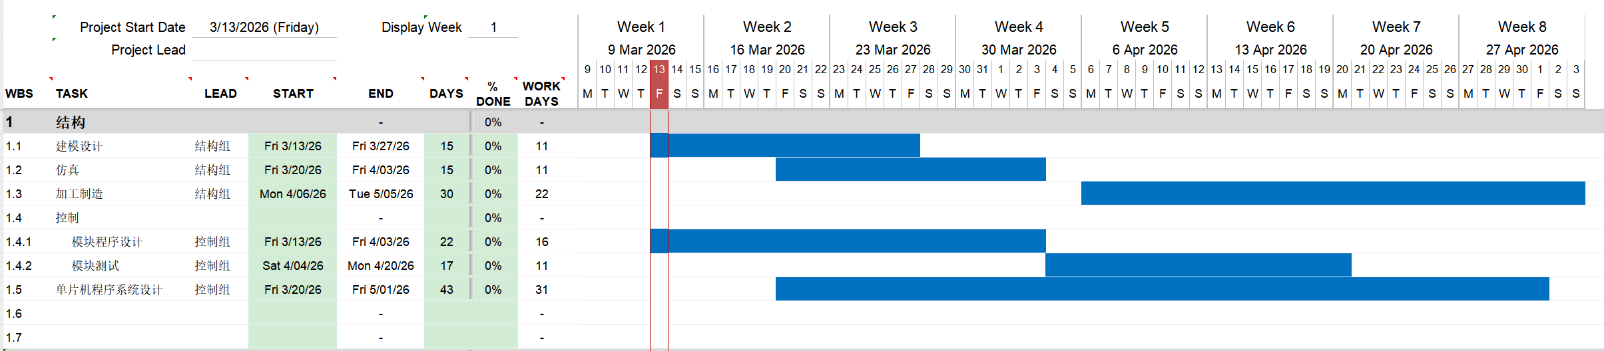
Structure
Personal Task Assignment and Progress Schedule
Subtasks | Specific Content
1.1 Modeling Design | 3D modeling of chassis, suspension and gimbal (SolidWorks); material selection and preliminary layout
1.2 Simulation | Dynamic simulation of suspension system (e.g. ANSYS/Simulink); kinematic verification; parameter optimization
1.3 Manufacturing | CNC machining of main structural parts; 3D printing of brackets; procurement of standard parts; assembly and preliminary debugging
Progress Schedule

Slide 10
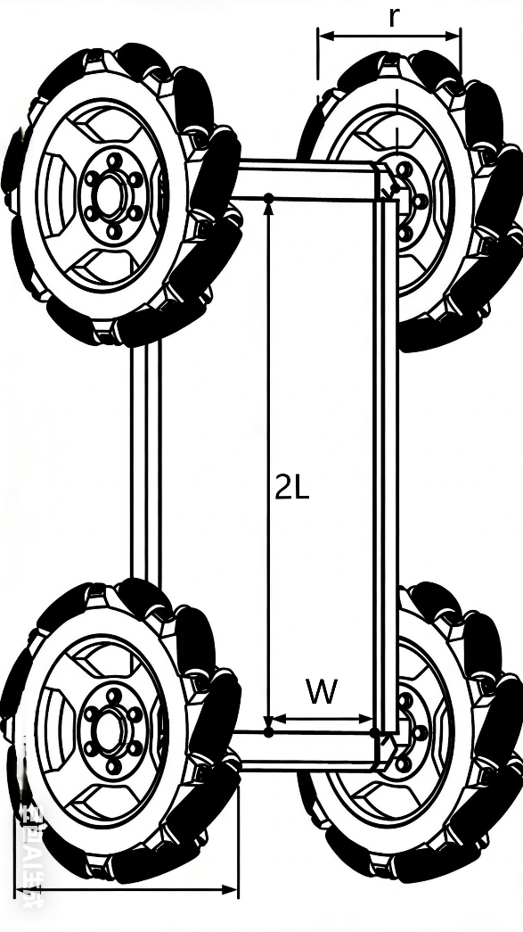
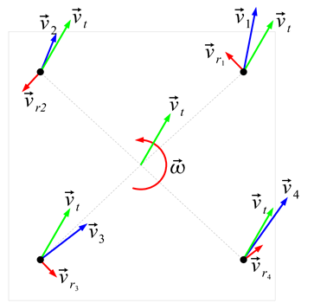
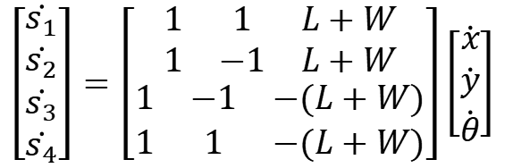
Control
Motion control of Mecanum wheels
In order to control the movement of the AGV in the 3 degrees of freedom on the plane, we need its
inverse kinematics matrix
$$\left[\begin{matrix}\begin{matrix}\dot{s_{1}} \\ \dot{s_{2}}\end{matrix} \\ \begin{matrix}\dot{s_{3}} \\ \dot{s_{4}}\end{matrix}\end{matrix}\right]=\left[\begin{matrix}\begin{matrix}1 & 1 & L+W \\ 1 & −1 & L+W\end{matrix} \\ \begin{matrix}1 & −1 & −(L+W) \\ 1 & 1 & −(L+W)\end{matrix}\end{matrix}\right]\left[\begin{matrix}\dot{x} \\ \dot{y} \\ \dot{θ}\end{matrix}\right]$$
Through inverse kinematics, we can calculate the required speeds/positions for each motor by simply inputting the speed/displacement values in the Cartesian coordinate system.

Slide 11
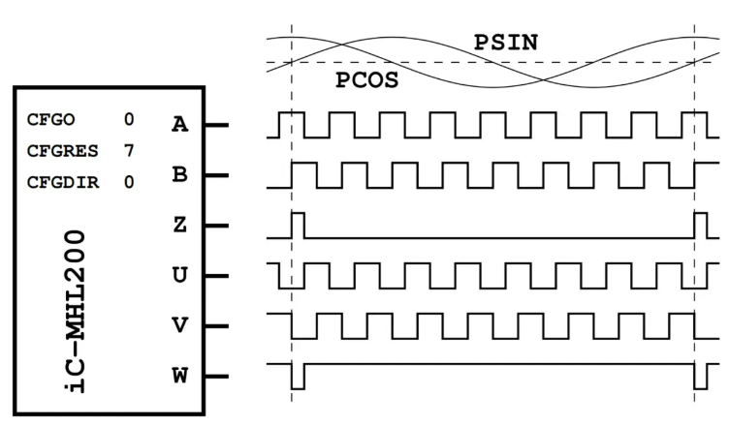
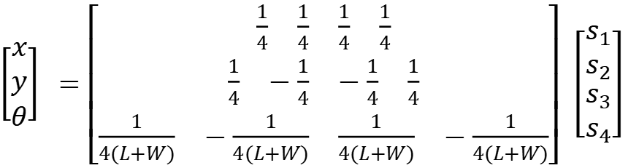
Control
Inertial navigation system based on encoder
Encoders are used to translate rotary or linear motion into a digital signal. Usually this is for the purpose of monitoring or controlling motion parameters such as speed, rate, direction, distance or position.
After obtaining the rotation distances of the four wheels through the encoder, we can calculate the position and orientation of the AGV using the
forward kinematics matrix
$\left[\begin{matrix}x \\ y \\ θ\end{matrix}\right] =\left[\begin{matrix}\begin{matrix}\begin{matrix}\frac{1}{4} & \frac{1}{4}\end{matrix} & \begin{matrix}\frac{1}{4} & \frac{1}{4}\end{matrix}\end{matrix} \\ \begin{matrix}\begin{matrix}\frac{1}{4} & −\frac{1}{4}\end{matrix} & \begin{matrix}−\frac{1}{4} & \frac{1}{4}\end{matrix}\end{matrix} \\ \begin{matrix}\begin{matrix}\frac{1}{4(L+W)} & −\frac{1}{4(L+W)}\end{matrix} & \begin{matrix}\frac{1}{4(L+W)} & −\frac{1}{4(L+W)}\end{matrix}\end{matrix}\end{matrix}\right]$ $\left[\begin{matrix}\begin{matrix}s_{1} \\ s_{2}\end{matrix} \\ \begin{matrix}s_{3} \\ s_{4}\end{matrix}\end{matrix}\right]$
In this way, we can calculate the AGV's position and orientation in real time using the encoder data from the four wheels.

Slide 12
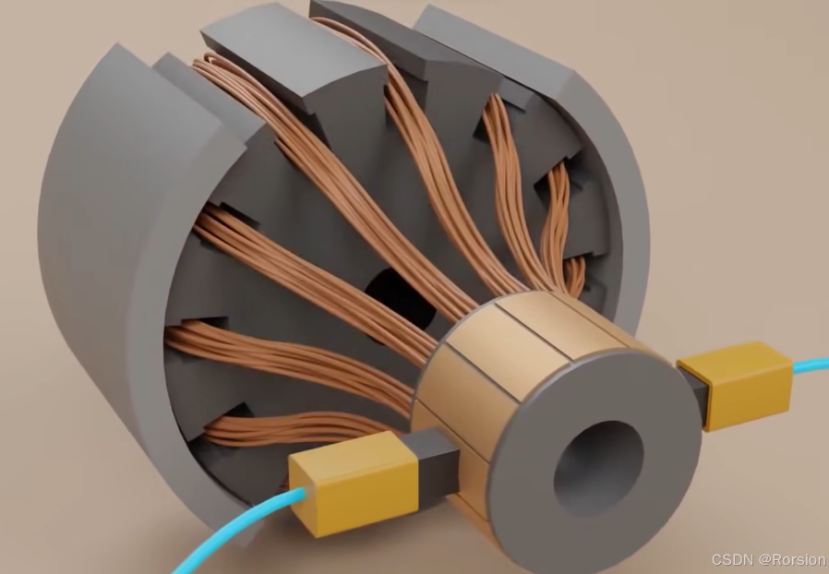

Control
Closed-loop control of two-phase servo motors
The transfer function of the ideal two-phase servo motor system is
$$G\left(s\right)=\frac{Ω_{m}(s)}{U_{a}(s)}=\frac{K_{m}}{T_{m}s+1}$$
Although the ideal two-phase servo motor system is a simple first-order linear system, this system is prone to dynamic lag and parameter fluctuations due to the presence of inductance, inertia, and other parameters, and the position and speed variables are strongly coupled. A single-loop PID is unable to balance both dynamic response and positioning accuracy, so a cascade PID is designed. The block diagram is shown as follows.
After applying this controller, we can precisely adjust the position and speed of the motor. Combined with the previous kinematic analysis and inertial navigation system, we can freely control the position of the AGV.

Slide 13
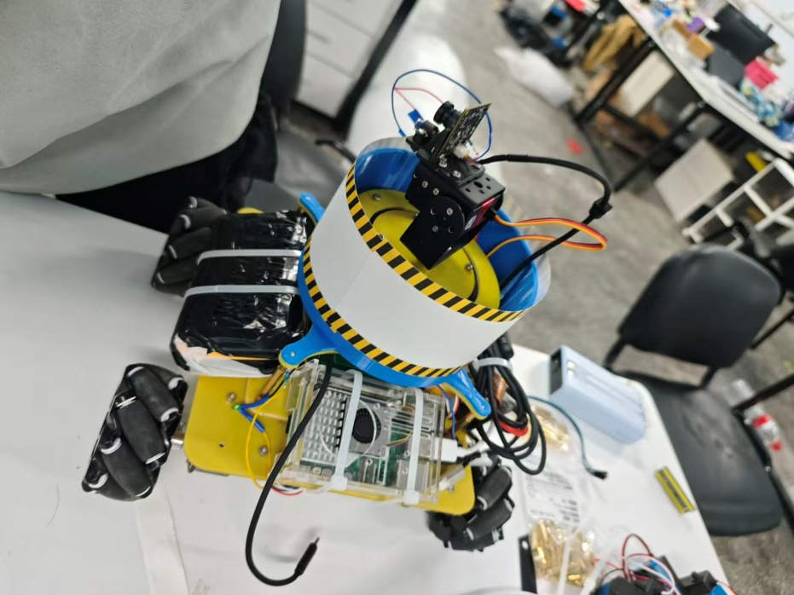

Control
An obstacle avoidance system composed of an ultrasonic sensor and a stepper motor
We use a stepper motor to drive the ultrasonic sensor installed on the conductive slip ring through a gear mechanism, causing it to rotate continuously. By combining the angle information from the stepper motor with the distance information input by the ultrasonic sensor, we can establish a polar coordinate system with the AGV as the origin to describe the information about the surrounding obstacles. Through the following algorithm, the obstacle information in the polar coordinate system can be converted into Cartesian coordinates.
$$\left\{\begin{aligned}x_{obstacle}=Rcos⁡(φ_{obstacle}) \\ y_{obstacle}=Rsin(φ_{obstacle})\end{aligned}\right.$$
We can also utilize the inertial navigation system of the AGV to transform the obstacle information from the robot's coordinate system to the world coordinate system.
$$\left[\begin{matrix}x_{world} \\ y_{world}\end{matrix}\right]=\left[\begin{matrix}cosθ_{robot} & −sinθ_{robot} \\ sinθ_{robot} & cosθ_{robot}\end{matrix}\right]\left[\begin{matrix}x_{obstacle} \\ y_{obstacle}\end{matrix}\right]+\left[\begin{matrix}x_{robot} \\ y_{robot}\end{matrix}\right]$$
The host computer records all the obstacle points detected by the AGV. We can even implement a simple SLAM system.

Slide 14
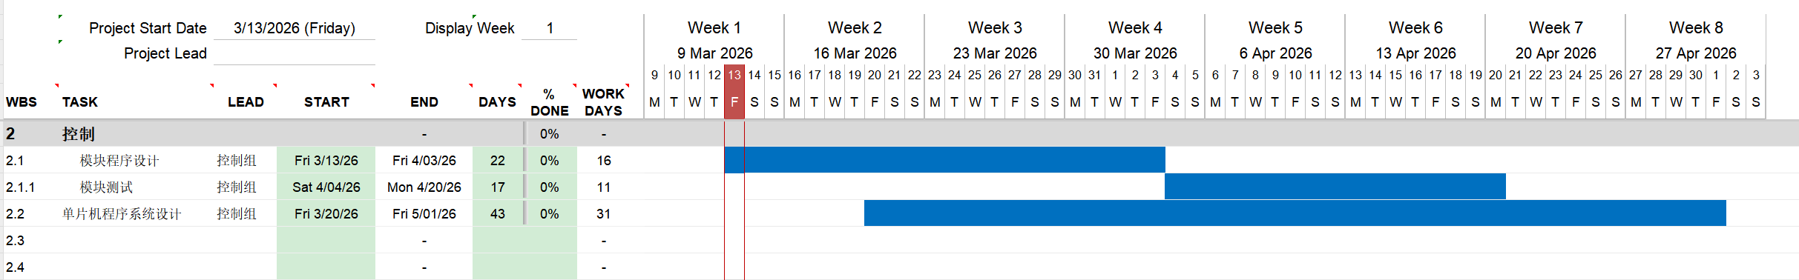
Control
Personal Task Assignment and Progress Schedule
Subtasks | Specific Content
2.1 Module Programming | Write the programs for each module, such as the filter module, the controller module, and the navigation system module program.
2.2 Module Testing | Test each module independently to ensure that there are no issues with the modules during the later system development process.
2.3 MCU System Design | Reorganize the previous modules into tasks within the RTOS, maintaining a system design with high cohesion and low coupling.
Progress Schedule

Slide 15
Electronic
Core Objective
Design a highly integrated, low latency, and highly reliable electronic hardware platform for the autonomous tracking robot of the Mecanum wheel, achieving main control computation, multi-sensor fusion, and stable power supply, ensuring millisecond level response.
Design Concept
Integrated driver and control:
High-density integration of the main control MCU, power array, and peripheral interfaces on a single carrier board, compressing space and improving system compactness.
High performance core:
Adopting STM32H723VGT6 (550MHz), it meets the real-time requirements of Mecanum wheel kinematics calculation and multi-source data fusion.
Anti interference foundation:
Optimize power topology and communication bus, and build a robust hardware foundation.

Slide 16
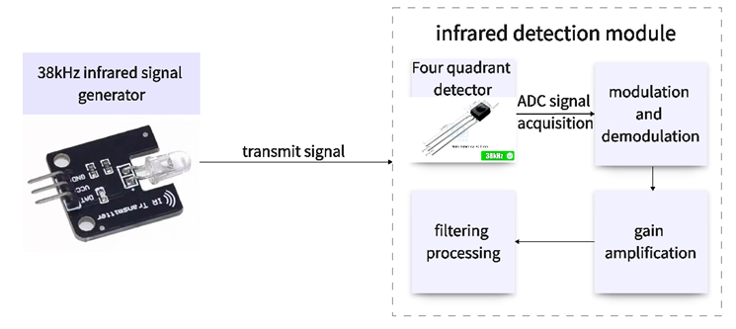
Electronic
Detailed plan and technical roadmap
Main control carrier board design
Power module
Core: STM32H723VGT6
Input: Wide voltage DC-DC pre stabilization.
Peripheral interface: Reserved UART/I2C/SPI/CAN, compatible with multiple sensors.
Output: Multiple independent LDOs provide power to MCU and sensors, with low noise.
Clock and reset: high-precision crystal oscillator, hardware watchdog.
Redundant design: Dual power hot backup to ensure operational stability.
Sensor circuit
PCB layout and testing
360 ° ultrasonic radar: self-developed continuous rotating mechanism
Signal conditioning: operational amplifier amplification, comparator shaping, optocoupler isolation.
Infrared locking array: high-frequency infrared transmitter/receiver
Thermal distribution simulation: layout optimization of key components (MOSFET, MCU), heat dissipation via holes.
Test plan: signal integrity test, ripple test, power load pull test, vibration test.

Slide 17
Electronic
Innovation Points
Technical Challenge
The single board integrates the main control, power supply, and interface, significantly reducing the size and minimizing interconnect latency.
Heat dissipation management under high-density integration(Thermal distribution simulation and testing)
Achieving 360 ° dynamic environment perception, and improving tracking robustness.
Signal integrity assurance for 550MHz high-speed signals(Impedance control, crosstalk suppression)
Achieves precise target locking during high-speed motion.
Hardware latency optimization for multi-sensor synchronization and data fusion
Ensure uninterrupted power supply under extreme working conditions and improve system reliability.
Reliability of connectors and solder joints under vibration environment

Slide 18
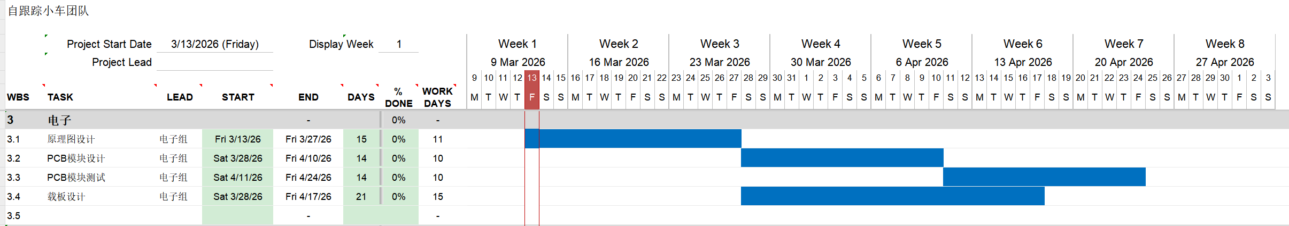
Electronic
Personal Task Assignment and Progress Schedule
Subtasks | Specific Content
3.1 Schematic Design | Design complete schematics for main carrier board using Altium Designer. Integrate STM32H723VGT6 MCU, power tree, sensor interfaces, and communication buses.
3.2 PCB Module Design | High-density PCB layout with impedance-controlled routing, thermal optimization, and power integrity design.
3.3 PCB Module Testing | Validate power rails (ripple <100mV), signal integrity, and communication protocols; perform thermal and vibration tests.
3.4 Carrier Board Design | Integrate PCB with motor and sensors; debug MCU–driver–sensor communication; optimize power design.
Progress Schedule

Slide 19
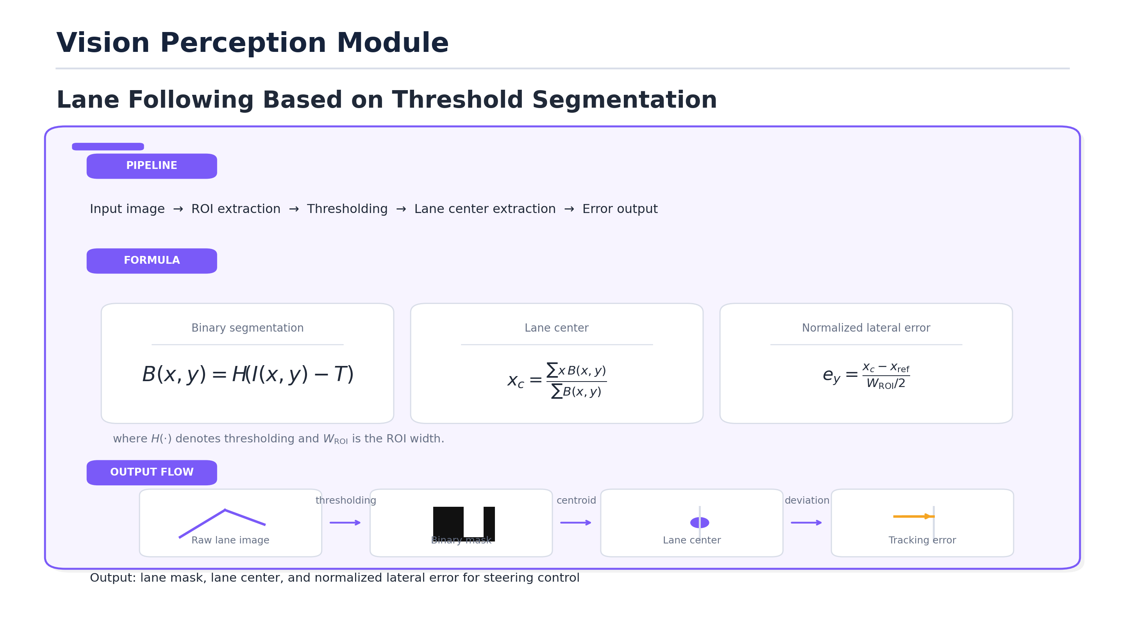
VISION

Slide 20
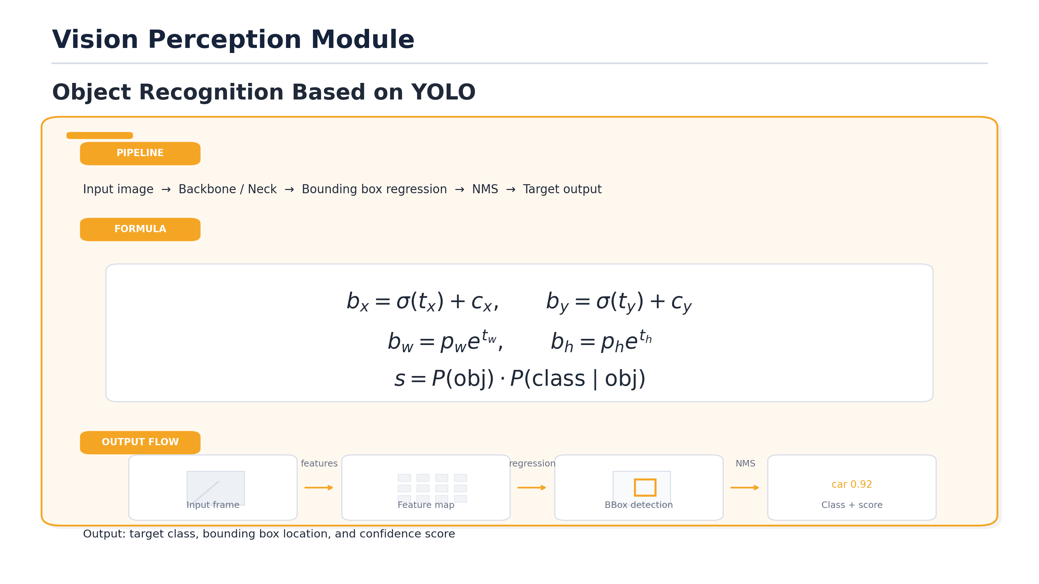
VISION

Slide 21
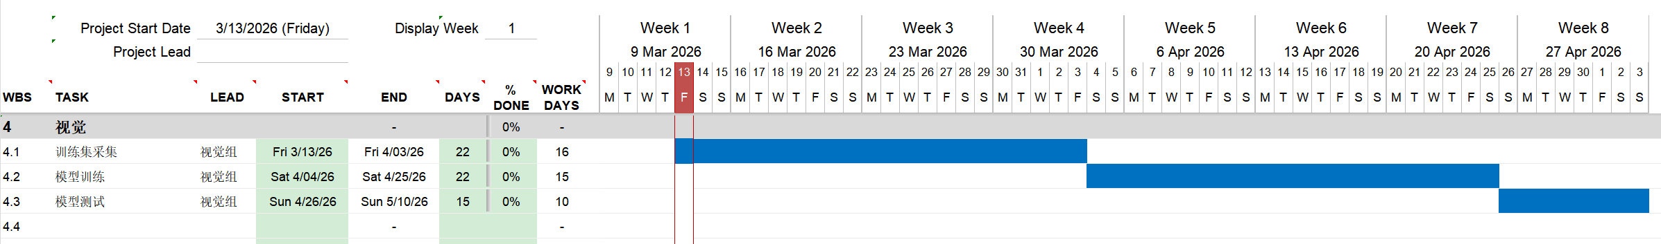
VISION
Personal Task Assignment and Progress Schedule
Subtasks | Specific Content
4.1 Training Set Collection | Calibrate the onboard camera and record video data under diverse lighting and road scenarios; extract frames and manually annotate lane boundaries for threshold‑based detection and bounding boxes for YOLO training.
4.2 Model Training | Test each module independently to ensure that there are no issues with the modules during the later system development process.
4.3 Model Testing | Verify lane mask accuracy, center extraction, and lateral error under varied conditions while ensuring YOLO delivers correct bounding boxes and class scores with effective NMS; run both modules concurrently to assess real‑time performance and format final outputs for control systems.
Progress Schedule

Slide 22
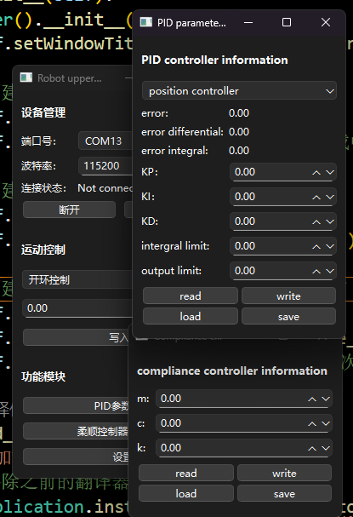



Software
AGV upper computer software
We have developed a cross-platform, visual, and user-friendly upper computer software using Python. Below are the modules we employed.
Pyside6
We utilize it to create an elegant GUI interface. The GUI library it provides enabled the implementation of video windows, numerical/string input, and various buttons. It helped us achieve the visualization of the software, significantly reducing the barrier for users to use the AGV.
OpenCV
We utilize it to achieve video stream retrieval and display, and to retain the backend interface for the tracking algorithm for the vision teamer, allowing them to input video and output mask images.
Pyserial
We use it to establish serial communication with the AGV, enabling the issuance of commands and the feedback of information.

Slide 23
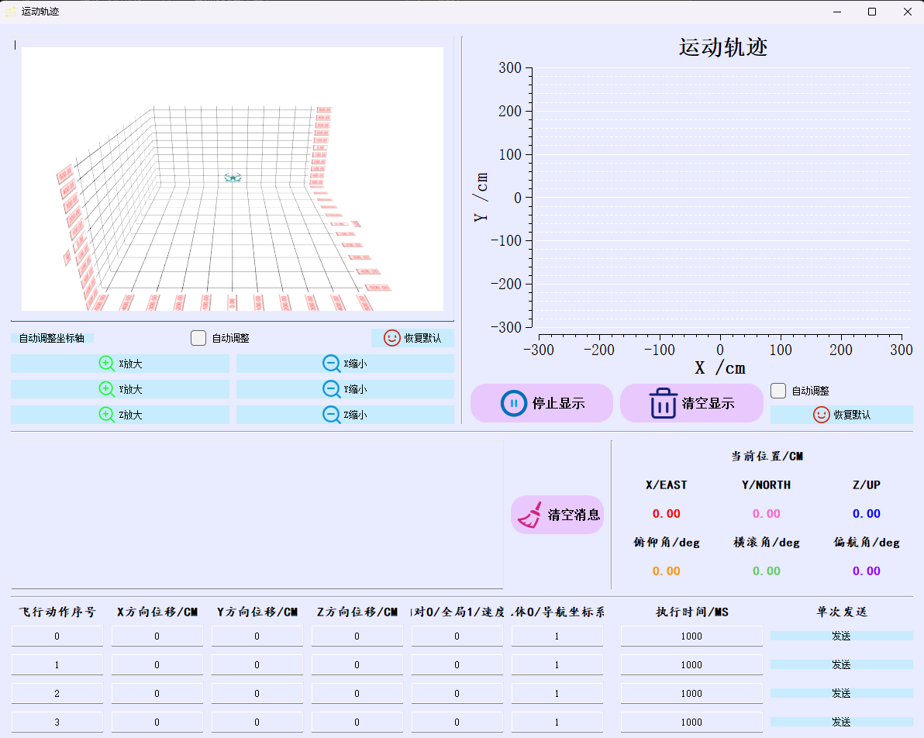

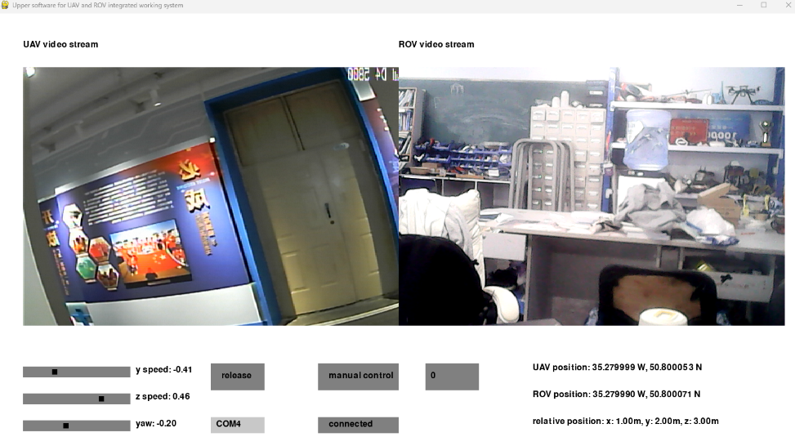


Software
AGV upper computer software
Pygame
We utilize its Joystick module to implement the input for the game controller, enabling the software to read and process most of the controllers available on the market, making the operation of the AGV more user-friendly. It also utilize its animation library to develop the visualization of the obstacle avoidance system and navigation system, making our software more aesthetically pleasing.
PyTorch
We have utilize it to incorporate some AI models, such as ultralytics' YOLO26, enabling us to accomplish the task of object detection within the software. In the future, it could even be used as a embodied intelligence platform, further leveraging this module.

Slide 24
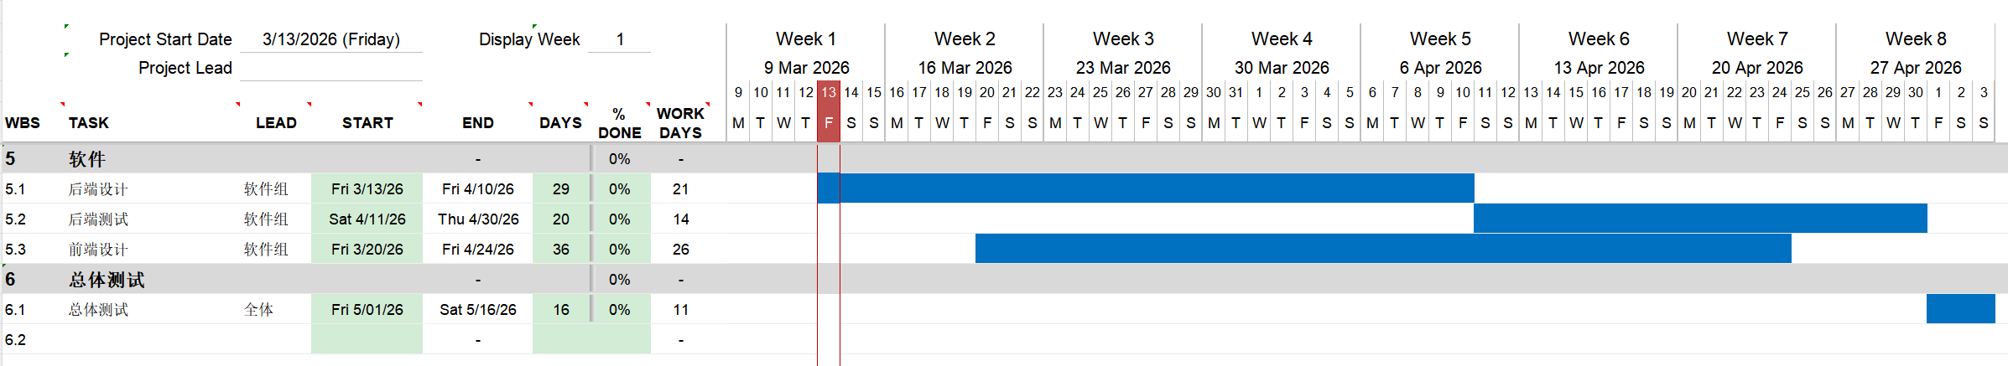
Software
Personal Task Assignment and Progress Schedule
Subtasks | Specific Content
5.1 Backend Design | Develop various backend task modules, such as serial port communication, video stream retrieval, and each module adheres to the principle of low coupling.
2.2 Backend Testing | Test each module independently to ensure that there are no issues with the modules during the later system development process.
2.3 Frontend Design | Design the front-end GUI page, connect the back-end interface, and create a beautiful and elegant software.
Progress Schedule

Slide 25
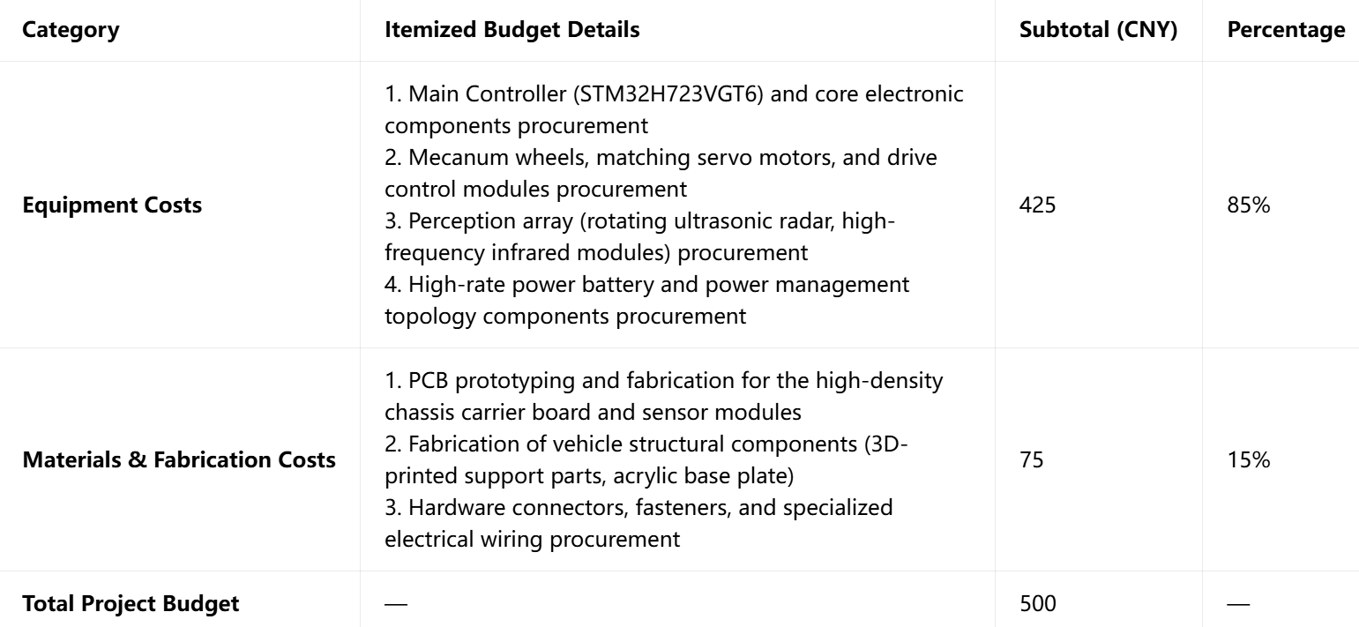
Budget Sheet

Slide 26
Summary
This project developed a modular Mecanum-wheeled tracking robot , with its core innovation lying in the high integration of hardware and software. Mechanically, independent suspensions effectively solve the Mecanum wheel vibration issue. For control, we designed a custom high-density motherboard and built low-level algorithms like cascade PID, kinematics, and multitasking scheduling from scratch. Software-wise, a Python-based GUI integrated with the YOLO model enables precise visual perception and obstacle avoidance. The entire system operates stably and is fully controllable.
Looking ahead, we will further expand functions based on this stable platform. We plan to incorporate wireless communication modules to enable more flexible remote control. Furthermore, we will introduce machine learning algorithms for automatic parameter tuning , ultimately upgrading the robot into a powerful embodied intelligence platform.

Slide 27

Mecanum-wheeled Autonomous Tracking Robot
Thesis Proposal
Thank you for watching
汇 报 人
姚康晨
汇报日期
2026.3.14
光电材料与器件物理技术研究所 I 半导体物理学与材料研究中心 I 计算机成像技术研究所
Trace Rover Team

