Slide 1
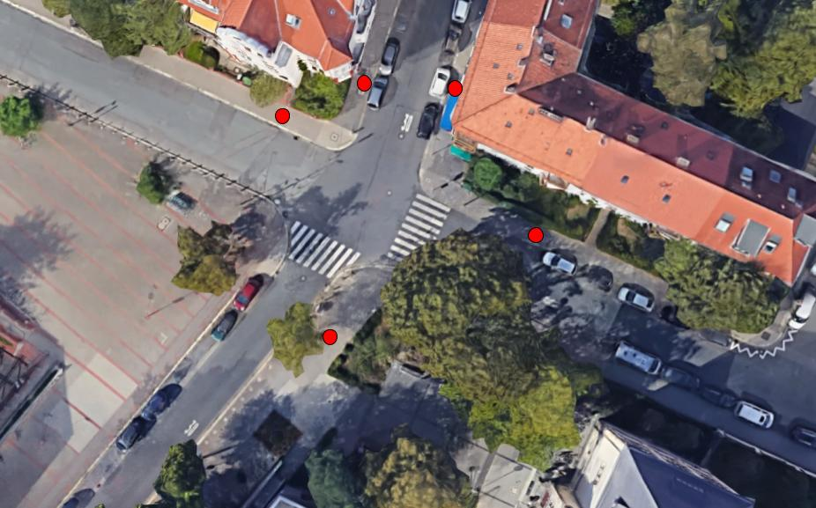
G1-1
G2-2

Slide 2
G3-2
G4-3

Slide 3
G5-1
G6-1

Slide 4
Free-G1-4
Free-G2-4

Slide 5
Free-G3-2

