Slide 1
YOLO
You Only Look Once
Unified,Real-Time Detector

Slide 2
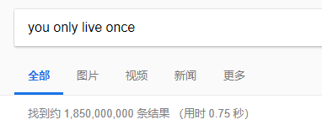
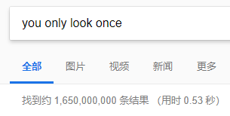
You Only Live Once
你只活一次➔人生苦短，及时行乐
你只看一次➔统一地，实时地检测器
  实时➔速度快

Slide 3
Look twice? Not unified ?
R-CNN,Fast R-CNN,Faster R-CNN系列
Region proposal ➔ classification

Slide 4
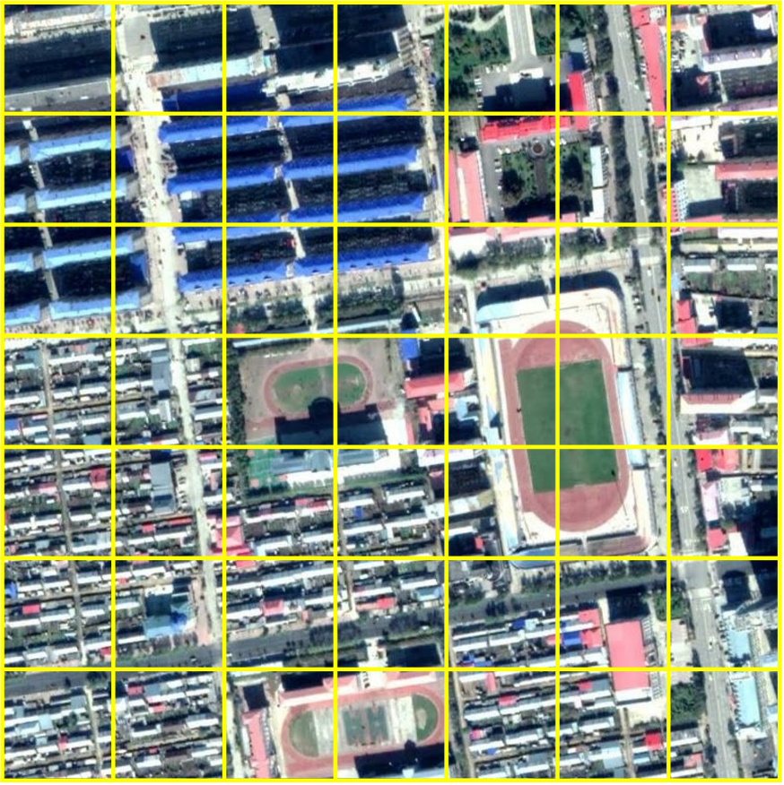
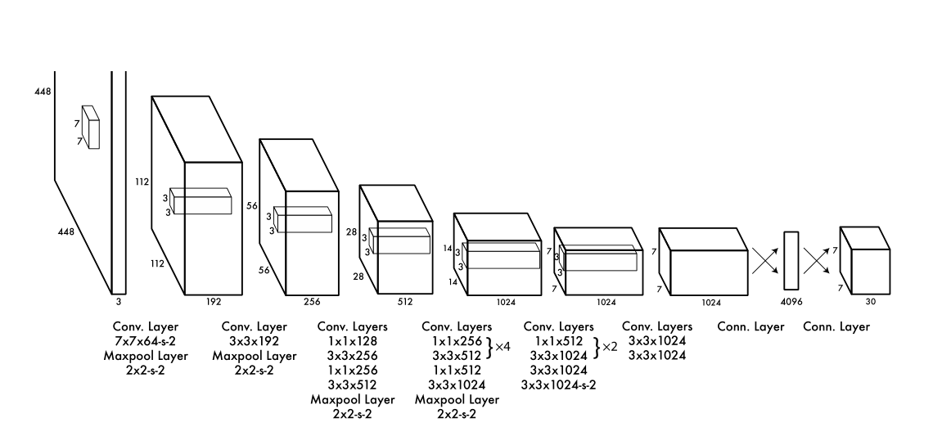
7×7×[（1+1+1+1+1）×2+20]
7×7×[（width+height+x+y+confidence）×2+20]

Slide 5
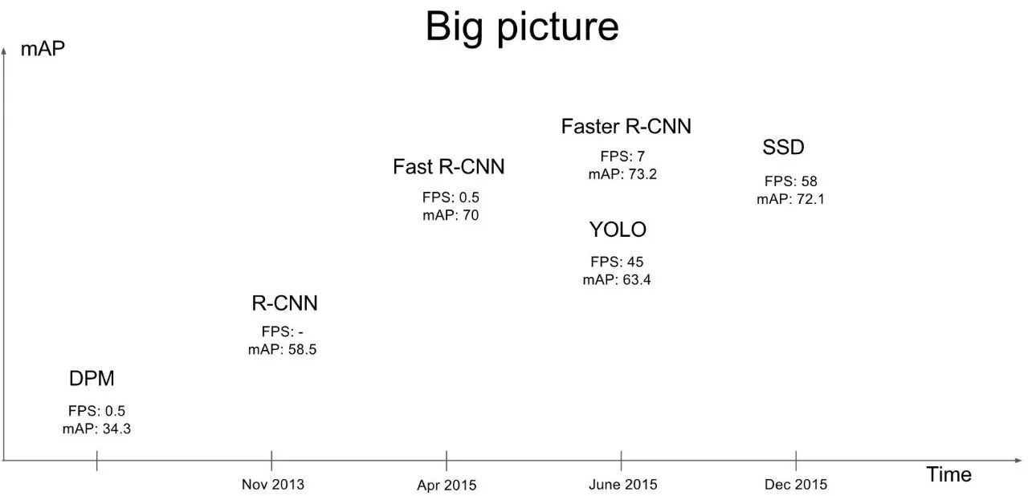
Comparison
https://cloud.tencent.com/developer/article/1052865

Slide 7
Thanks!

