Slide 1

Luther
D.H. Kim

Slide 2
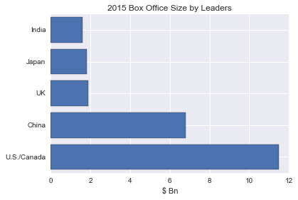
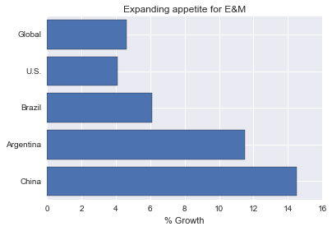
The narrative
Film market is robust despite competitiveness
600 MPAA rated movies each year
50,000 total films globally
Over 80% of movies fail
Growth concentrated in the big “6”
80% market share

Slide 3
Problem to investigate
Which movies perform well on revenue?
Rationale: interest for this investigation is not the profitability of studios, but the preference of consumers

Slide 4
Dataset
The Numbers
Database of 5321 movies
Reservations
Not scaled for FX adjustments or inflation
Measuring mistakes
Missing values (opted not to impute missing values)

Slide 5
Parameters
Regressand – Box office revenue (more or less ticket sales)
Regressors – Genre, Release Year, Production Budget, … and other reliable and measurable parameters by data set
3281 data points x 35 parameters

Slide 6
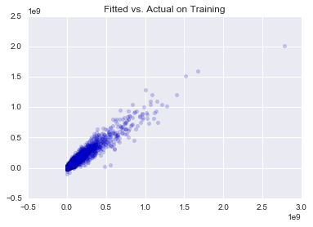
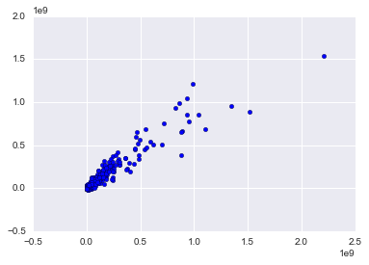
Fitted vs. Actual on Train
Fitted vs. actual on test

Slide 7
performance
CV Scores: 0.8982948 0.89324894 0.91377667 0.91753944 0.90100841
CV Mean Score: 0.90477365523
R-squared: 0.785177847709
Adj. R-squared: 0.633846372
MSE: 6.4 tr
AVG Benchmark MSE: 29.8 tr

Slide 8
Commentary…

Slide 9
Thank you
http://www.pwc.com/gx/en/industries/entertainement-media/outlook.html
http://www.the-numbers.com/movie/budgets/all

