Slide 1
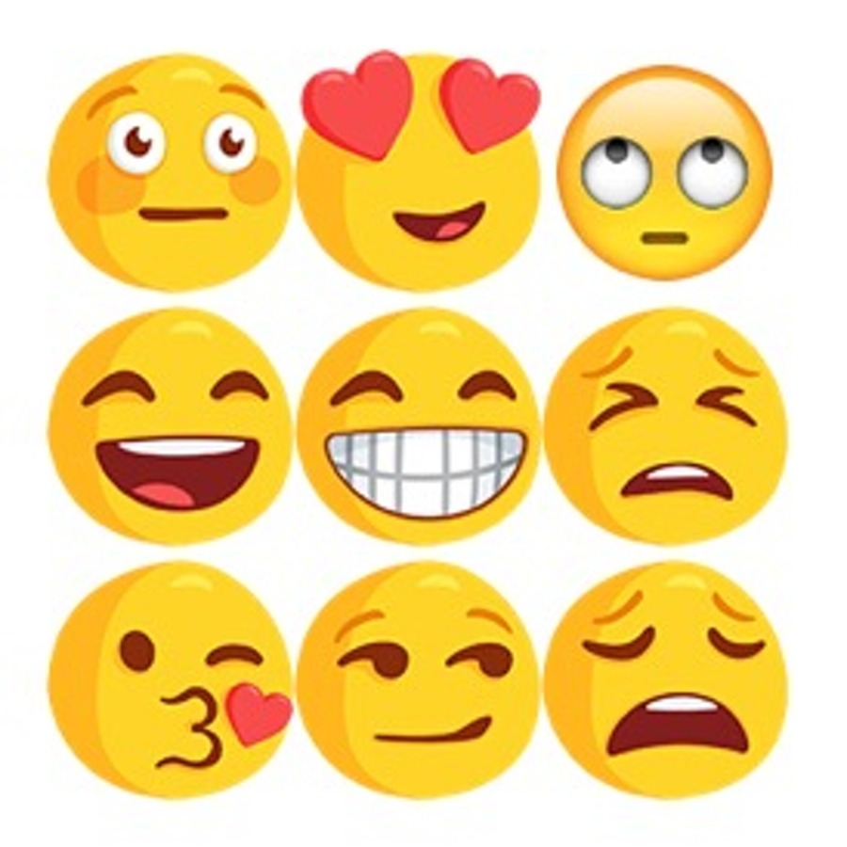
Mental Health Tracking with NLP

Slide 2
Goal
Use NLP techniques to get better insight into:
My emotional arc
How my outward persona changes over time
Am I becoming more cheerful?
Am I becoming a negative nancy?
How did relationships progress?
How did my relationships evolve emotionally?
Were there warning signs in the data from my previous relationship?

Slide 3


Dataset
~ 160,000 Facebook chat messages sent/received
~ 350,000 MSN chat messages sent/received
Spanned over 10 years (~140 msg/day)
~ 5 million words

Slide 4
Dataset
~ 160,000 Facebook chat messages sent/received
~ 350,000 MSN chat messages sent/received
Spanned over 10 years (~140 msg/day)
~ 5 million words
Most frequent message:

Slide 5
Dataset
~ 160,000 Facebook chat messages sent/received
~ 350,000 MSN chat messages sent/received
Spanned over 10 years (~140 msg/day)
~ 5 million words
Most frequent message:
lol

Slide 6
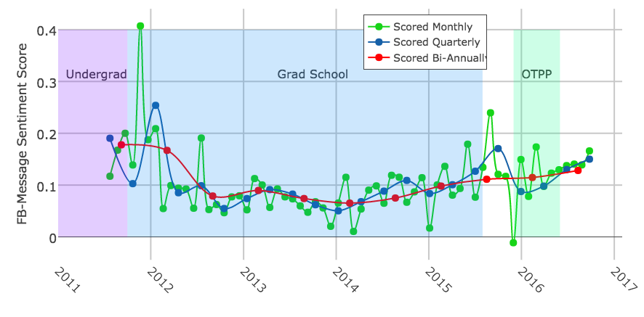
Bob’s Emotional Arc
VADER Sentiment Algorithm (NLTK) + Rolling time-window

Slide 7

Bob’s Emotional Arc
Expectations

Slide 8

Bob’s Emotional Arc
reality

Slide 9

Bob’s Emotional Arc
I’M A DOCTOR NOW!!!
CALL ME DOCTOR

Slide 10

Bob’s Emotional Arc
I’M STILL UNEMPLOYED!!!

Slide 11

Bob’s Emotional Arc
I’m….Metis?

Slide 12
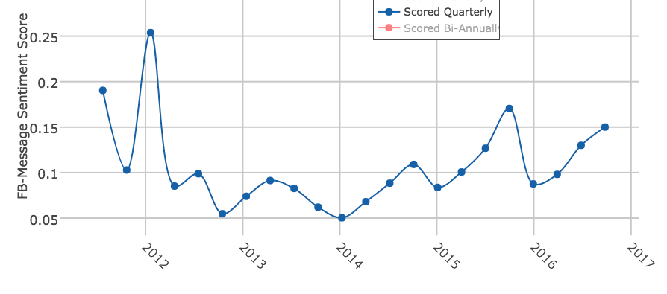
Annual Cycle…but why?

Slide 13
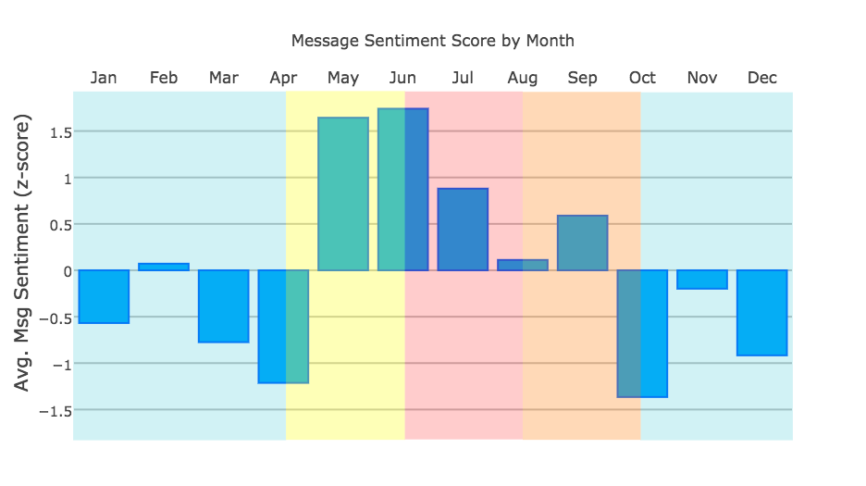
Do I Have SAD?
Canadian
Winter
Canadian
Winter

Slide 14
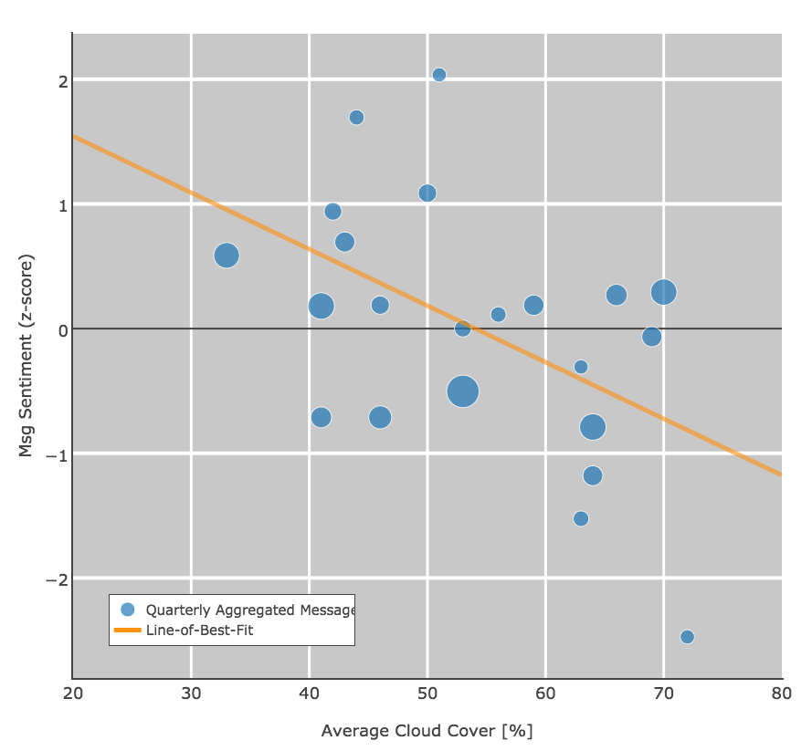
Do I Have SAD?
Sentiment z-score vs.
Cloud cover

Slide 15
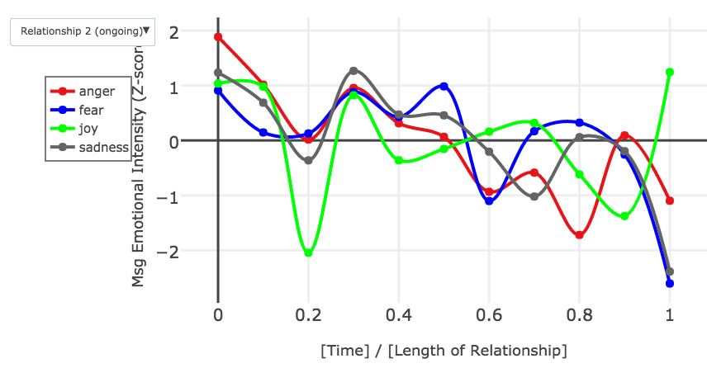
The Tale of Two Relationships
NRC Word-Emotion Association Lexicon

Slide 16
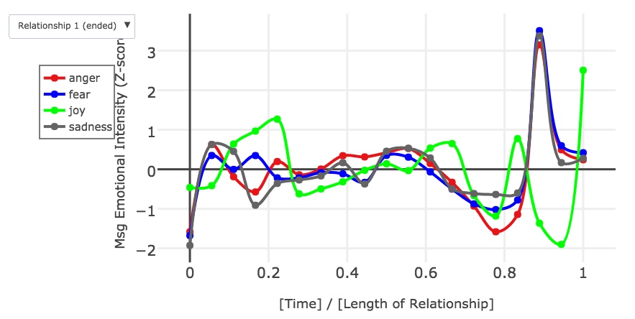
The Tale of Two Relationships
NRC Word-Emotion Association Lexicon

Slide 17
Applications
Mental health history tracking for patients
Extreme event onset detection warnings
Suicide risk
Anxiety attacks
Manic episodes
Communication coaching/therapy
Maybe an app that predicts the onset of fights
“I’m sorry Dave, I’m afraid I can’t let you say that to her for your own safety”

