Slide 1
Project structure overview
Access Control
Front End
Angular(components)
Angular-material
Static resources
Interaction
Angular(Services): HTTP POST, HTTP GET
Business
Application(Employee + HR)
Authentication(LOGIN/Registration)
Persistency
Hibernate
Database
MySQL
Remote Server
AWS RDS
AWS S3

Slide 2
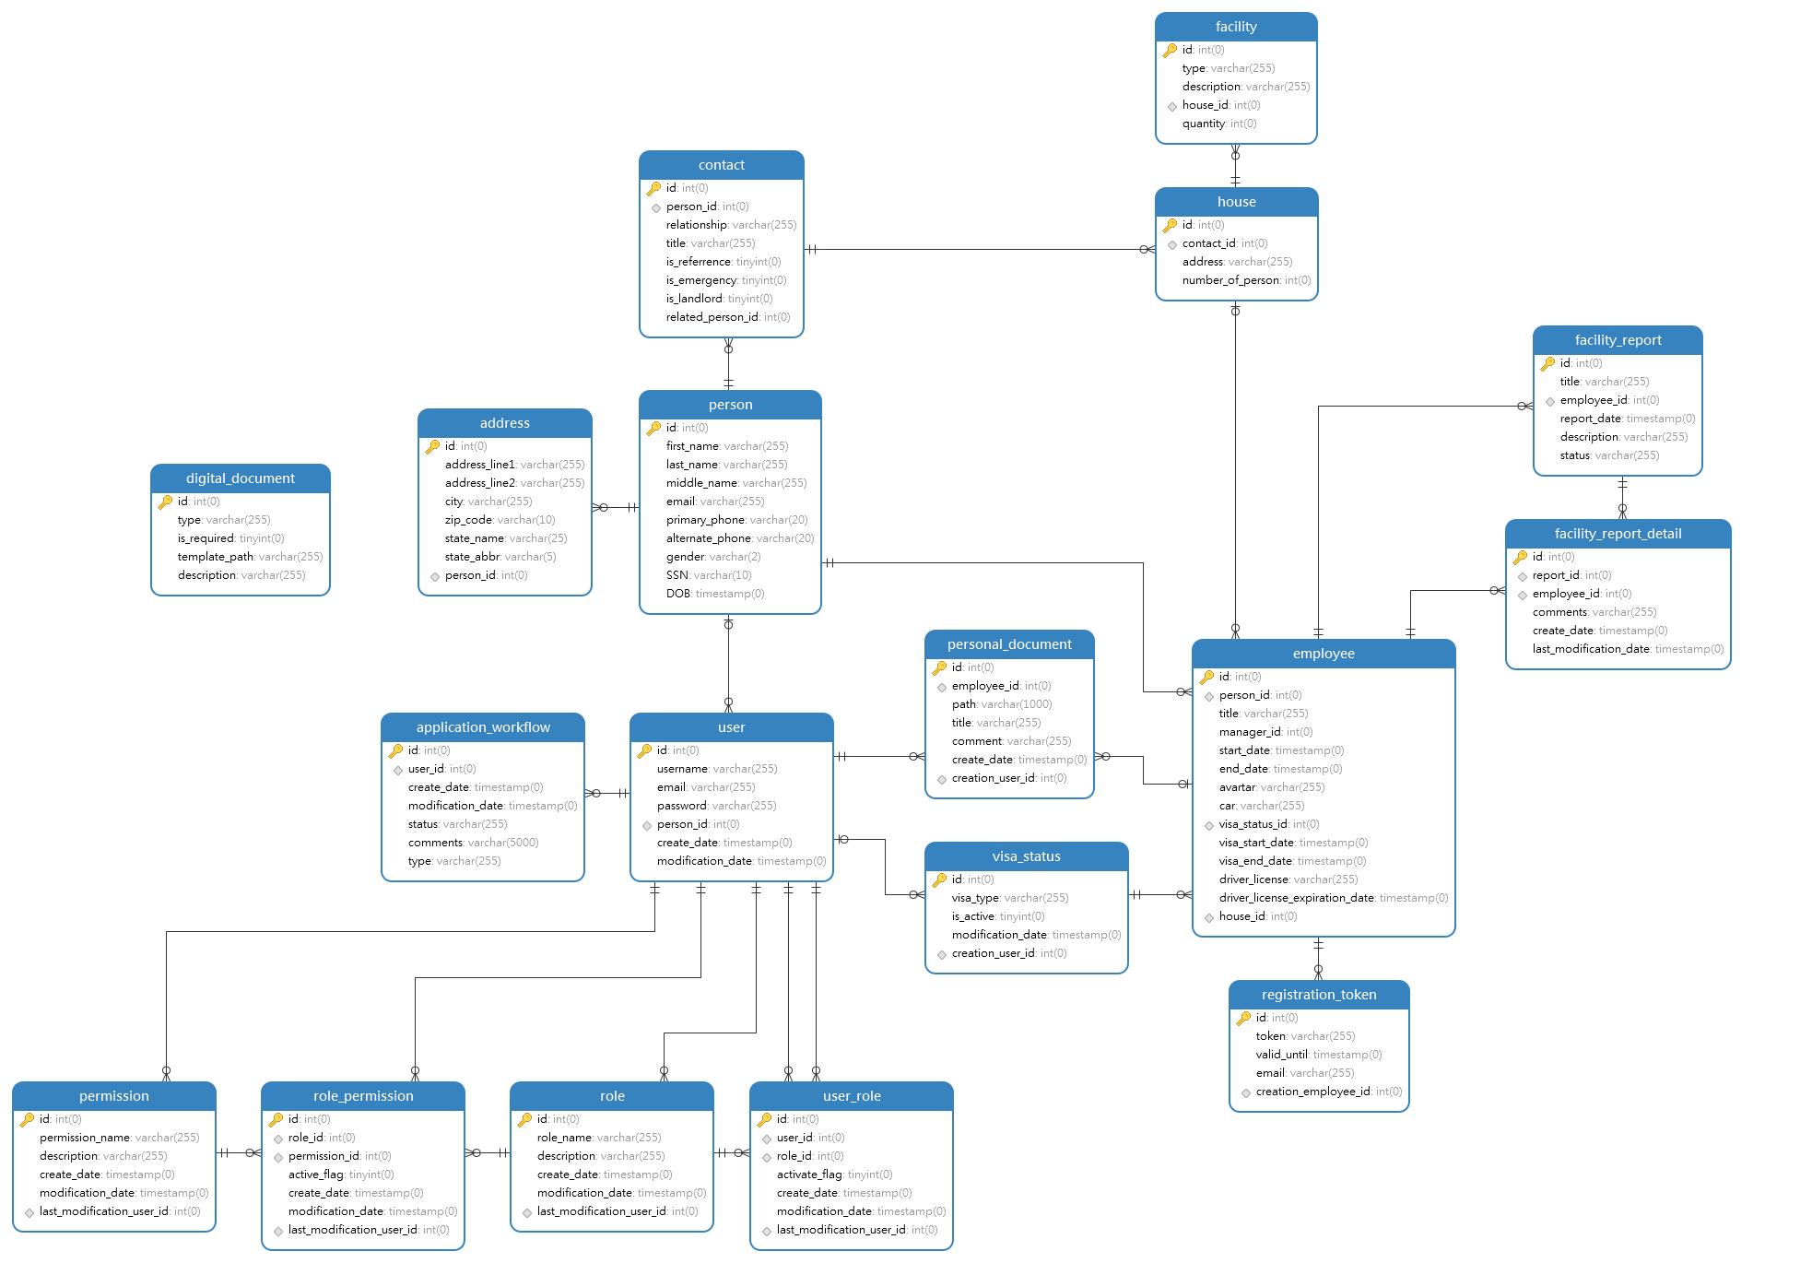

Slide 3
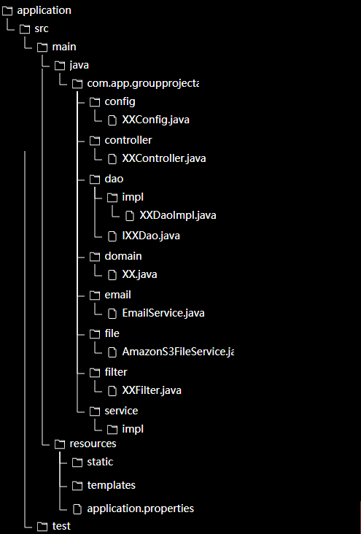
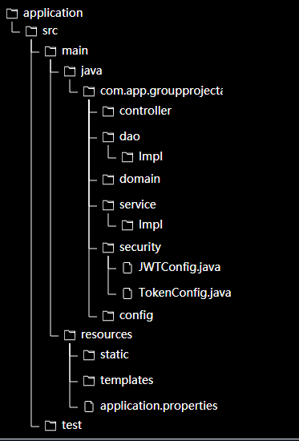
Application Server Structure
Authentication Server Structure

Slide 4
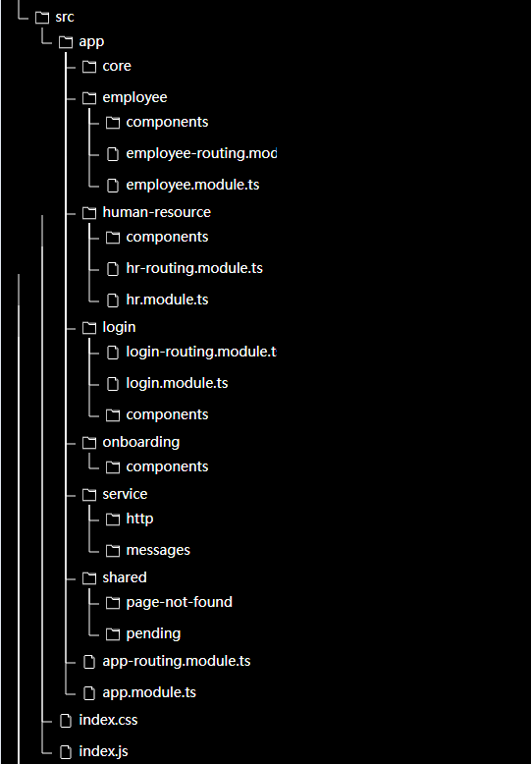
Frontend Structure

Slide 5
Team member tasks(Zhongqiu Gao)
2. Creation of spring boot projects
Application backend
Authentication backend
Database connection configuration
Amazon S3 connection configuration
Spring boot email service configuration
1. Database, Github and File Server
Database and File Server
Amazon RDS creation and configuration
Convert data tables in excel sheet into data tables in MySQL
Amazon S3 bucket creation and configuration
Github repo creation
4. Application Server
Onboarding
Hire (token generation + onboarding application audit)
File upload backend
Email service backend
filter
3. Authentication server
Login/Registration backend
JWT token
5. Front end
Front end project creation and structure design
UI library decision
Http services/message services
Onboarding frontend
Hire frontend(token generation + application audit)

Slide 6
Team member tasks(Bailey Bai)
1. Backend server
Entity classes for Hibernate
Simple Dao and DaoImpl (with Shida)
2. Registration and login
User login frontend
User registration frontend
3. Personal Info
Personal information for employee(frontend + backend)
Personal information for HR(frontend + backend)
4. Visa status management
Visa status for employee(frontend + backend)
Visa status for HR (frontend + backend)

Slide 7
Team member tasks(Shida Sheng)
1. Employee homepage
Employee homepage frontend
2. HR homepage
frontend
3. Personal information
Personal info for employee(backend)
Personal info for HR (backend)
4. Visa status
HR visa status frontend
HR visa status backend
5. Check employee information
frontend
backend

Slide 8
Team member tasks(Yaocheng Tong)
2. Frontend functionalities
Prototype for onboarding
Auth guard for routing
Page not found components
File preview
File upload
1. Frontend structure
Frontend structure design
Navigation page for employee and HR
Routing
Material-UI research
3. Housing
frontend
backend
4. House management
frontend
backend

Slide 9
Demo

