Slide 1
Intro to Ethical Hacking

Slide 2
Objectives
Hacking Concepts & Different Hacker Classes
Ethical Hacking Concepts & Scope
Ethical Hacking Methodologies & Frameworks

Slide 3
Hacking concepts & Different hacker classes

Slide 4
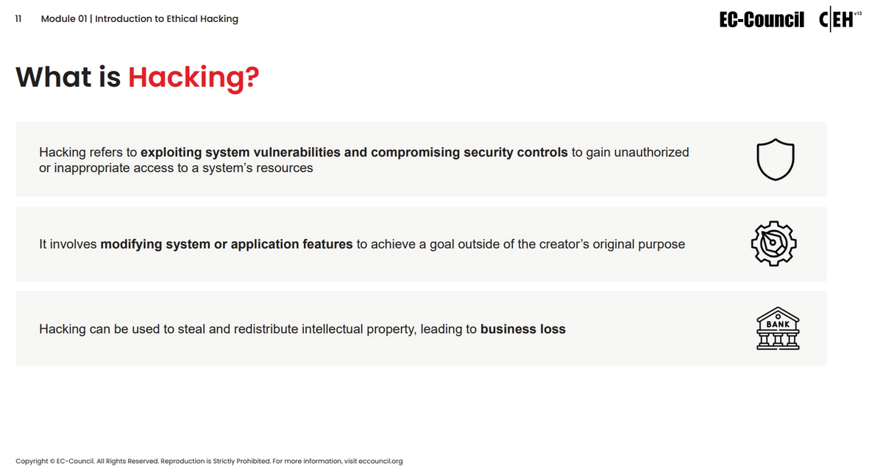

Slide 5
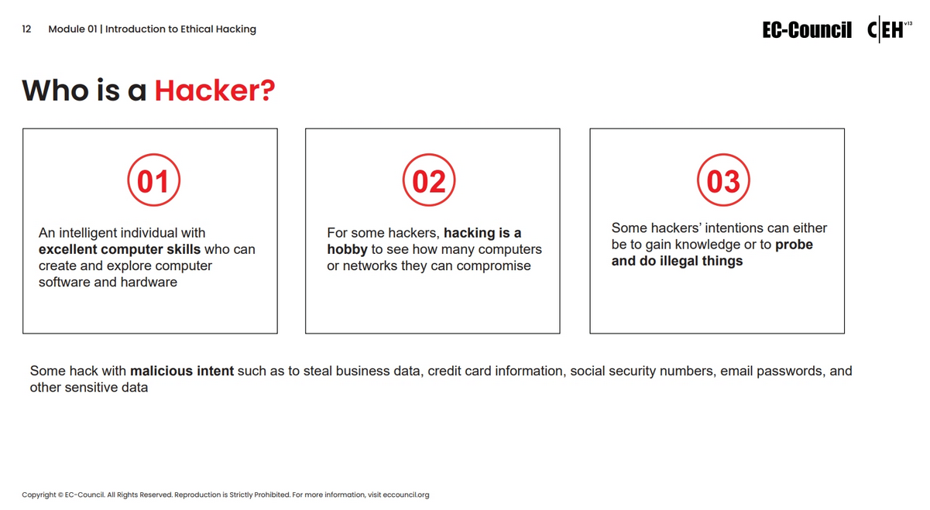

Slide 6
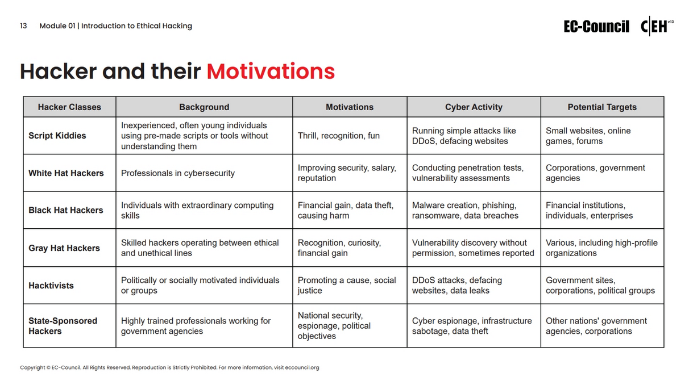

Slide 7
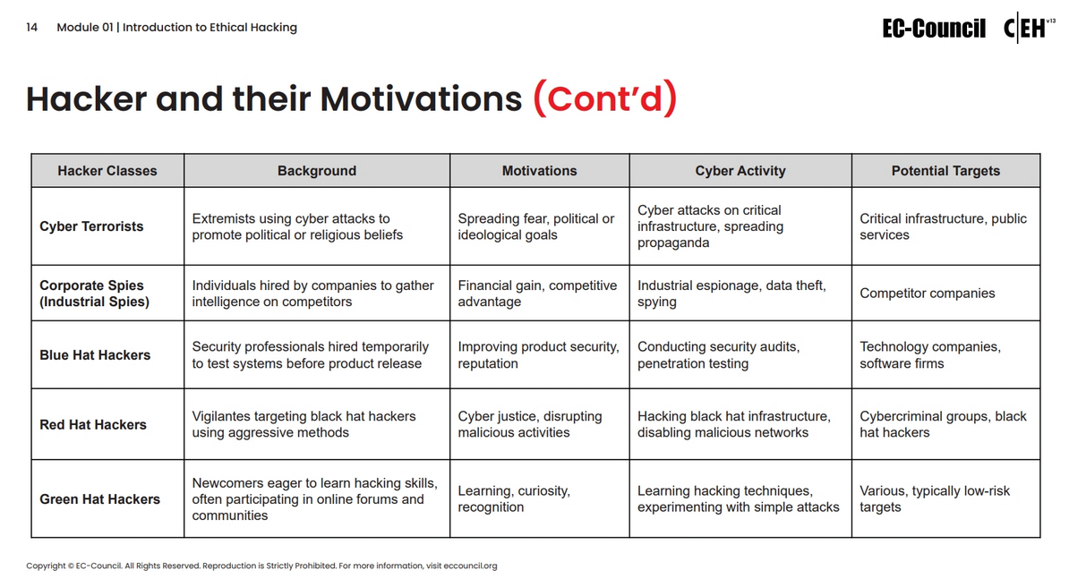

Slide 8
Ethical hacking concepts & scope

Slide 9
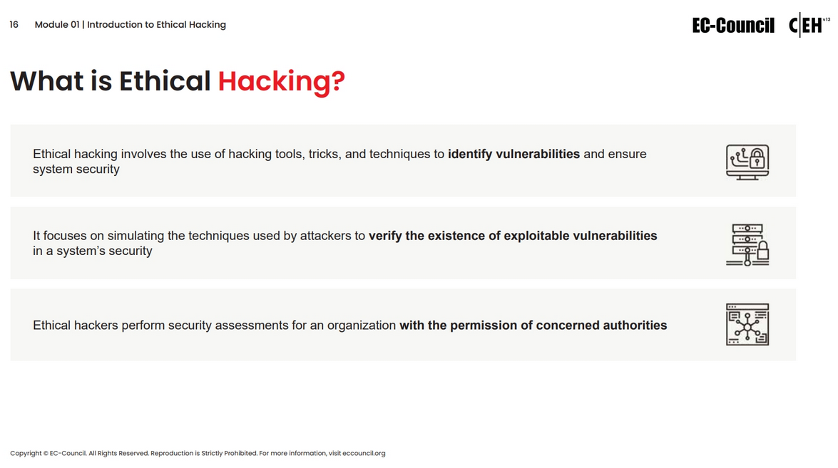

Slide 10
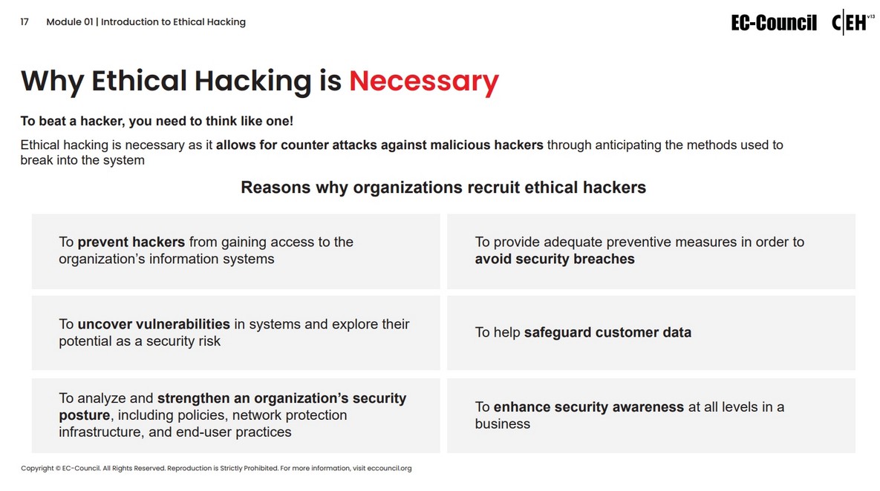

Slide 11
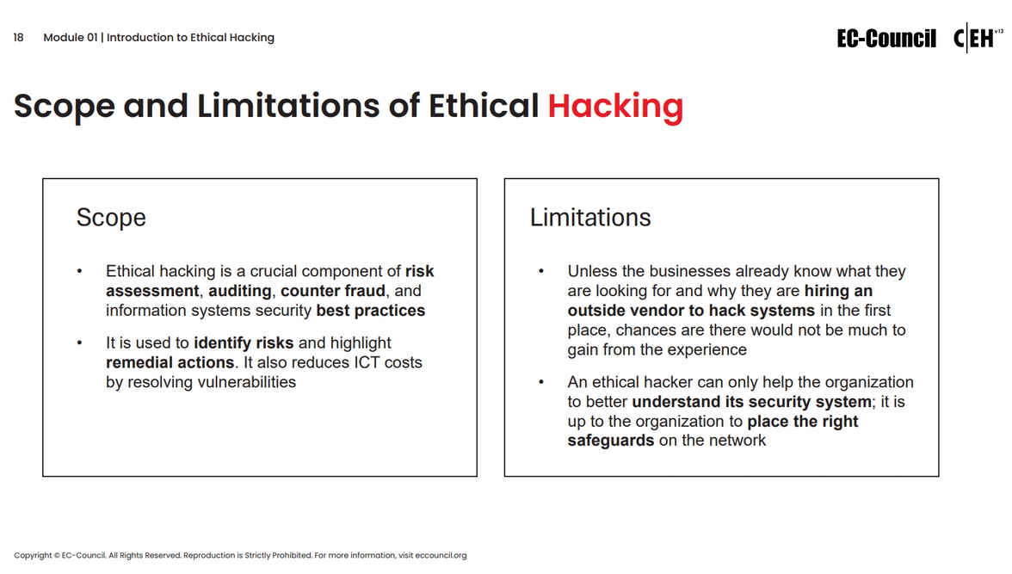

Slide 12
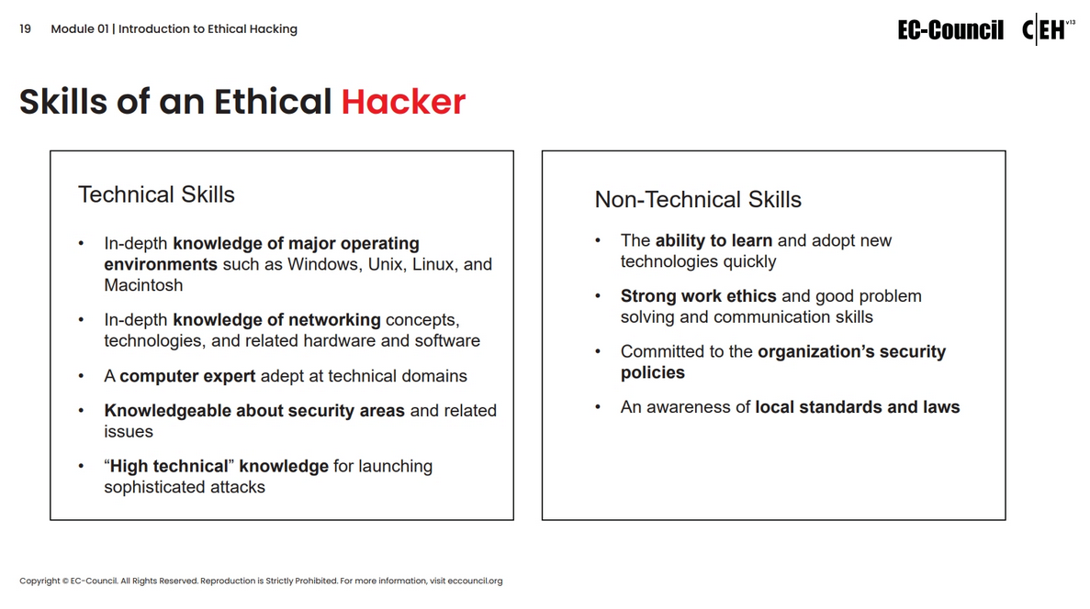

Slide 13
Ethical hacking Methodologies & Frameworks

Slide 14
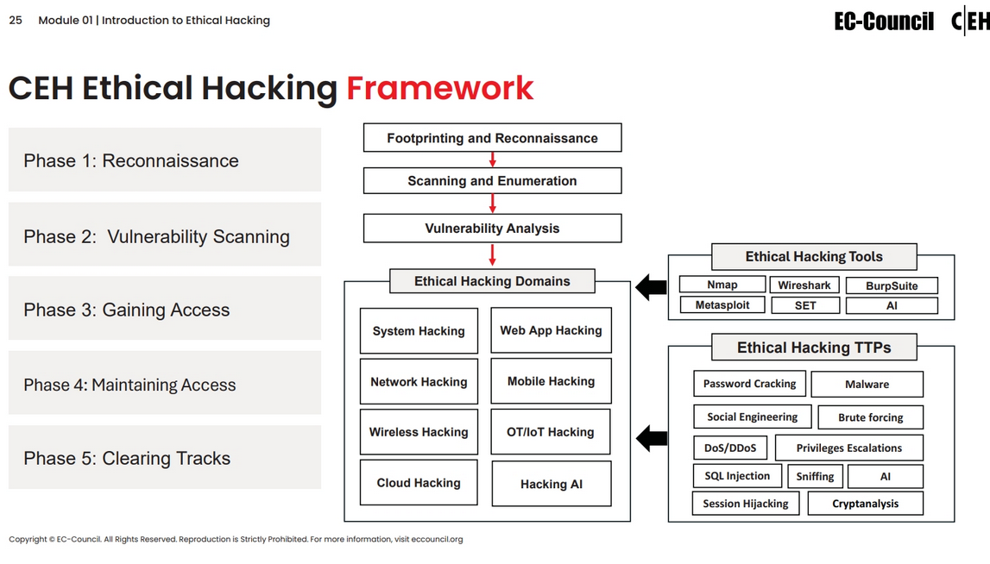

Slide 15
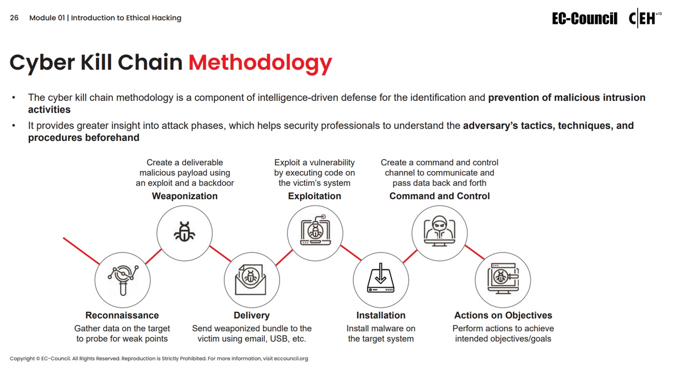

Slide 16
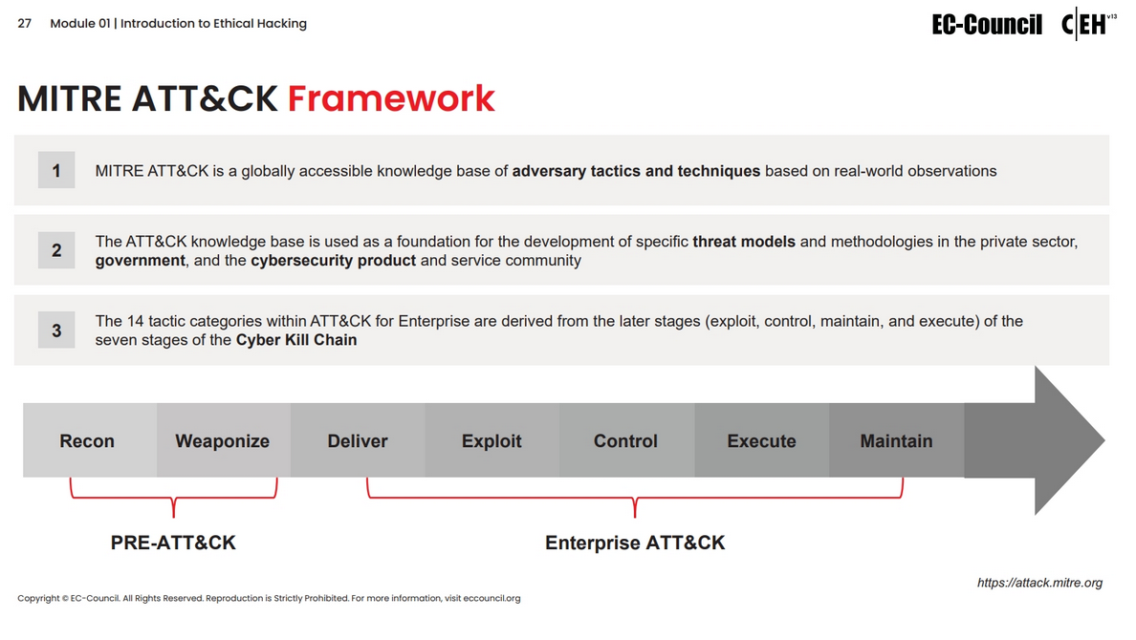

Slide 17
