Slide 1
Linux OS Fundamentals

Slide 2
Objectives
Linux System Fundamentals
Linux CLI Familiarisation
Basic Navigation
File and Directory Commands
Editing Text Files
Core System Configuration Files

Slide 3
Linux System fundamentals

Slide 4

Linux System Fundamentals
Linux
Created in 1991.
Fast, reliable and small (runs on very little hardware resources).
De-facto OS of choice for hackers!

Slide 5






Linux System Fundamentals
Redhat Linux distribution
‘Debian’ distribution
NOTE: These are just TWO of the many Linux distributions available out there!

Slide 6
Linux CLI Familiarisation

Slide 7
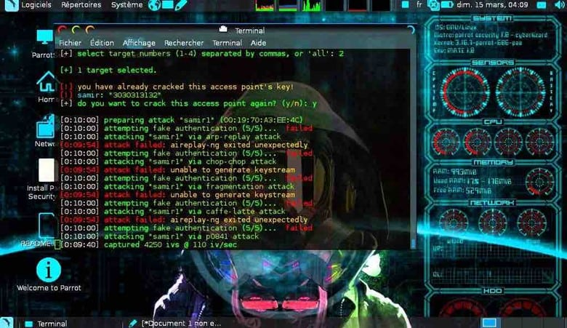
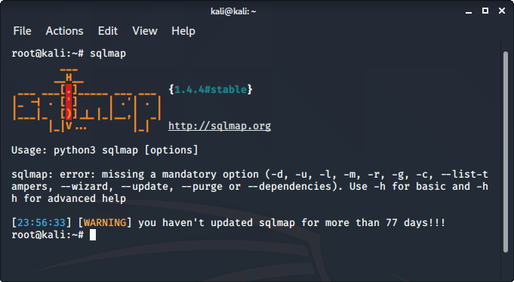
Linux CLI Familiarisation
Although there are graphical interfaces for Linux, as a hacker you will most likely be navigating in hacked machines via CLI.
The only background color you would see most of the time is black (by default).
So, ‘git gud’ with the CLI!

Slide 8
Linux CLI Familiarisation
Following set of slides shows some basic Linux commands that you should use.
If not, best is to have the Red Team Field Manual at all times (located in Brightspace LMS).

Slide 9
Linux CLI Familiarisation [Basic Commands]
Command | Description
mv | Moves or renames files and directories.
chmod | Modifies file permissions.
chown | Changes the ownership of a file.
dd | Copies data from an input to an output.
pwd | Displays the name of the current directory.
ps | Lists the processes that are currently running in the system.
su | Simulates a login as another user or to become a superuser.

Slide 10
Linux CLI Familiarisation [Basic Commands]
Command | Description
sudo | Runs a command as a super user, by default, or another named user.
grep | Used to search for specific strings of characters within a file or other command outputs.
ifconfig | Used to display or configure network card related information.
apt-get | Used to install, configure and remove packages on Debian and its derivatives.
iwconfig | Used to display or configure wireless network card related information.
shutdown | Shuts down the system and performs shut down related tasks including restart, halt, put to sleep or kick out all currently connected users.
passwd | Used to change the password.
cat | Used to list the contents of a file and expects the file name as the parameter.
man | Used to display the documentation for a specific command.

Slide 11
Linux CLI Familiarisation [File and Directory Commands]
Command | Description
Is | Displays the files inside a directory.
cd | Changes the current directory.
mkdir | Creates a directory under the current directory.
cp | Copies files from source to destination.
mv | Moves files to a different directory.
rm | Removes files.
grep | Searches for specific strings of characters within a file or other commands outputs.
cat | Lists the contents of a file and expects the file name as the parameter.

Slide 12
Linux CLI Familiarisation
Command Line Text Editors
So far there are two common CLI Text Editors, namely:
vi/vim
nano
My advice: learn vi / vim because it is installed by default ☺

Slide 13
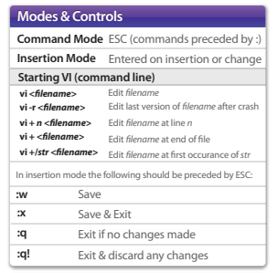
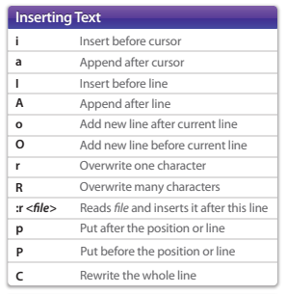
Linux CLI Familiarisation

Slide 14
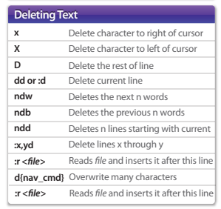
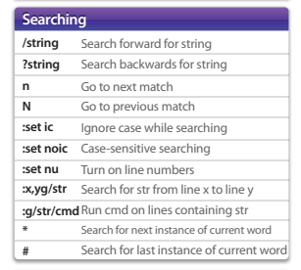
Linux CLI Familiarisation

Slide 15
Core System configuration files

Slide 16
Core System Configuration Files
There are certain configuration files that provide vital information such as the list of users, networks and so on.
Do take note that these system files SHOULD exist across all Linux OS distros.

Slide 17
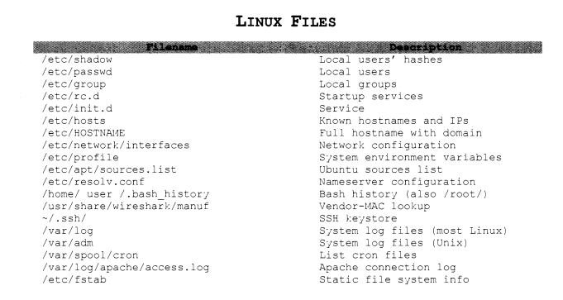
Core System Configuration Files

