Slide 1
Footprinting & Reconnaissance

Slide 2
Objectives
Footprinting Concepts
Footprinting through Search Engines
Whois Footprinting
DNS Footprinting

Slide 3
Footprinting Concepts

Slide 4
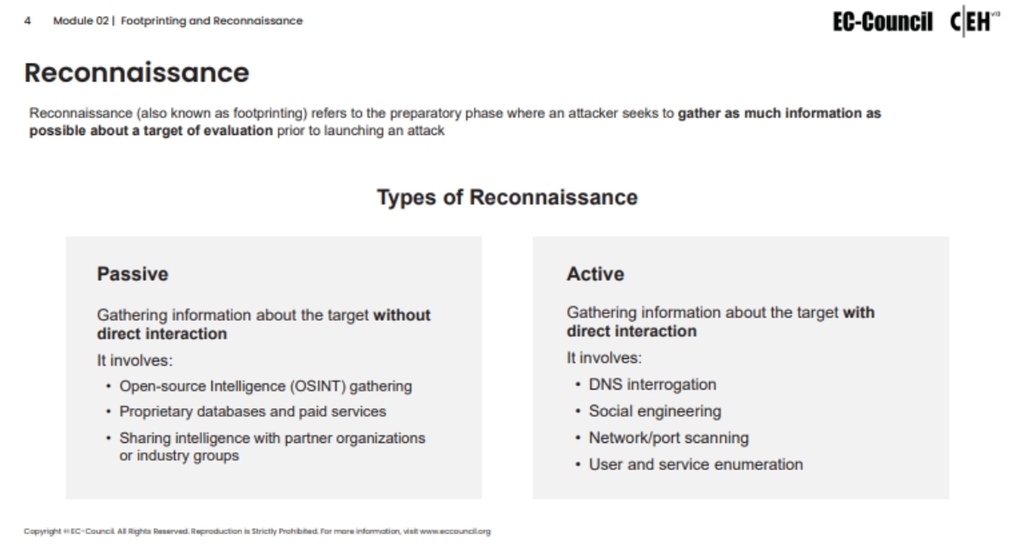

Slide 5
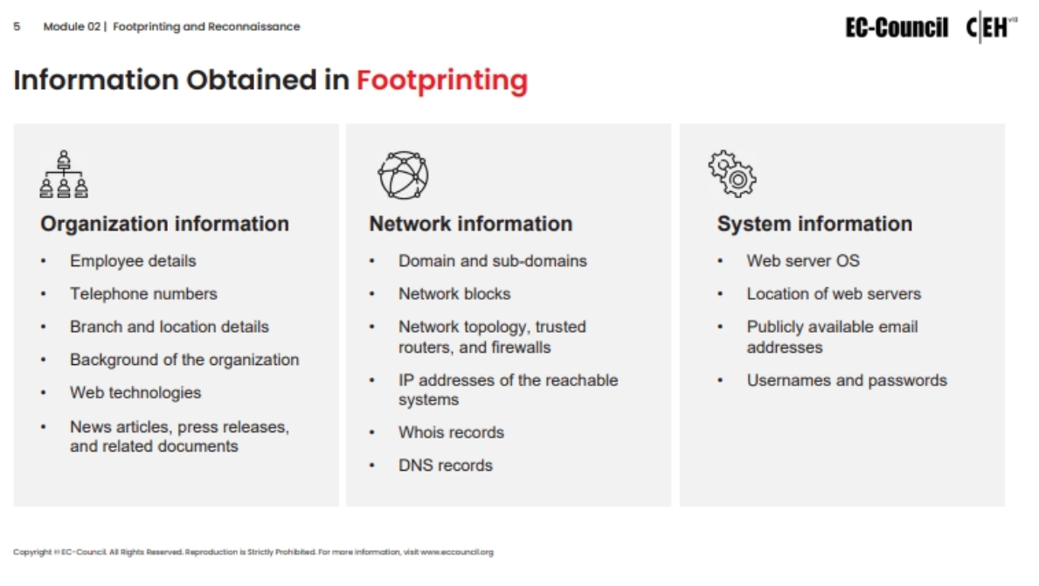

Slide 6
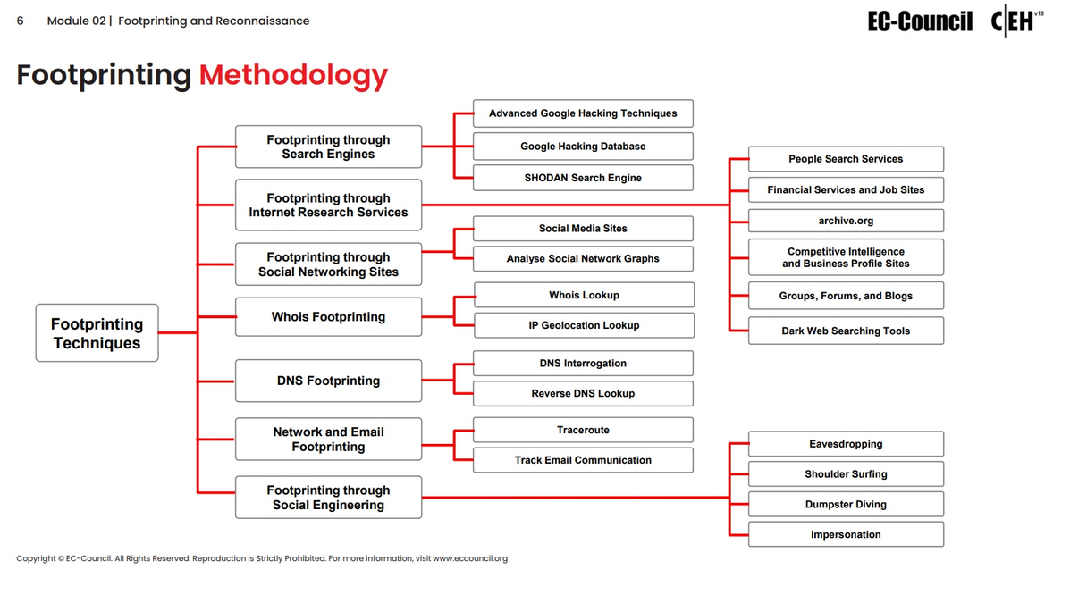

Slide 7
Footprinting through Search Engines

Slide 8
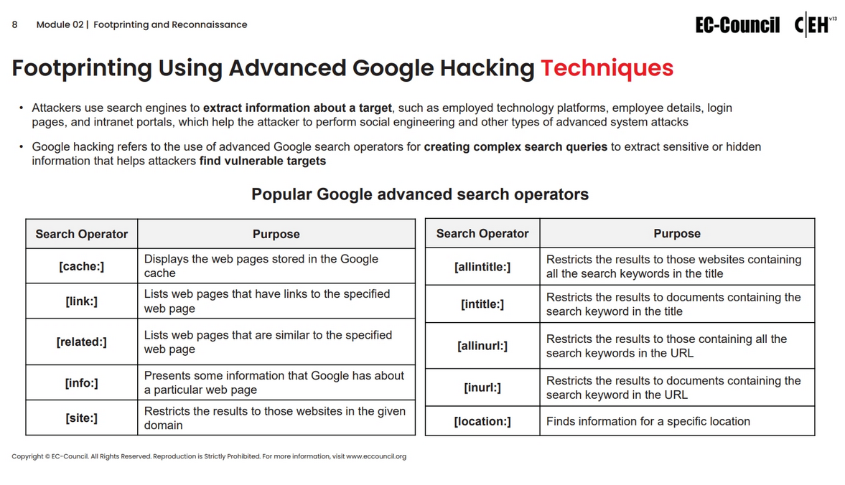

Slide 9
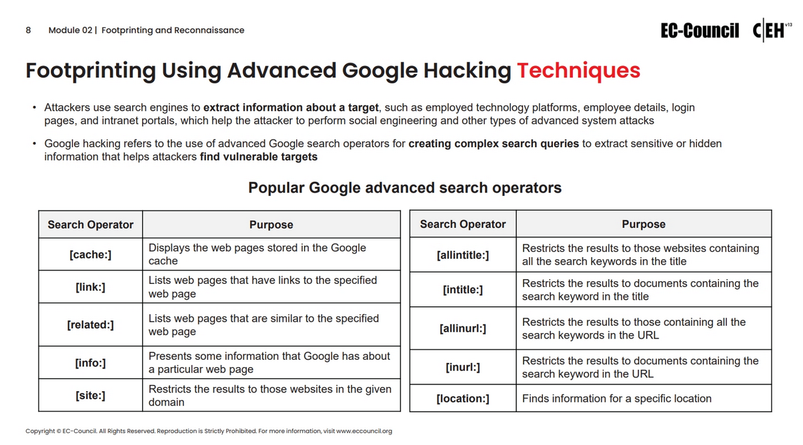

Slide 10
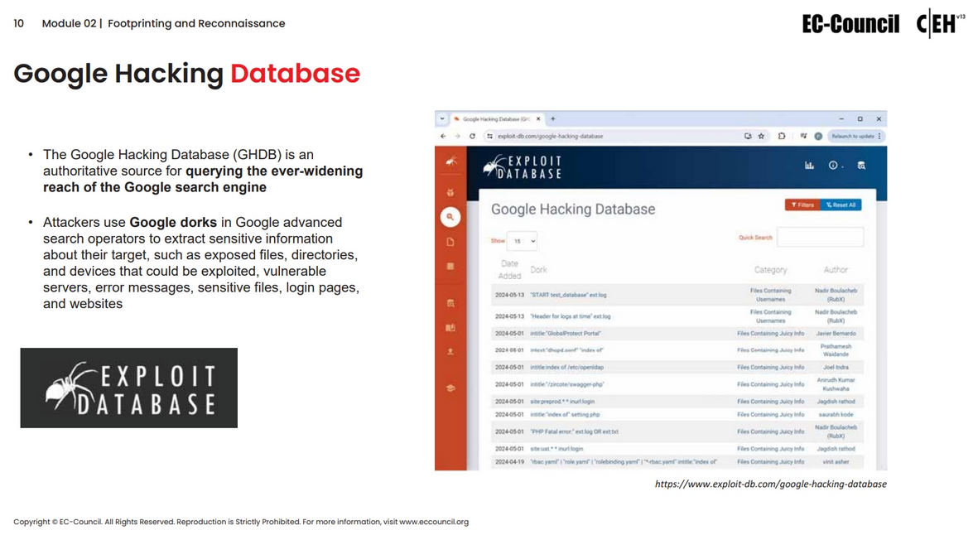

Slide 11
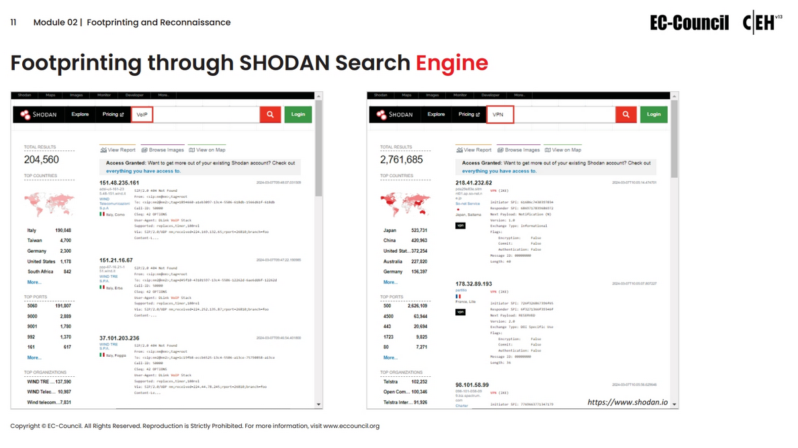

Slide 12
Whois Footprinting

Slide 13
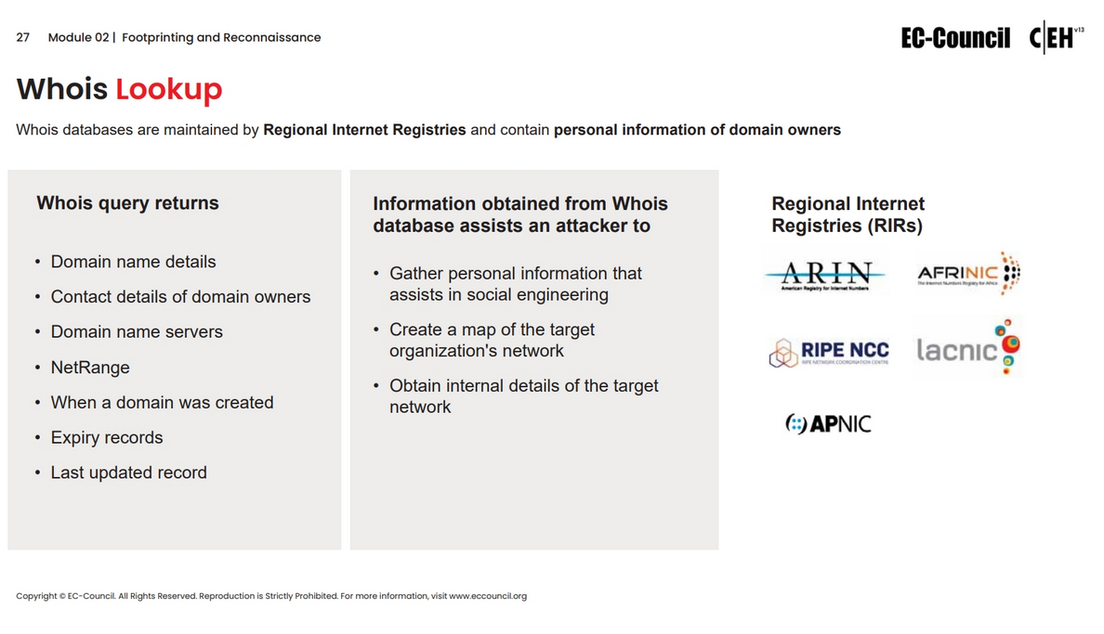

Slide 14
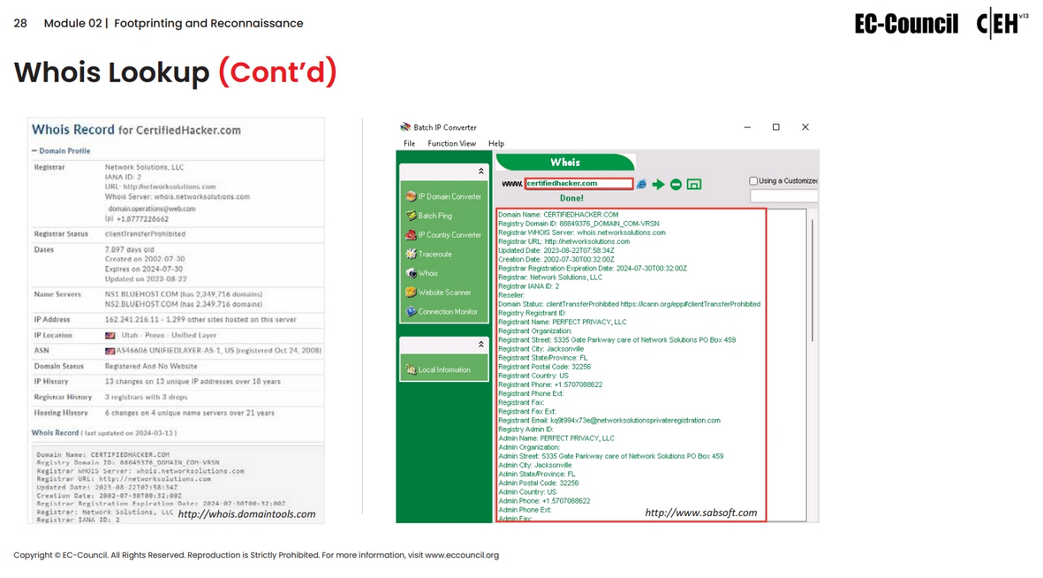

Slide 15
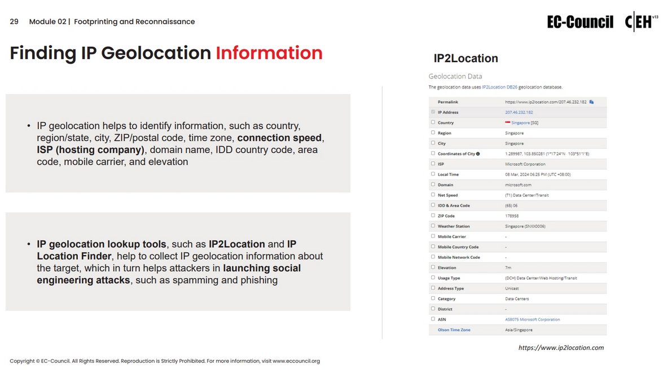

Slide 16
DNS Footprinting

Slide 17
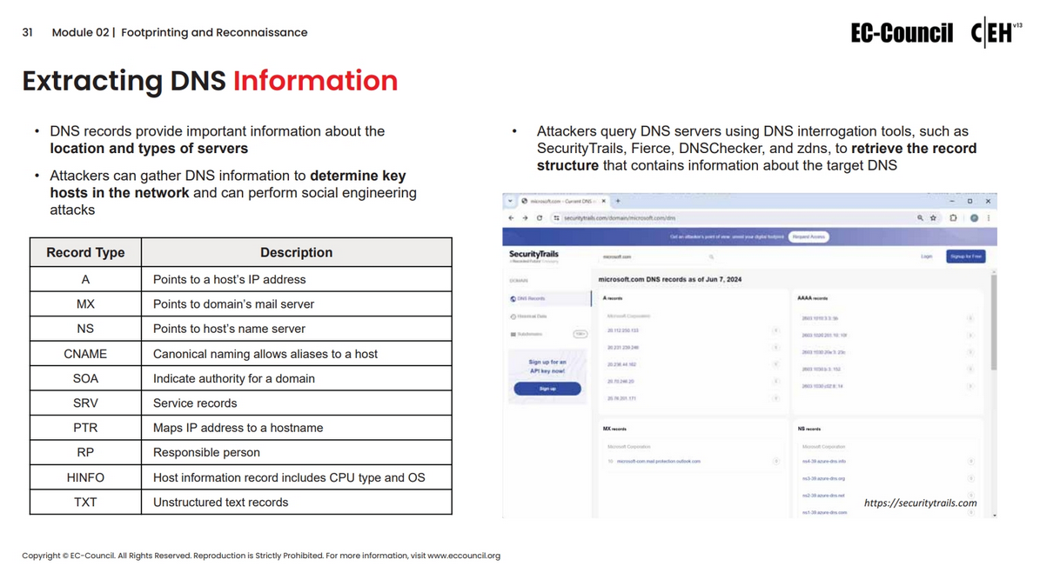

Slide 18
