Slide 1
Scanning Networks

Slide 2
Objectives
Scanning Networks Concepts
Host Discovery
Port & Service Discovery
OS Discovery

Slide 3
Scanning Networks Concepts

Slide 4
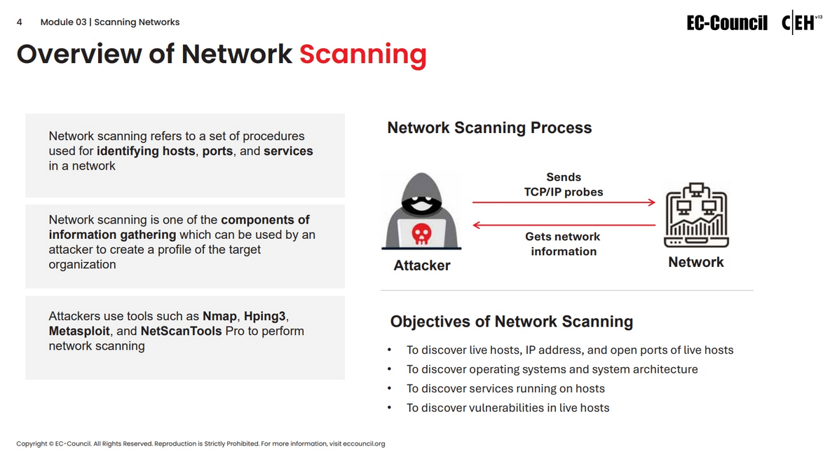

Slide 5
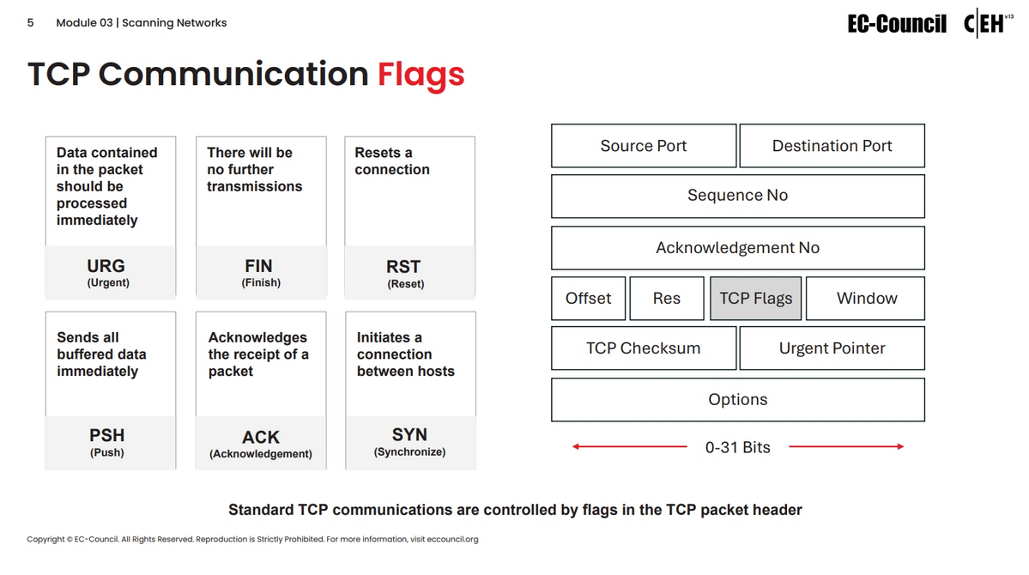

Slide 6
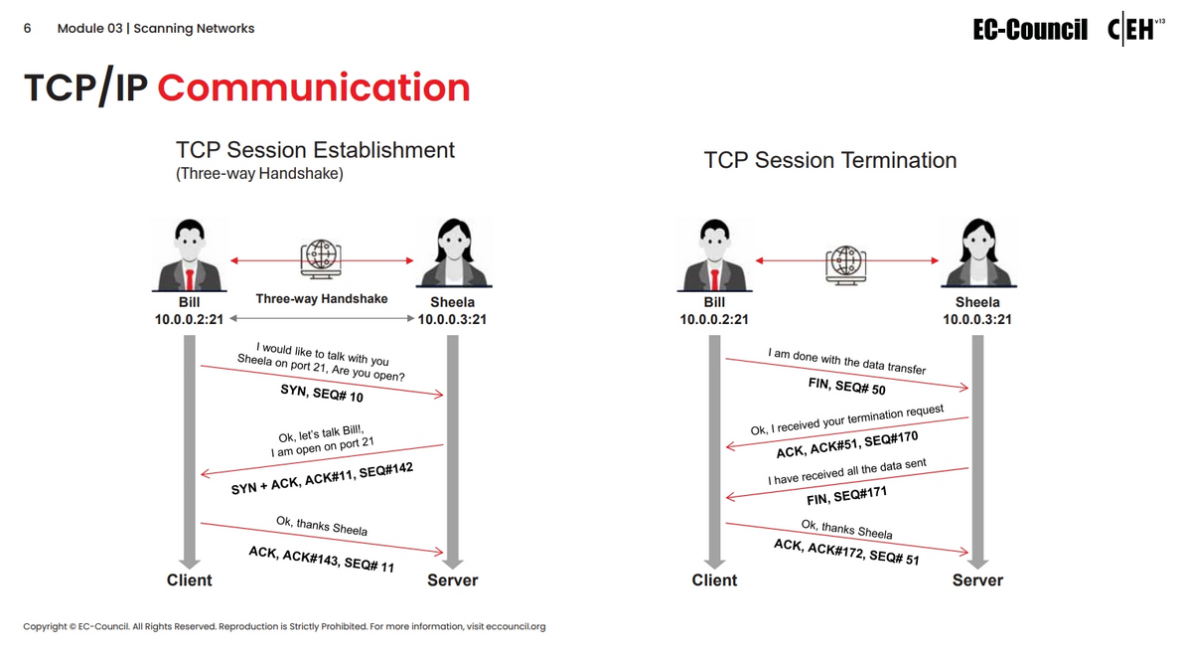

Slide 7
Host Discovery

Slide 8
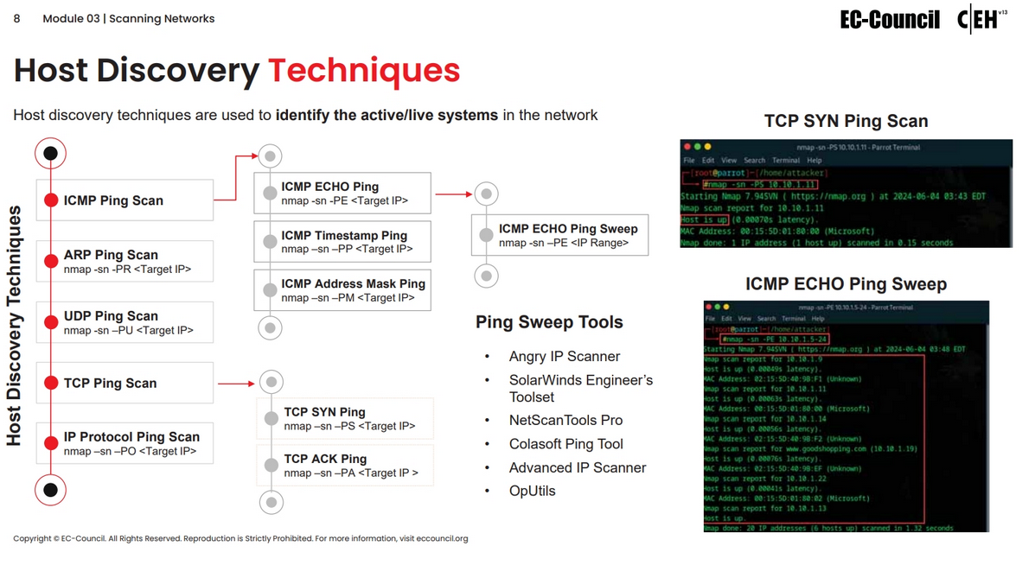

Slide 9
Port & Service Discovery

Slide 10
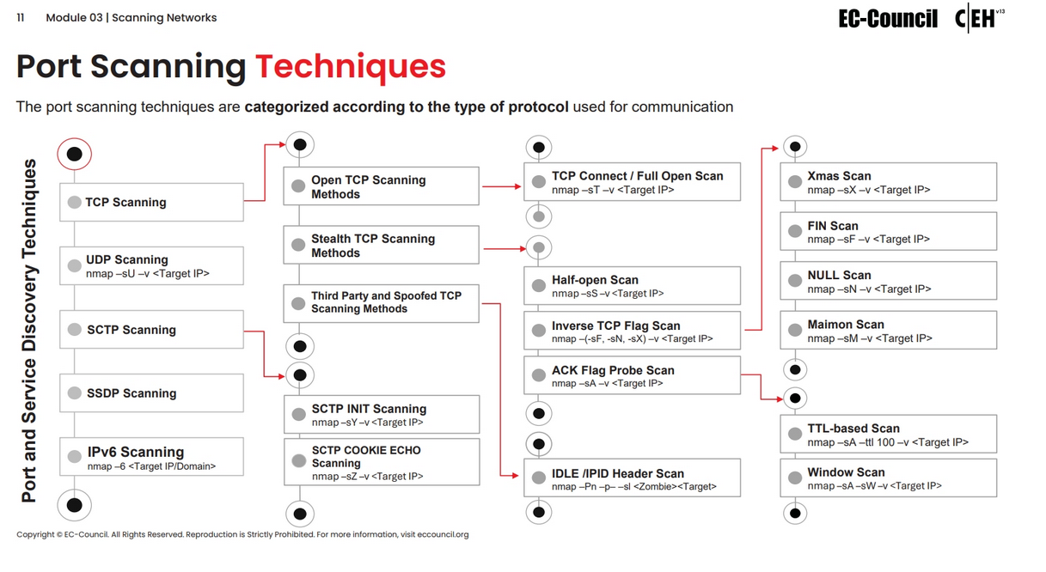

Slide 11
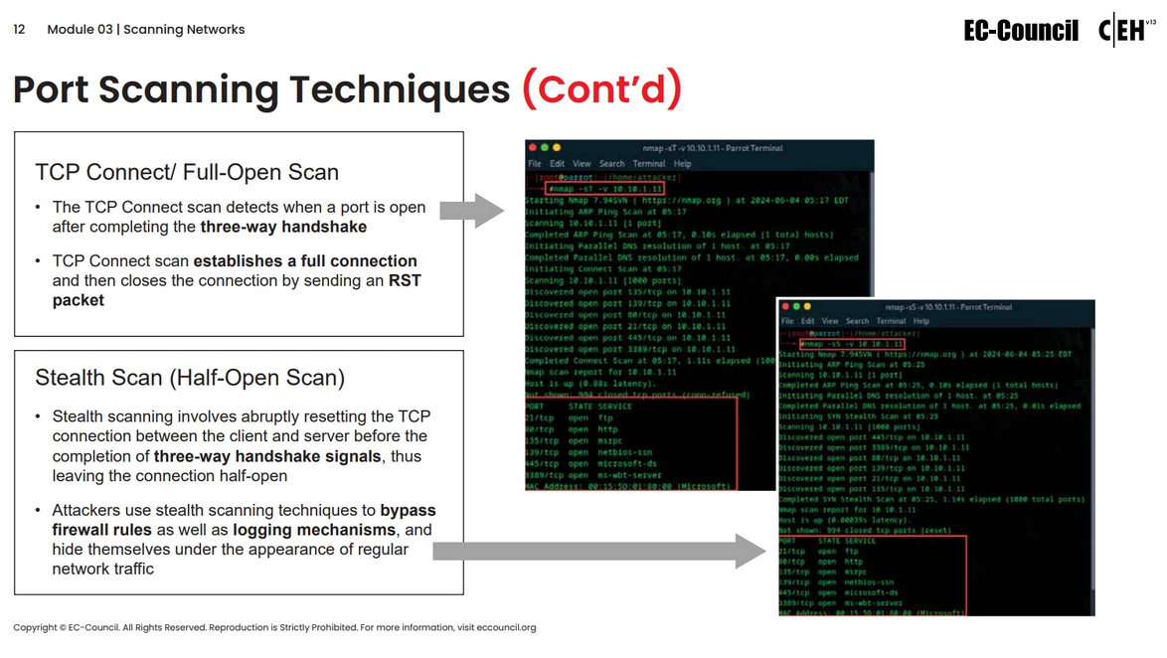

Slide 12
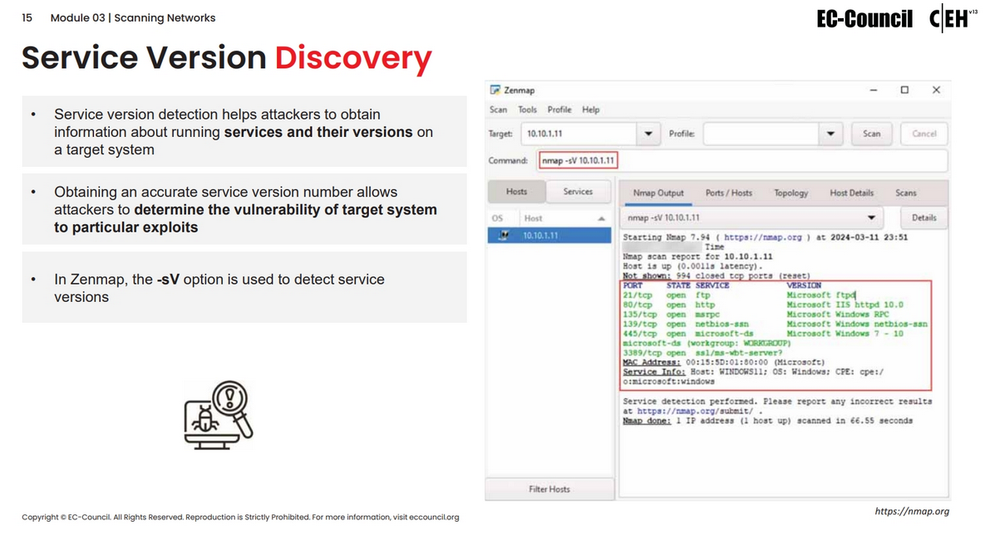

Slide 13
OS Discovery

Slide 14
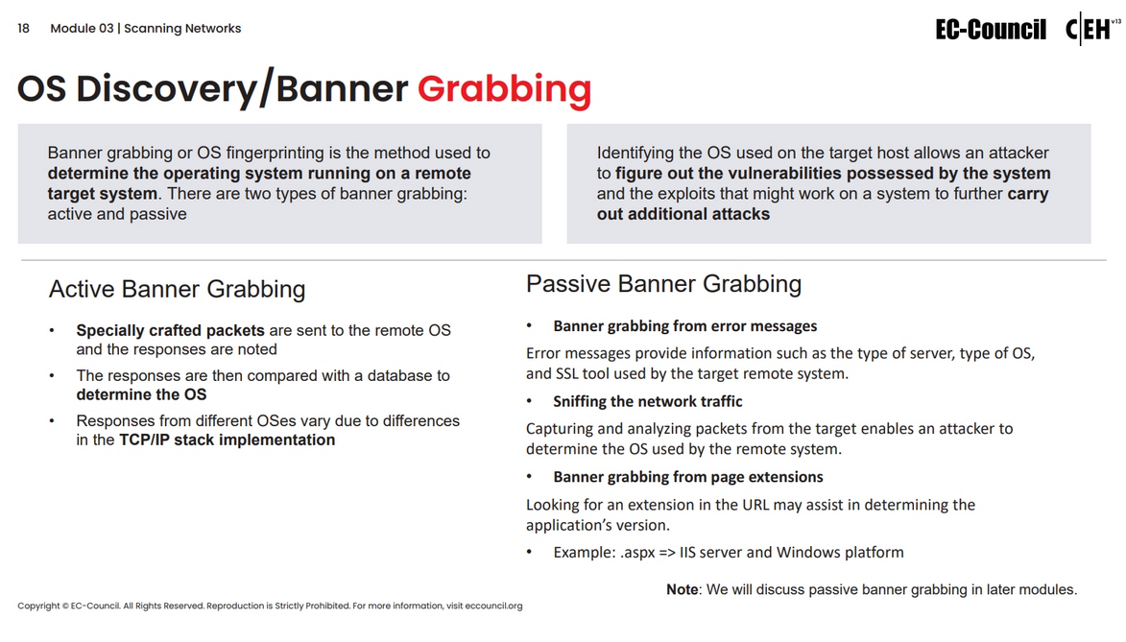

Slide 15
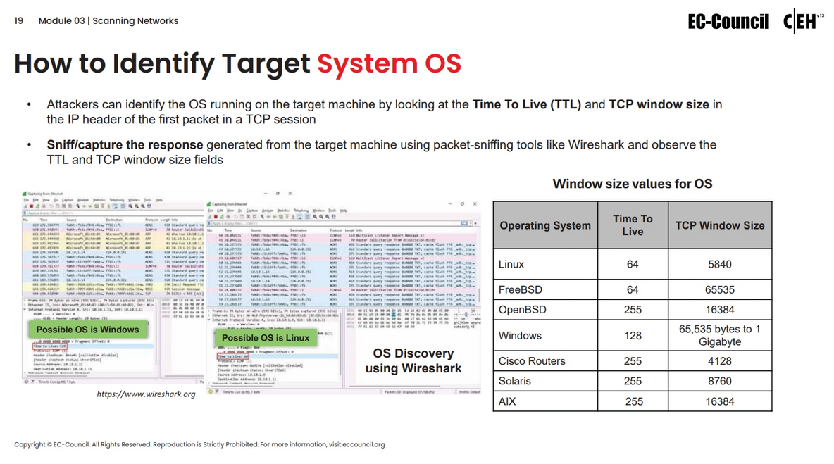

Slide 16
