Slide 1
Enumeration

Slide 2
Objectives
Enumeration Concepts
NetBIOS Enumeration
Linux Enumeration

Slide 3
Enumeration Concepts

Slide 4
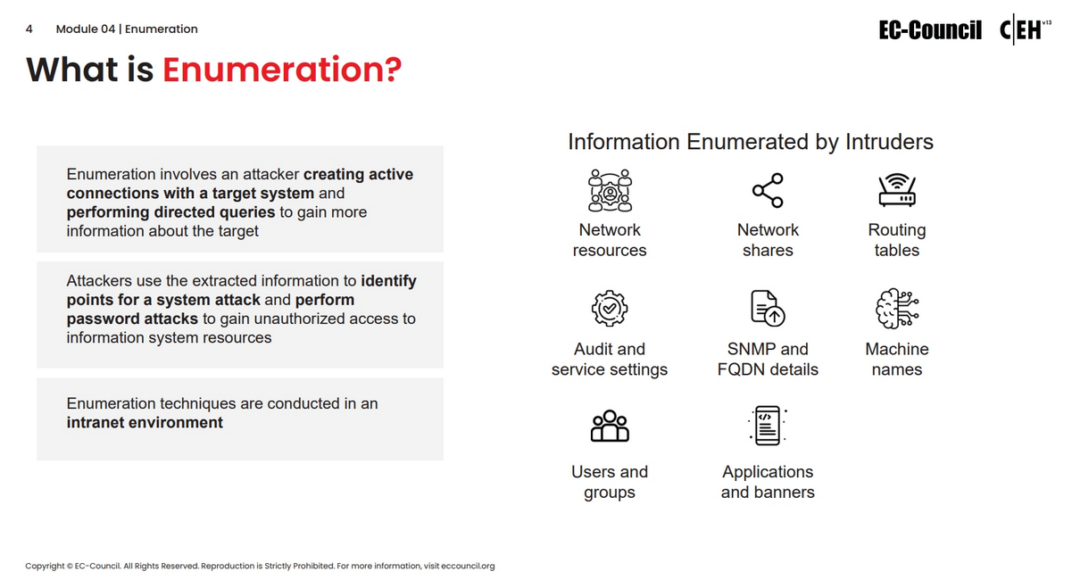

Slide 5
NetBIOS Enumeration

Slide 6
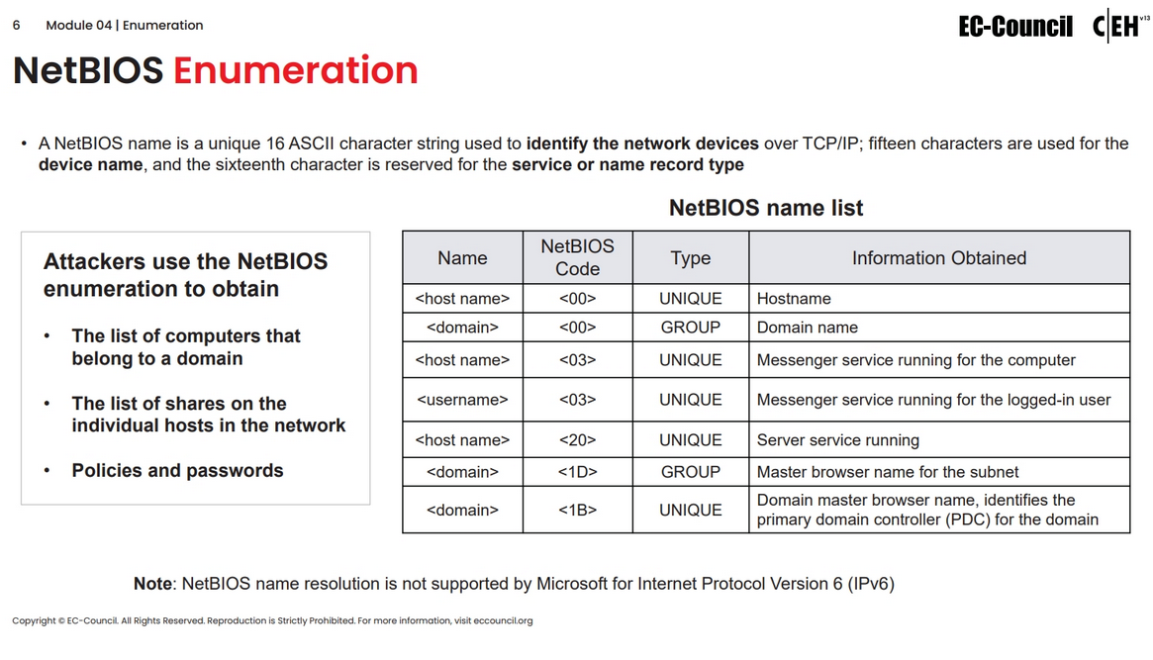

Slide 7
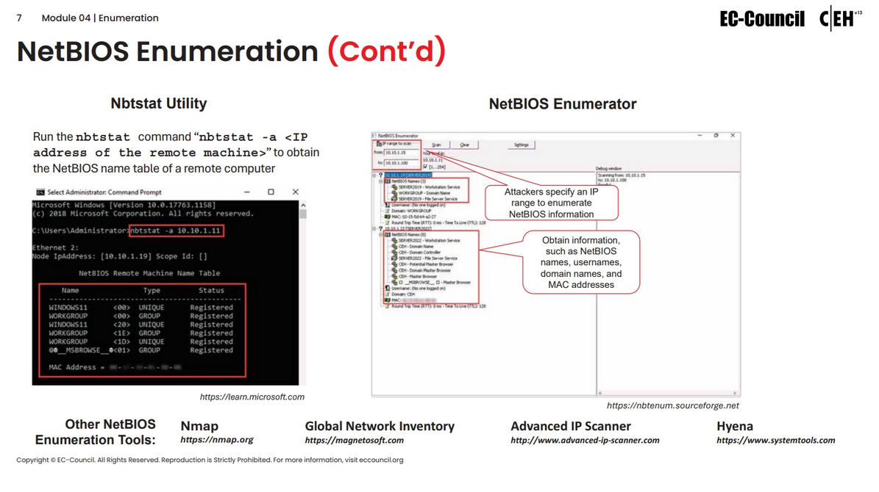

Slide 8
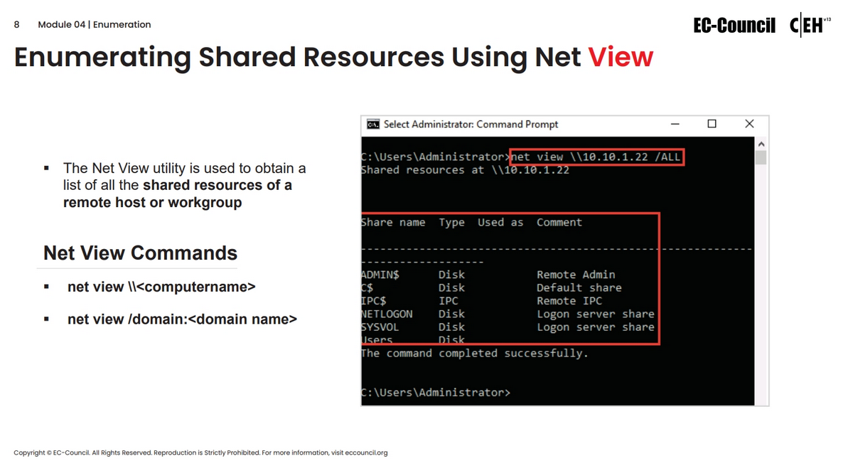

Slide 9
Linux Enumeration

Slide 10
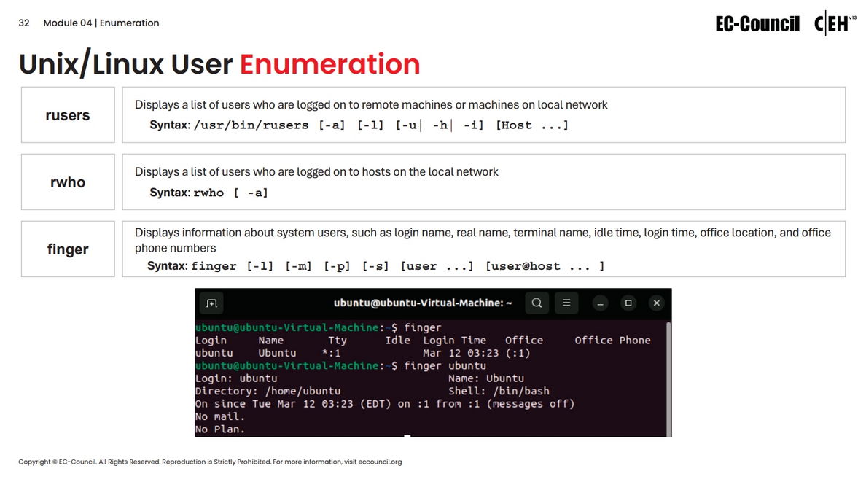

Slide 11
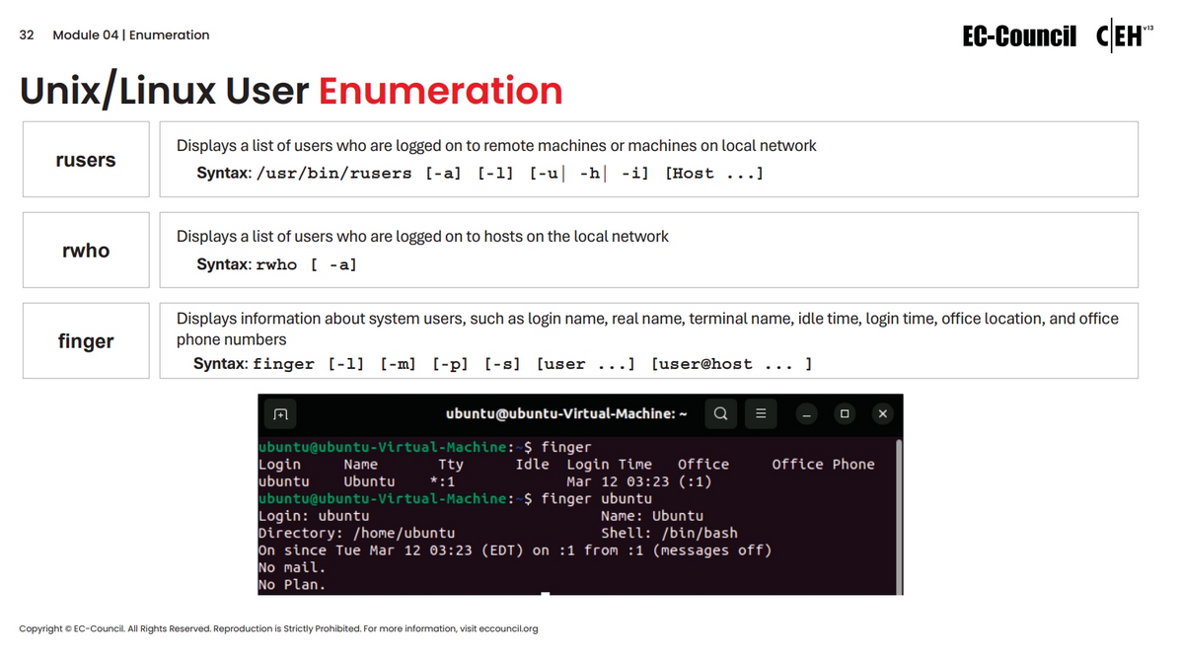

Slide 12
