Slide 1
System Hacking

Slide 2
Objectives
Vulnerability Exploitation
Password Cracking
Privilege Escalation
SUID
Sudo
Cron

Slide 3
Vulnerability Exploitation

Slide 4
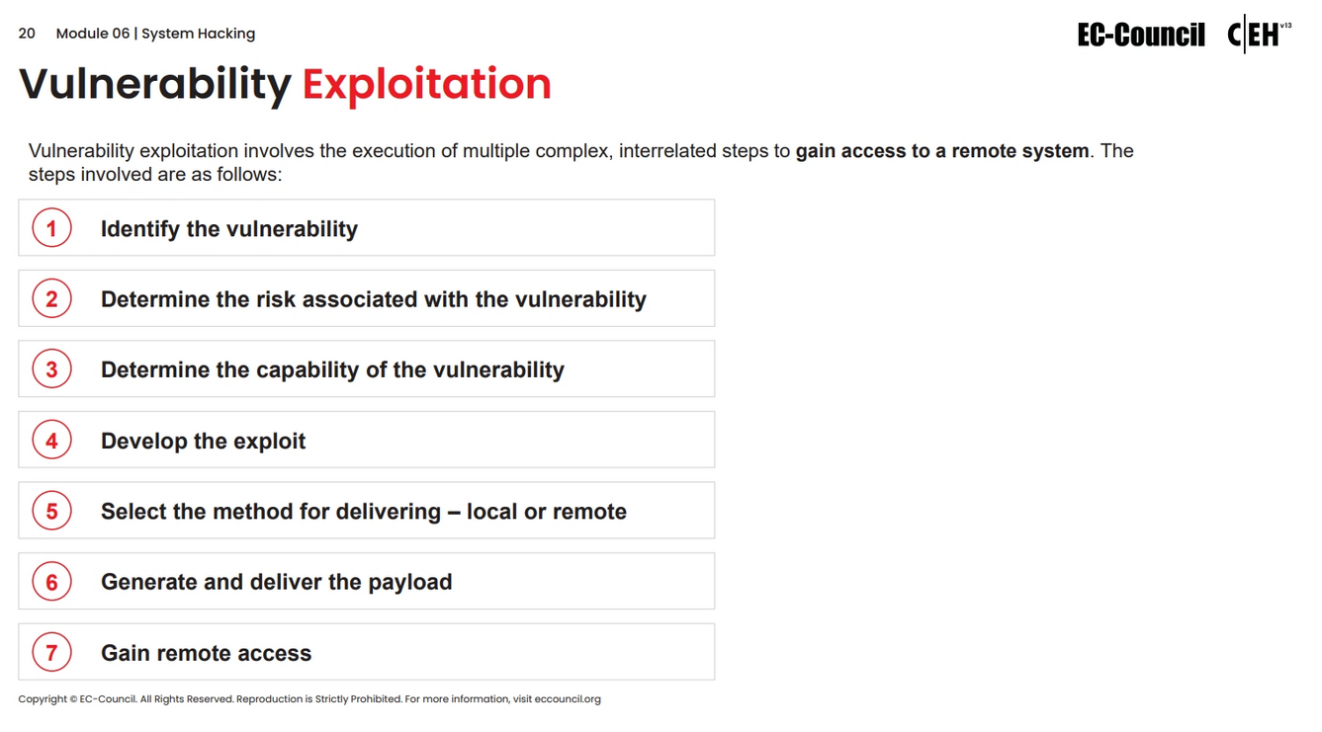

Slide 5
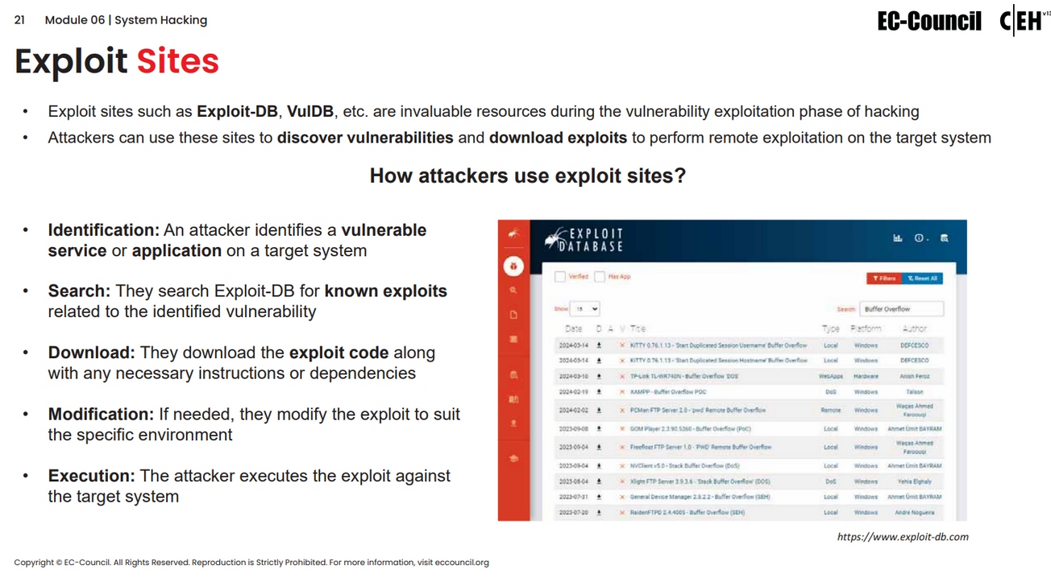

Slide 6
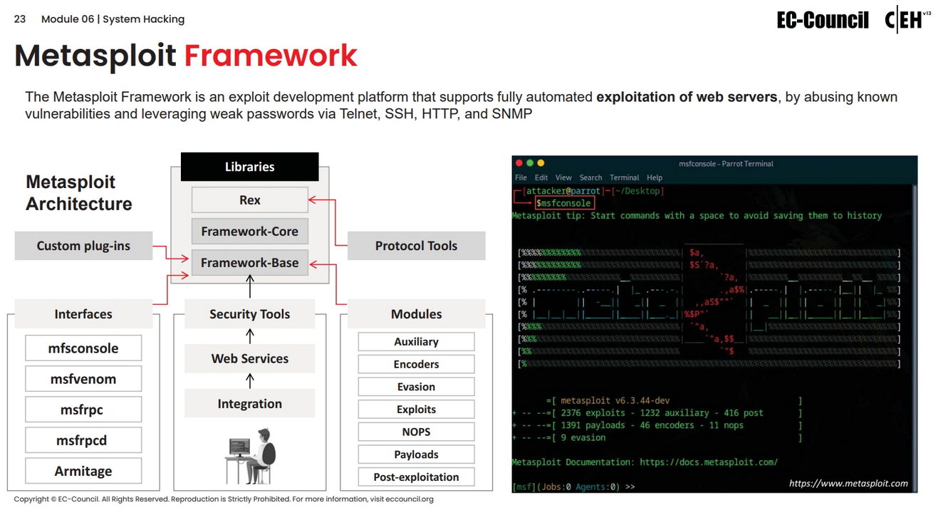

Slide 7
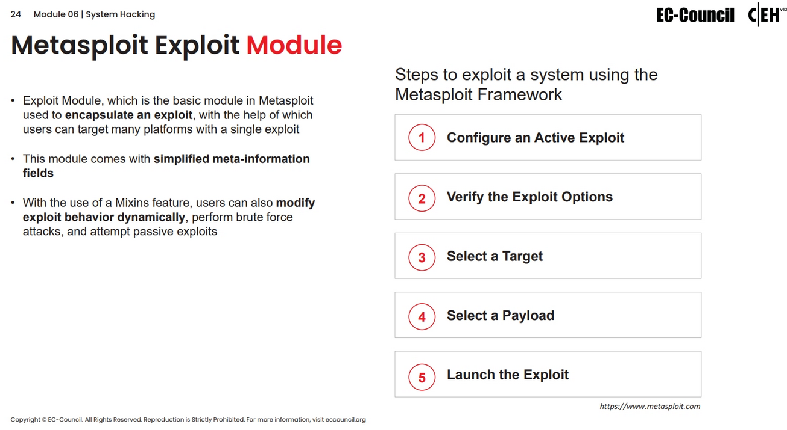

Slide 8
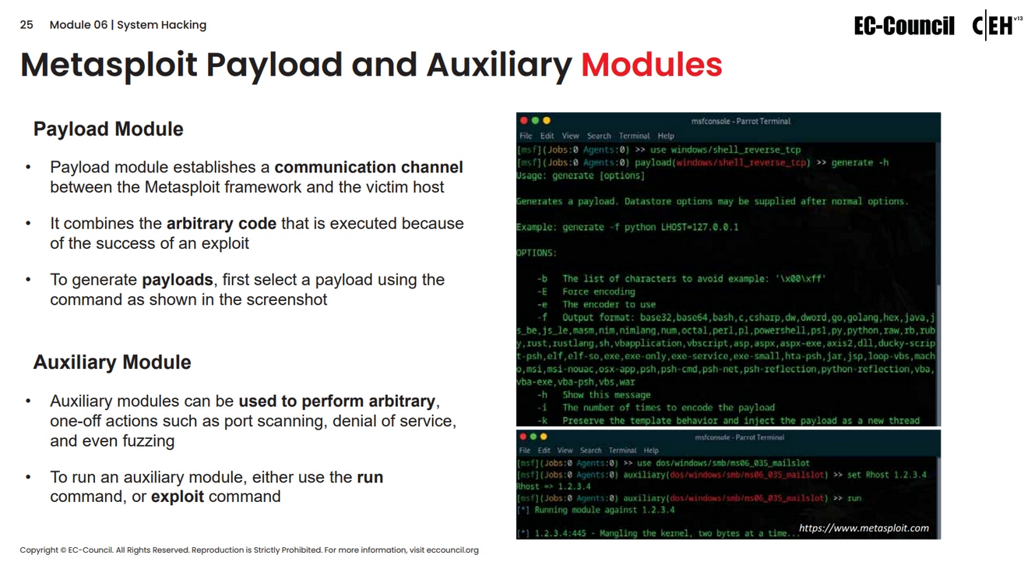

Slide 9
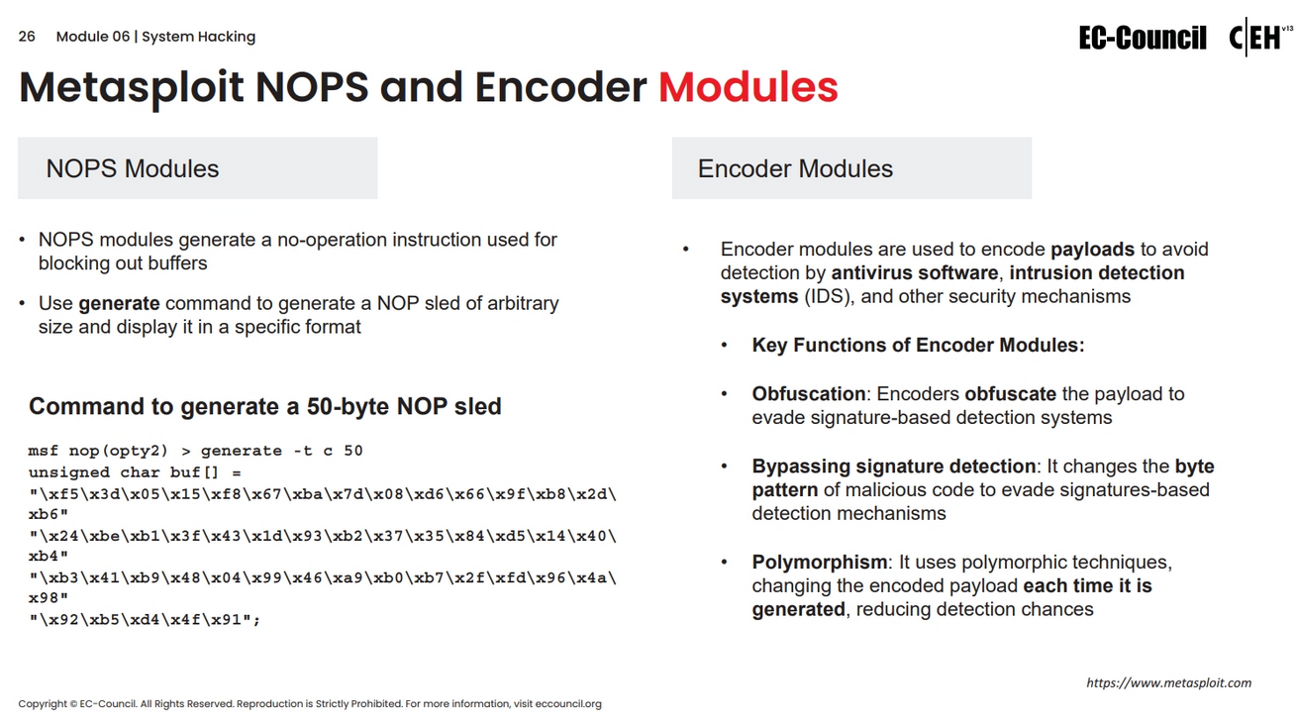

Slide 10
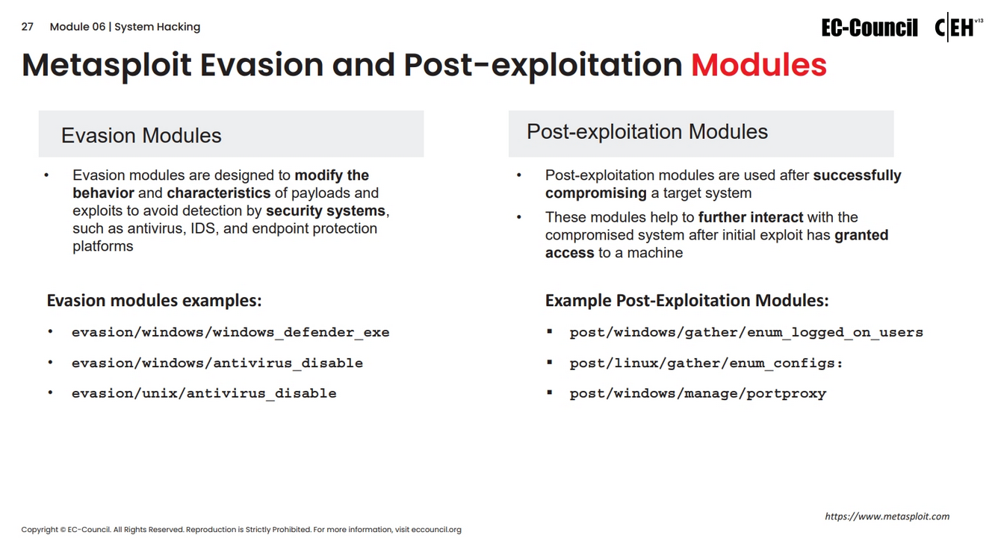

Slide 11
Password Cracking

Slide 12
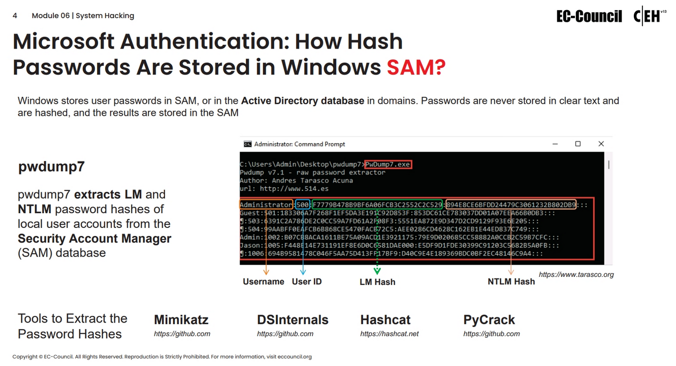

Slide 13
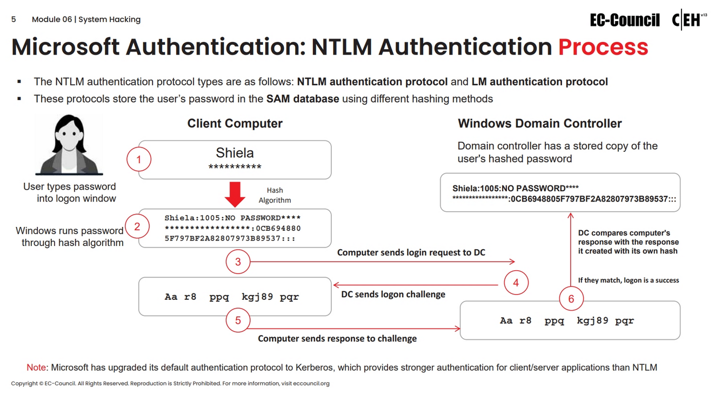

Slide 14
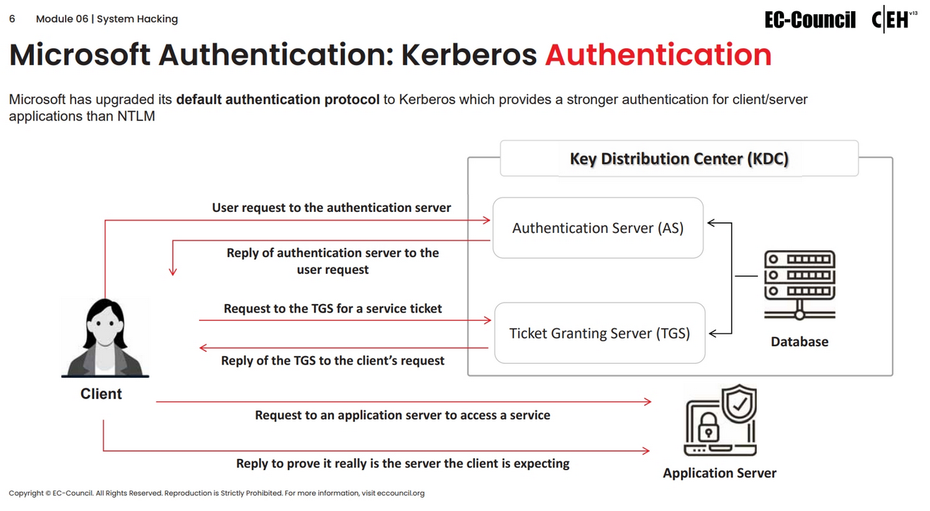

Slide 15
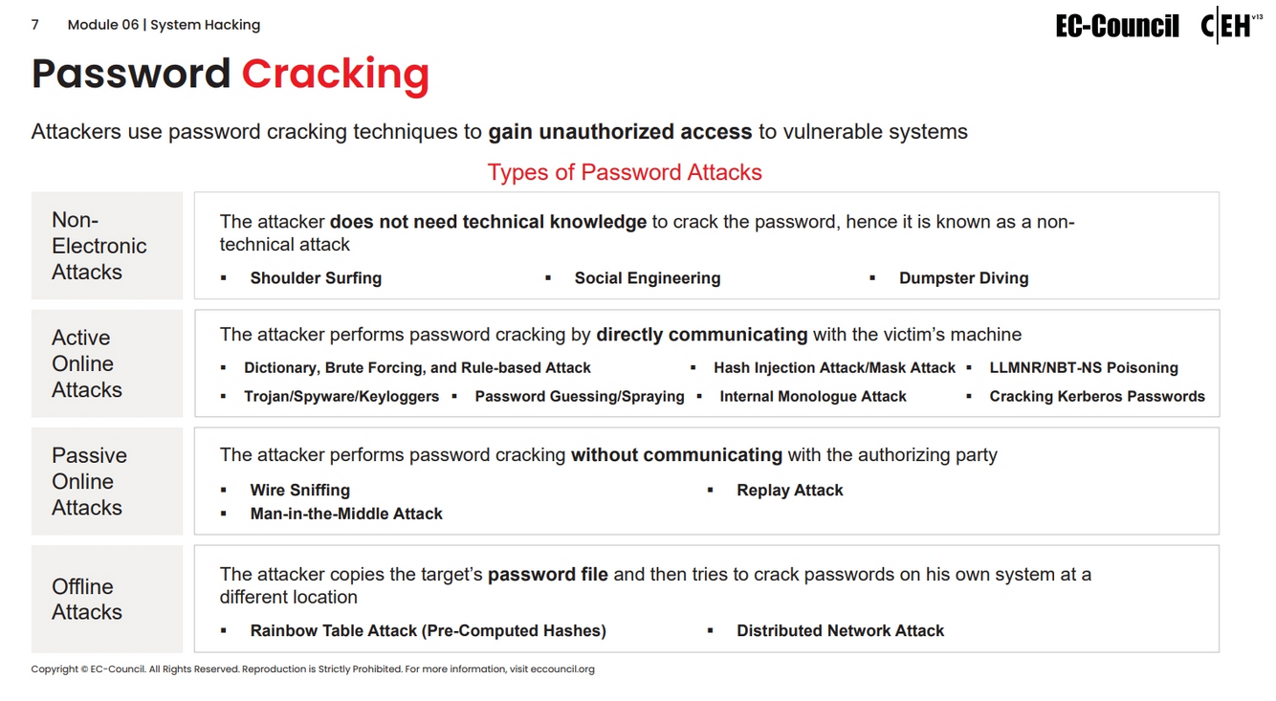

Slide 16
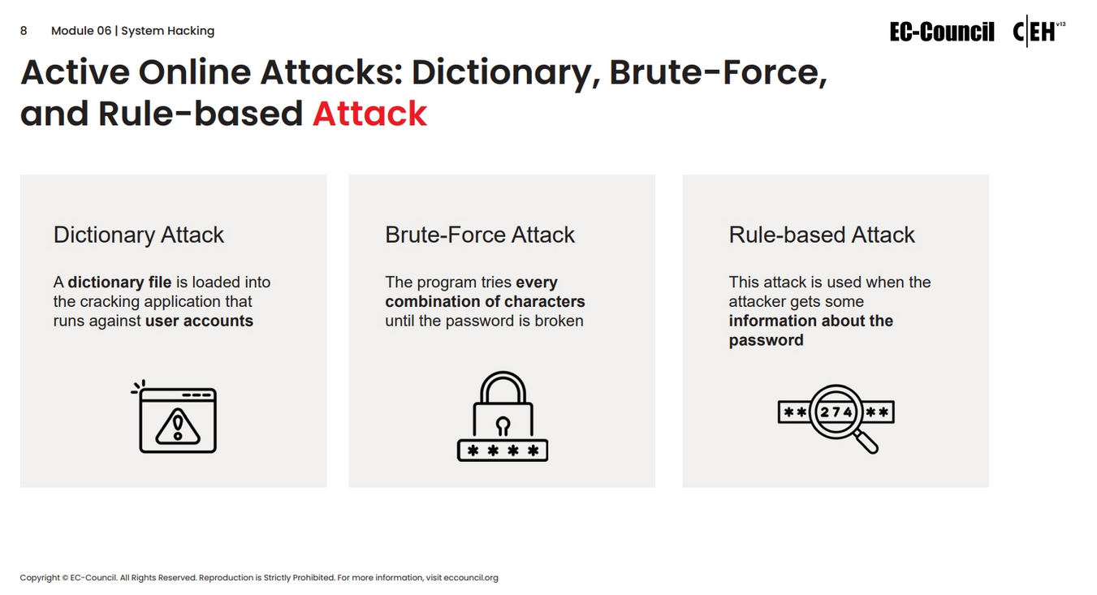

Slide 17
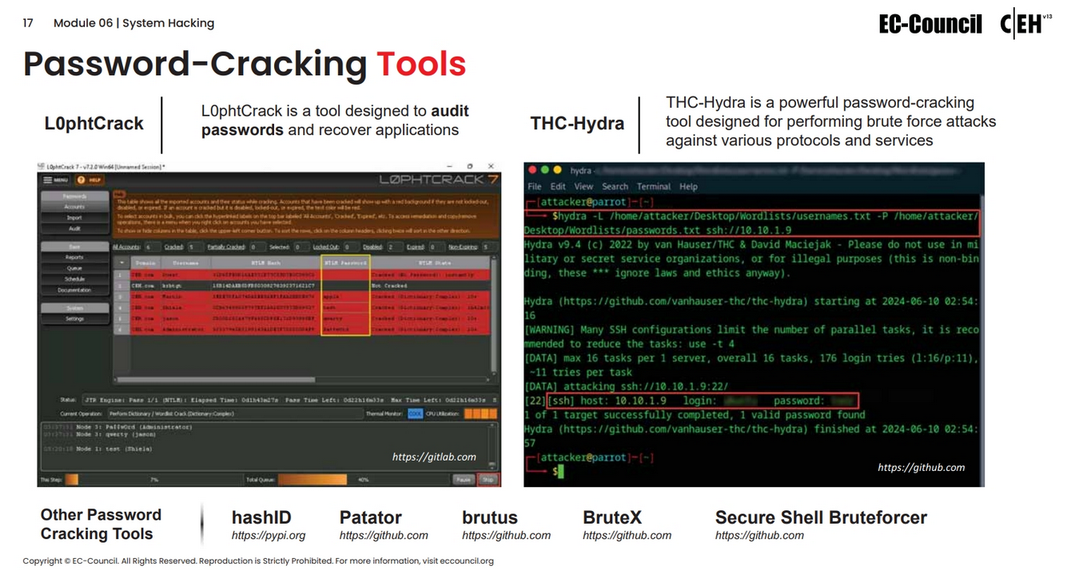

Slide 18
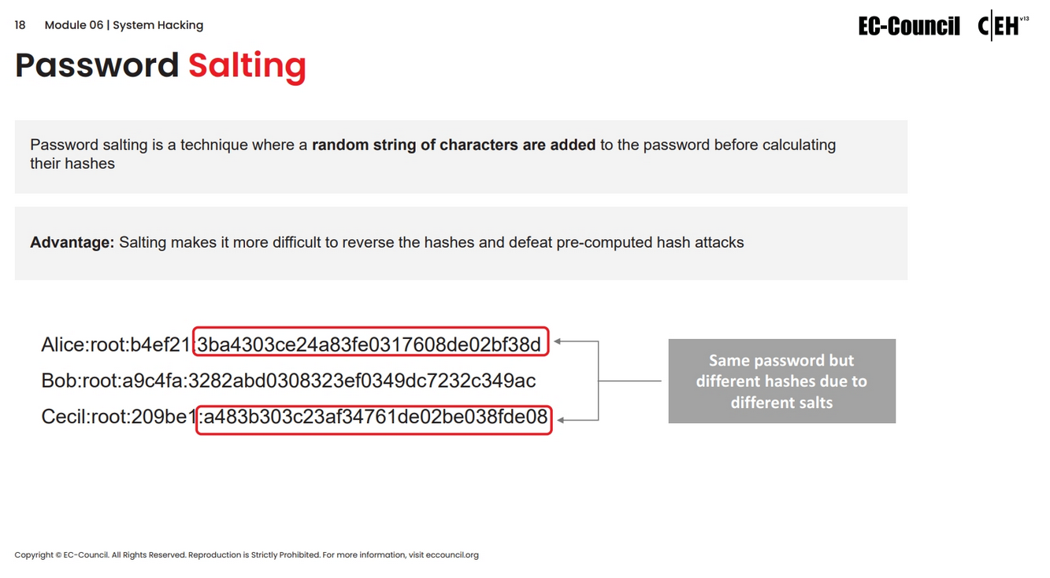

Slide 19
Privilege Escalation

Slide 20
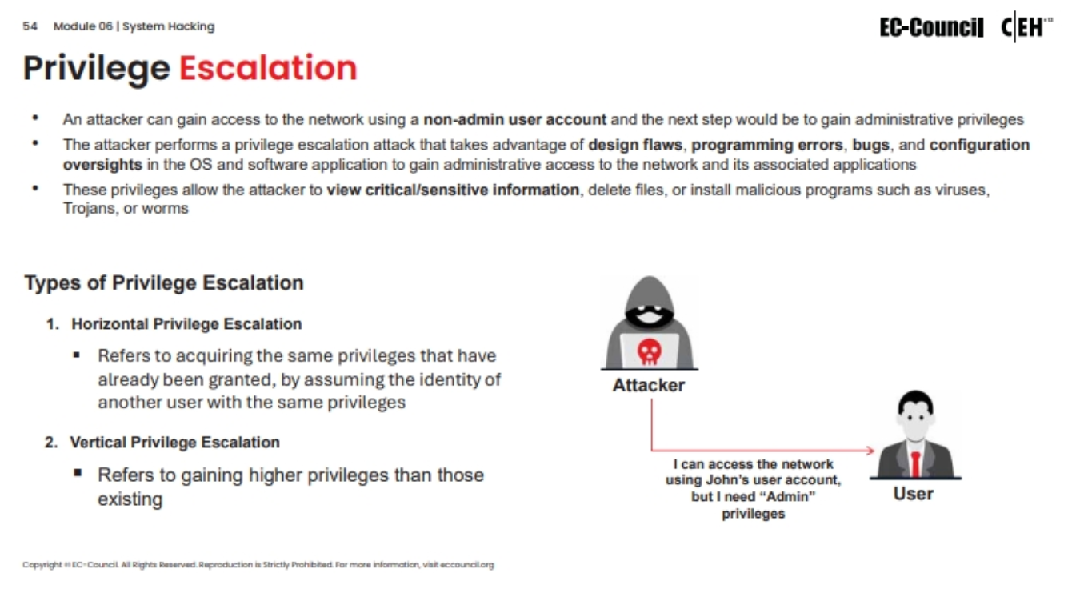

Slide 21
Linux Privilege Escalation
Based on previous labs and lessons,
Exploitation of target = Root / Admin Privileges
In reality, this is NEVER the case.

Slide 22
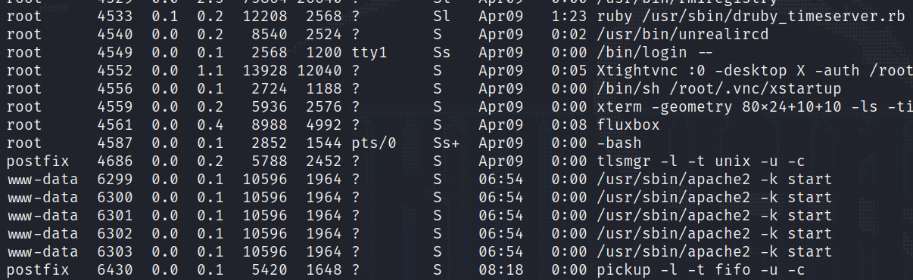
Linux Privilege Escalation
Inheritance of Privileges
Each application/service is owned by a specific user when it is running.
Type the following command in Linux to see the list of processes and process owners (Linux user accounts):
ps aux

Slide 23
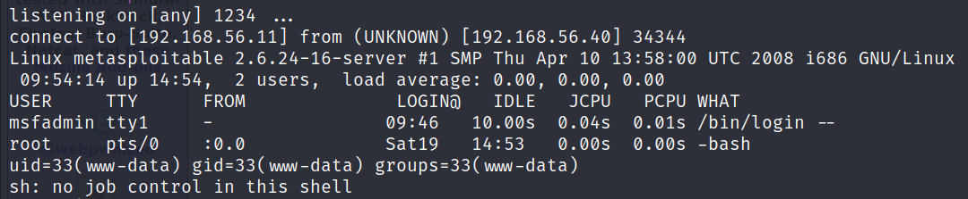
Linux Privilege Escalation
When a service is exploited, the shell privileges will be based on the ownership of the service:
TCP Reverse Shell (via webapp exploit):

Slide 24

Linux Privilege Escalation
Based on g0tm1lk’s Basic Linux Privilege Escalation Cheat Sheet, privilege escalation is all about:
Collect - Enumeration
Process – Sort through data, analyse and prioritization.
Search – Know what to search and find exploit code
Adapt – Customise the exploit accordingly to the target environment
Try – Get ready for lots of trial and error.
Link here: https://blog.g0tmi1k.com/2011/08/basic-linux-privilege-escalation/
Notes:
https://blog.g0tmi1k.com/2011/08/basic-linux-privilege-escalation/

Slide 25
Linux Privilege Escalation
Will not be covering all privilege escalation techniques in the slides (expected to explore more in this course, especially for case study).
Some examples of privilege escalation covered:
SUID Binary configuration
Misuse of sudo privileges
Scheduled Cron Jobs

Slide 26
Linux Privilege Escalation
Information Gathering Process
Two ways of doing this:
Take down notes using a text editor or something.
Utilisation of a Linux Local Privilege Escalation (LPE) scripts
One such example of a Linux LPE script: Linux Privilege Escalation Awesome Script (LinPEAS)

Slide 27
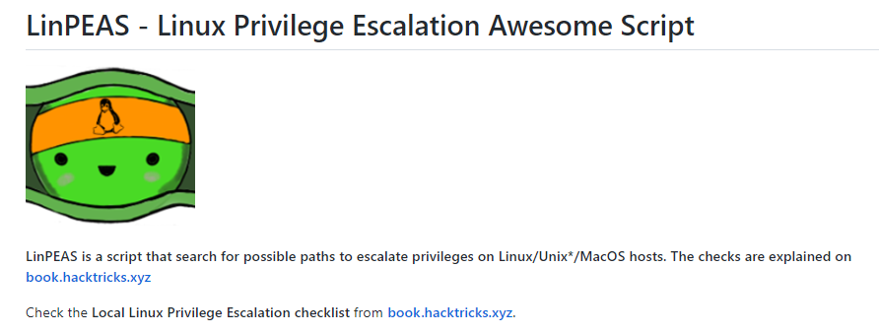
Linux Privilege Escalation

Slide 28
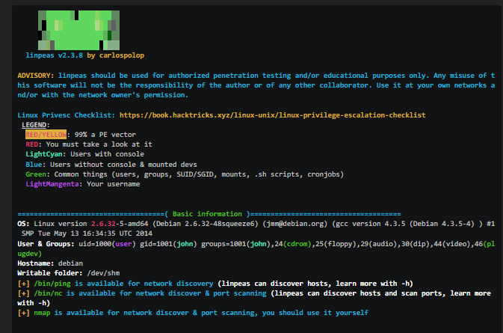
Linux Privilege Escalation
Script also gives some suggestions of possible privilege escalation techniques that you can do.
Whatever you do, take your time in reading the output.

Slide 29
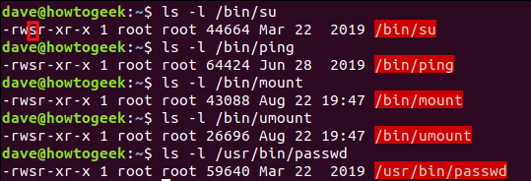
Linux Privilege Escalation (SUID Bit Configuration)
What is SUID bit?
Special permission bit that allows a user to run a binary in the context of the file owner.
Example: if user dave uses the ‘ping’ binary, he is executing the binary as if he was ‘root’.

Slide 30
Linux Privilege Escalation (SUID Bit Configuration)
Why is it useful?
Certain binaries, if owned by the root user and set with the SUID bit, can result in escalation of privileges.
You can refer to this resource for more information: https://gtfobins.github.io/

Slide 31
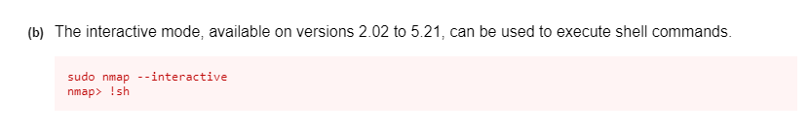
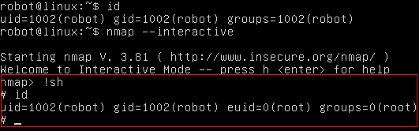
Linux Privilege Escalation (SUID Bit Configuration)

Slide 32
Linux Privilege Escalation (Sudo Privilege Misconfiguration)
sudo – ability for a low-privileged user to run high-level binaries/commands.
If running sudo for first time, user needs to key in the current user’s password.
Subequent sudo commands no longer need the password (same session)
Only applicable to Debian/Ubuntu distributions (not sure for RedHat/CentOS)

Slide 33
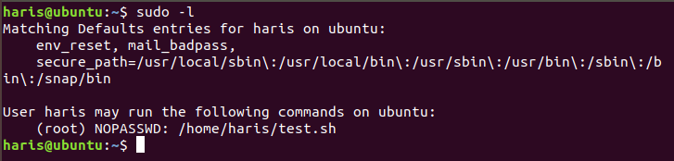
Linux Privilege Escalation (Sudo Privilege Misconfiguration)
However sudo privileges can be misconfigured (take example from screenshot below):
This means that the user ‘haris’ can run the /home/haris/test.sh script WITHOUT the use of a password ☺

Slide 34
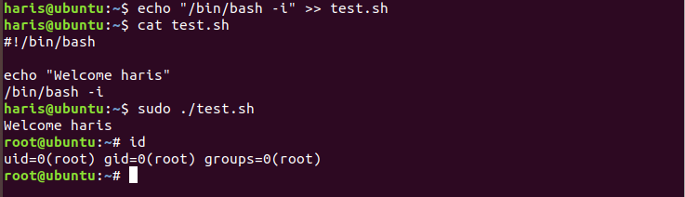
Linux Privilege Escalation (Sudo Privilege Misconfiguration)
How to exploit?
You can refer to this resource for more information: https://gtfobins.github.io/

Slide 35
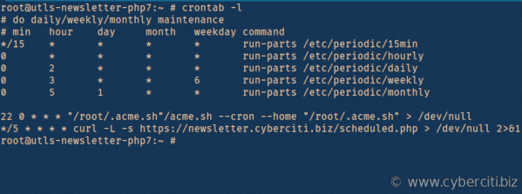
Linux Privilege Escalation (Scheduled Cron Jobs)
Cron Jobs - Scheduled Tasks (should be part of your SADS content)
Used for automating certain tasks to be done within a specific time period (e.g every Monday at 8am).
Main locations to look at:
/etc/cron.d/ (system-wide)
/etc/crontab (user-wide)

Slide 36
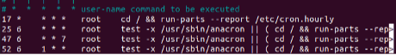
Linux Privilege Escalation (Scheduled Cron Jobs)
The beauty of Cron Jobs is that you can specify which user executes the cron job:
Of course, this can only be done if the cron job file is created by a user that is of at least the same privileges as the user running the script, or higher.
For example, given that there are two users, ‘root’ and ‘student’:
Root user creates a cron job and specifies the ‘student’ user to do it (OK CAN)
Student user creates a cron job and specifies the ‘root’ user to do it (NOPE)

Slide 37
Linux Privilege Escalation
Of course, all other privilege escalation derivatives might require more research, but ask yourself these questions when performing the privilege escalation:
When you gain access into the system, what current privileges do you have?
Can you do any file read/write operations through an application powered by ‘root’?
Are there any commands/applications that I can run commands as root WITHOUT keying in the password?

