Slide 1
Hacking Web Servers

Slide 2
Objectives
Web Server Concepts
Web Server Attack Methodology
Web Server Attacks

Slide 3
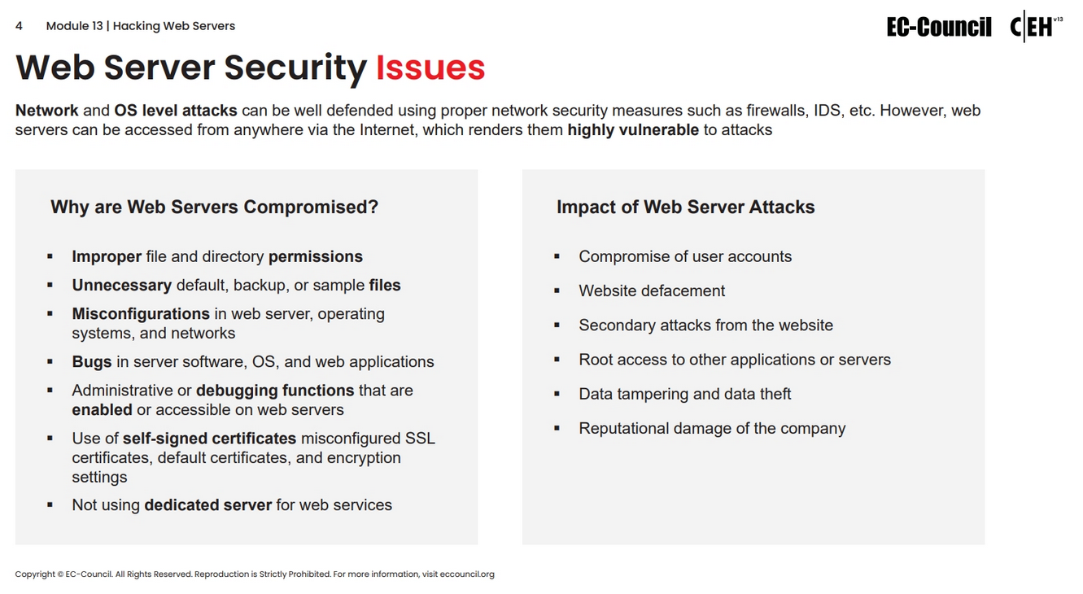

Slide 4
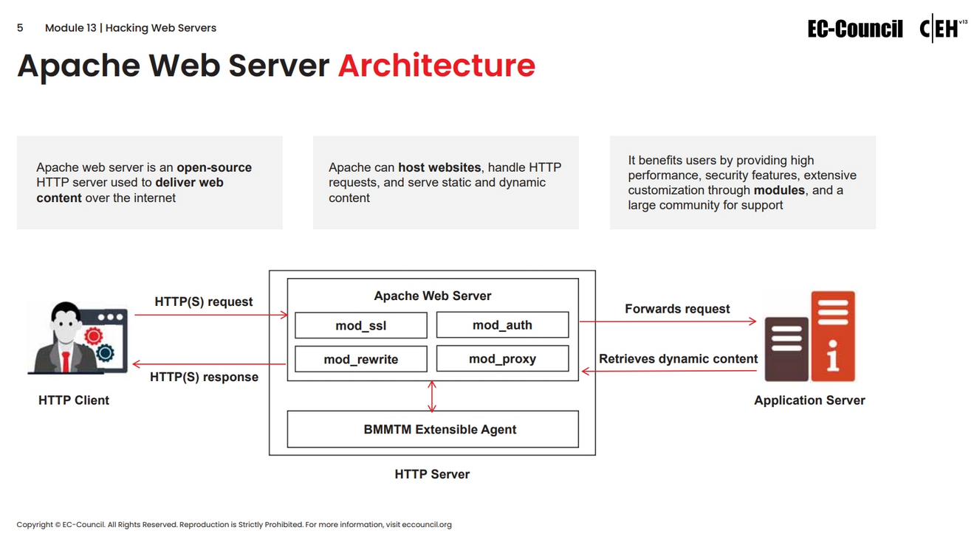

Slide 5
Web Server Attack Methodology

Slide 6
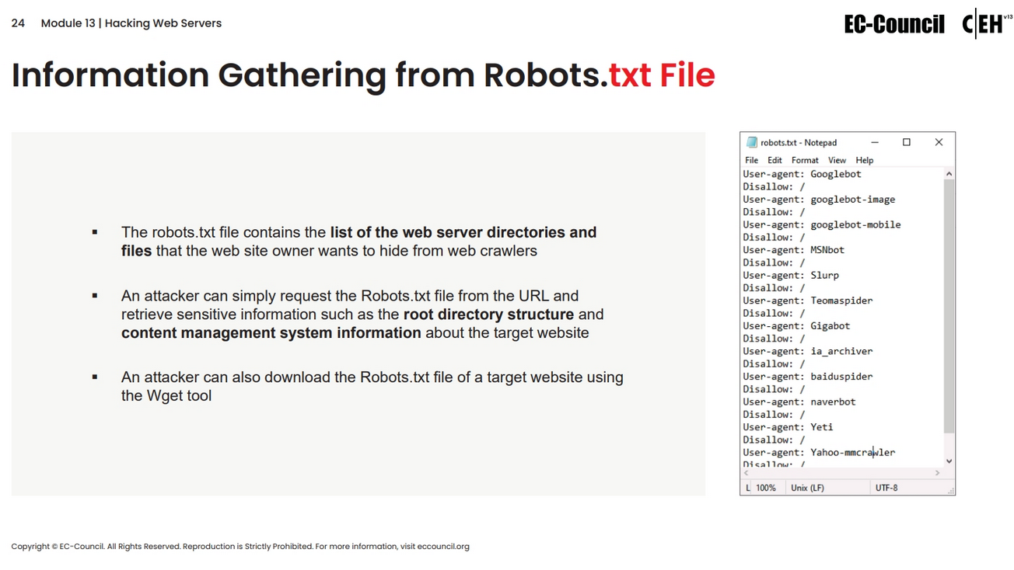

Slide 7
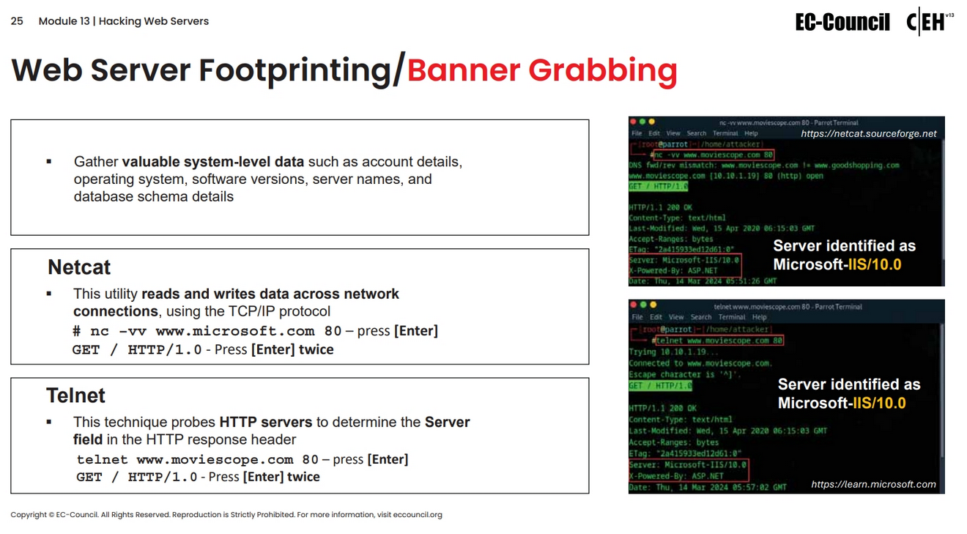

Slide 8
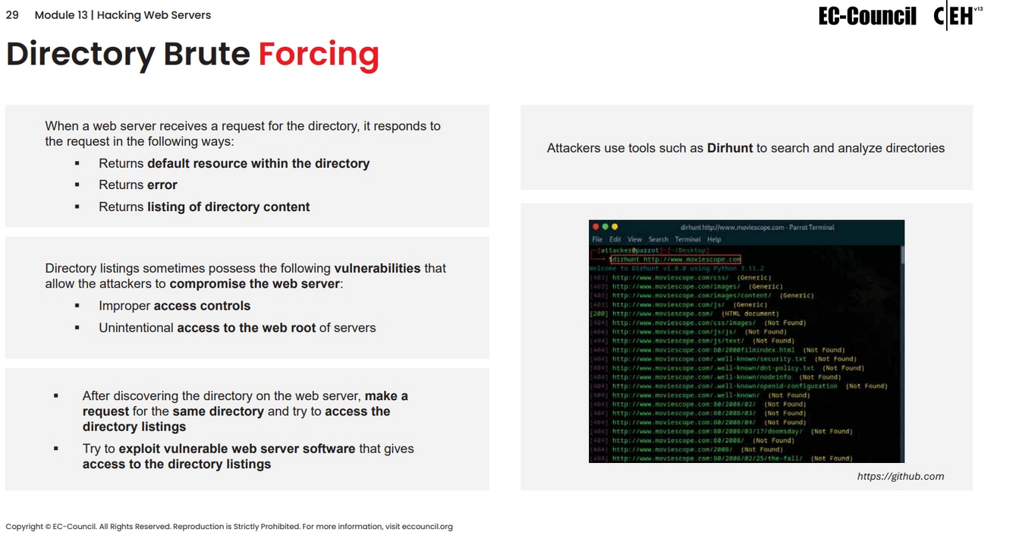

Slide 9
Web Server Attacks

Slide 10
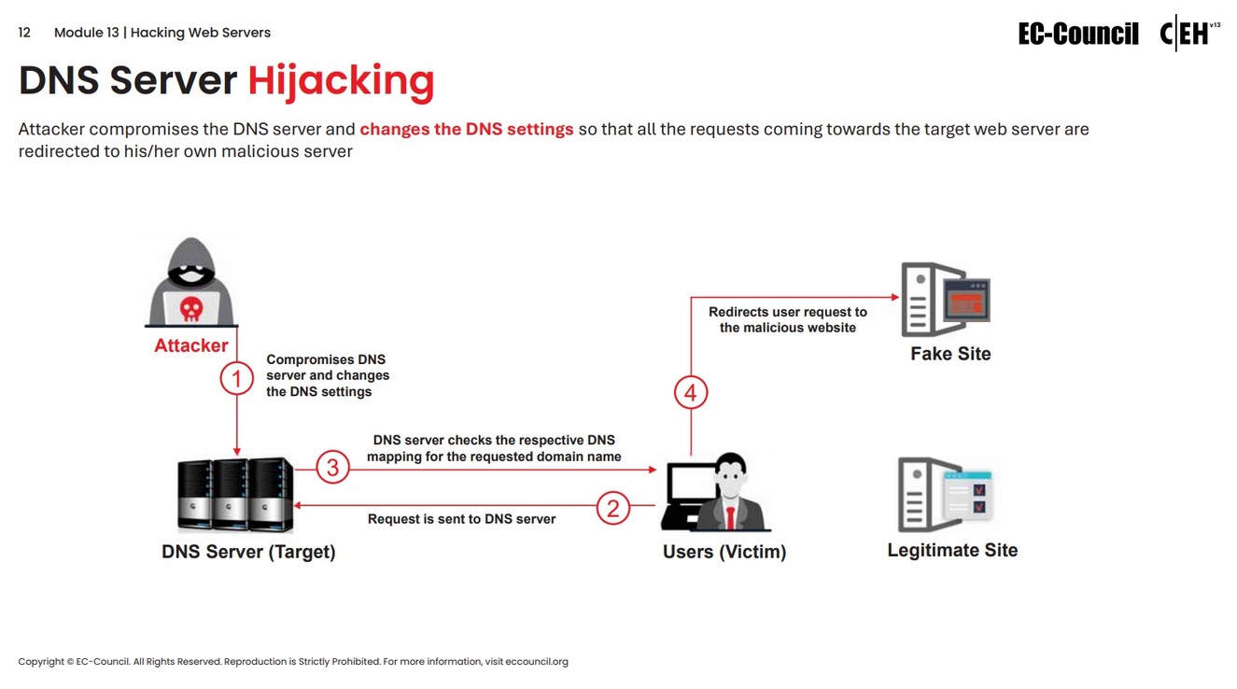

Slide 11
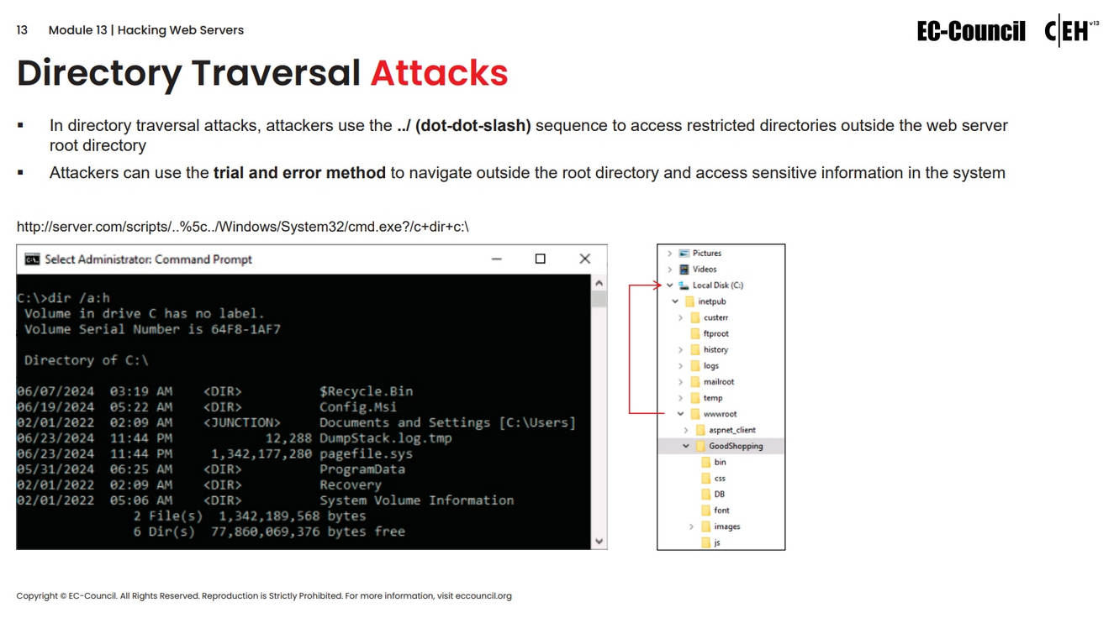

Slide 12
