Slide 1
Hacking Web Applications

Slide 2
Objectives
Web Application Concepts
Web Application Hacking Methodology
Web Application Threats

Slide 3
Web Application Concepts

Slide 4
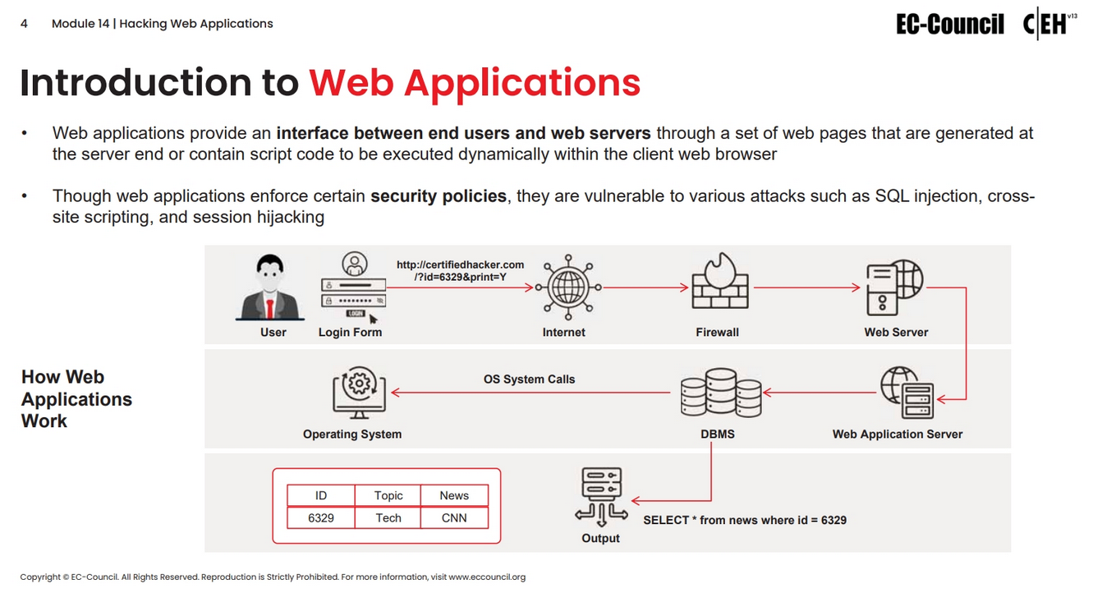

Slide 5
Web Application Hacking Methodology

Slide 6
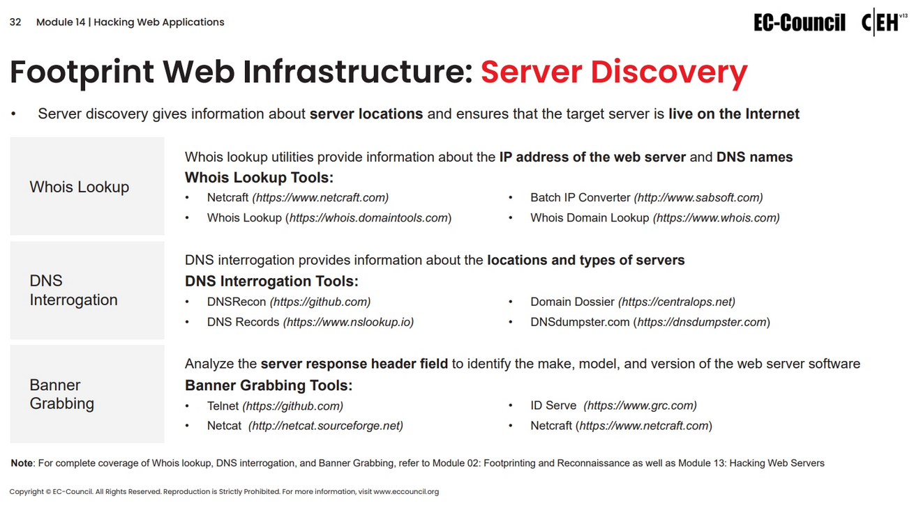

Slide 7
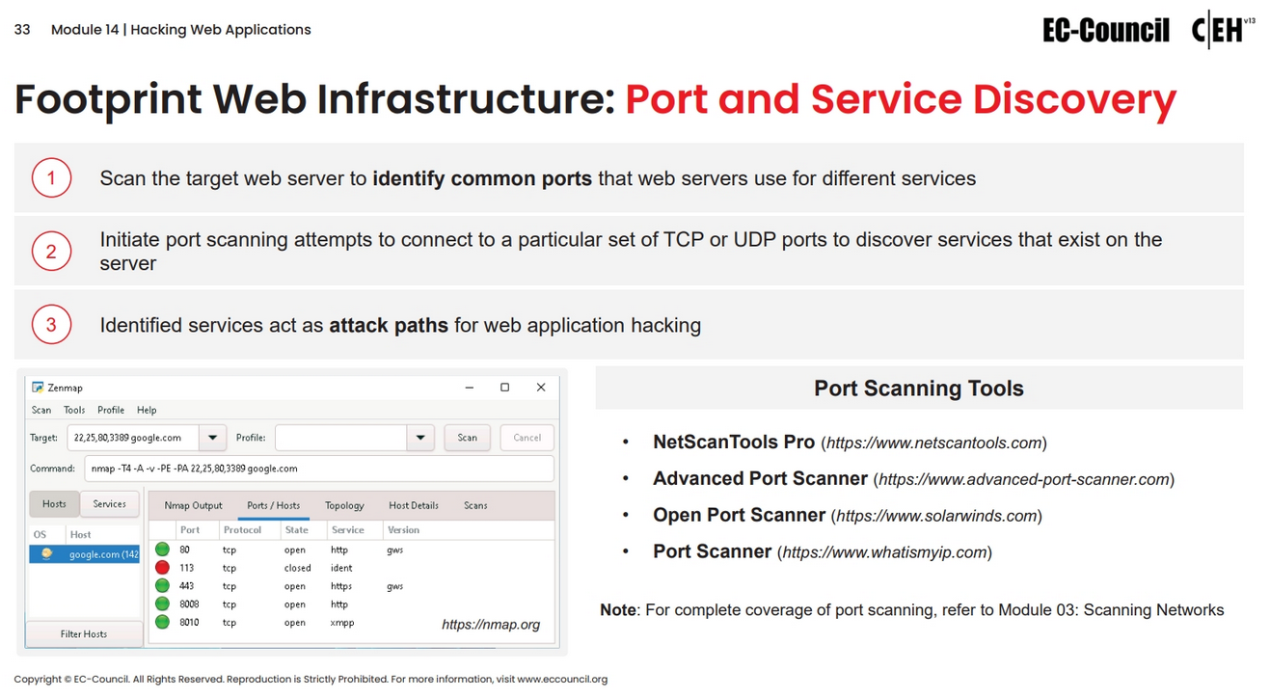

Slide 8
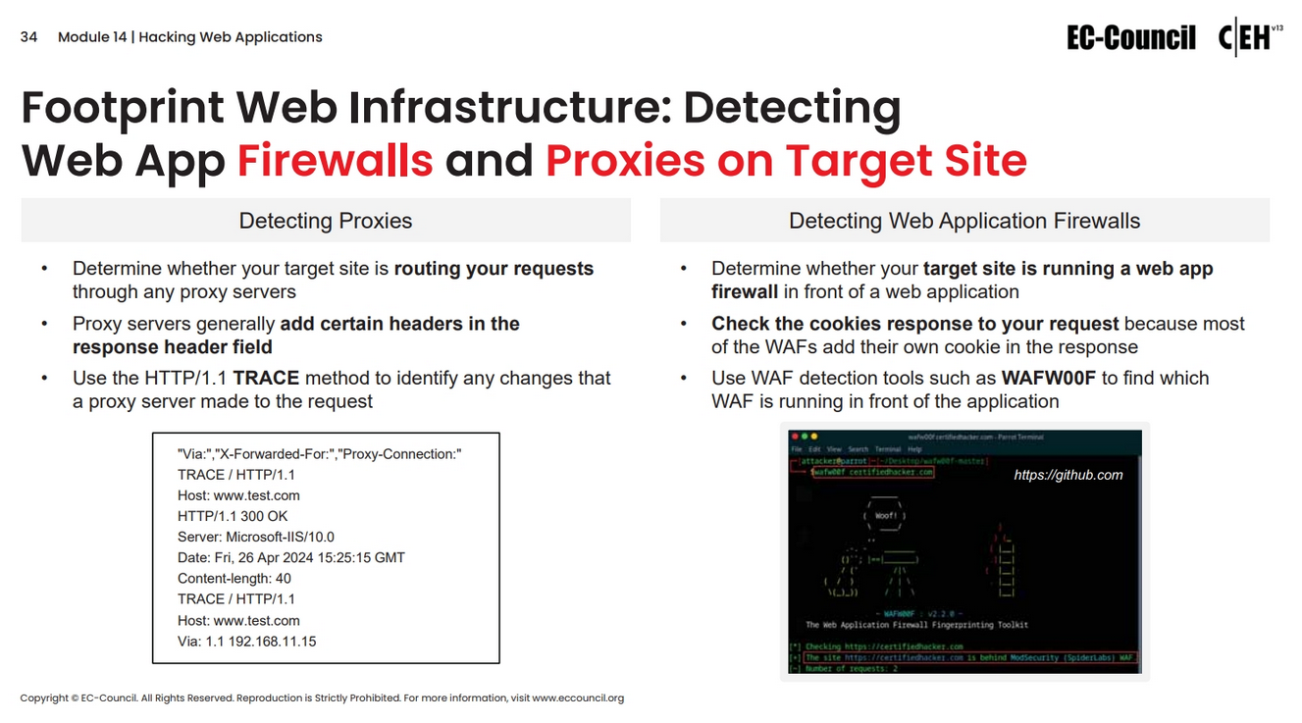

Slide 9
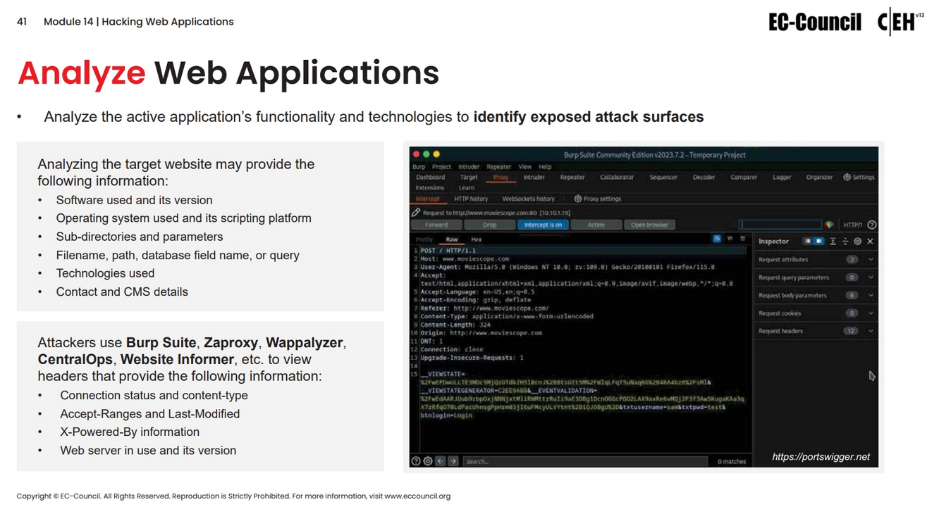

Slide 10
Web Application Threats

Slide 11
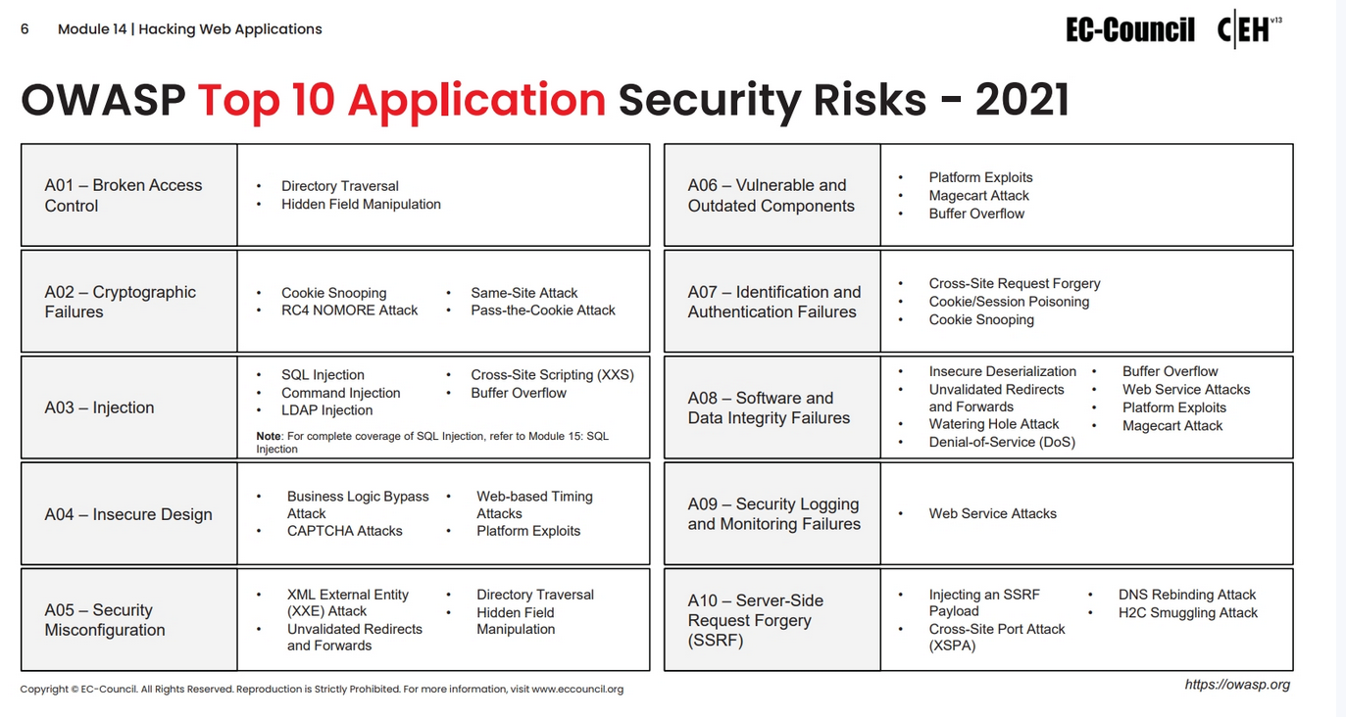

Slide 12
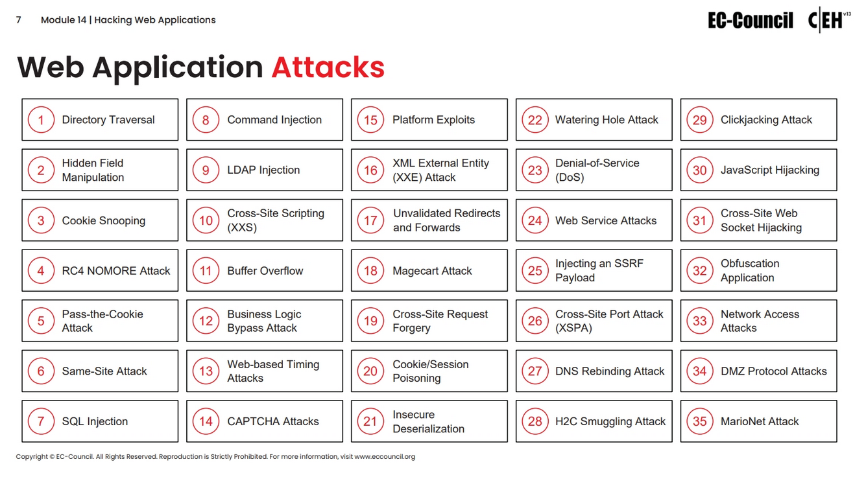

Slide 13
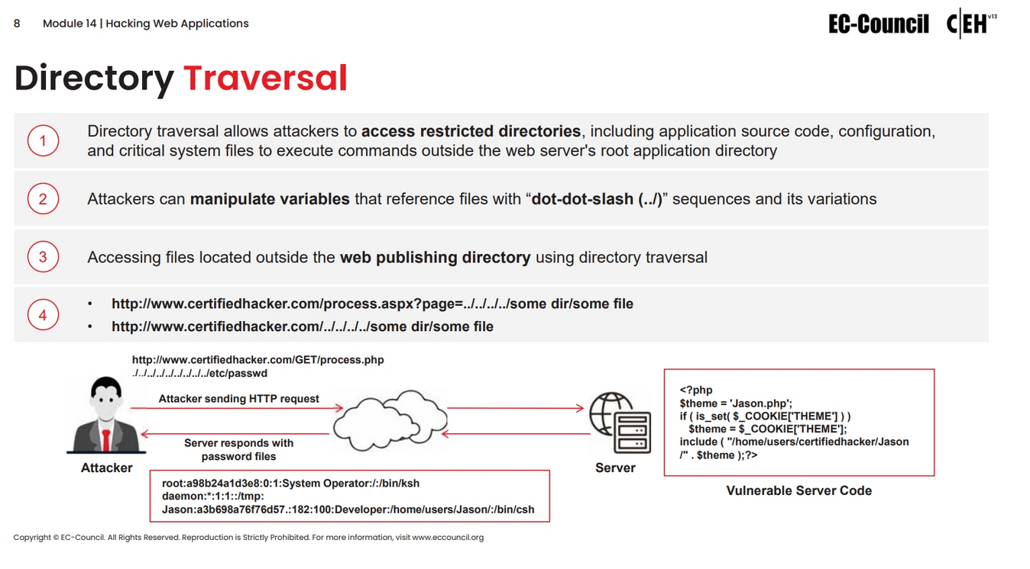

Slide 14
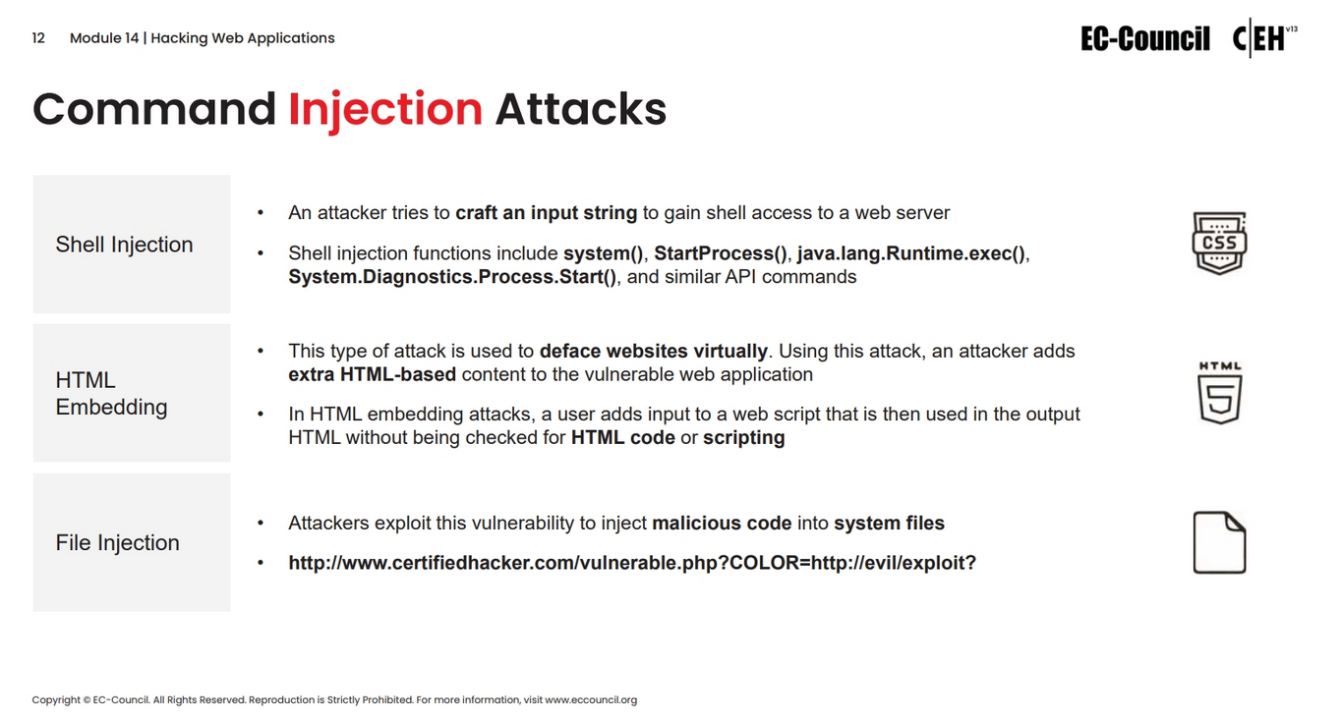

Slide 15
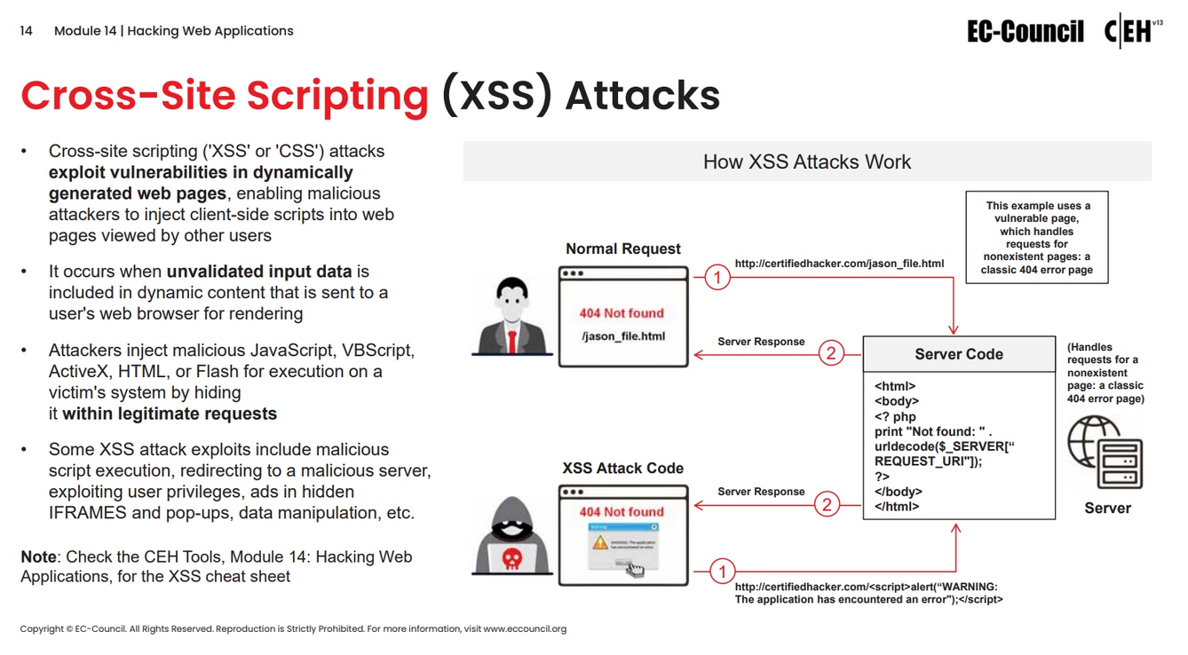

Slide 16
