Slide 1
SQL Injection

Slide 2
OWASP Top 10 2017 A1: Injection
Injection – ability to provide user input to result in unintended outcomes
Samples of Injection related vulnerabilities:
SQL Injection (covered)
LDAP Injection
OS Command Injection
SMTP Header Injection
etc.

Slide 3
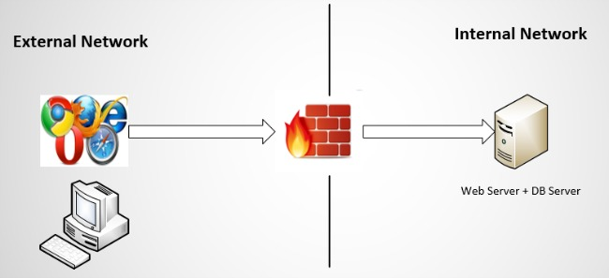
OWASP Top 10 2017 A1: Injection – SQL Injection
Notes:
https://www.synopsys.com/blogs/software-security/attributes-of-secure-web-application-architecture/

Slide 4
OWASP Top 10 2017 A1: Injection – SQL Injection
To perform SQL Injection, one must understand SQL
SQL – Structured Query Language
Language of the databases
MySQL
MSSQL
MariaDB
PostgreSQL
etc.

Slide 5
OWASP Top 10 2017 A1: Injection – SQL Injection
Think of databases like huge Excel tables
SQL Basic Syntax (SELECT statement)
SELECT <column name 1>,<column name 2>,..
FROM <database table name>
WHERE <column name> = <specific value>

Slide 6
OWASP Top 10 2017 A1: Injection – SQL Injection
‘users’ Table
username | profile_name | profile_pic
hamzah | Sayed Hamzah | http://img.google.com/img.jpg
edmund | Edmund Wee | http://img.google.com/img2.jpg
john_doe | John Doe | http://img.google.com/img3.jpg

Slide 7
OWASP Top 10 2017 A1: Injection – SQL Injection
Example
SELECT *
FROM users
WHERE username = ‘john_doe’
Result
username | profile_name | profile_pic
john_doe | John Doe | http://img.google.com/img3.jpg

Slide 8
OWASP Top 10 2017 A1: Injection – SQL Injection
Quick check: What is the database output for the following SQL queries?
Example 1
SELECT profile_id
FROM users
WHERE username = ‘john_doe’
Example 2
SELECT is_valid_user
FROM users

Slide 9
OWASP Top 10 2017 A1: Injection – SQL Injection
2
Server-Side Code in profile.php
<?php
id = $_GET[‘id’];
String stmt = “SELECT * FROM users WHERE username =‘”.$id.”’”;
?>
4
Result
username | profile_name | profile_pic
edmund | Edmund Wee | http://img.google.com/img2.jpg
3
1
SQL Syntax for user input
SELECT * FROM users
WHERE username = ‘edmund’
https://www.xyz.com/profile.php?id=edmund
Client
Server

Slide 10
OWASP Top 10 2017 A1: Injection – SQL Injection
2
What if I replace the value ‘edmund’ with a single quote?
Server-Side Code in profile.php
<?php
$id = $_GET[‘id’];
$stmt = “SELECT * FROM users WHERE username =‘”.$id.”’”;
?>
4
Result
Error in SQL query! Database cannot process it!
3
1
SQL Syntax with user input
SELECT * FROM users
WHERE username = ‘’’
https://www.xyz.com/profile.php?id=’
Client
Server

Slide 11
OWASP Top 10 2017 A1: Injection – SQL Injection
2
What if I replace with the following value:
‘ OR 1=1#
Server-Side Code in profile.php
<?php
$id = $_GET[‘id’];
$stmt = “SELECT * FROM users WHERE username =‘”.$id.”’”;
?>
4
Result
username | profile_name | profile_pic
hamzah | Sayed Hamzah | http://img.google.com/img.jpg
edmund | Edmund Wee | http://img.google.com/img2.jpg
john_doe | John Doe | http://img.google.com/img3.jpg
3
1
SQL Syntax with user input
SELECT * FROM users
WHERE username = ‘’ OR ‘1=1’
https://www.xyz.com/profile.php?id=’ OR ‘1=1
Client
Server

Slide 12
OWASP Top 10 2017 A1: Injection – SQL Injection
Impacts
Unauthorised read/write operations on data stored in database
Remote Command Execution
Run OS commands on DB
Recommendation
Input Validation (will describe more in XSS)
Parameterised Queries

Slide 13
OWASP Top 10 2017 A1: Injection – SQL Injection
2
Inject following value with current server-side code (no prepared statement):
‘ OR ‘1=1
Server-Side Code in profile.php
<?php
$id = $_GET[‘id’];
$stmt = “SELECT * FROM users WHERE username =‘”.$id.”’”;
?>
4
Result
username | profile_name | profile_pic
hamzah | Sayed Hamzah | http://img.google.com/img.jpg
edmund | Edmund Wee | http://img.google.com/img2.jpg
john_doe | John Doe | http://img.google.com/img3.jpg
3
1
SQL Syntax with user input
SELECT * FROM users
WHERE username = ‘’ OR ‘1=1’
https://www.xyz.com/profile.php?id=’ OR ‘1=1
Input regarded as part of SQL syntax
Client
Server

Slide 14
OWASP Top 10 2017 A1: Injection – SQL Injection
2
Inject following value with modified server-side code (with prepared statement):
‘ OR 1=1#
Server-Side Code in profile.php
<?php
$id = $_GET[‘id’];
$stmt = $conn->prepare(“SELECT * FROM users WHERE username = ‘?’”);
?>
4
Result
3
1
SQL Syntax with user input
SELECT * FROM users
WHERE username = ‘’ OR ‘1=1’
https://www.xyz.com/profile.php?id=’ OR ‘1=1
Regarded as a String value, not part of the SQL command
DB looks for system whereby username is ‘ OR ‘1=1
Client
Server

Slide 15
OWASP Top 10 2017 A1: Injection – SQL Injection
What application functionalities to look out for when finding SQL injection vulnerabilities?
Viewing-based functionalities
Product info (‘item.php?id=2’, id is vulnerable parameter)
Creation/modification-based functionalities
Edit profile information
Authentication logic (checking username and password against database)

