Slide 1
Security Vulnerabilities

Slide 2
Vulnerabilities
What is a vulnerability?
Bug/Weakness in application/system/asset
Potentially impacts Confidentiality, Integrity or Availability
How is it represented and categorized?
Demonstration of impact
Risk level
Standards: CVSSv3, RSS-MD, IVSS
Notes:
What are vulnerabilities?
A flaw / weakness → potentially be exploited by a threat agent → realizing the threat of CIA.
How to identify, rate and report them?
Test tools, observations, research…
When to report vulnerabilities?
As soon as possible.
First.org/CVSS2:
“Vulnerability: a bug, flaw, weakness, or exposure of an application, system, device, or service that could lead to a failure of confidentiality, integrity, or availability.”

Slide 3
Vulnerability Risk Rating
Common Vulnerability Scoring System v3 (CVSSv3)
Rating | CVSS Score
None | 0.0
Low | 0.1 - 3.9
Medium | 4.0 - 6.9
High | 7.0 - 8.9
Critical | 9.0 - 10.0
Notes:
https://www.first.org/cvss/specification-document

Slide 4
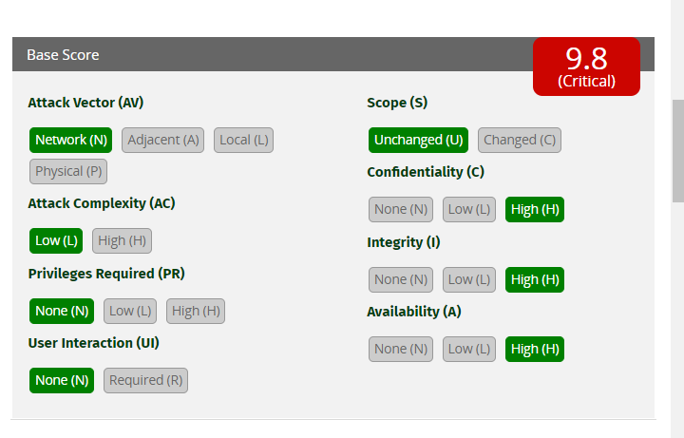
Vulnerability Risk Rating
Risk Rating System
Common Vulnerability Scoring System v3.1 (CVSSv3.1)
https://www.first.org/cvss/calculator/3.1
Notes:
https://www.first.org/cvss/specification-document

Slide 5
Vulnerability Risk Rating (CVSSv3)
Attack Vector
How does an attacker exploit the vulnerability to demonstrate the impact?
4 Metrics (and examples of vulnerabilities)
Notes:
https://www.first.org/cvss/specification-document

Slide 6
Vulnerability Risk Rating (CVSSv3)
Attack Vector
Metric Value | Description
Network (N) | Attacker only requires the IP address of the target to connect to the service. Attack is classified as a ‘remote’ attack, as long as the attacker can connect to the vulnerable service/application via its IP address.
Adjacent (A) | In addition to IP address, as part of performing the attack, the attacker MUST be in the same network medium as the target hosting the vulnerable service. Same network medium – Bluetooth, WiFi, LAN cable, etc)
Local (L) | Attacker needs to have some form of initial access within the target to perform the attack. (e.g SSH access, reverse shell)
Physical (P) | Attacker needs to be physically present in front of the target to perform the attack (e.g USB malware dropping)
Notes:
Same network medium – Bluetooth connection, wifi connection, etc

Slide 7
Vulnerability Risk Rating (CVSSv3)
Attack Complexity
Are there any prerequisites or conditions that are beyond the controls of an attacker to exploit the vulnerability?
Metric Value | Description
Low (L) | There is no specific condition that requires the attack to be successful for each run. (e.g running VSFTPD 2.3.4 exploit on a server hosting the same vulnerable version).
High (H) | Success of the attack is dependent on specific conditions that exist. (e.g SSH brute force attacks are only successful IF the list used contains a set of credentials (username/password) that exist. If it is not successful, then this finding should not be documented)
Notes:
https://www.first.org/cvss/specification-document

Slide 8
Vulnerability Risk Rating (CVSSv3)
Privilege Required
Does the attacker require (high) privilege to exploit the vulnerability at the start of the attack?
Metric Value | Description
None (N) | No privileges are required when performing the exploit (e.g no user credentials needed to be used)
Low (L) | Privileges are required; however, the nature of user accounts can be of low privilege. (e.g normal user account that can be used just to authenticate to the service)
High (H) | Privileges are required; however, the nature of user accounts can be of high privilege. (e.g web administrator account, root, local administrator)
Notes:
https://www.first.org/cvss/specification-document

Slide 9
Vulnerability Risk Rating (CVSSv3)
User Interaction
Does an attacker require the user to perform an activity before exploitation is possible?
E.g “User needs to click on something, then exploit will work”
Metric Value | Description
None (N) | As part of the attack, there is no need for the target user/victim to interact with the environment to continue.
Required (R) | The target user/victim need to perform an action such as clicking a button or visiting a specific website to continue with the attack. (e.g Client-side exploits such as Cross Site Scripting)
Notes:
https://www.first.org/cvss/specification-document

Slide 10
Vulnerability Risk Rating (CVSSv3)
Scope
Requires understanding of the following:
Resource/object – data/program/process that the subject needs.
Subject/actor – entity that accesses the resource/object
Security authority – mechanism that enforces access control (e.g application, OS)
Normally, you would identify (1) and (2) first, before identifying (3).
Notes:
https://www.first.org/cvss/specification-document

Slide 11
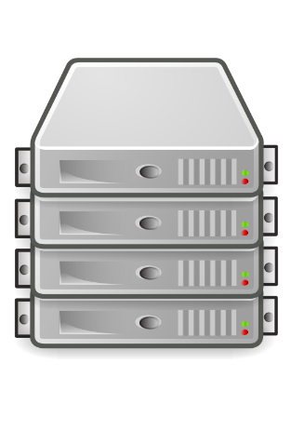


Vulnerability Risk Rating (CVSSv3)
Scope
For example:
SECURITY SCOPE
Request
Request
Response
Response
Subject/Actor
Security Authority
(Web Application)
Resource/Object (Database Query)
Logged-in user of the web application.
Server-side code does the verification if user allowed access to the data.
Data fetched from the database to be shown on the website.
Notes:
https://www.first.org/cvss/specification-document

Slide 12
Vulnerability Risk Rating (CVSSv3)
Scope
Based on the security scope and the vulnerability:
Identify the vulnerable component first (e.g web application, network service)
Construct the security scope based on the vulnerable component.
Ask these 2 questions:
Who/what is the subject? (can be a program, user, etc)
What is the subject trying to access? (Identify resource)
Determine the impact (or outcome) of the vulnerability, some examples include:
Remote command execution on the server
Manipulation of database tables within the SQL database
Controlling the victim’s application (e.g web browser)
Notes:
https://www.first.org/cvss/specification-document

Slide 13
Vulnerability Risk Rating (CVSSv3)
Scope
Based on the security scope and the vulnerability:
Based on the identified impact (and relevant impacted resource), create another security scope but this time from the aspect of the impacted resource.
If the two security scopes do not have the same resource, security mechanism and object, then the scope is ‘Changed’.
Else, it will be ‘Unchanged’
Notes:
https://www.first.org/cvss/specification-document

Slide 14
Vulnerability Risk Rating (CVSSv3)
Example 1 – HTTP Used for Communications
HTTP Service used for a web application
All communications to the web application are unencrypted.
Impact: Attacker can intercept unencrypted traffic to read/modify data of an unsuspecting victim BEFORE it is delivered to the affected web application.

Slide 15
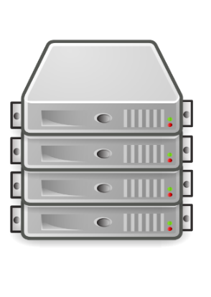

Vulnerability Risk Rating (CVSSv3)
Example 1 – HTTP Used for Communications
Vulnerable component: Web application
Impacted component: Web application
- Based on the ‘Impact’ writeup in previous slide
- No need to generate another security scope.
Scope: Unchanged
Request
Response
Subject/Actor
[User]
Security Authority
(Web Application)
Resource/Object (Website page)

Slide 16
Vulnerability Risk Rating (CVSSv3)
Example 2 – Stored Cross-Site Scripting
Ability to run store malicious JavaScript code on a website.
Impact: Users who visit the affected webpage of the website will render the malicious JavaScript code on their laptop/PC web browsers.
Attackers can control the users’ web browsers based on this vulnerability.

Slide 17
Vulnerability Risk Rating (CVSSv3)
Example 2 – Stored Cross Site Scripting
Vulnerable component is the ‘Web Application’
Request
Request
Response
Response
Subject/Actor
[Web User]
Security Mechanism
[Web Application]
Resource
[Database]
User access the page that is based on data stored in the database.
Web Application responsible for fetching the data from DB and load it to the website.
Malicious JavaScript code stored in DB

Slide 18
Vulnerability Risk Rating (CVSSv3)
Example 2 – Stored Cross Site Scripting
Impacted component is the ‘Web Browser’:
Subject/Actor
[Web Browser]
Security Mechanism
[Operating System]
Resource
[Webpage]
The subject is the web browser as it is the application used to ACCESS the webpage.
OS is the one the allows the user to launch the Web Browser (because it is installed).
The resource accessed by the victim is the webpage with the malicious JavaScript code.
Notice the difference between vulnerable component and impacted component? Therefore Scope is ‘Changed’.

Slide 19
Vulnerability Risk Rating (CVSSv3)
Impact
With respect to affected system/application
Confidentiality
Low: Some loss of confidentiality
High: Entire loss of confidentiality or loss of confidentiality with SERIOUS impact(password/private key etc)
Integrity
Low: Modification of data
High: Modification of all files or able to modify files with serious impact (password files)
Notes:
https://www.first.org/cvss/specification-document

Slide 20
Vulnerability Risk Rating (CVSSv3)
Impact
Availability
Low: Some impact on availability (Reduced performance or intermittent interruption)
High: Complete loss of availability
Always consider the business impact as well when filling up the C-I-A metrics.
Notes:
https://www.first.org/cvss/specification-document

