Slide 1
Project Reporting

Slide 2
Penetration Testing Process
Feedback loop
2
1
Project Kick-off + Start testing
Identify possible attack vector in app/system
Verify if attack vector can demonstrate impact
Calculate CVSS rating of vulnerability
Suggest recommendation to remediate the vulnerability
Report
4
Attempt to fix vulnerabilities based on fixes
Verify fixes
3
Communicate
5
Clean up
Notes:
Consultant touches base with the client to understand the pre-requisites before the testing starts (e.g user credentials, application system ready before start of testing)
When testing starts, it is a matter of performing the penetration testing based on the various penetration testing methodologies, as listed in the examples below:
PCI (Penetration Test Guidance Special Interest Group, PCI Security Standards Council, 2015)
- 4.1 Pre-Engagement: Scoping, Documentation, Rules of Engagement, Third-Party-Hosted / Cloud Environments, Success Criteria, Review of Past Threats and Vulnerabilities, Avoid scan interference on security appliances.
- 4.2 Engagement: Penetration Testing: Application, Network, Segmentation, Sensitive Data handling upon discovery, Post-exploitation
- 4.3 Post-Engagement: Remediation Best Practices, Retesting Identified Vulnerabilities, Cleaning up the Environment
SANS (Web Application Penetration Testing Course | Ethical Hacking Training, no date)
- Recon -> Map -> Discovery -> Exploit -> Reporting
Open Source Security Testing Methodology Manual (“OSSTMM”) : (Open Source Security Testing Methodology Manual (OSSTMM), no date)
- Summary: Recon -> Discover -> Exploit -> Reporting
OWASP Testing Guide (https://www.owasp.org/index.php/Testing_Guide_Frontispiece) – “With V4 we realized a new guide that will be the standard de-facto guide to perform Web Application Penetration Testing. -- Matteo Meucci”
PTES (Main Page (no date) Available at: http://www.pentest-standard.org/index.php/Main_Page (Accessed: 17 October 2015).)
- Pre-engagement Interactions, Intelligence Gathering, Threat Modeling, Vulnerability Analysis, Exploitation, Post Exploitation, Reporting
(3) Generate a report and present it to the client (mostly a mix of management + technical personnel)
(4) Client takes the report and performs the fixes. Once they are ready, they will call down the consultant to verify the fixes and update the report.
(5) Once it is okay, then environment needs to clean up.

Slide 3
Penetration Testing Methodology (continued)
Rule of Engagement (ROE)
Guidelines / Constraints
Assets within scope of testing
Don’t have to keep asking Client for permissions
Permissions (from client, cloud or hosting)
Normally for clients who host their applications on third-party services (e.g security clearance)
Written authorization is required
Notes:
Rules of Engagement ("Pen Test Rules of Engagement Worksheet" (SANS List of Penetration Testing Tips Sheets, Downloads and pdfs, 2015))
- Need a SANS account to login and then download the file.
Another good reference is NIST800-115 (2008) Available at http://csrc.nist.gov/publications/nistpubs/800-115/SP800-115.pdf (Accessed: 17 October 2015).
“Rules of Engagement (ROE): Detailed guidelines and constraints regarding the execution of information security testing. The ROE is established before the start of a security test, and gives the test team authority to conduct defined activities without the need for additional permissions. ”
1. Purpose: Names of parties involved and purpose of test.
2. Scope
3. Assumptions and limitations
4. Risks and mitigations
5. Schedule
6. Test site
7. Test equipment
8. Communication during normal and during crisis.
9. Test plan
10. Data handling
11. Reporting
12. Signed by client authorizing the test
Permissions from external e.g. "AWS Penetration Testing" (Penetration Testing - Amazon Web Services (AWS), 2010)
Ref:
SANS List of Penetration Testing Tips Sheets, Downloads and pdfs(2015) Available at: https://pen-testing.sans.org/resources/downloads#rules (Accessed: 17 October 2015).
Penetration Testing - Amazon Web Services (AWS) (2010) Available at: https://aws.amazon.com/security/penetration-testing/ (Accessed: 17 October 2015).

Slide 4
Penetration Testing Methodology (continued)
Apply Tools and Techniques (Bulk of work)
80% effort during engagement
Document regularly
Walkthrough / step-by-step process to replicate exploit
20% effort, IF documentation is properly done
Do not leave this as the last minute
Communicate (issues, material findings)

Slide 5
Penetration Testing Reporting (continued)
Tangible IP of the engagement
Presentation meeting to client
Key attributes
Target the right audience
Executive
Technical
Objective (factual, observed, detected)
Repeatable steps (Technical Details)
Practical recommendations
Confidential and protected
You will have opportunities to document your PT throughout the course module
Notes:
Sample Reports to compare and contrast
Ref:
Offsec, https://www.offensive-security.com/reports/sample-penetration-testing-report.pdf
Writing a Penetration Testing Report (SANS), https://www.sans.org/reading-room/whitepapers/testing/writing-penetration-testing-report-33343
ABS, http://abs.org.sg/docs/library/abs-pen-test-guidelines.pdf

Slide 6
Record Keeping (Final Report)
Project Scope (NOT COVERED)
Executive Summary
Findings Overview
Findings Details
Testing Methodology and Vulnerabilities Coverage
Limitations

Slide 7
Record Keeping (Final Report)
Project Scope (NOT COVERED)
Type of Engagement
(White|Black|Grey) Box Testing
Testing Duration
IP addresses and URLs
Credentials provided (if possible)

Slide 8
Record Keeping (Final Report)
Executive Summary
Duration of the assessment
Brief description of the findings
Impact for each finding
Recommendation for each finding
Possible to chain two findings to show a bigger impact
e.g Unpatched Software + Weak Administrator Password
User able to run commands on the server, able to elevate to administrator privileges.
Provide advice on overall security posture of the organization.

Slide 9
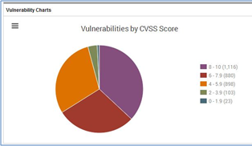
Record Keeping (Final Report)
Findings Overview
Total number of Critical, High, Medium, Low, Advisory/Informational
Make sure that findings are ordered in level of score and severity. (Critical/High first, followed by the rest).
Make sure the order of findings is the same for BOTH the Findings Overview and the report.

Slide 10
Record Keeping (Final Report)
Findings Details
Name
CVSSv3.1 Details
Risk Rating
Score
Vector String
Impact
Technical Details
Recommendations
Affected Assets
References

Slide 11
Record Keeping (Final Report)
Findings Details
CVSSv3.1
Kindly refer to C1 – Security Vulnerabilities.pptx for a comprehensive writeup.
Ensure that the risk rating, risk score and vector string details are correct by using the CVSSv3.1 calculator. An example will be as follows:
Risk Rating: Medium
Risk Score: 6.3
Vector String: CVSS:3.1/AV:N/AC:L/PR:L/UI:N/S:U/C:L/I:L/A:L

Slide 12
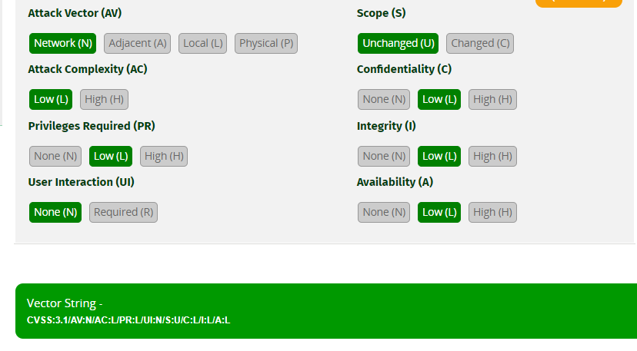
Record Keeping (Final Report)
Findings Details
CVSSv3.1
Note: To get the vector string, it is located at the bottom of the base score calculator:

Slide 13

Record Keeping (Final Report)
Findings Details
CVSSv3.1
Note: Alternatively, you can get it on the Web Browser Address Bar (copy the contents after the ‘#’ symbol).
To verify scores, you can copy a vector string from a known report and replace it (but make sure it’s using the same CVSS version)

Slide 14
Record Keeping (Final Report)
Findings Details
Impact
What can an attacker do with the exploited vulnerability?
This section should describe the CIA impacts listed in your CVSSv3.1 risk rating.

Slide 15
Record Keeping (Final Report)
Finding Details
Technical Details
Step by step process of exploiting the vulnerability
Screenshots to indicate expected outcomes.
Commands used for the exploitation.
Take note that as part of the Technical Details, you are supposed to ensure that what was written earlier in CVSSv3.1 and Impact section is demonstrated here.
NOT REQUIRED to show the information gathering process (e.g nmap scans, port discovery, etc). Immediately document the steps that lead to the execution of the exploit based on the vulnerability.
Write-up of technical details must be in “Active voice”

Slide 16
Record Keeping (Final Report)
Finding Details
Recommendations
How can the finding be resolved?
If possible, provide a technical solution (steps to fix the vulnerability)
Technical solution != buy new products (e.g putting a WAF in place)
Technical solution e.g options to configure for specific configuration files, etc.
If not, provide a general approach of the solution.
Example 1: VSFTPD 2.3.4 vulnerability
Fix: Update VSTPD to version 3.0.5. If there is no such option available, do reconsider utilizing another FTP service.

Slide 17
Record Keeping (Final Report)
Finding Details
References
Any links or resources that will be useful to understanding the finding and the recommendations
For your case study, you are required to find reference numbers for the following:
Common Attack Pattern Enumerations and Classifications (CAPEC)
Common Weakness Enumeration (CWE)
Put BOTH the reference number title and the link in the References table.

Slide 18
Record Keeping (Final Report)
Finding Details
References
Reference Type | Description | Example (both related)
CAPEC | Community-developed list of known attack patterns based on software and hardware weaknesses. | CAPEC-66: SQL Injection https://capec.mitre.org/data/definitions/66.html
CWE | Community-developed list of common software and hardware weaknesses. | CWE-89: Improper Neutralization of Special Elements used in an SQL Command ('SQL Injection’) https://cwe.mitre.org/data/definitions/89.html

Slide 19
Record Keeping (Final Report)
Finding Details
Reference Table Example
Reference Type | Example (both related)
CAPEC | CAPEC-591: Reflected XSS - https://capec.mitre.org/data/definitions/591.html
CWE | CWE-79: Improper Neutralization of Input During Web Page Generation ('Cross-site Scripting’) - https://cwe.mitre.org/data/definitions/79.html

