Slide 1


Slide 2
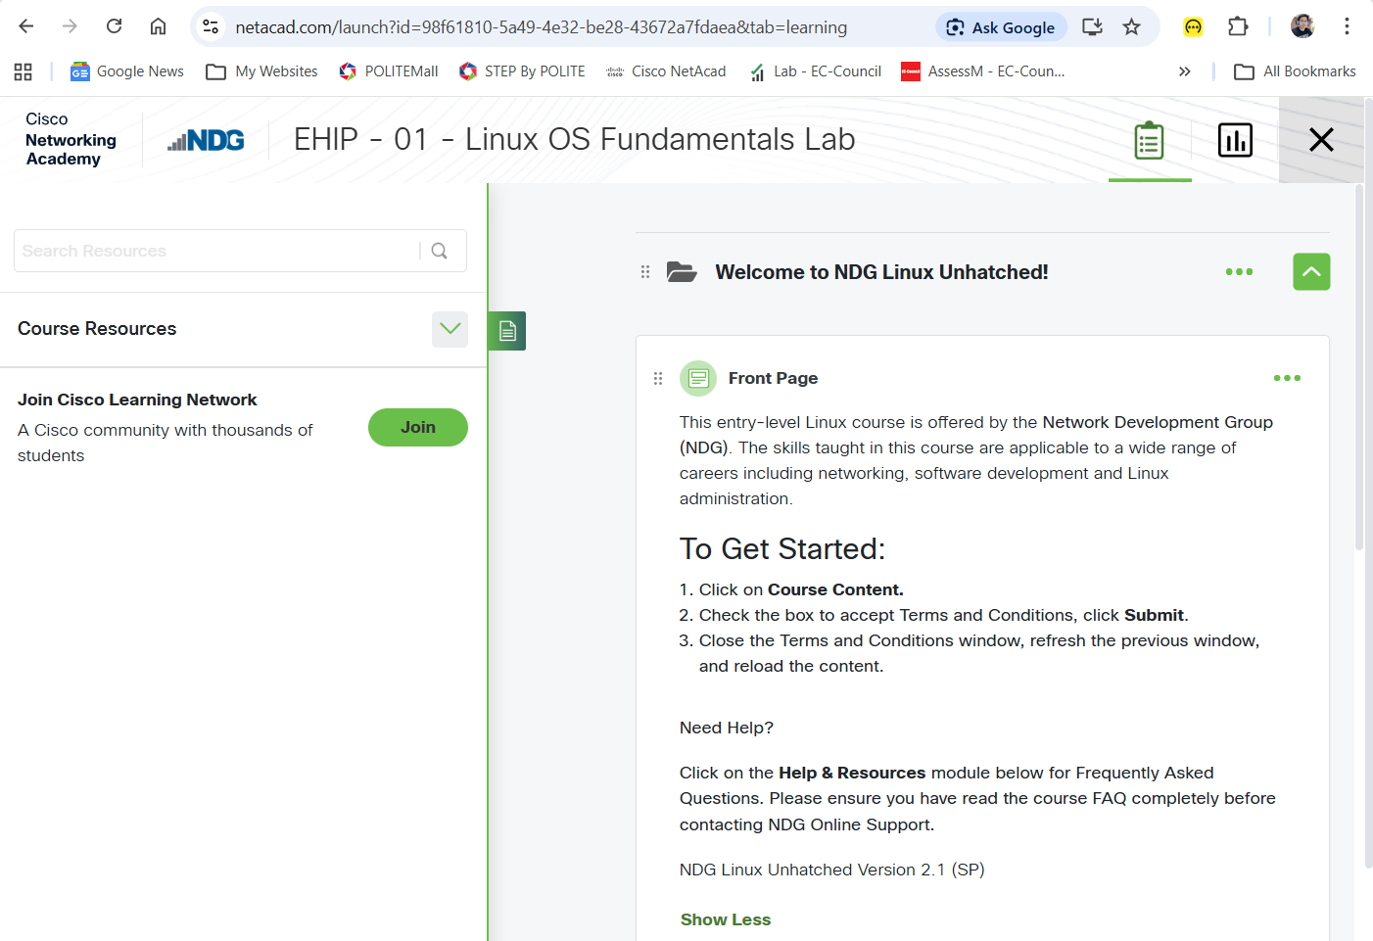

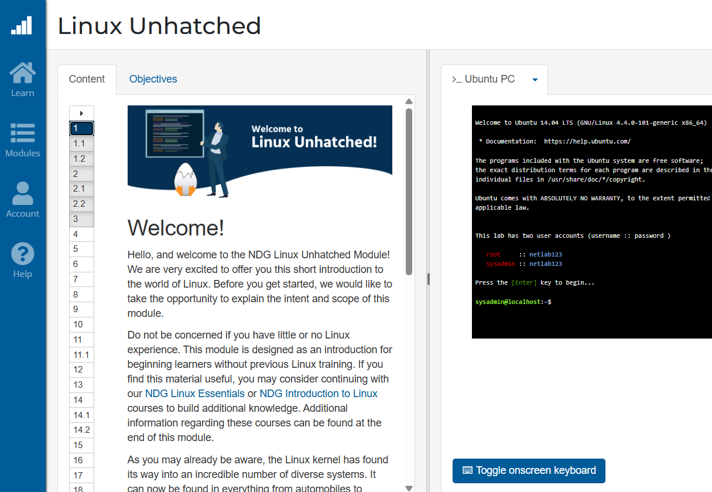
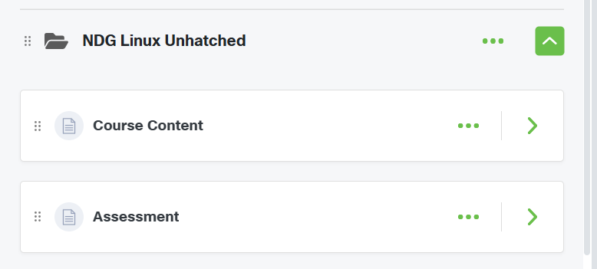

Slide 3
Linux is Everywhere
Linux jobs are everywhere; demand for Linux skills across industries.
Fun and rewarding to work with Linux, though few people understand it.
Linux experience may involve configuring systems, running servers, or managing services.
Linux administration now covers nearly all modern organizational tasks.
Learning Linux opens paths to cybersecurity, development, networking, big data, AI.
Everyday activities (searching, streaming, shopping) often rely on Linux.
Notes:
There is a demand for Linux skills in just about every industry and job category –
Linux experience, it might refer to configuring systems, running web servers, or any number of other services and programs that operate on top of Linux.
Over time, Linux administration has evolved to encompass just about every task that a modern business, educational institution or government organization might use in their daily operations.
Learning Linux opens paths from cybersecurity to application and game development, system administration, networking, big data, and artificial intelligence; all of these fields are rooted in Linux.

Slide 4
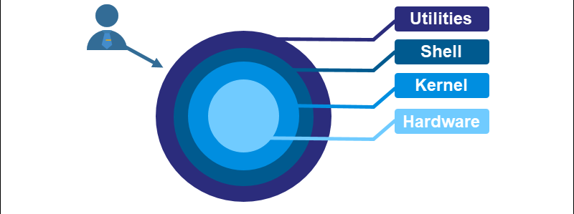


Linux is a Kernel
Linux - refer to the combination of GNU and Linux (GNU/Linux)
Linux = the kernel of the system
Kernel manages CPU, RAM, and Drivers
GNU – is the OS with C compiler, text editors, and a command-line shell
GNU Provides the UI, Shell, and Utilities
GNU is a recursive acronym for "GNU's Not Unix."
Notes:
E.g. Utilities:
File Utilities – let us manipulate files and directories. If you've ever used a Linux terminal, you've used these:
ls: Lists the contents of a directory. cp: Copies files or directories. mv: Moves or renames files, chmod / chown: Changes file permissions or ownership.
Text Processing Utilities - powerful text manipulation tools, which are essential for scripting and system administration
Development Utilities – Complier, execution of source code, Debugging programs, etc.
GNU provides the essential tools and software that make the computer usable for humans.

Slide 5
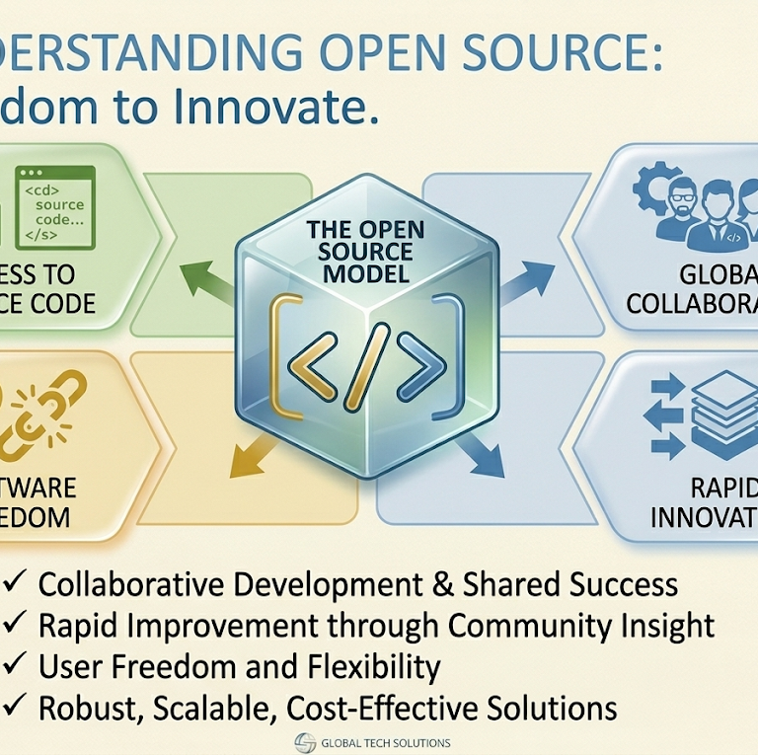
Linux is Open Source
Open source = right to access, modify, and share source code
Linux source code is freely available.
Linux is written in C, aiding adoption for internet servers.
Volunteer community shaped Linux, accelerating development and avoiding past mistakes.
Notes:
The open source philosophy is that you have a right to obtain the software source code and to modify it for your own use.
Linus Torvalds (Finnish-born computer scientist studying at the University of Helsinki) made the source programming code freely available, allowing others to join in and shape this fledgling operating system.
alongside this development was the GNU Project, created by Richard Stallman in 1983. … focuses on building an OS that mimic the UNIX operating system (developed at AT&T Bell Labs in the 1970s), a “close” source that requires licensing and software certification.
So from this humble beginning, Linux has grown to be the dominant operating system on the Internet

Slide 6
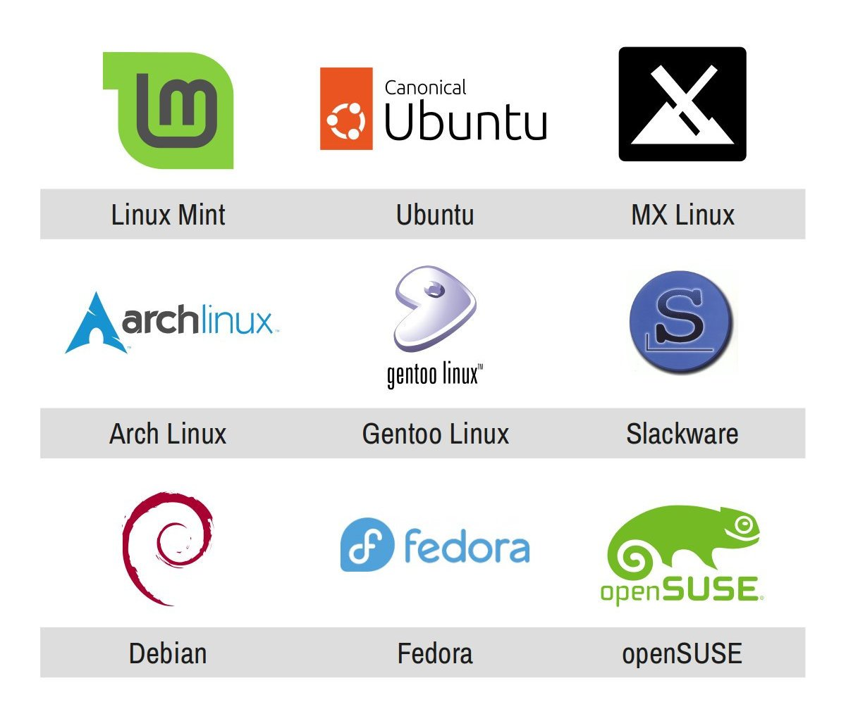


Linux Has Distributions
“Founding fathers" of Linux distributions
Kali
Kali is a specialised Debian-based distribution
pre-loaded with over 600 penetration testing tools (like Nmap, Wireshark, and Metasploit)
Notes:
Linux systems are bundled into distributions (kernel + tools + applications).
Distributions include storage setup, kernel installation, and software management.
Full-featured distributions provide system management tools and package managers.
Distributions serve different purposes: servers, desktops, industry-specific tools.
Major families: Red Hat, Debian, Slackware - three names represent the "founding fathers" of Linux distributions. Each one took the Linux kernel and the GNU tools and organized them into a complete, installable package
Key differences include package managers, file locations, and philosophies.

