Slide 1
Lab Overview: Practical Ethical Hacking
Real-World Simulation: Meticulously designed environments featuring diverse operating systems and configurations to mirror industry scenarios.
Proactive Security: Focuses on ethical hacking to identify and remediate vulnerabilities before they can be exploited by malicious actors.
Immersive Learning: Hands-on application of hacking techniques to understand and anticipate cybercriminal methodologies.
Bridging the Gap: Transitions theoretical knowledge into practical expertise, preparing students to defend complex digital infrastructures.
Notes:
Two interfaces: GUI (Graphical) and CLI (Command Line Interface).
GUI is user-friendly; CLI is powerful, fast, and scriptable.
ability to accomplish a vast array of tasks with a single command line instruction
CLI requires learning commands, file locations, and navigation. (challenging because it requires memorizing a dizzying amount of commands and their options.)
Mastery of CLI enables productivity across all Linux distributions. (easily be productive almost instantly on ANY distribution of Linux)
CLI reduces reliance on GUIs and enhances automation.

Slide 2
Skill Development & Course Outcomes
Industry-Standard Tooling: Hands-on experience with the specific software and tools utilized by modern penetration testers.
End-to-End Penetration Testing: Mastery of the full security lifecycle, from vulnerability exploitation to the implementation of robust defense measures.
Structured Progression: Lab sessions utilize a step-by-step framework designed to build technical confidence and practical skill depth.
Organizational Readiness: Graduates emerge with a comprehensive skill set capable of safeguarding sensitive data and maintaining secure digital environments.
Notes:
Two interfaces: GUI (Graphical) and CLI (Command Line Interface).
GUI is user-friendly; CLI is powerful, fast, and scriptable.
ability to accomplish a vast array of tasks with a single command line instruction
CLI requires learning commands, file locations, and navigation. (challenging because it requires memorizing a dizzying amount of commands and their options.)
Mastery of CLI enables productivity across all Linux distributions. (easily be productive almost instantly on ANY distribution of Linux)
CLI reduces reliance on GUIs and enhances automation.

Slide 3
Third-Party & Cloud Resources
Service Requirements: Certain labs utilize open-source or trial-licensed software that may require the creation of live accounts and the review of third-party service agreements.
Cloud Integration: Exercises may connect to major providers like AWS, Google Cloud, or Microsoft Azure via free-tier, educational, or promotional credit accounts.
Cost Management: While most labs are designed to be completed within free-tier limits, users are responsible for monitoring their third-party accounts to avoid unintended usage fees.
Data Privacy: EC-Council will never request personal payment details or sensitive credentials; all third-party sign-ups are managed independently by the student.
Notes:
Two interfaces: GUI (Graphical) and CLI (Command Line Interface).
GUI is user-friendly; CLI is powerful, fast, and scriptable.
ability to accomplish a vast array of tasks with a single command line instruction
CLI requires learning commands, file locations, and navigation. (challenging because it requires memorizing a dizzying amount of commands and their options.)
Mastery of CLI enables productivity across all Linux distributions. (easily be productive almost instantly on ANY distribution of Linux)
CLI reduces reliance on GUIs and enhances automation.

Slide 4
EC-Council Portal & Lab Account
Register with lab code https://eccouncil.learnondemand.net/User/Register?OrganizationId=1133
Lab codes has been sent via email to our students
E.g. of lab code CEHV99ILYIACKXKGXSUV99HZ9
https://eccouncil.learnondemand.net/User/Login?ReturnUrl=%2F
Notes:
Two interfaces: GUI (Graphical) and CLI (Command Line Interface).
GUI is user-friendly; CLI is powerful, fast, and scriptable.
ability to accomplish a vast array of tasks with a single command line instruction
CLI requires learning commands, file locations, and navigation. (challenging because it requires memorizing a dizzying amount of commands and their options.)
Mastery of CLI enables productivity across all Linux distributions. (easily be productive almost instantly on ANY distribution of Linux)
CLI reduces reliance on GUIs and enhances automation.

Slide 5
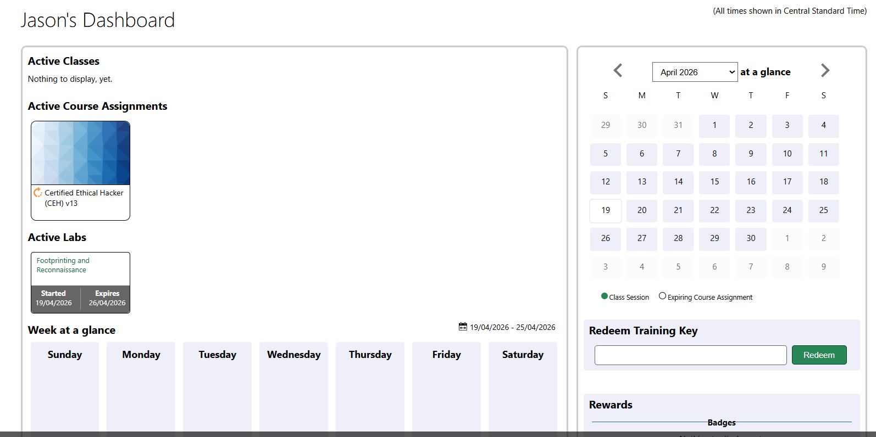
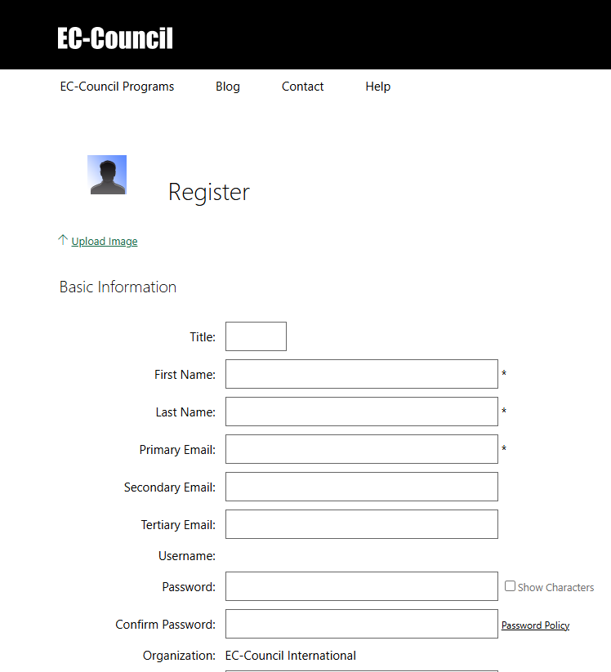
EC-Council Portal & Lab Account
https://eccouncil.learnondemand.net/User/Register?OrganizationId=1133
Register your lab account
Password Policy
Requires at least:
8 characters
1 numbers
1 letters
1 lower-case letters
1 special characters
CEHV99ILYIACKXKGXSUV99HZ9
Notes:
Two interfaces: GUI (Graphical) and CLI (Command Line Interface).
GUI is user-friendly; CLI is powerful, fast, and scriptable.
ability to accomplish a vast array of tasks with a single command line instruction
CLI requires learning commands, file locations, and navigation. (challenging because it requires memorizing a dizzying amount of commands and their options.)
Mastery of CLI enables productivity across all Linux distributions. (easily be productive almost instantly on ANY distribution of Linux)
CLI reduces reliance on GUIs and enhances automation.

Slide 6
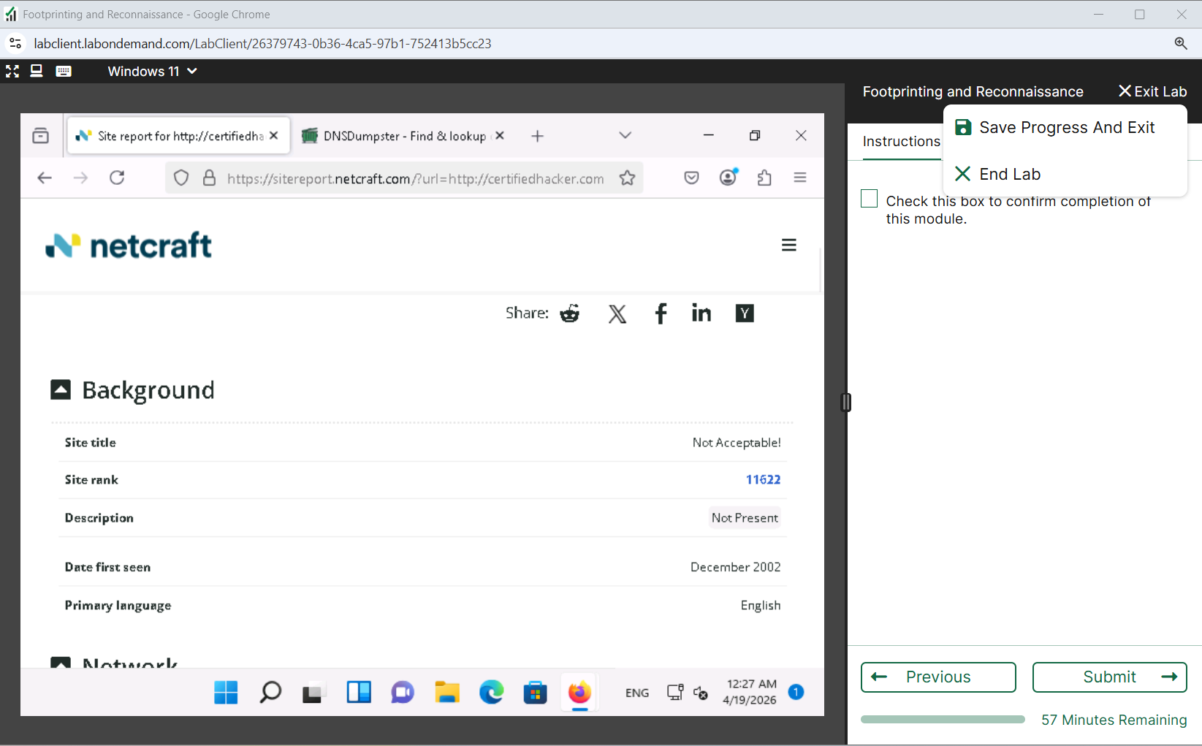
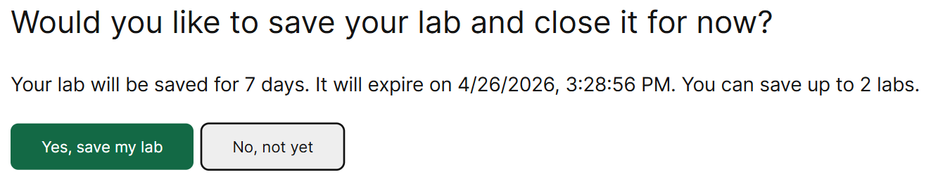
Save & Exit Lab exercises
Notes:
Two interfaces: GUI (Graphical) and CLI (Command Line Interface).
GUI is user-friendly; CLI is powerful, fast, and scriptable.
ability to accomplish a vast array of tasks with a single command line instruction
CLI requires learning commands, file locations, and navigation. (challenging because it requires memorizing a dizzying amount of commands and their options.)
Mastery of CLI enables productivity across all Linux distributions. (easily be productive almost instantly on ANY distribution of Linux)
CLI reduces reliance on GUIs and enhances automation.

Slide 7
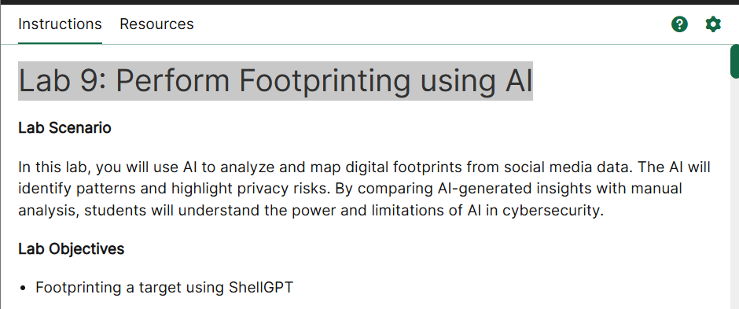
Optional Lab exercises
E.g.
Lab 9: Perform Footprinting using AI
Notes:
Two interfaces: GUI (Graphical) and CLI (Command Line Interface).
GUI is user-friendly; CLI is powerful, fast, and scriptable.
ability to accomplish a vast array of tasks with a single command line instruction
CLI requires learning commands, file locations, and navigation. (challenging because it requires memorizing a dizzying amount of commands and their options.)
Mastery of CLI enables productivity across all Linux distributions. (easily be productive almost instantly on ANY distribution of Linux)
CLI reduces reliance on GUIs and enhances automation.

