Slide 1
VLANs & TRUNKs

Slide 2
What is VLAN?
A virtual LAN (VLAN) is a group of networking devices in the same broadcast domain, logically
It means that the devices in the same VLAN may be widely separated in the network, both by geography and location.
VLANs logically segment the network into different broadcast domains so that packets are only switched between ports that are designated for the same VLAN.

Slide 3
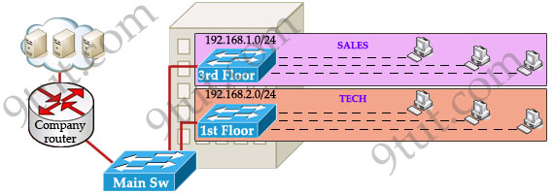
Example
To understand the benefits of VLAN. Suppose you are working in a big company with many departments, some of them are SALES and TECHNICAL departments.
You are tasked to separate these departments so that each of them can only access specific resources in the company.
This task is really easy, you think.
To complete this task, you just need to use different networks for these departments and use access-list to allow/deny that network to a specific resource.
For example, you assign network 192.168.1.0/24 for SALES and 192.168.2.0/24 for TECH. At the “Company router” you apply an access-list to filter traffic from these networks.
Below is the topology of your network without VLANs:

Slide 4
Problems w/o VLANs
Everything looks good and you implement this design to your company. But after one month you receive many complaints from both your colleagues and leaders.
+ First, your department leaders need to access to additional private resources which employees are not allowed. + Second, the company has just recruited some new SALES employees but now the SALES room is full so they have to sit at the 1st floor (in the TECH area). They want to access to SALES resources but they can only access to the TECH resources because they are connecting to TECH switch.
To solve the first problem maybe you will create a new and more powerful network for your leaders. But notice that each leader sits at different floor so you will need to link all of them to a switch -> what a mess!
The second problem is more difficult than the first one. Maybe you have to create another network at the TECH area and apply the same policy as the SALES department for these hosts -> another mess in management!

Slide 5
VLANs
Maybe you will be glad to know VLAN can solve all these problems. VLAN helps you group users together according to their function rather than their physical location.
This means you can use the same network for hosts in different floors (of course they can communicate with each other).

Slide 6
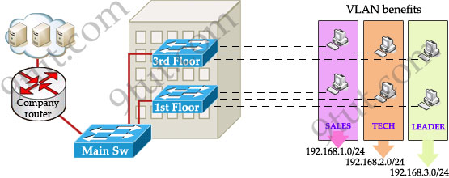
VLAN Solution
In this design:
+ you can logically create a new network with additional permissions for your leaders (LEADER network) by adding another VLAN. + employees can sit anywhere to access the resources in their departments, provided that you allow them to do so. + computers in the same department can communicate with each other although they are at different floors.
If these departments expand in the future you can still use the same network in any other floor.
For example, SALES vlan needs to have 40 more employees -> you can use 4th floor for this expansion without changing the current network.

Slide 7
Questions about VLANs
How can 2 computers connecting to 2 different switches communicate?
If one computer sends a broadcast packet will it be flooded to other departments as switch doesn’t break up broadcast domains? The answer is “Yes, they can!” and it is the beauty of VLAN. Hosts in the same VLAN can communicate normally even they are connecting to 2 or more different switches. This makes the management much more simple.
Although layer 2 switches can only break up collision domains but VLANs can be used to break up broadcast domains.
So if a computer in SALES vlan broadcasts, only computers in SALES vlan will receive that frame.

Slide 8
Do we still need a router?
The answer is “we still need a router” to enable different VLANs to communicate with each other.
Without a router, the computers within each VLAN can communicate with each other but not with any other computers in another VLAN.
For example, we need a router to transfer file from LEADER vlan to TECH vlan. This is called “interVLAN routing”.

Slide 9
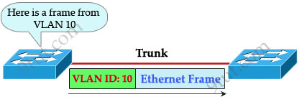
TRUNKs
When using VLANs in networks that have multiple interconnected switches, you need to use VLAN trunking between the switches.
With VLAN trunking, the switches tag each frame sent between switches so that the receiving switch knows which VLAN the frame belongs to.
This tag is known as a VLAN ID. A VLAN ID is a number which is used to identify a VLAN.

Slide 10
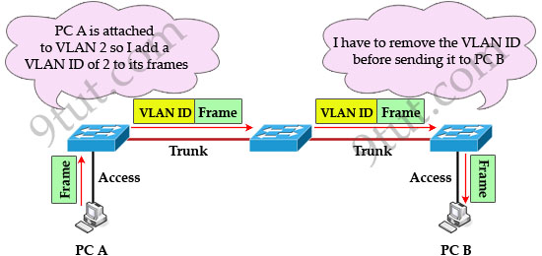
VLAN Tagging in TRUNKs
Notice that the tag is only added and removed by the switches when frames are sent out on the trunk links.
Hosts don’t know about this tag because it is added on the first switch and removed on the last switch. The picture below describes the process of a frame sent from PC A to PC B.

Slide 11
Trunks & Inter-VLAN routing
Trunk link does not belong to a specific VLAN, rather it is a conduit for VLANs between switches and routers.
To allow interVLAN routing you need to configure trunking on the link between router and switch.

Slide 12
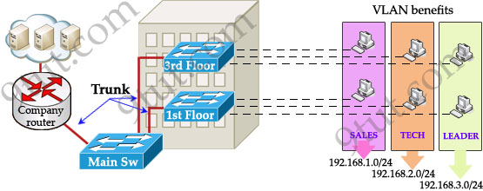
InterVLAN routing

Slide 13
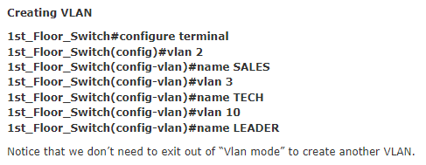
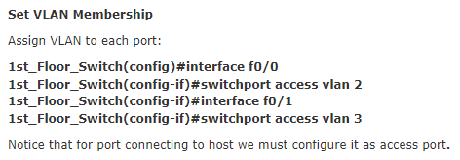
VLAN Configuration on a Switch

Slide 14
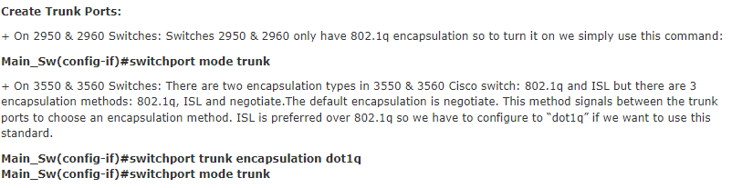
TRUNK Configuration on a Switch

Slide 15
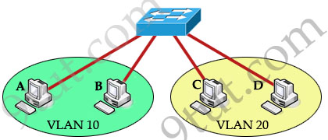
What is InterVLAN routing?
devices within a VLAN can communicate with each other without the need of Layer 3 routing.
But devices in separate VLANs require a Layer 3 routing device to communicate with one another.
For example, in the topology below host A and B can communicate with each other without a router in the same VLAN 10; host C and D can communicate in the same VLAN 20.
But host A can’t communicate with host C or D because they are in different VLANs.

Slide 16
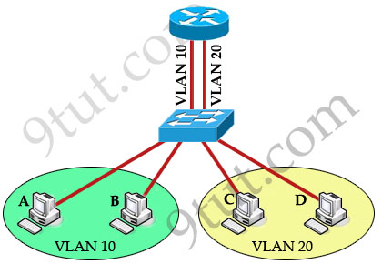
InterVLAN Routing
To allow hosts in different VLANs communicate with each other, we need a Layer 3 device (like a router) for routing:

Slide 17
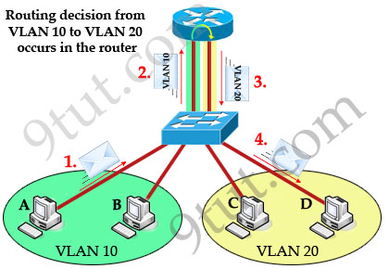
InterVLAN Routing…
The routing traffic from one VLAN to another VLAN is called InterVLAN routing.
Now host A can communicate with host C or D easily. Now let’s see how the traffic is sent from host A to host D.
First, host A knows the destination host is in a different VLAN so it sends traffic to its default gateway (on the router) through the switch.
The switch tags the frame as originating on VLAN 10 and forwards to the router.
In turn, the router makes routing decision from VLAN 10 to VLAN 20 and sends back that traffic to the switch, where it is forwarded out to host D.
Notice that the routing decision to another VLAN is done by the router, not the switch. When frames leave the router (step 3 in the picture above), they are tagged with VLAN 20.
Also notice that receiving ends (host A & D in this case) are unaware of any VLAN information. Switch attaches VLAN information when receiving frames from host A and removes VLAN information before forwarding to host D.

Slide 18
Problem with the earlier network routing
One disadvantage in the topology above:
For each VLAN we need a physical connection from the router to the switch but in practical, the interfaces of the router are very limited.
To overcome this problem, we can create many logical interfaces in one physical interface.
For example from a physical interface fa0/0 we can create many sub-interfaces like fa0/0.0, fa0/0.1 …
Now this router is often called “router on a stick” (maybe because there is only one physical link connecting from router so it looks like a router on a stick.

Slide 19
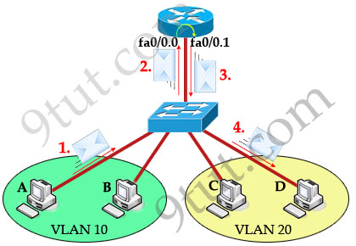
Router-on-a-stick
The router treats each sub-interface as a separate physical interface in routing decisions
This means data can be sent and received in the same physical interface (but different sub-interfaces) without being dropped by the split-horizon rule in the case you want to send routing updates through the router from one VLAN to another.

Slide 20
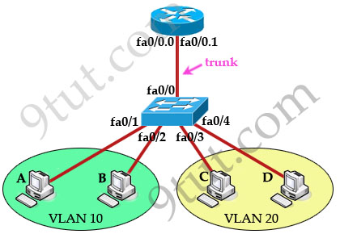
Configuring InterVLAN routing
The switch port connected to the router interface must be configured as trunk port.
The router sub-interfaces must be running a trunking protocol. Two popular trunking protocols in CCNA are 802.1q (open standard) and InterSwitch Link (ISL, a Cisco propriety protocol).
Set IP address on each sub-interface.

Slide 21
Configuring InterVLAN routing…
Configure trunk port on switch:
Switch(config)#interface f0/0 Switch(config-if)#no shutdown Switch(config-if)#switchport mode trunk

Slide 22
Create sub-interfaces, set 802.1Q trunking protocol and ip address on each sub-interface
Configuring InterVLAN routing…
Router(config)#interface f0/0 Router(config-if)#no shutdown
(Note: The main interface f0/0 doesn’t need an IP address but it must be turned on)
Router(config)#interface f0/0.0 Router(config-subif)#encapsulation dot1q 10 Router(config-subif)#ip address 192.168.1.1 255.255.255.0 Router(config-subif)#interface f0/0.1 Router(config-subif)#encapsulation dot1q 20 Router(config-subif)#ip address 192.168.2.1 255.255.255.0

Slide 23
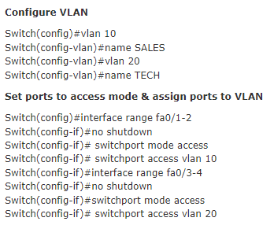
Switch VLAN/TRUNK configuration
Configuring InterVLAN routing…

Slide 24
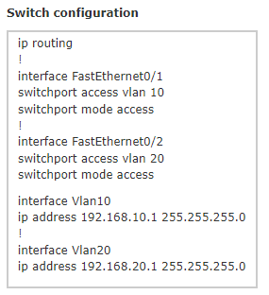
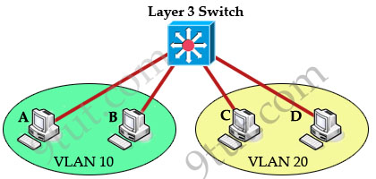
Using Layer 3 Switch
In practice, we often use a Layer 3 switch instead of a switch and a “router on the stick”, this helps reduce the complexity of the topology and cost.
With this topology, we don’t need to use a trunking protocol and the “switchport mode trunk” command. The full configuration of Layer 3 switch is listed below:

Slide 25
Summary
VLANs are used to create logical broadcast domains and Layer 3 segments in a given network
A VLAN is considered a logical segment because the traffic it carries may traverse multiple physical network segments
Cisco switches support two different trunking protocols, Inter-Switch Link (ISL) and IEEE 802.1q. In 802.1q, native VLAN frames are untagged.
The benefits of VLANs
1. Segment networks into multiple smaller broadcast domains without Layer 3 network devices such as routers. VLANs make switched Ethernet networks more bandwidth-efficient through this segmentation of broadcast domains.
2. Group users together according to function rather than physical location. In a traditional network, users in a given work area are on the same network segment regardless of their job description or department. Using VLANs, however, you could have one salesperson in each work area of the building sitting next to engineers in their work area, yet on a separate logical network segment.
3. The ability to reconfigure ports logically without the need to unplug wires and move them around. If a user takes his or her computer to a new work area, no cables need to be swapped on the switch, just access the switch and issue commands to change the VLAN assignments for the old and new ports. VLANs thus simplify the process of adding, moving, and deleting users on the network. They also improve network security by avoiding cabling mishaps that can arise when users are moved in traditional Ethernet networks.

