Slide 1
EtherChannel

Slide 2

EtherChannel
EtherChannel is the technology which is used to combine several physical links between switches or routers into one logical connection and treat them as a single link.
Let’s take an example to see the benefits of this technology: Suppose your company has two switches connecting with each other via a FastEthernet link (100Mbps):

Slide 3

Problem with Just Redundant Links
Your company is growing and you need to transfer more than 100 Mbps between these switches.
If you only connect other links between the two switches it will not work because Spanning-tree protocol (STP) will block redundant links to prevent a loop:

Slide 4

To extend the capacity of the link you have two ways:
Buy two 1000Mbps (1Gbps) interfaces
Use EtherChannel technology to bundle them into a bigger link The first solution is expensive with the new hardware installed on the two switches.
By using EtherChannel you only need some more unused ports on your switches:

Slide 5

How EtherChannel works
EtherChannel bundles the physical links into one logical link with the combined bandwidth and it is awesome! STP sees this link as a single link so STP will not block any links!
EtherChannel also does load balancing among the links in the channel automatically.
If a link within the EtherChannel bundle fails, traffic previously carried over the failed link is carried over the remaining links within the EtherChannel.
If one of the links in the channel fails but at least one of the links is up, the logical link (EtherChannel link) remains up. EtherChannel also works well for router connections:

Slide 6
Types of EtherChannel
When an EtherChannel is created, a logical interface will be created on the switches or routers representing for that EtherChannel.
You can configure this logical interface in the way you want. For example, assign access/trunk mode on switches or assign IP address for the logical interface on routers…
Note:
A maximum of 8 Fast Ethernet or 8 Gigabit Ethernet ports can be grouped together when forming an EtherChannel.
There are three mechanisms you can choose to configure EtherChannel: + Port Aggregation Protocol (PAgP) + Link Aggregation Control Protocol (LACP) + Static (“On”)

Slide 7
Types of EtherChannel…
LACP is the IEEE Standard (IEEE 802.3ad) and is the most common dynamic ether-channel protocol, whereas PAgP is a Cisco proprietary protocol and works only between supported vendors and Cisco devices.
All ports in an EtherChannel must use the same protocol; you cannot run two protocols on two ends. In other words, PAgP and LACP are not compatible so both ends of a channel must use the same protocol.
The Static Persistence (or “on” mode) bundles the links unconditionally and no negotiation protocol is used. In this mode, neither PAgP nor LACP packets are sent or received. (Reference: http://www.cisco.com/en/US/tech/tk389/tk213/technologies_tech_note09186a0080094714.shtml)

Slide 8


Port Aggregation Protocol (PAgP)
PAgP dynamically negotiates the formation of a channel. There are two PAgP modes:
The table below lists if an EtherChannel will be formed or not for PAgP:

Slide 9


Link Aggregation Protocol (LACP)
LACP also dynamically negotiates the formation of a channel. There are two LACP modes:
The table below lists if an EtherChannel will be formed or not for LACP:

Slide 10
Static (“On”)
In this mode, no negotiation is needed. The interfaces become members of the EtherChannel immediately.
When using this mode make sure the other end must use this mode too because they will not check if port parameters match.
Otherwise the EtherChannel would not come up and may cause some troubles (like loop…).
Note: All interfaces in an EtherChannel must be configured identically to form an EtherChannel. Specific settings that must be identical include: + Speed settings + Duplex settings + STP settings + VLAN membership (for access ports) + Native VLAN (for trunk ports) + Allowed VLANs (for trunk ports) + Trunking Encapsulation (ISL or 802.1Q, for trunk ports)

Slide 11
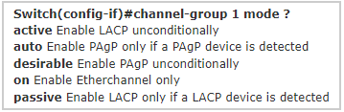
EtherChannel Configuration
To assign and configure an EtherChannel interface to an EtherChannel group, use the channel-group command in interface mode:
channel-group number mode { active | on | {auto [non-silent]} | {desirable [non-silent]} | passive}
For example we will create channel-group number 1:

Slide 12

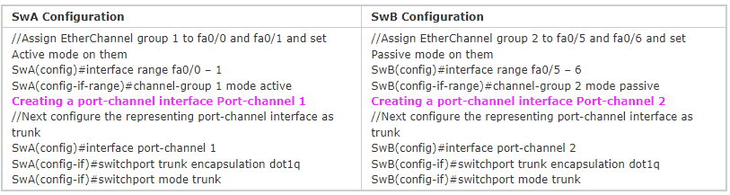
EtherChannel Configuration…
In this example, we will create an EtherChannel via LACP between SwA & SwB with the topology shown below:
That is all the configuration for the EtherChannel to work well on both switches.
We can verify with the “show etherchannel <port-channel number> port-channel” or “show etherchannel summary” command.

Slide 13
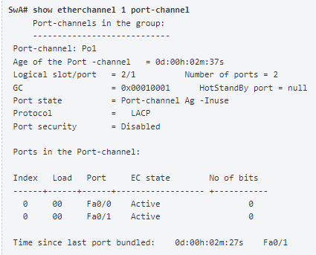
EtherChannel Configuration…
The “show etherchannel number port-channel” command can be used to display information about a specific port channel (in this case port-channel 1).
From the command above we can see Port-channel 1 consists of Fa0/0 & Fa0/1 and they are in Active state.

Slide 14
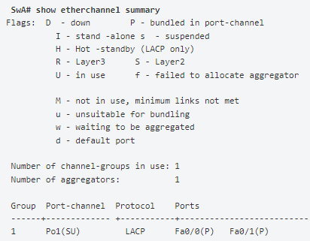
EtherChannel Configuration…
The “show etherchannel summary” can be used to simply display one line of information per port-channel.
In this case we learn from the last line that Group 1 uses LACP.
This is a Layer 2 EtherChannel (symbolized by “SU”, in which “S” means “Layer2” & “U” means this port-channel is up.

Slide 15
Summary
Rational for EtherChannel to overcome the redundant STP issues and yet provide higher bandwidth
Types of EtherChannel
Configuration of EtherChannel

