Slide 1
Hot Standby Router Protocol (HSRP)

Slide 2
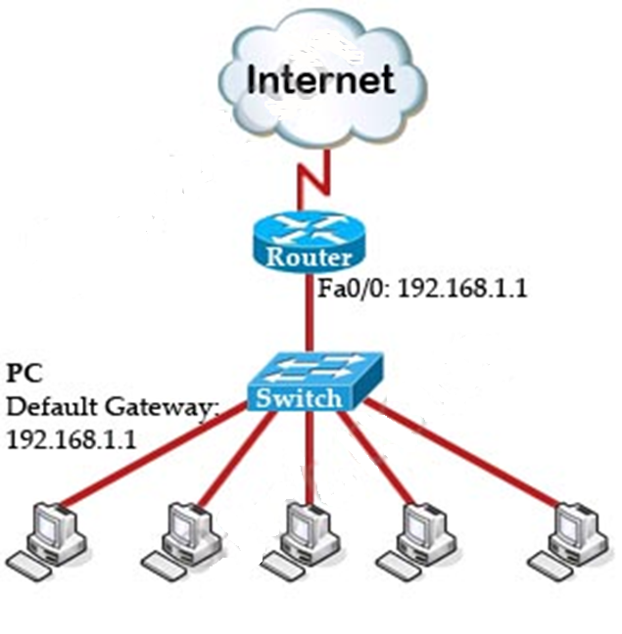
Internet Connectivity
All organizations have some form of Internet connectivity

Slide 3
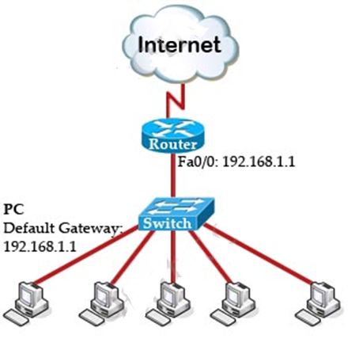
Network setup
To make above topology work we need to:
Configure IP addresses on two interfaces of the Router.
Suppose the IP address of Fa0/0 interface (the interface connecting to the switch) is 192.168.1.1.
Assign the IP addresses, default gateways and DNS servers on all PCs.
In this case we have to set the default gateways to Fa0/0 interface (with the IP address 192.168.1.1) of the router.
This can be done manually or automatically via DHCP.

Slide 4
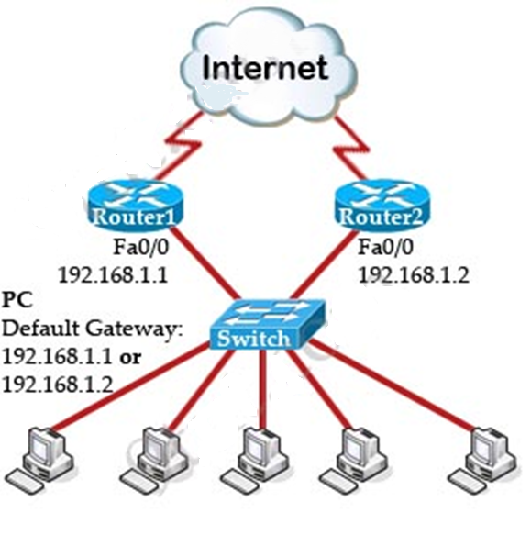
Redundancy for Network Resilence
We can implement some redundancy so that even the Router fails, all PCs can still access the Internet without any manual configuration at that time.
So we need one more router to connect to the Internet as the topology

Slide 5
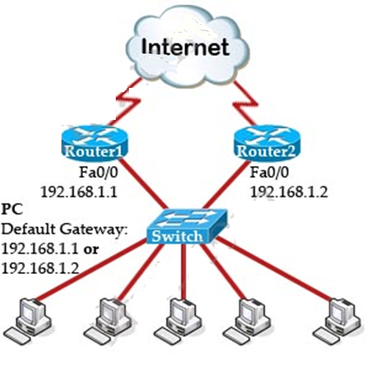
Problem!
We have a problem:
There is only one default gateway on each host
so if Router1 is down and we want to access the Internet via Router2, we have to change the default gateway (to 192.168.1.2).
Also, when Router1 comes back we have to manually change back to the IP address on Router1.
And no one can access to the Internet in the time of changing the default gateway.
HSRP can solve all these problems!

Slide 6
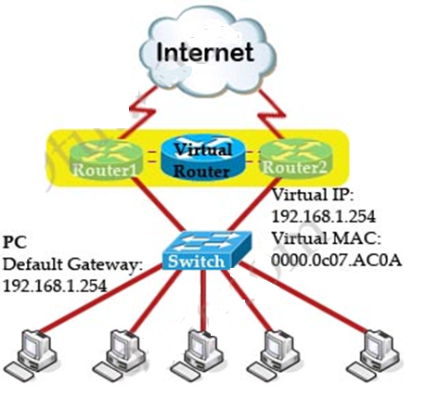
HSRP Operation
With HSRP, two routers Router1 and Router2 in this case will be seen as only one router.
HSRP uses a virtual MAC and IP address for the two routers to represent with hosts as a single default gateway.
For example, the virtual IP address is 192.168.1.254 and the virtual MAC is 0000.0c07.AC0A.
All the hosts will point their default gateway to this IP address.

Slide 7
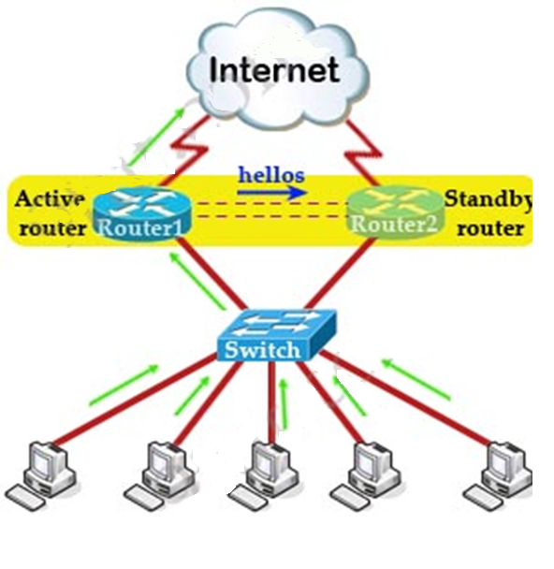
HSRP Operation…
One router, through the election process, is designated as active router while the other router is designated as standby router.
Both active and standby router listen but only the active router proceeds and forwards packets.
Standby router is backup when active router fails by monitoring periodic hellos sent by the active router (multicast to 224.0.0.2, UDP port 1985) to detect a failure of the active router.

Slide 8
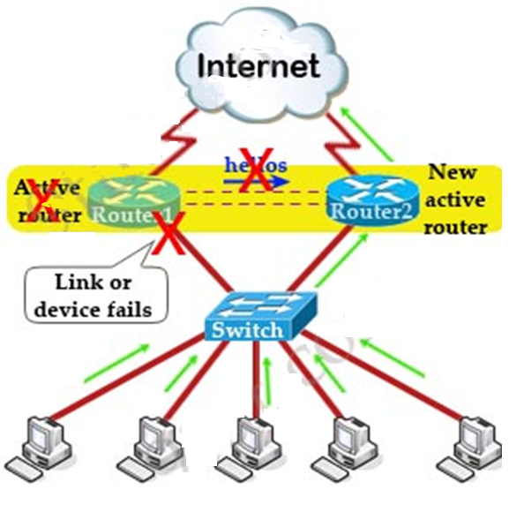
HSRP Operation…
When a failure on the active router detected, the standby router assumes the role of the forwarding router.
Because the new forwarding router uses the same (virtual) IP and MAC addresses, the hosts see no disruption in communication.
A new standby router is also elected at that time (in the case of there are more than two routers in a HSRP group).
Note: All routers in a HSRP group send hello packets.
By default, the hello timer is set to 3 seconds and the dead timer is set to 10 seconds.
It means that a hello packet is sent between the HSRP standby group devices every 3 seconds, and the standby device becomes active when a hello packet has not been received for 10 seconds

Slide 9
Some points to note
The virtual MAC address of HSRP version 1 is 0000.0C07.ACxx, where xx is the HSRP group number in hexadecimal based on the respective interface.
For example, HSRP group 10 uses the HSRP virtual MAC address of 0000.0C07.AC0A.
HSRP version 2 uses a virtual MAC address of 0000.0C9F.FXXX (XXX: HSRP group in hexadecimal).
But please notice that the virtual MAC address can be configured manually.
HSRP version 1 hello packets are sent to multicast address 224.0.0.2 while HSRP version 2 hello packets are sent to multicast address 224.0.0.102.
Currently HSRPv1 is the default version when running HSRP on Cisco devices.

Slide 10
Summary
+ HSRP is Cisco proprietary which allows several routers or multilayer switches to appear as a single gateway IP address.
+ HSRP has 6 states: Initial, learn, listen, speak, standby and active.
+ HSRP allows multiple routers to share a virtual IP and MAC address so that the end-user hosts do not realize when a failure occurs.
+ The active (or Master) router uses the virtual IP and MAC addresses.
+ Standby routers listen for Hellos from the Active router. A hello packet is sent every 3 seconds by default. The hold time (dead interval) is 10 seconds.
+ HSRP version 1 uses the MAC address range 0000.0C07.ACxx while HSRP version 2 uses the MAC address range 0000.0C9F.Fxxx , where xxx is the hexadecimal number of HSRP group.
+ The group numbers of HSRP version 1 range from 0 to 255. HSRP does support group number of 0 (we do check it and in fact, it is the default group number if you don’t enter group number in the configuration) so HSRP version 1 supports up to 256 group numbers. HSRP version 2 supports 4096 group numbers.

