Slide 1
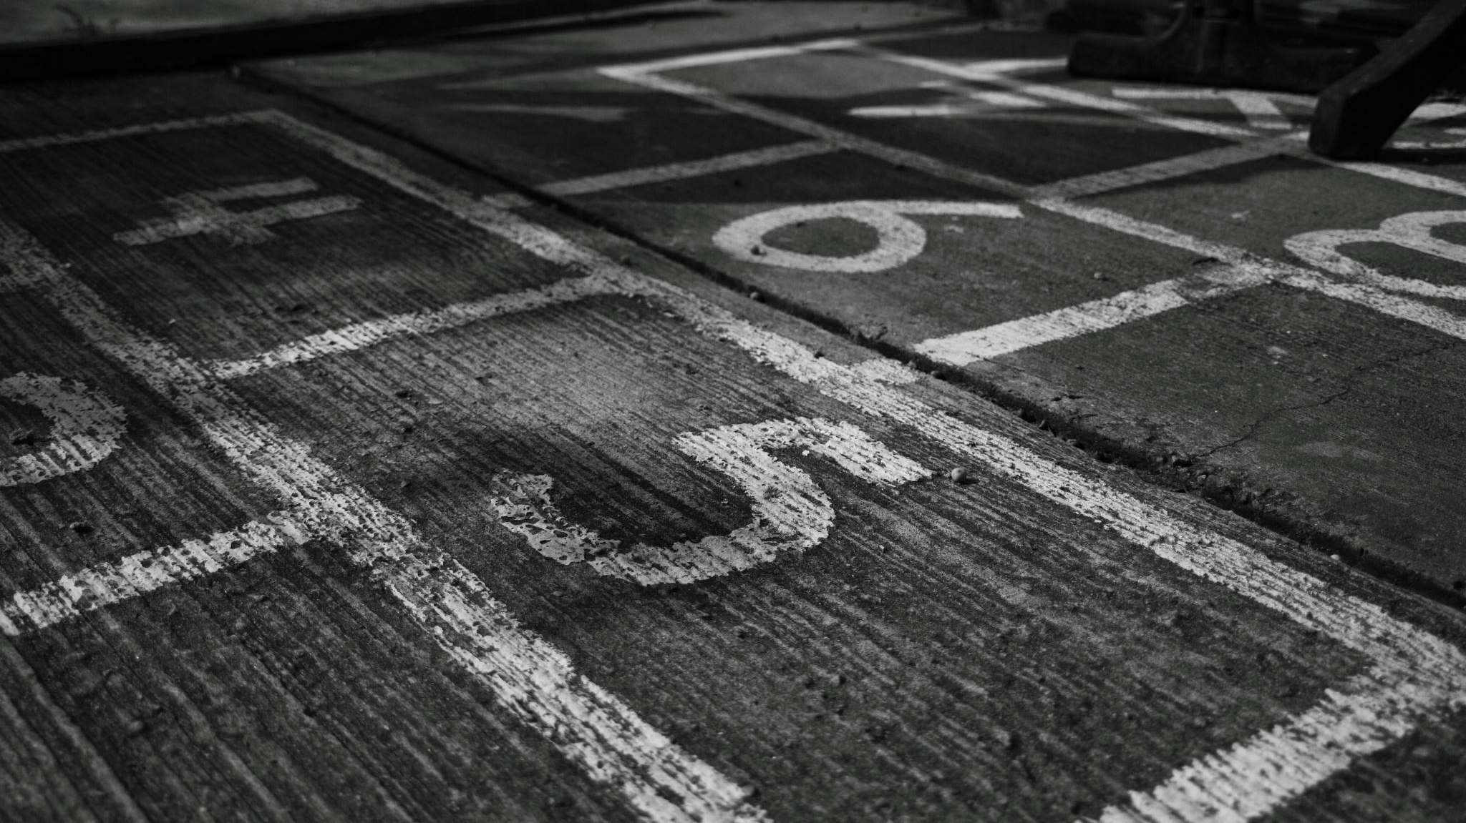
IP Address Concepts

Slide 2
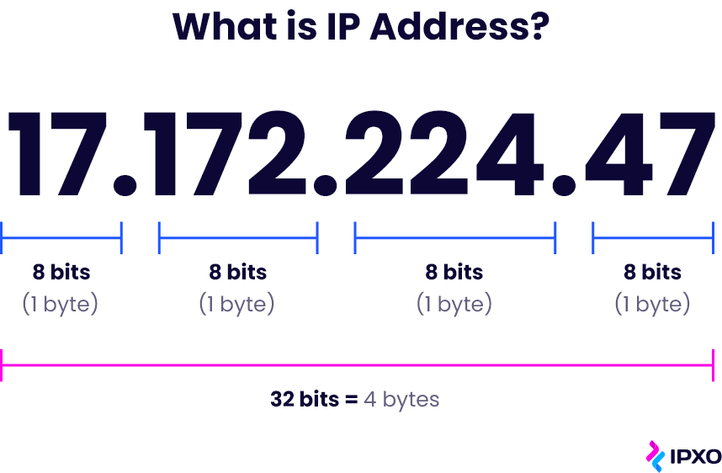
IP Address?

Slide 3
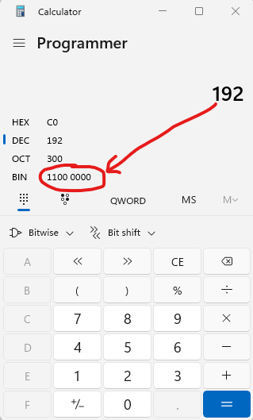
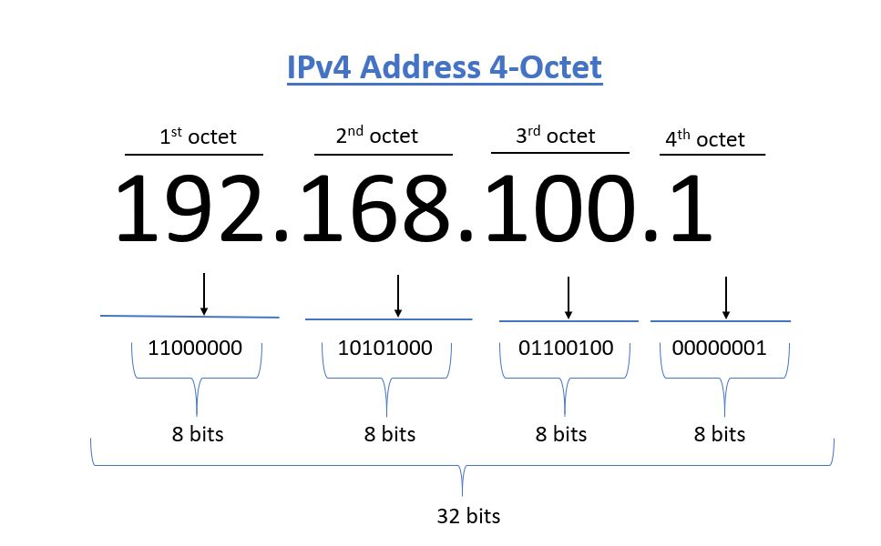

Slide 4
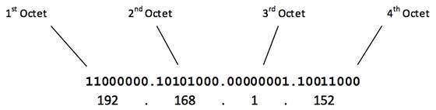
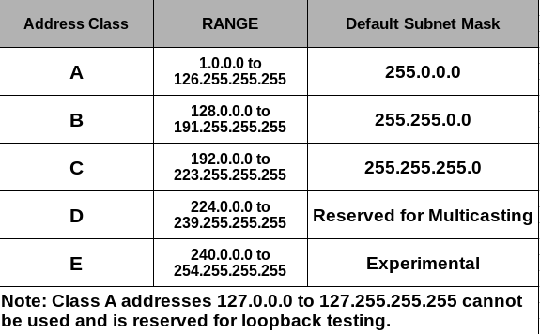
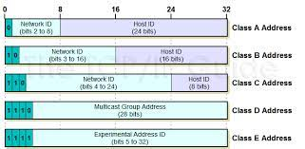
IP Address Class

Slide 5
Subnet Masks & Subnetting
Custom Subnet Mask Examples
255.192.0.0 11111111.11000000.00000000.0000000000
255.255.128.0 11111111.11111111.10000000.0000000000
255.255.255.252

Slide 6
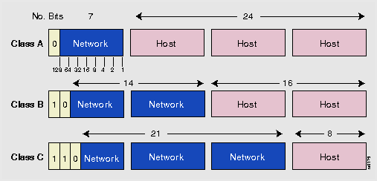
IP Address Types
3 Types are:
IP Network Address
IP Host Address
IP Broadcast Address
IP Network Address is where the Host portion
of the IP address is all ZEROs
IP Broadcast Address is where the Host portion
of the IP address is all ONEs
Lastly, IP Host Address is where the Host portion
of the IP address is mixture ONEs & ZEROs

Slide 7
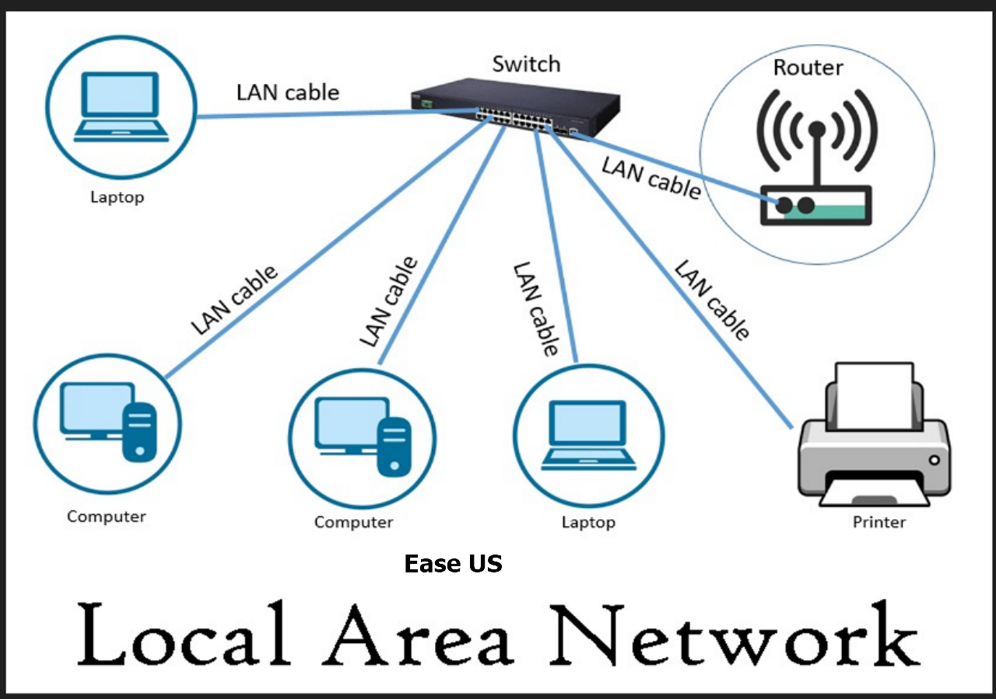
Local Area Network
Consist of
Switch/Hub
Lan Cable
Hosts/End devices/Computer

Slide 8
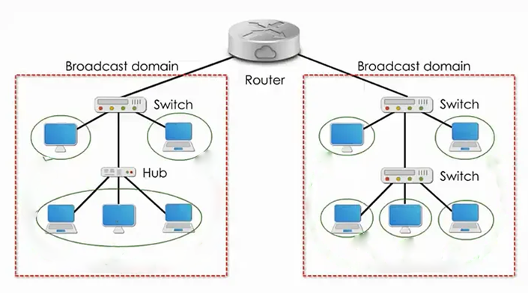
Broadcast Domain of Networks
All hosts must have an IP HOST address
If we “zero-lised” the IP Address
host portion of computers in
a broadcast domain, they SHOULD
have the same IP NETWORK Address
Important
Hence, each network broadcast domain
EQUALS to 1 IP NETWORK Address

Slide 9
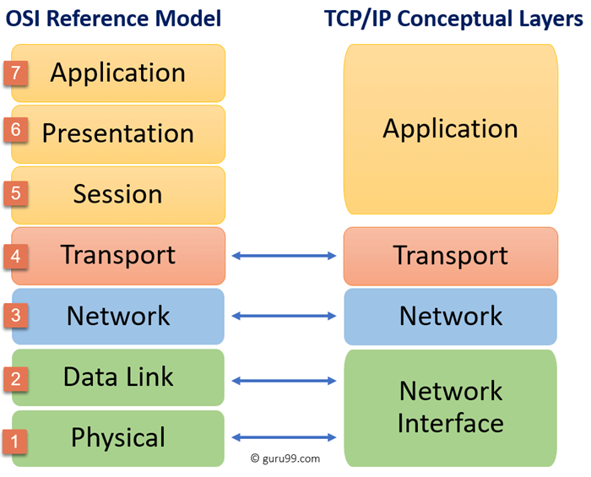
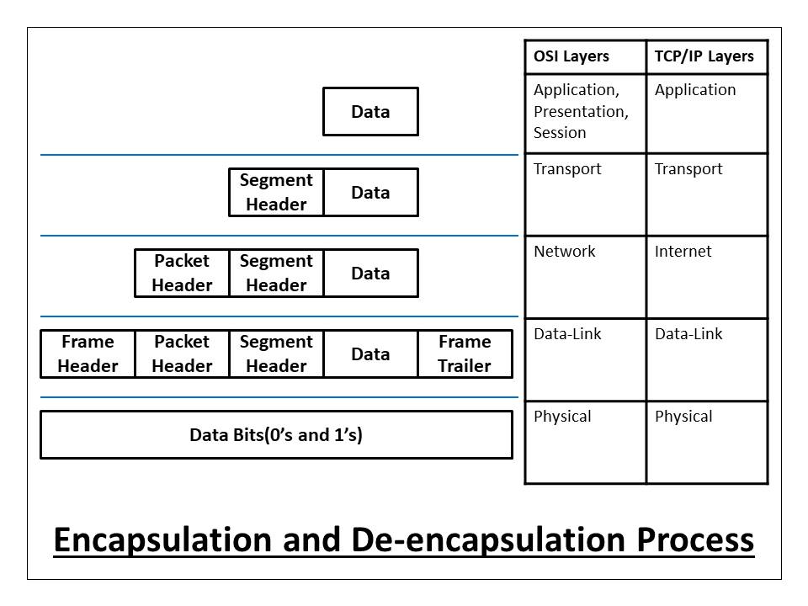
OSI Model vs TCP/IP Model

Slide 10

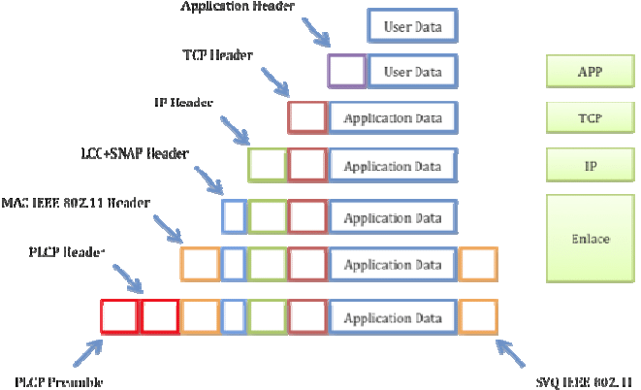
Data Encapsulation
10 Gb File
10 Gb File
Video:
Data Encapsulation OSI TCPIP
https://www.youtube.com/watch?v=xaKvGnnuYmk&t=785s

Slide 11
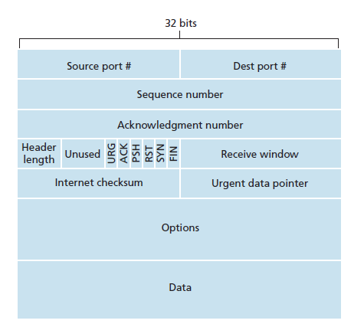
Segment Header

Slide 12
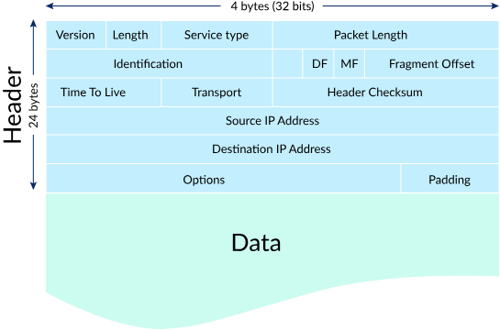
Packet Header

Slide 13
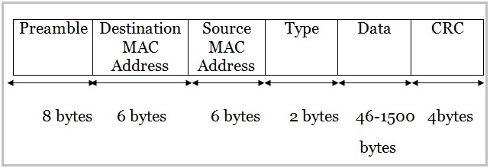
General Frame Header/Trailer
Header
Trailer

Slide 14
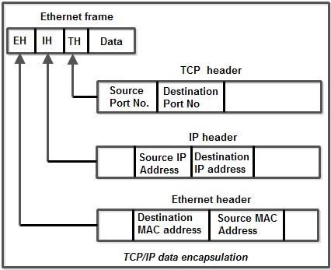
Important to Remember
segment
packet
frame

