Slide 1
SuperHealthyYou!
GROUP 1
Partner 1 Shin-Yu Wu | shinyuw@andrew.cmu.edu
Partner 2 Yaohan Jiang | yaohanj@andrew.cmu.edu
Partner 3 Shan Xiao | shanxiao@andrew.cmu.edu
Partner 4 Hsuan Ouyang | houyang@andrew.cmu.edu
Partner 5 Sheng Xu | shengxu@andrew.cmu.edu

Slide 2
AGENDA
Vision
Team
Problem
Approach / Solution
Market
Business Model
Competition
Go-to-Market

Slide 3
VISION
What is your vision?
Helping people live healthy lives.

Slide 4
TEAM
For each team member, include:
Photo
Name (and link to LinkedIn profile)
Title
Experience

Slide 5
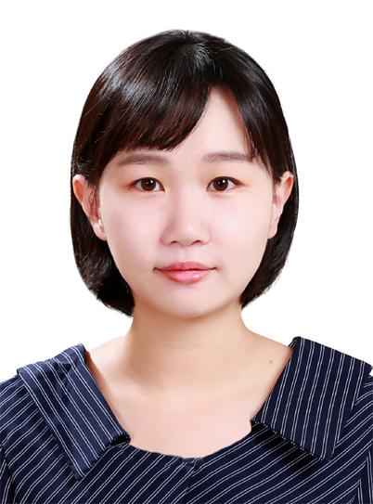
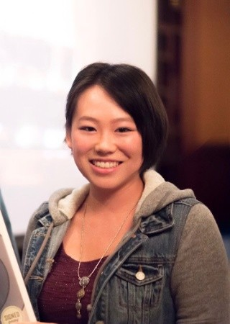
TEAM
Founder
Shin-Yu Wu
LinkedIn：https://www.linkedin.com/in/shin-yu-wu-175ba9160/
Experience: Data analyst
Founder
Yaohan Jiang
LinkedIn:https://www.linkedin.com/in/yaohan-jiang/
Experience: Data analyst

Slide 6


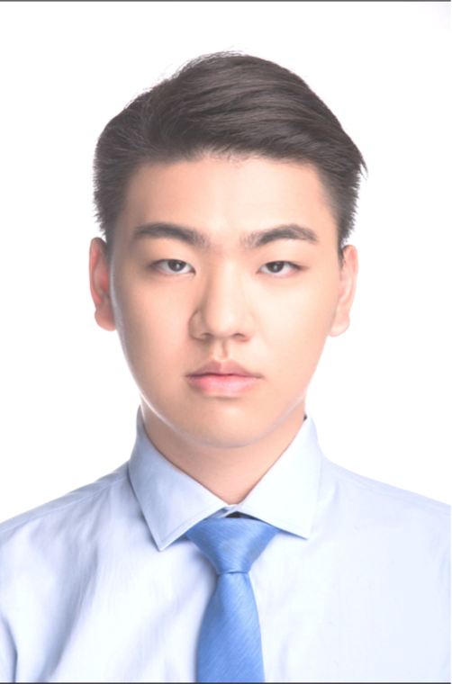
Founder
Shan Xiao
LinkedIn:https://www.linkedin.com/in/shan-xiao-201050139/
Experience: Data analyst
Founder
Hsuan Ouyang
LinkedIn:https://www.linkedin.com/in/hsuan-ouyang-07baaab1/
Experience: Data analyst
Founder
Sheng Xu
LinkedIn:https://www.linkedin.com/in/sheng-xu-472712138/
Experience: Data analyst

Slide 7
PROBLEM (CUSTOMER PAIN)
What is the customer pain point?
- Eating disorder and sports anxiety.
- Time-consuming meal preparation.
What is the current solution for this pain?
- One stop service for smart-eating and time-saving meal solution.
- Custom recommended daily calorie intake.
- Accurately estimate sports calorie burned.
How much does it cost?
- Free, but customers can choose to upgrade for premium membership. If any, pay for the food package and gym fee.
Why is it broken?
- Time-consuming and costly.

Slide 8
SOLUTION / PRODUCT
Explain your product
Provide healthy diet plans and recommend meal recipes for customers. Customers can directly buy packages of food from our website. Further, we also help customer to choose the most suitable fitness plan.
Articulate the value proposition
People nowadays are usually too busy to lead a healthy life. We create an opportunity for them to achieve a healthy fitness plan.
Demonstrate the impact on your customer (dollars / time saved, etc.)
Customers only need to spend little money for their own diet and exercise plans.

Slide 9
MARKET
Describe your market / target customer
People who want to control their weight and their daily diet.
How big is the market?
The whole population from 20-50 ages.
What are the market forces / drivers?
One stop service for nutrition support and online healthy food (food package) shopping.

Slide 10
BUSINESS MODEL / UNIT ECONOMICS
How does your company make money?
We charge from food suppliers, farmers, retailers when users buy their products through our website or app.
Subscription fee for premium account.
Cooperate with gyms, hospitals, Dietitians, fitness tracker companies and charge advertisement fee from them.

Slide 11
BUSINESS MODEL / UNIT ECONOMICS
Pricing details
commission fee: 10% per order (from food package supplier):
premium account: $10 per month
advertisement fee: $100 per month
Include metrics, e.g.:
Average Order Value (AOV)
Estimated number of order for a month: 100
Estimated revenue per month: $450
$150 (food suppliers, farmers, retailers) + $100 (gym advertisement) + $200 (subscription fee) = $450
AOV = 4.5
Lifetime Value (LTV)
$4.5 * 12 * 2 = $108

Slide 12
COMPETITION
Frame the competition:
Who are the key players?
MyFitnessPal, Lifesum, Calm, Prepped etc.
How are you differentiated?
We provide a mix of suggestions, including nutrition, diet and fitness, by using a magic formula which can combine them perfectly. We also collaborate with hospitals, food suppliers and gyms to provide direct information.

Slide 13
LAUNCH STRATEGY / GO-TO-MARKET
What is your customer acquisition approach?
We will pay for advertisement on Facebook, Google at the beginning.
After accumulating a solid base of customers, we offer discounts to loyal customers if they bring in their friends to us.
Annual members can share their memberships with a friend for one month. The friend might join us after this year.
What are key drivers and potential milestones?
Key drivers: health consciousness, accuracy and feasibility of our diet suggestions, popularity of gyms. Potential milestones: reach a customer size of 100, 500, 1000, 10,000, 100,000.

