Slide 1
DBMS System
Team: Alex, Tom, Tony

Slide 2
Design principles
Create functions in separate files for easier check (i.e: table.py, database.py, tableoperators.py)
GitHub as a tool for easier collaboration.
Optimize space, time when possible. Simplify code & variable uses
Consider the ‘human error’ in designing UI:
  explain options carefully to prevent typo or invalid input
  present relevant information to help with choice selection
  provide immediate feedback

Slide 3
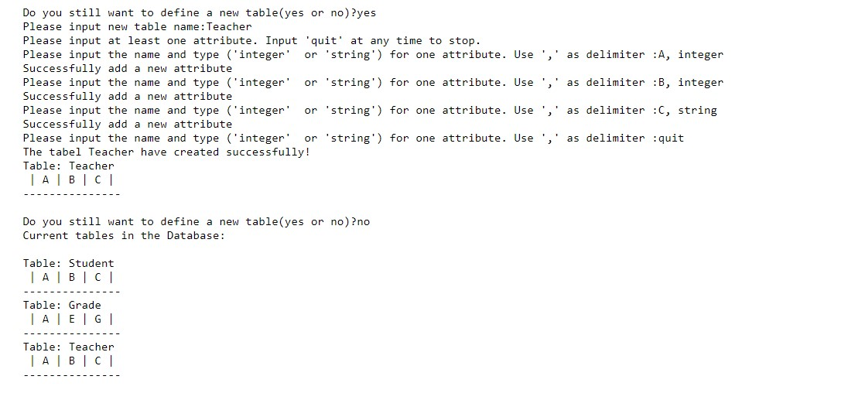
Input:
Limit choice to ‘integer’ and ‘string’ only for attribute type
Functions:
db = Database()
new_table = create_tables()
db.add_table(new_table)
Output:
List all tables in DB

Slide 4
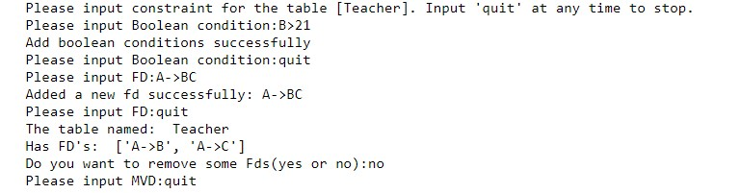
Input:
- Return error if input can’t be split to RHS and LHS
- Automatically check whether attributes are in the table
Functions:
table = create_constraint(table, db)
Output:
- Automatically convert FDs to non-trivial form if RHS has more than 1 attribute
- Add implied MVD from FDs
- Automatically remove trivial FD

Slide 5
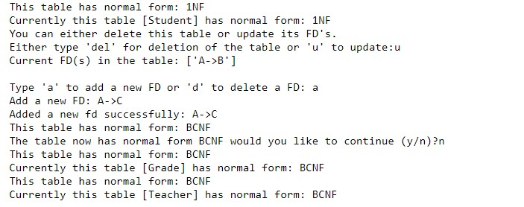

Input:
- NF check: FD that will bring table to BCNF
- Key: either user select or automatic selection
Functions:
table = update_normal_form(db, table)
table.user_define_key()

Slide 6
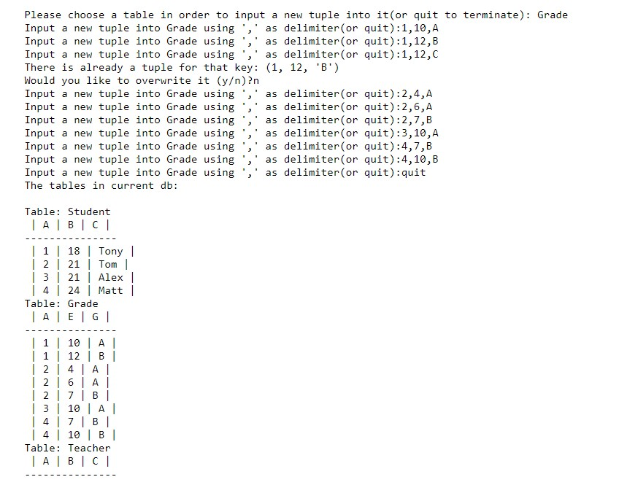
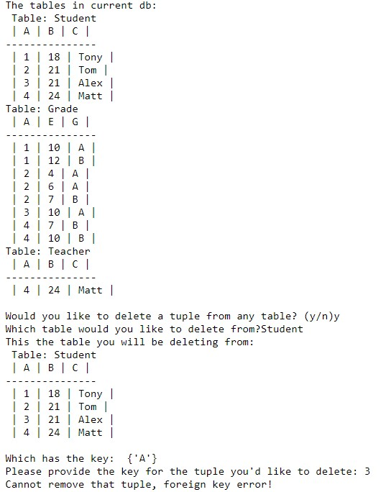
Input:
- Automatically check for attribute type for consistency
- Automatically check for tuple integrity based on FD & foreign key
Output:
- All tables in Database after add/delete
Functions:
table.add_tuple(input)
table.remove_tuple(key)

Slide 7
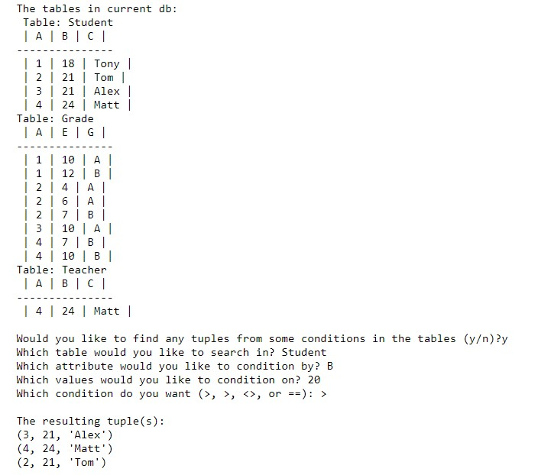
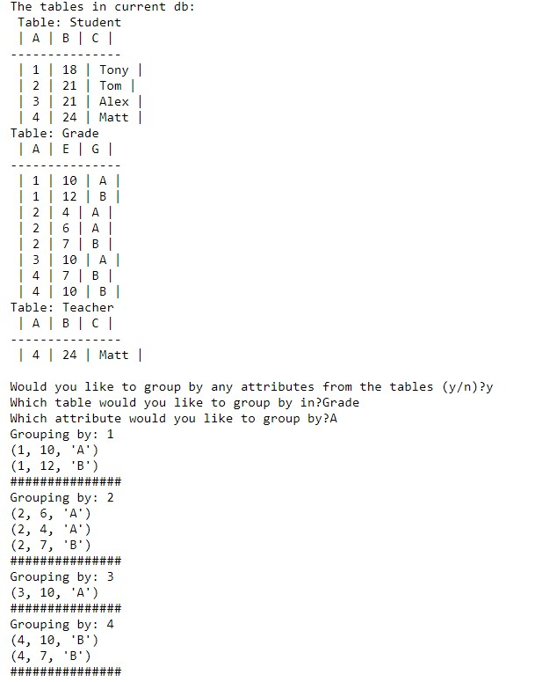
Input:
- Find all the student whose age (‘B’) is larger than 20
- Group the grades by Student ID (‘A’)
Functions:
table.get_tuple_conditions(attr_name, values, conditions)
table.group_by(attr_name)

Slide 8
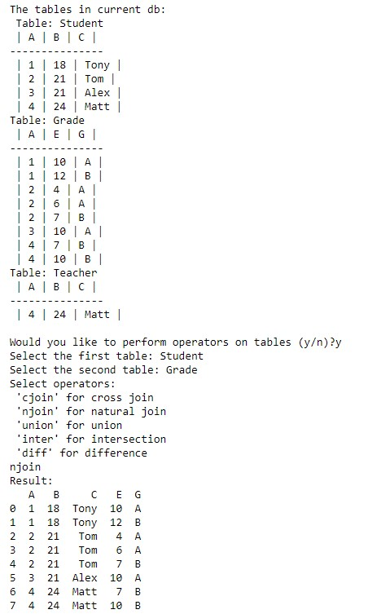
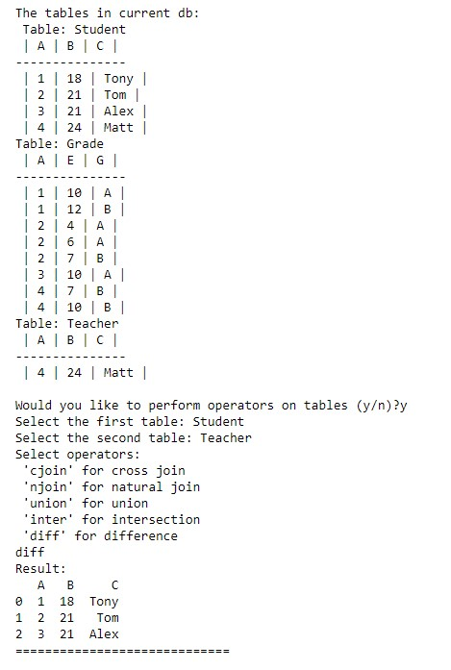

Input:
Operators:
- Only two tables
- Choice for cross join, natural join, union, intersection, difference
Deletion: automatically check for across table integrity
Functions:
njoin_table(table1,table2)
difference(table1,table2)
db.delete_table(table_to_del)

