Slide 1
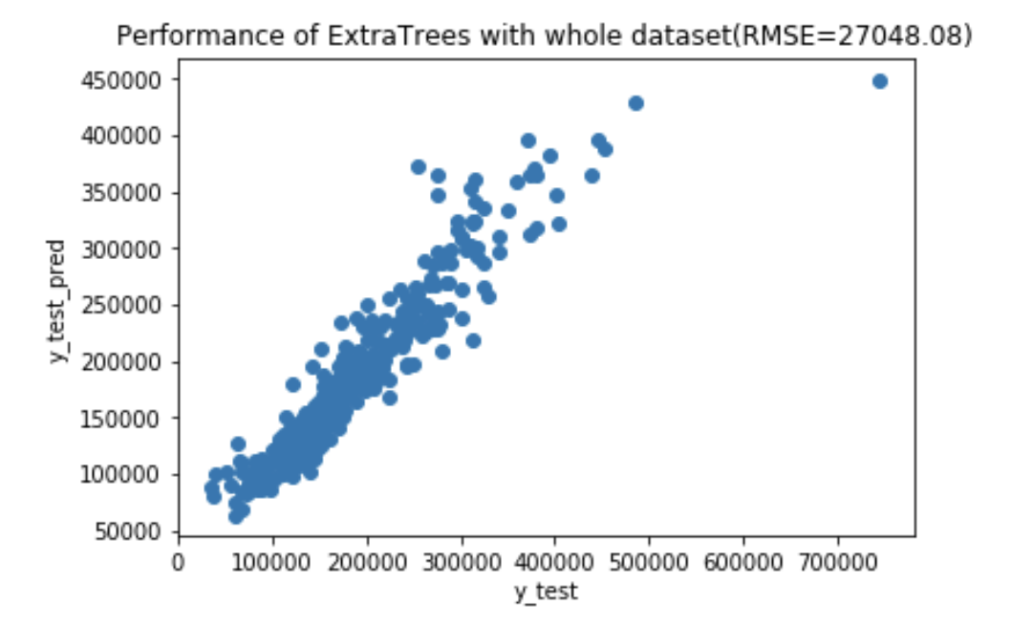
FeatureSelectionWithTrees

Slide 2
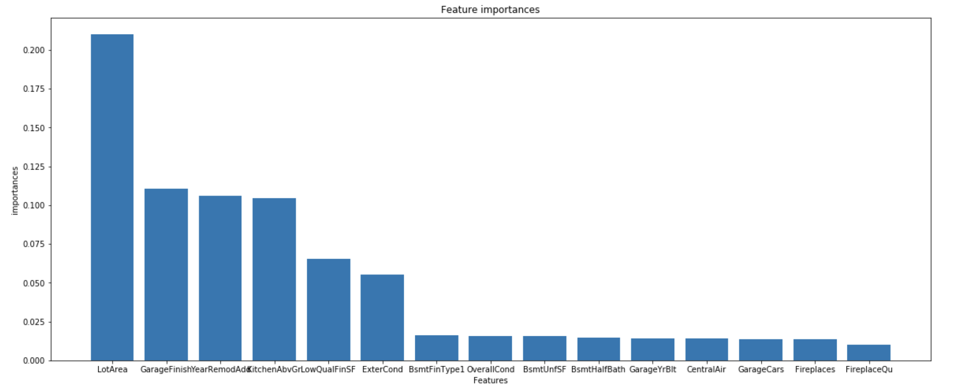
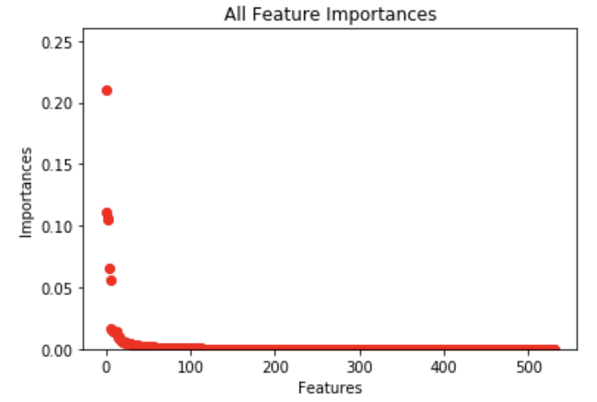
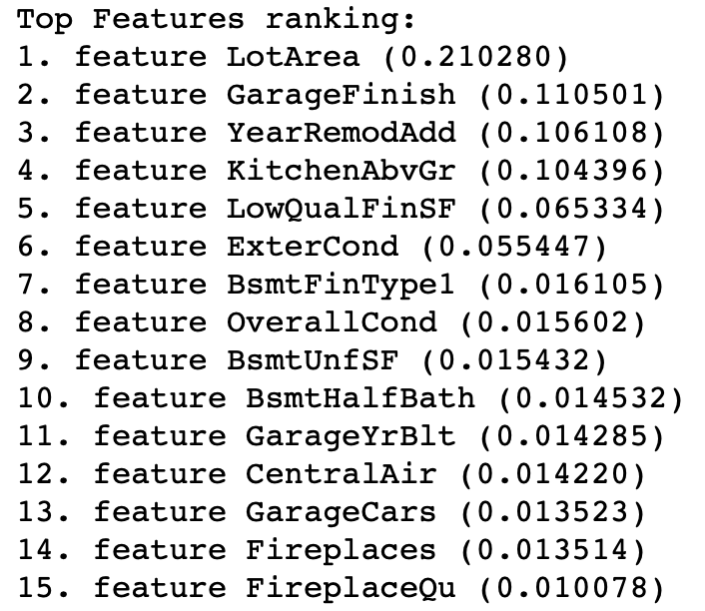
FeatureSelectionWithTrees
The most important feature is LotArea, Lot size in square feet.

Slide 3
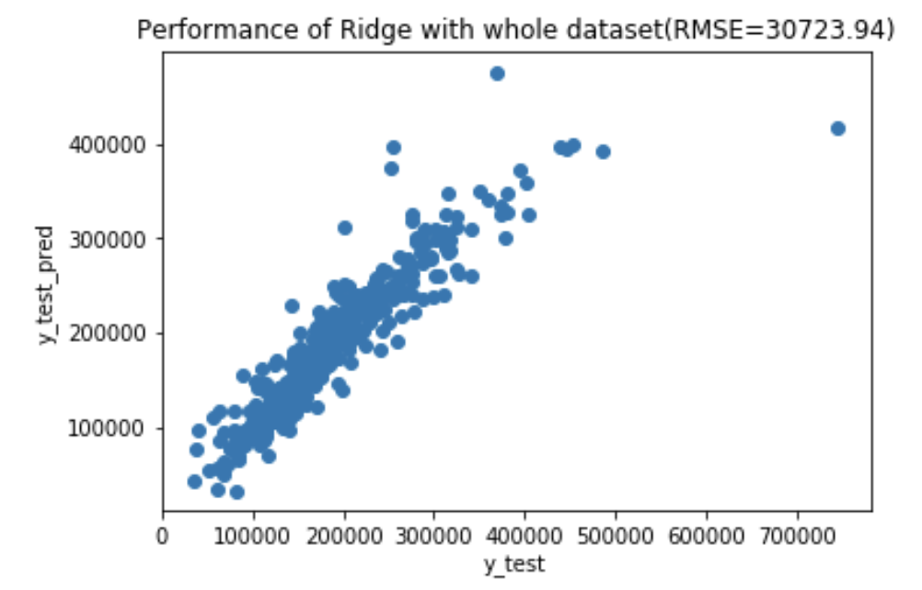
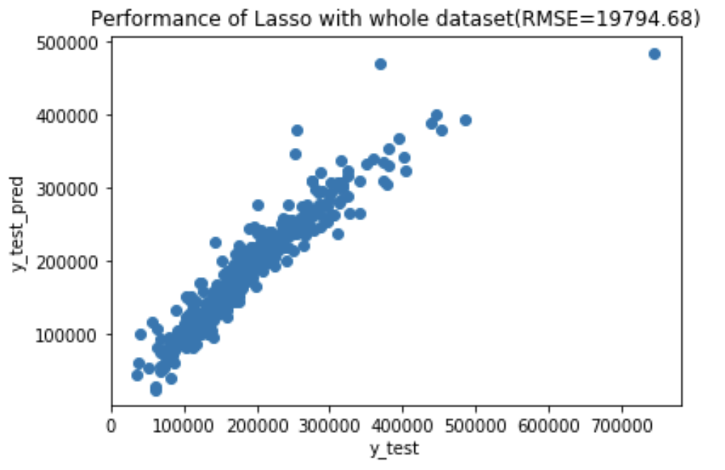
Fit into models

Slide 4
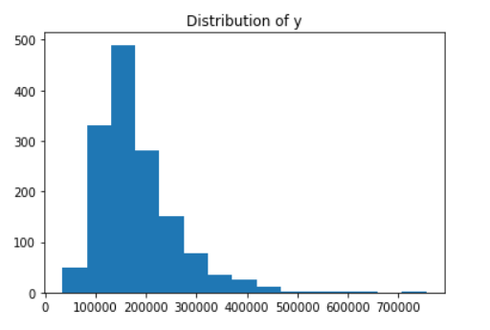
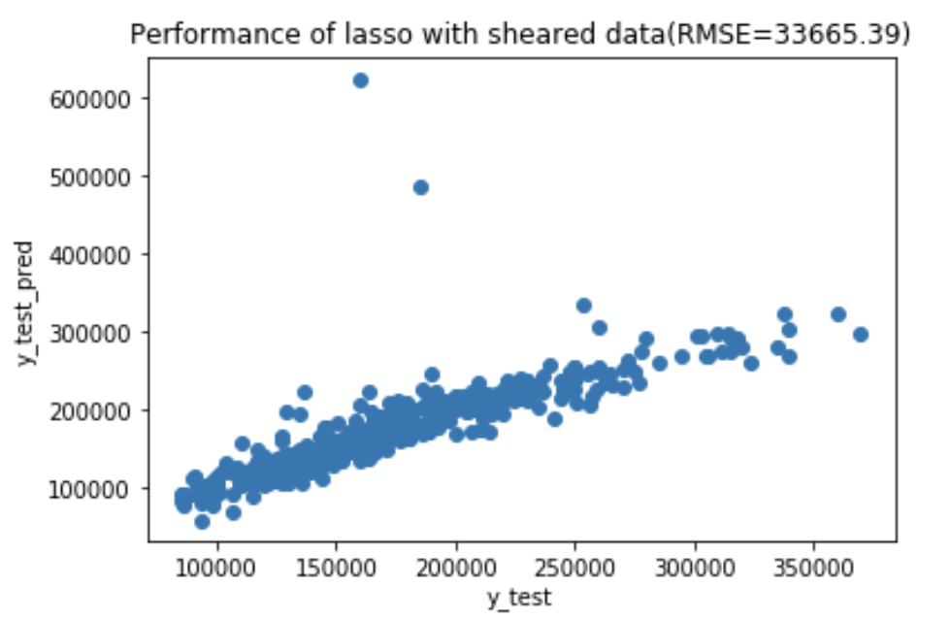
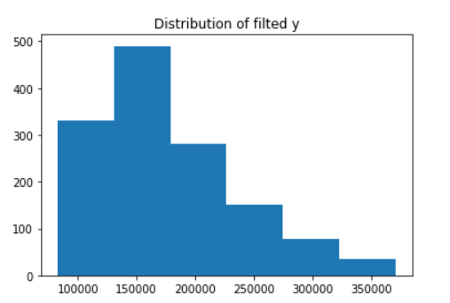
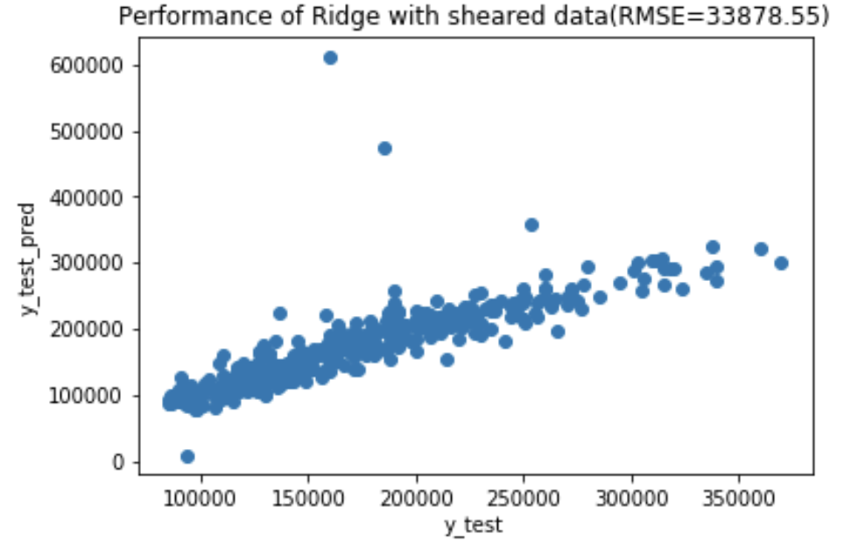
Remove outliers

Slide 5
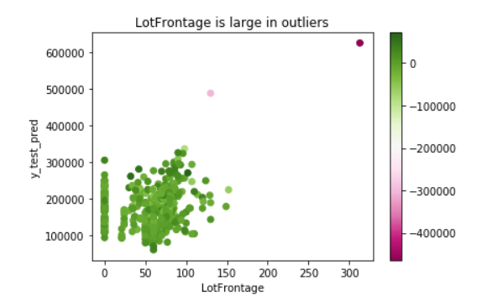
Remove outliers

Slide 6
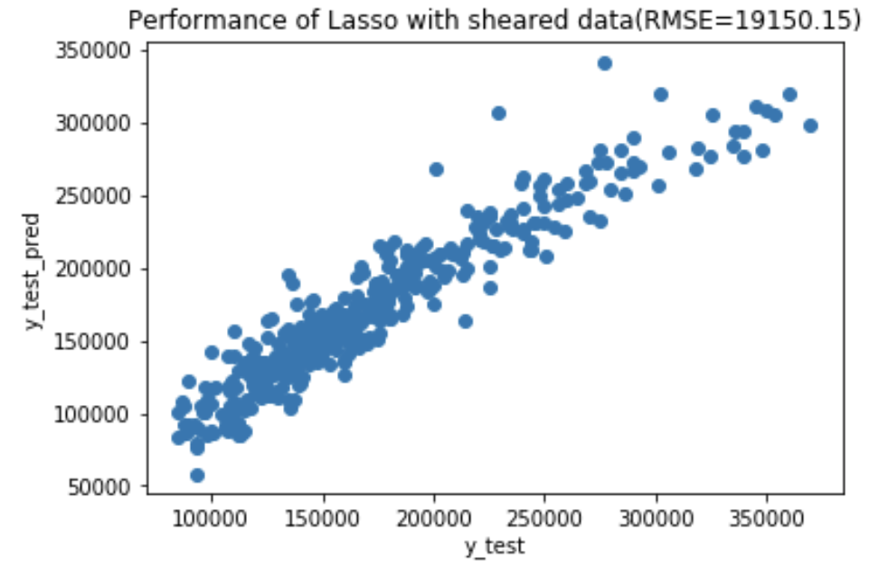
Remove outliers

Slide 7
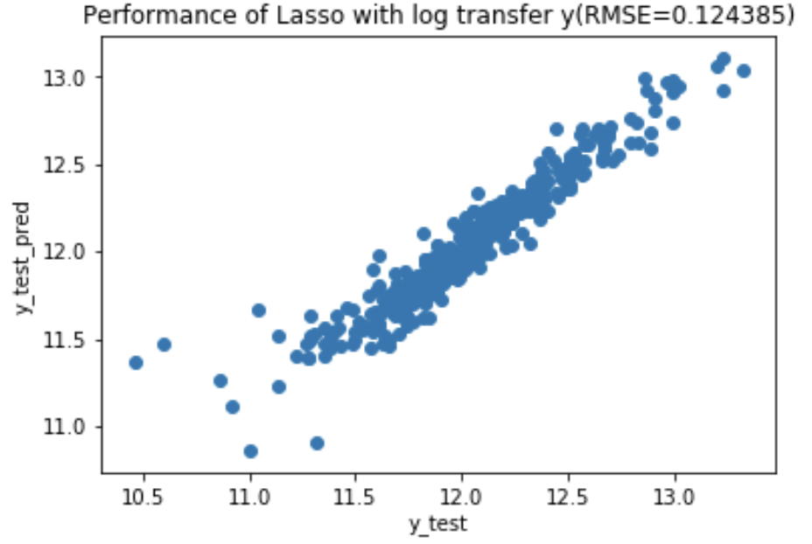
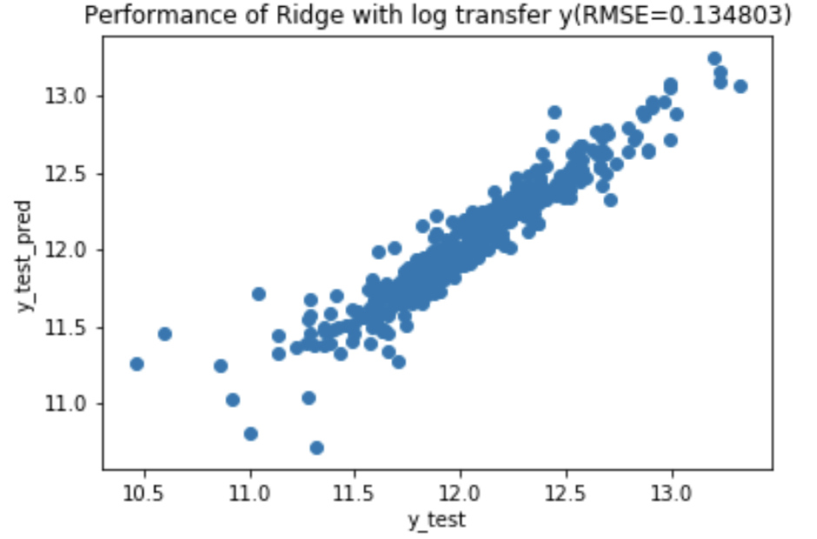
Log transform y

Slide 8
Conclusion
RMSE:
ExtraTrees 27048.08
Lasso 26802.87
Ridge 30723.94
Bagging Lasso 37058.150
Bagging Ridge 36500.47
Lasso with sheared data 19150.15
Lasso with log transformed y 0.124385
Ridge with log transformed y 0.134803

