Slide 1
House Prices: Advanced Regression Techniques
Team members:
Yaohua Chang
Wenyu Fan
Tamer Ibrahim
DSE I2100 Applied Machine Learning and Data Mining

Slide 2
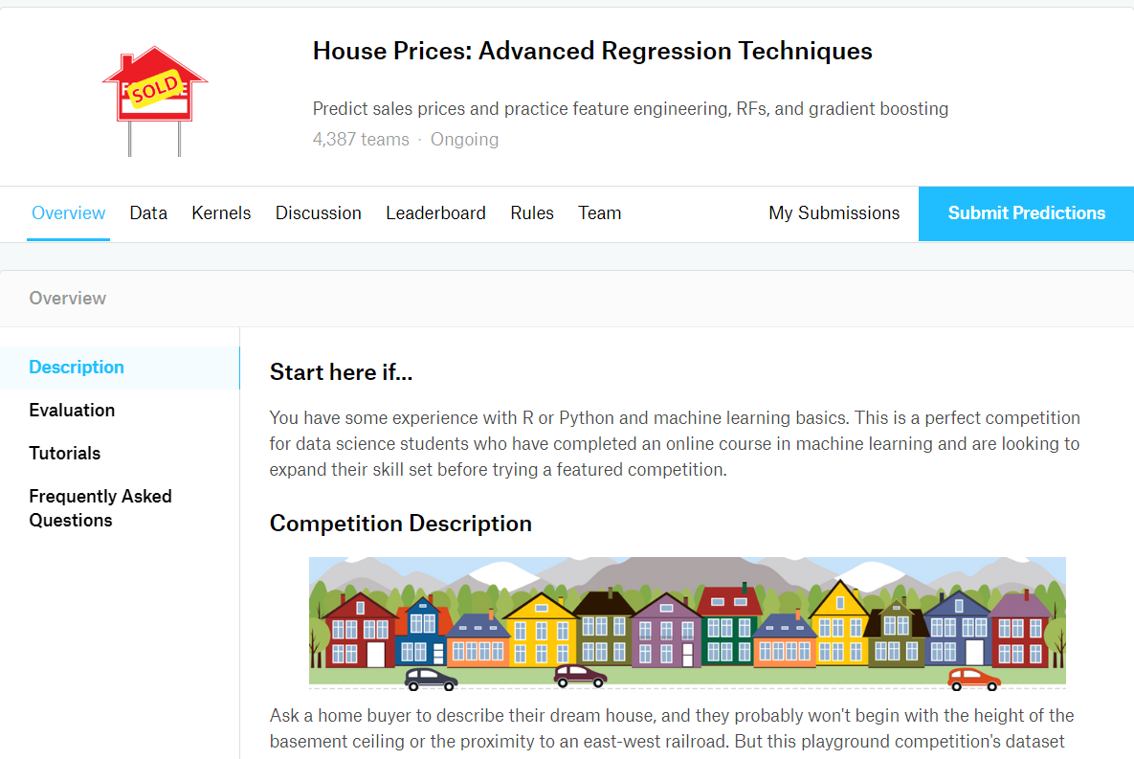
Kaggle Challenge

Slide 3
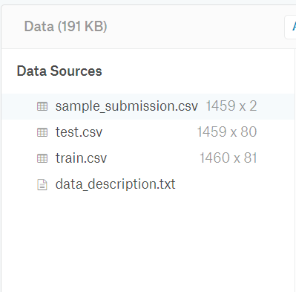
Train and Test data

Slide 4
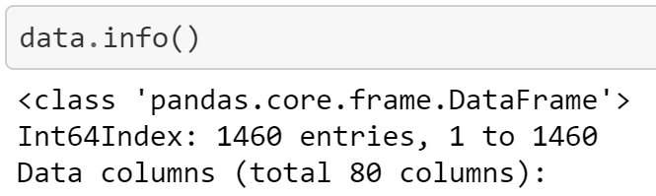
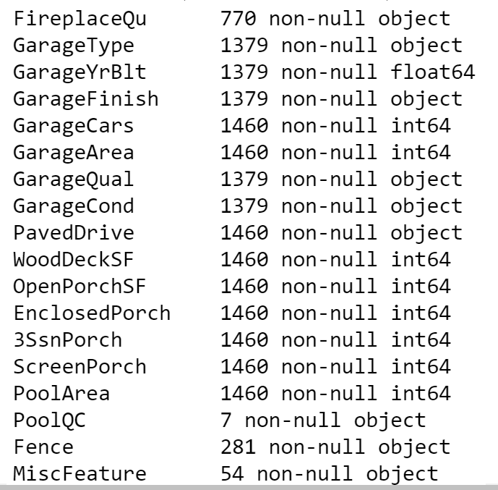
Missing Data

Slide 5
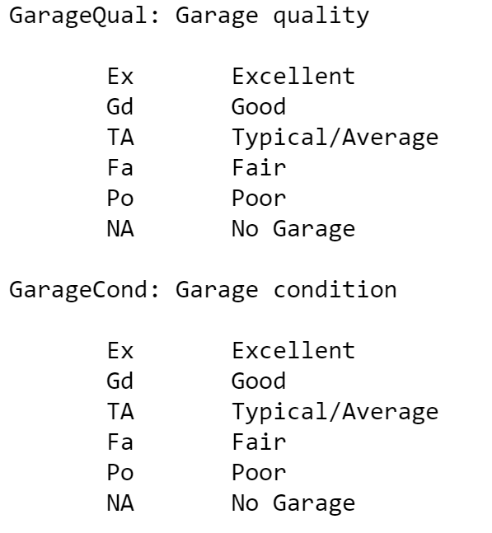
Missing Data

Slide 6
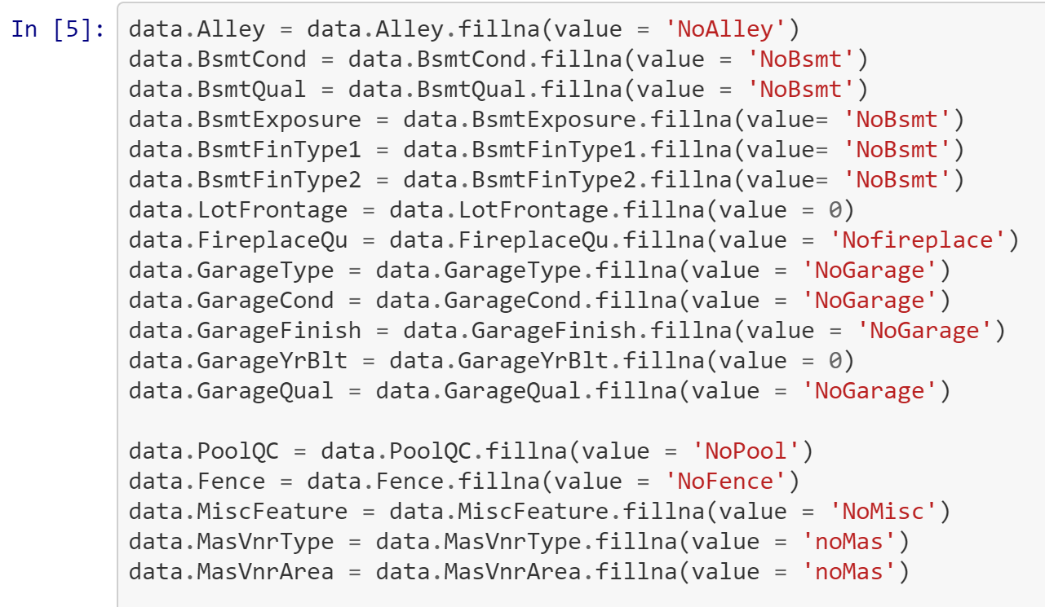
Data Cleaning

Slide 7
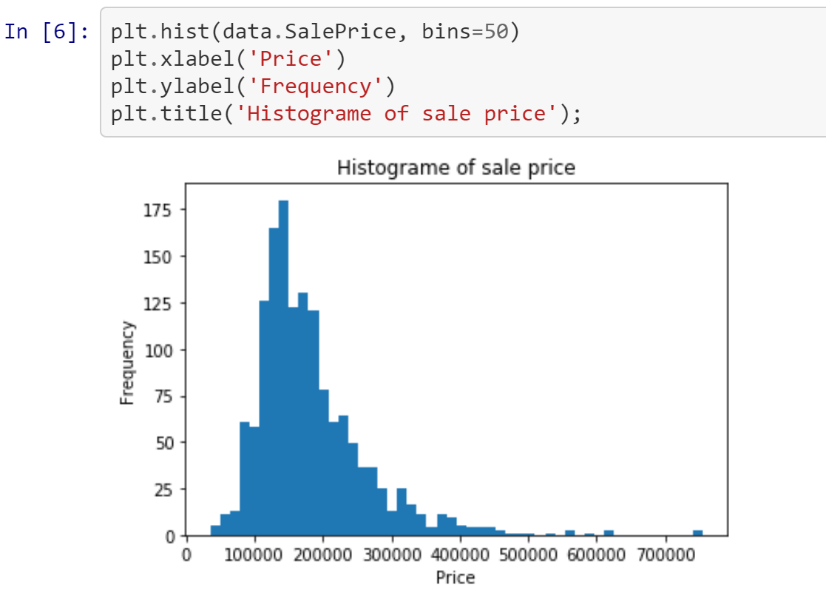
EDA

Slide 8
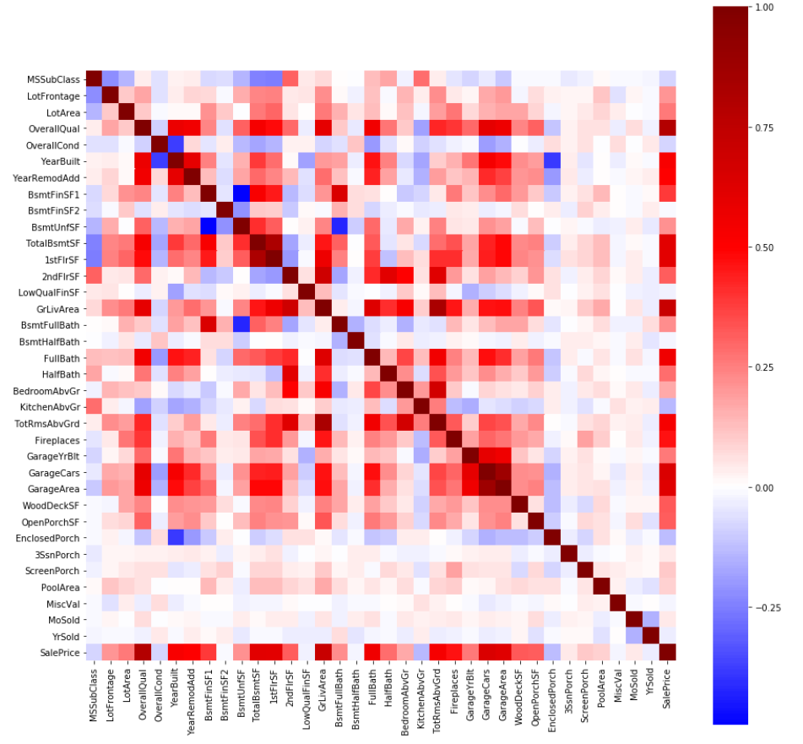
EDA

Slide 9
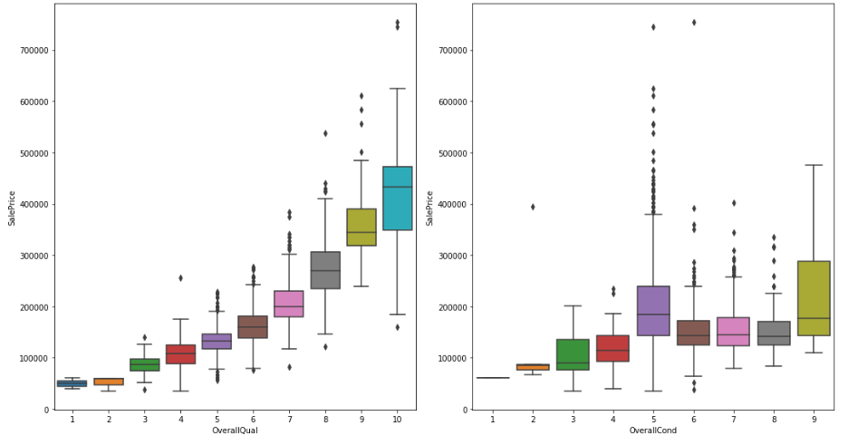
EDA

Slide 10
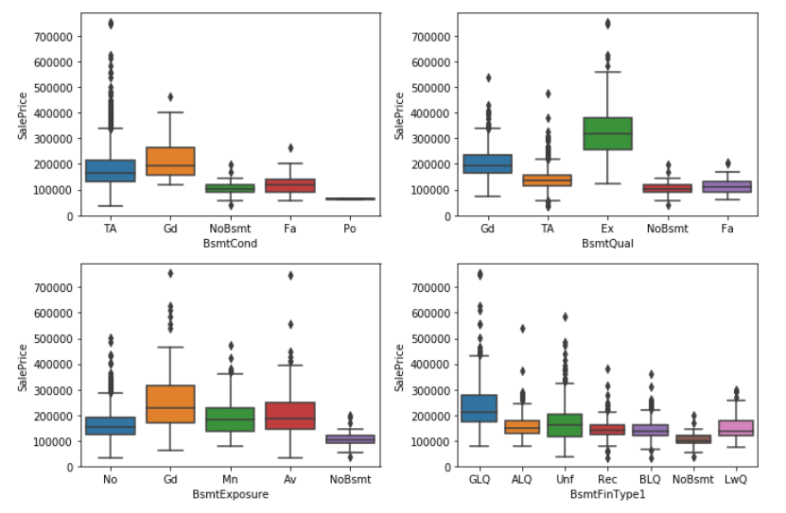
EDA

Slide 11
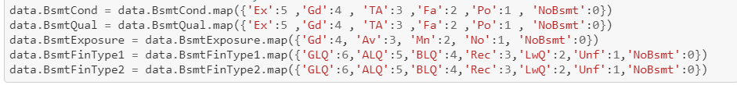
Label Encoder for Ordinal columns

Slide 12
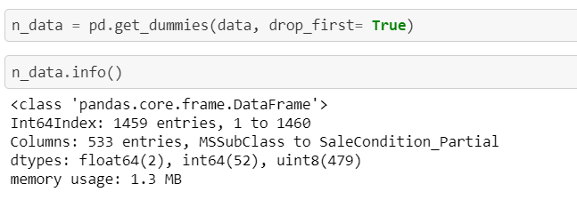
Convert nominal columns to One-hot encode

Slide 13
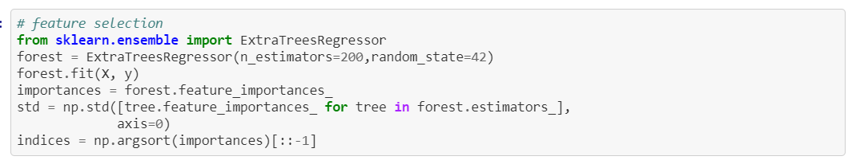
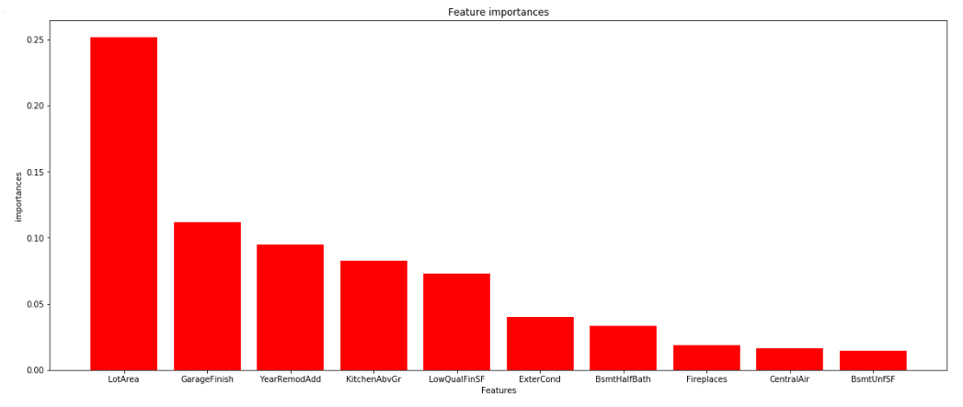
Feature Selection

Slide 14
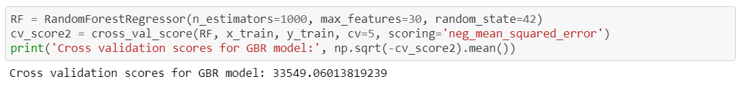
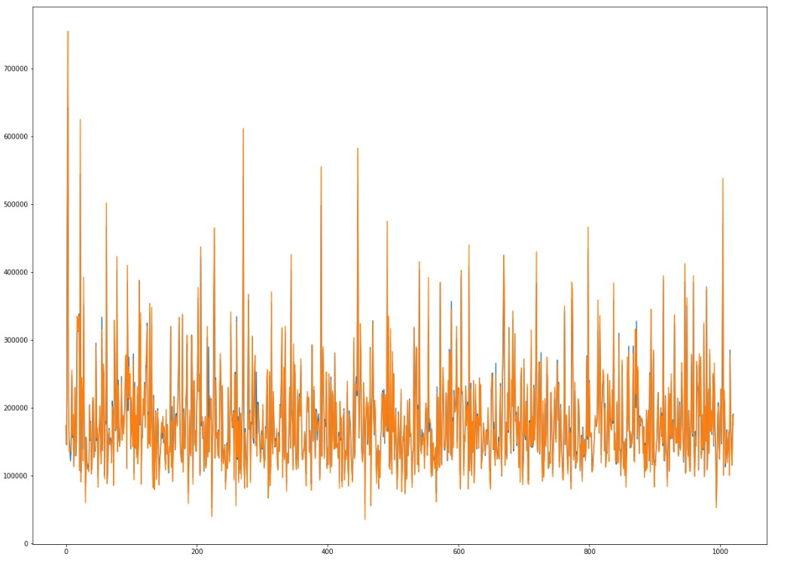
First attempt with Random Forest

Slide 15
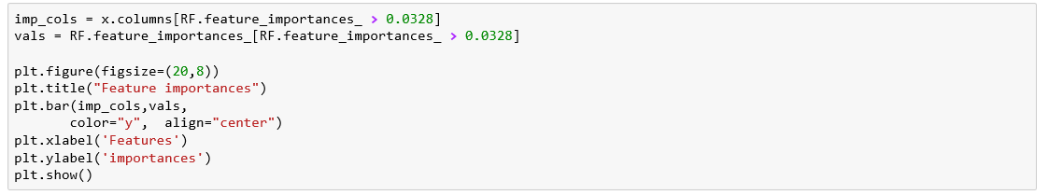
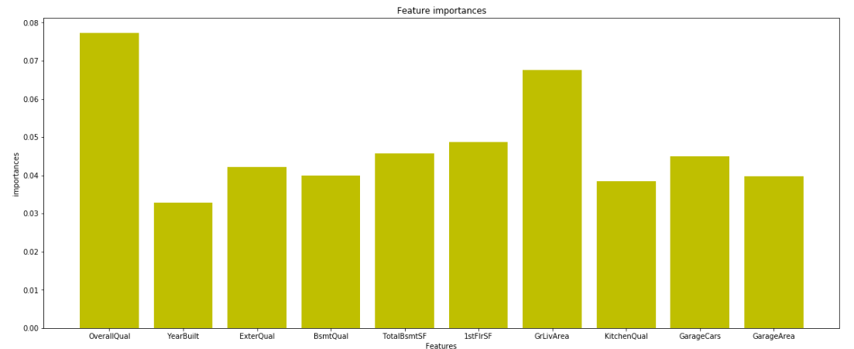
First attempt with Random Forest

Slide 16
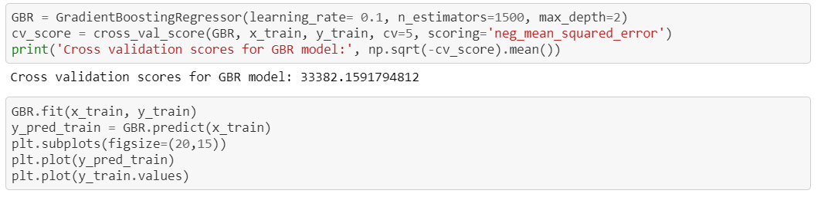
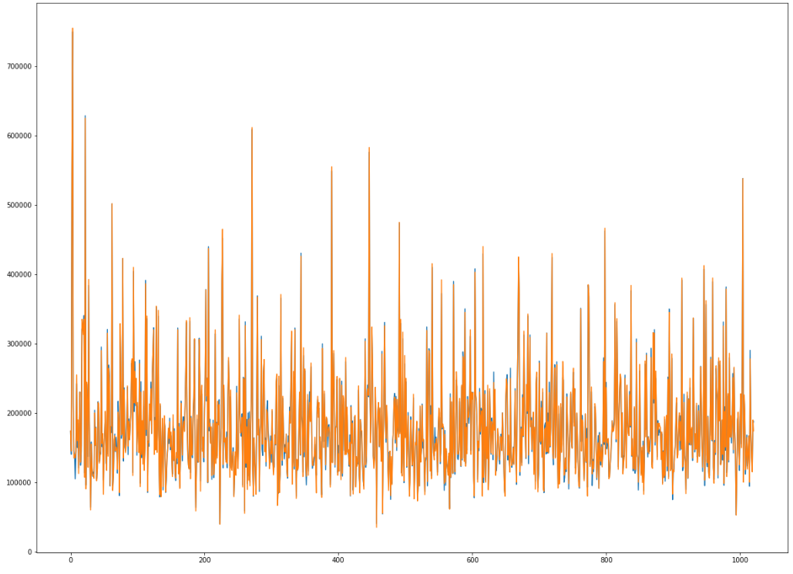
Second Attempt with Gradient Boost

Slide 17
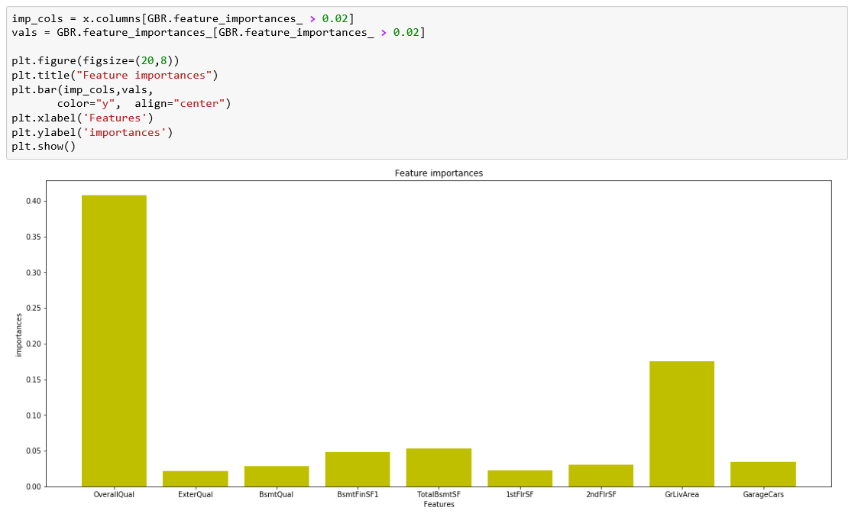
Second Attempt with Gradient Boost

