Slide 1
House Prices: Advanced Regression Techniques
Team members:
Yaohua Chang
Wenyu Fan
Tamer Ibrahim
DSE I2100 Applied Machine Learning and Data Mining

Slide 2
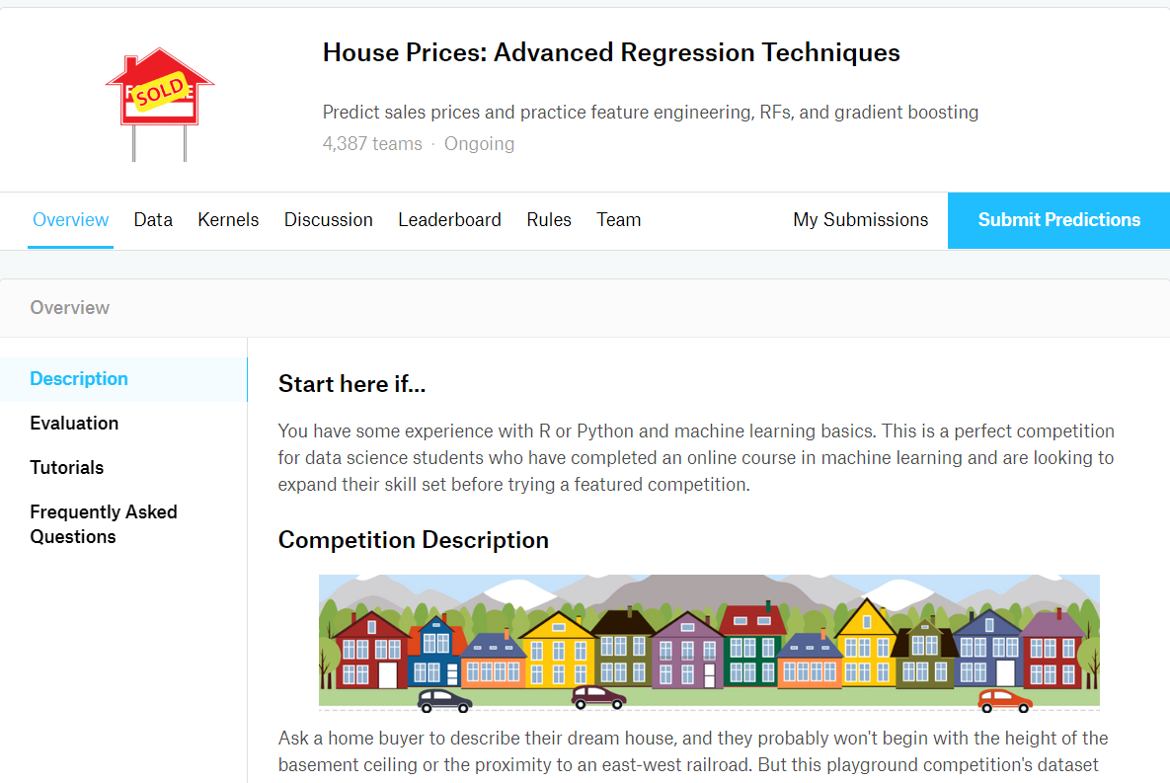
Kaggle Challenge

Slide 3
Importance of the Problem
A model like this would be very valuable for a real state agent who could make use of the information provided in a daily basis.
Evaluate the price of your house to get a loan from bank
If you are looking for house, an app can use the prediction of house prices to help customers where to look.

Slide 4
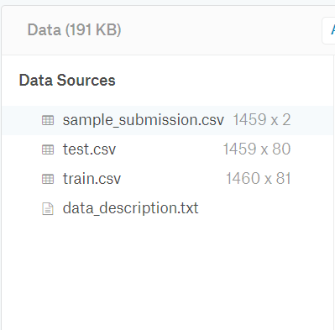
Train and Test data

Slide 5
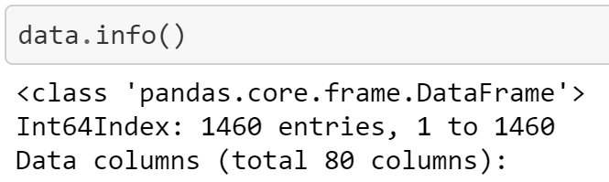
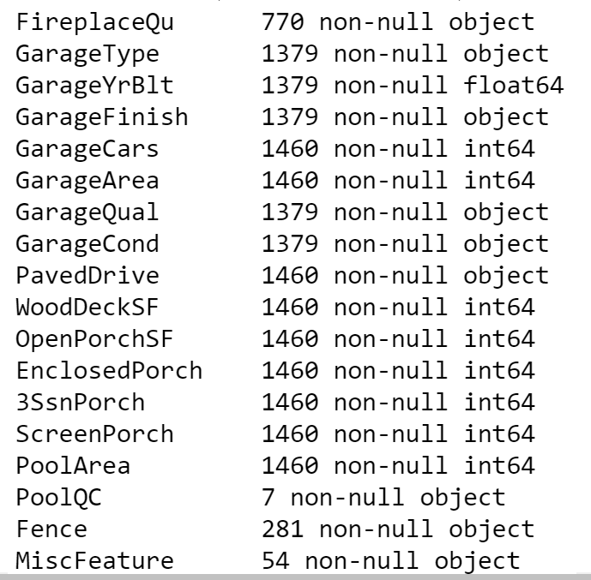
Missing Data

Slide 6
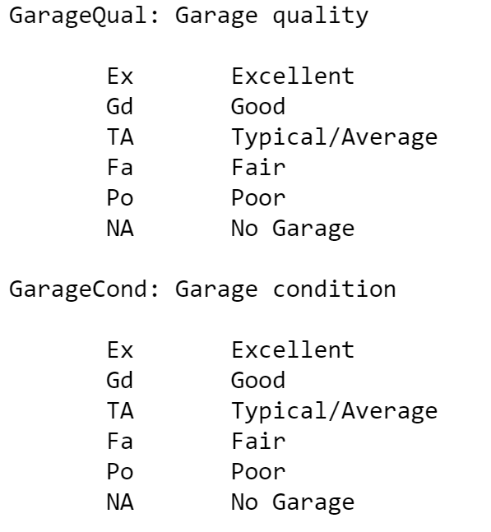
Missing Data

Slide 7
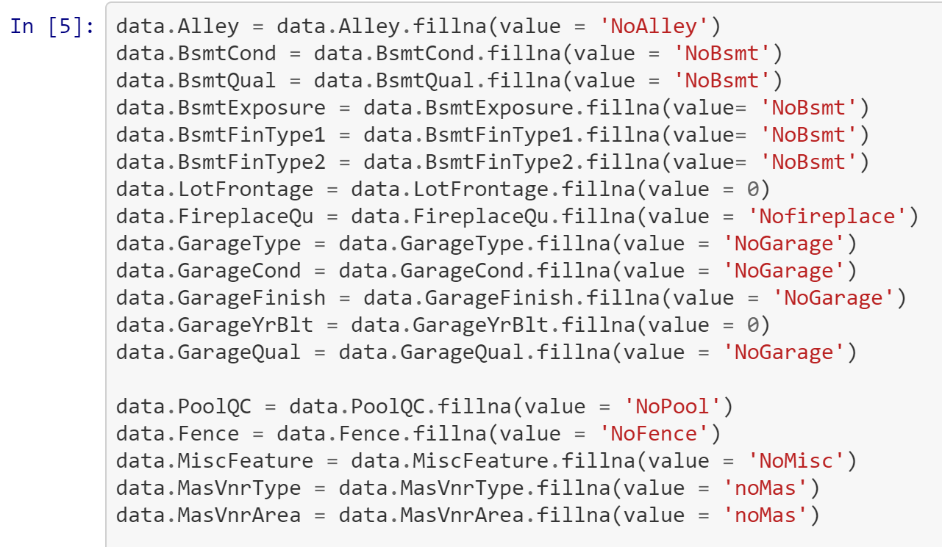
Data Cleaning

Slide 8
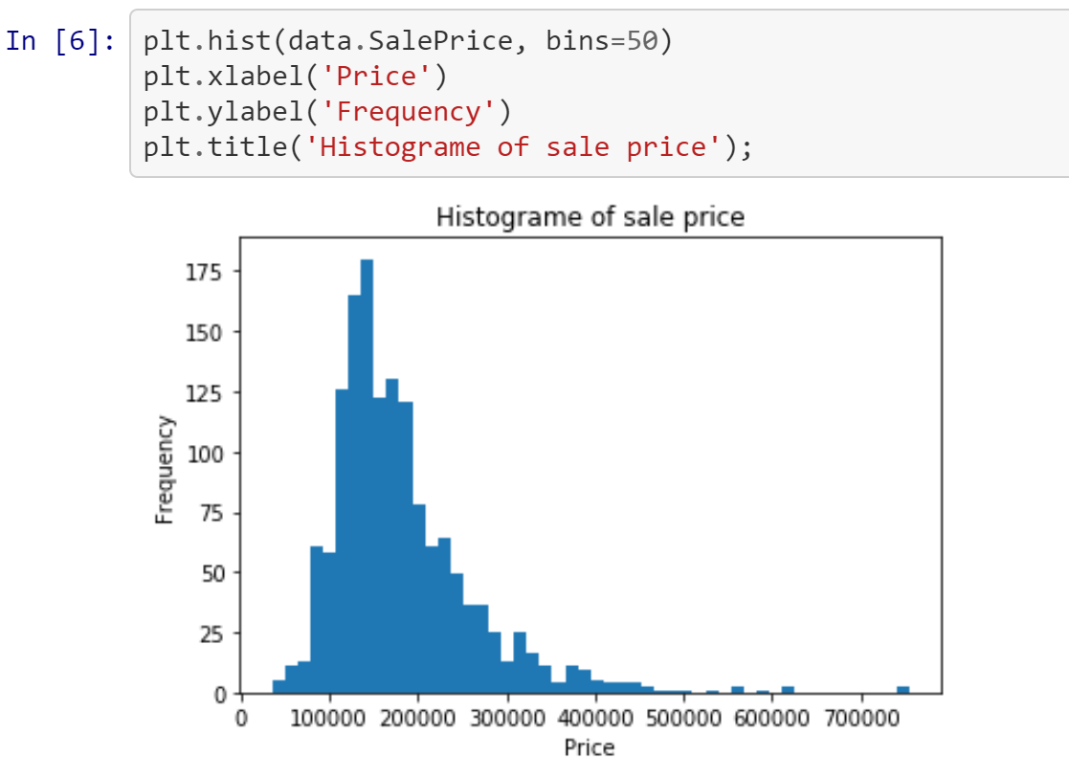
EDA

Slide 9
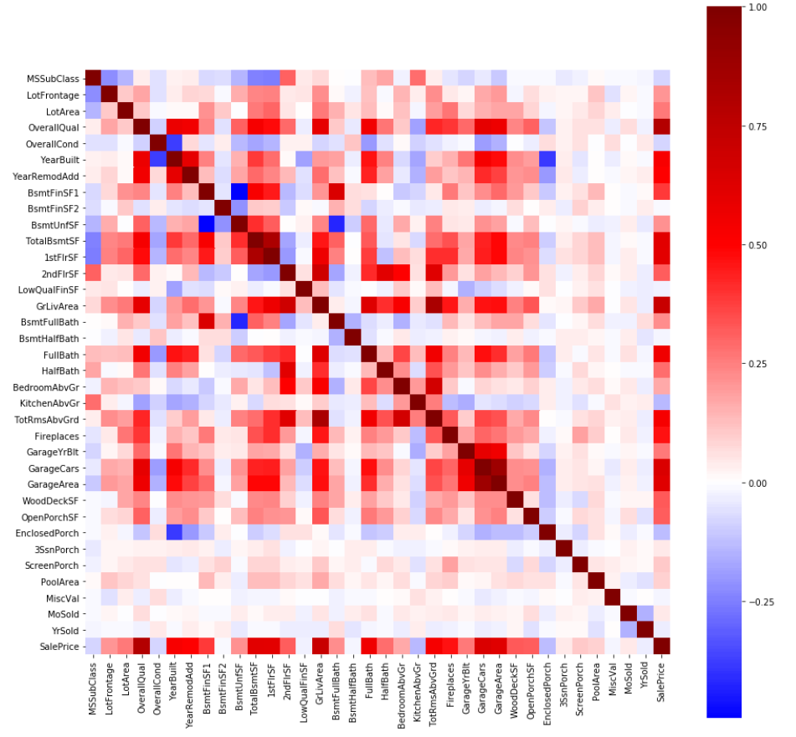
EDA

Slide 10
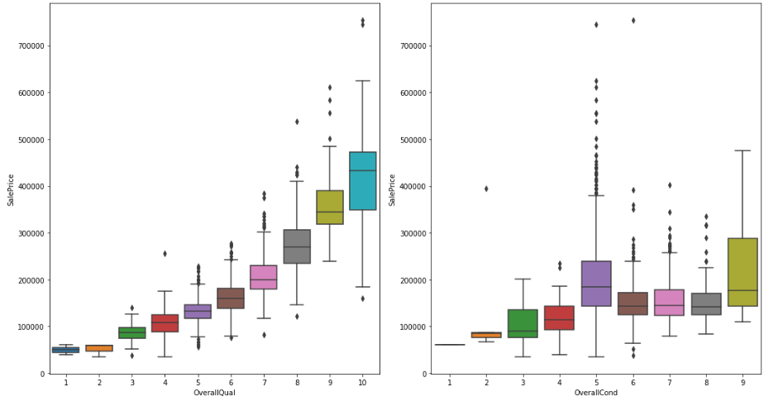
EDA

Slide 11
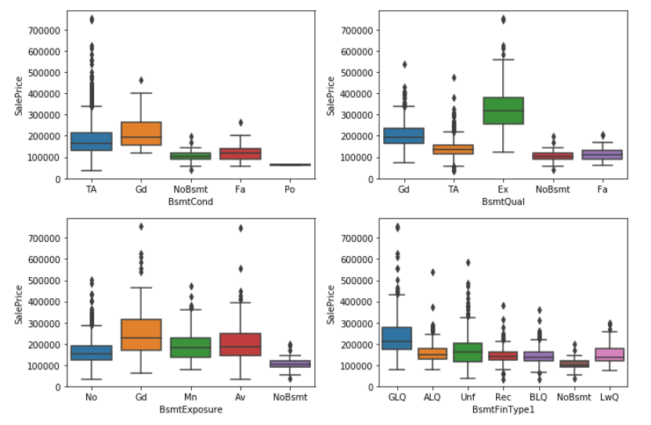
EDA

Slide 12
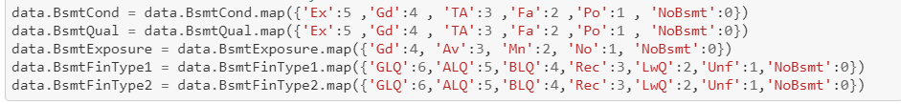
Label Encoder for Ordinal columns

Slide 13
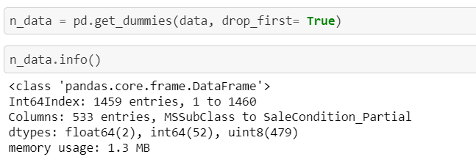
Convert nominal columns to One-hot encode

Slide 14
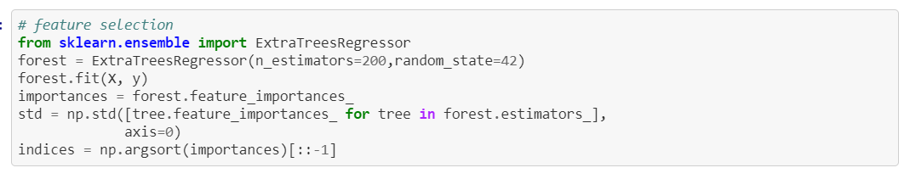
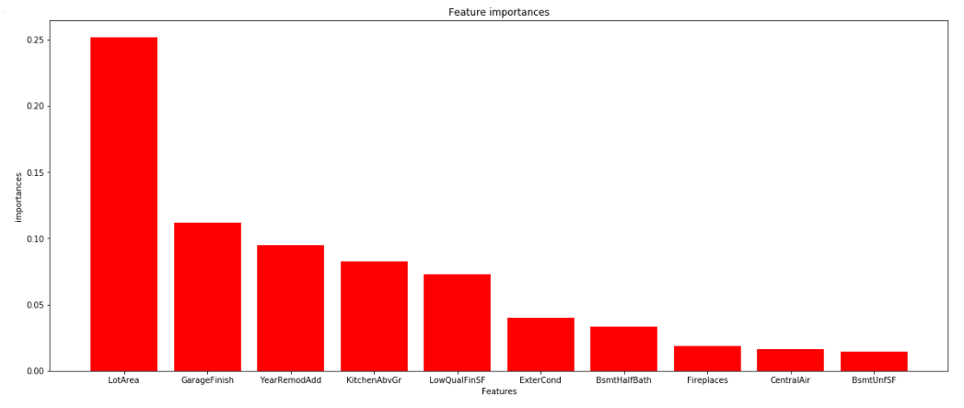
Feature Selection

Slide 15
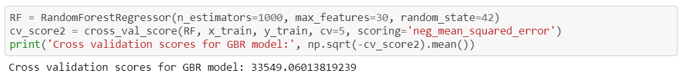
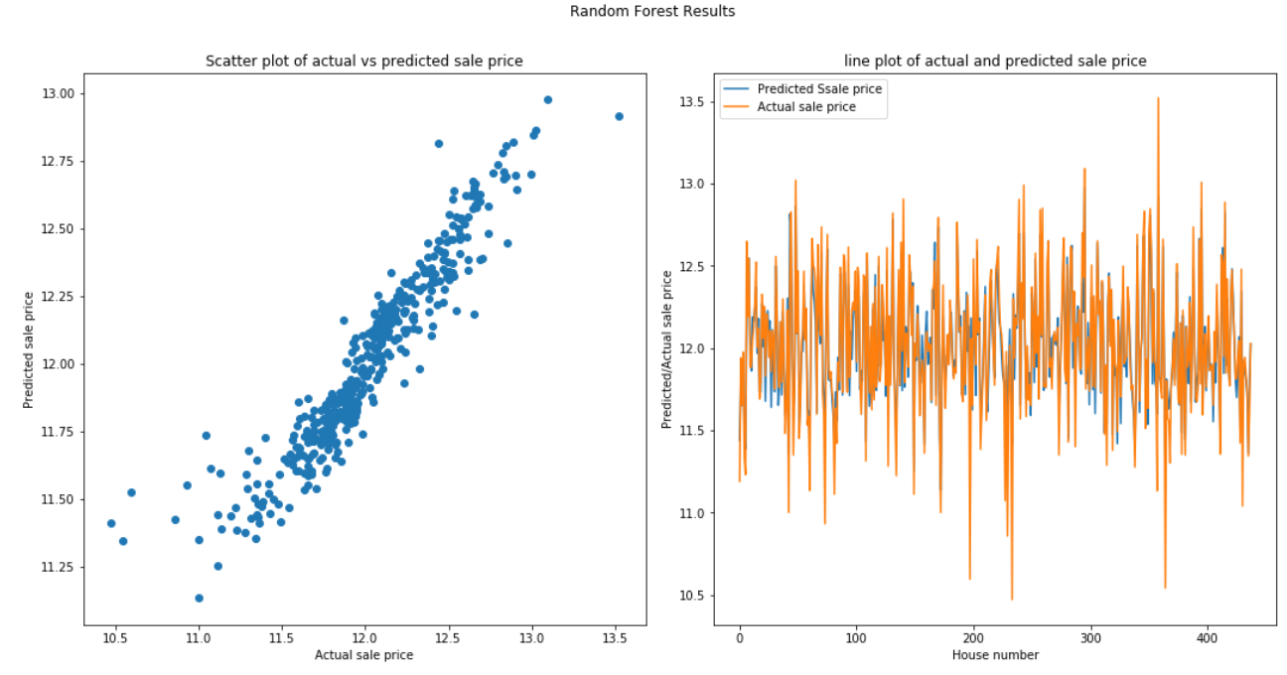
First attempt with Random Forest

Slide 16
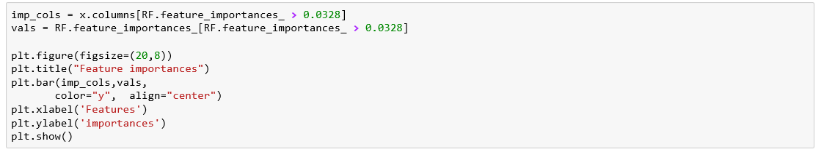
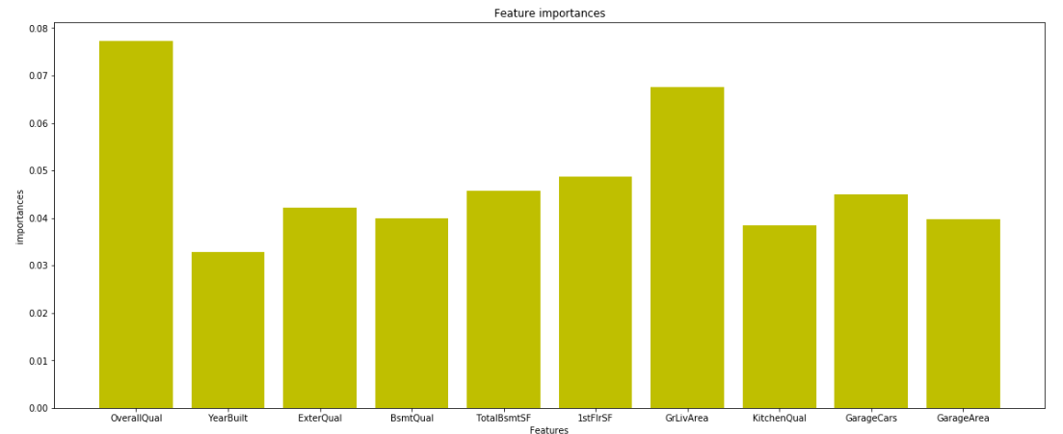
First attempt with Random Forest

Slide 17
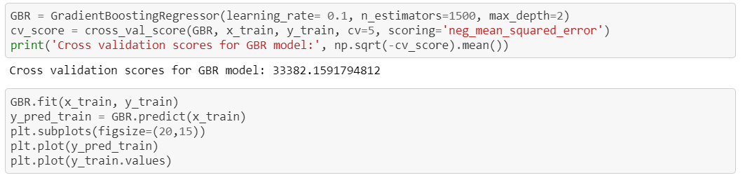
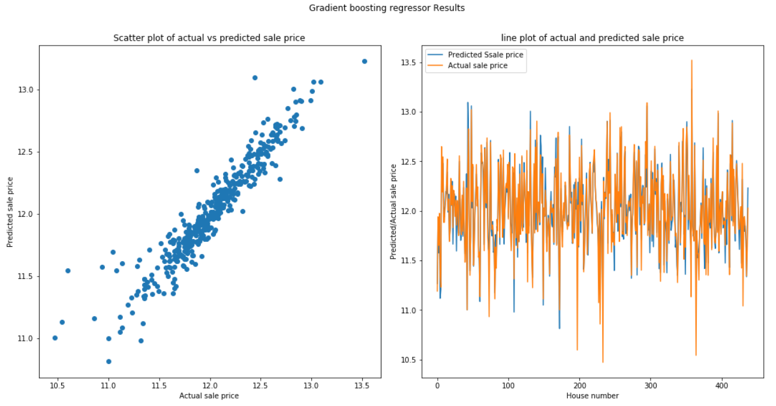
Second Attempt with Gradient Boost

Slide 18
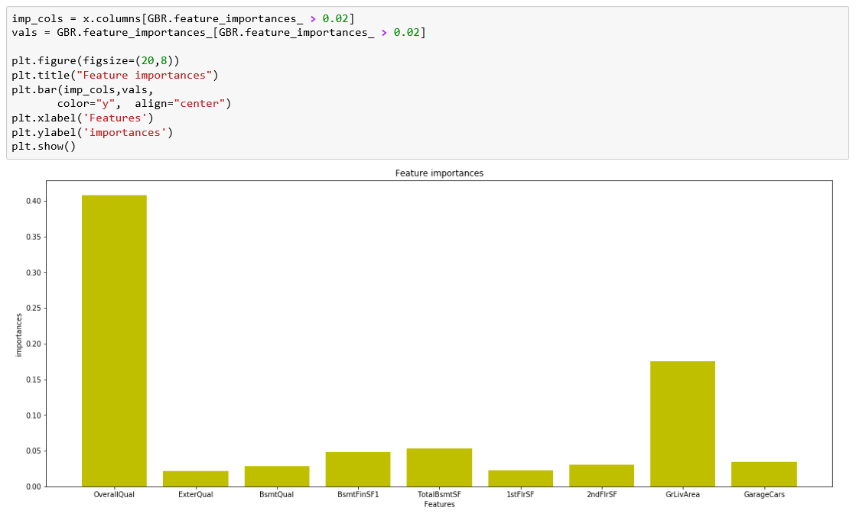
Second Attempt with Gradient Boost

Slide 19
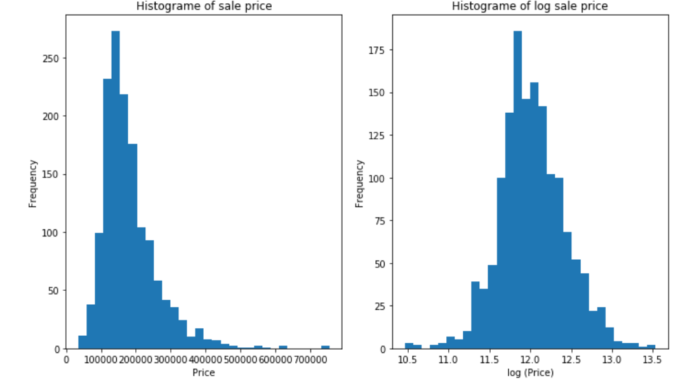
Sale Price Histogram

Slide 20
Our Plan
Algorithm
Org price
Log(Price)
Remove outliers

Slide 21
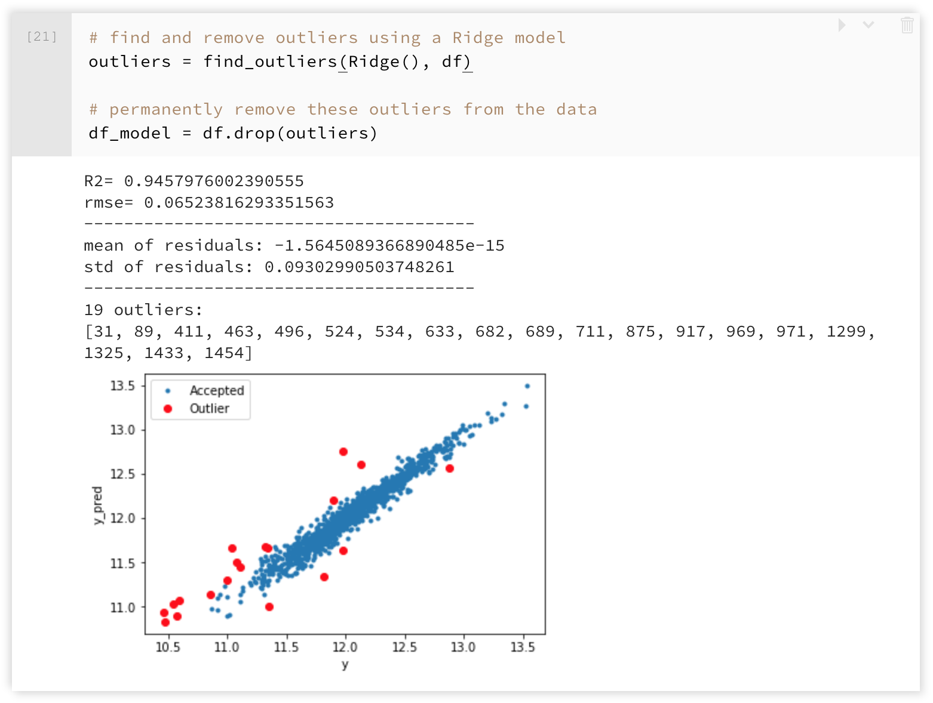
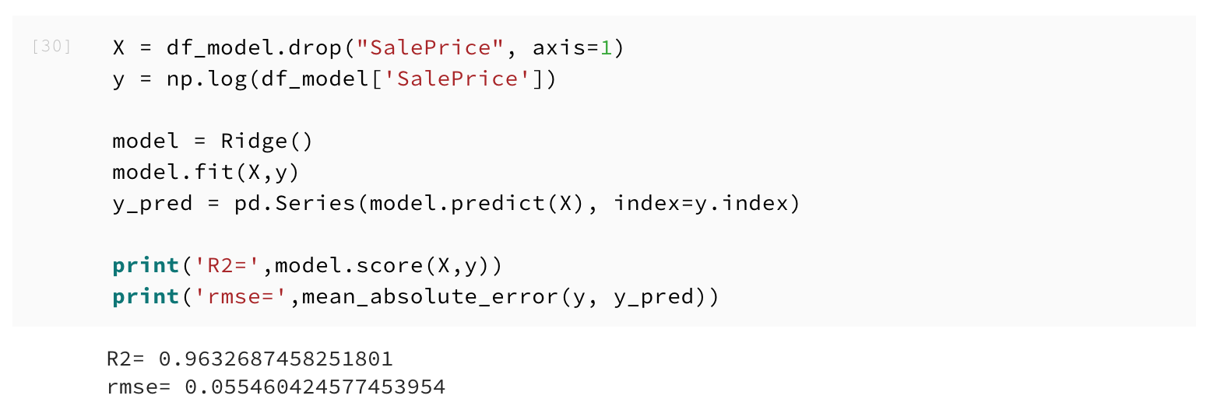
Identify and Remove Outliers

Slide 22
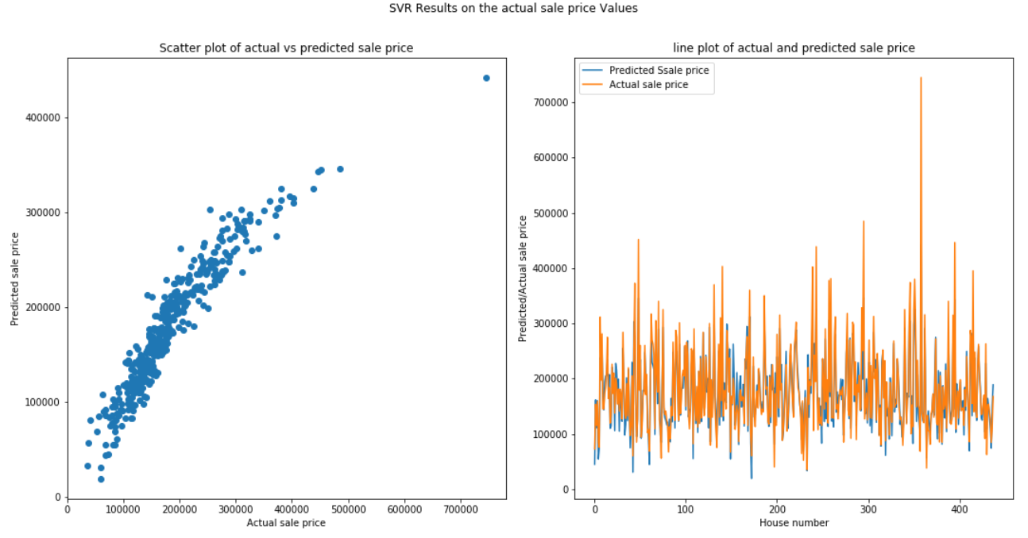
SVR Actual Price
Train on important Feature

Slide 23
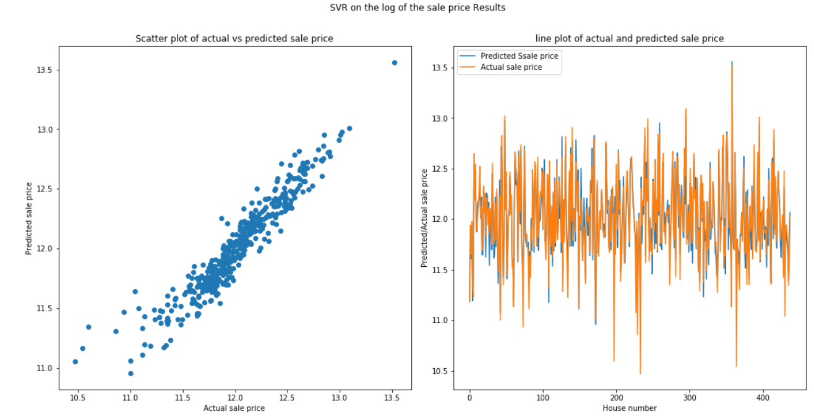
SVR Log (Price)
Train on important Feature

Slide 24
Conclusion
1: Model trained on actual data
2: Model trained on log(sale Price)
3: Model trained of data without outliers

Slide 25
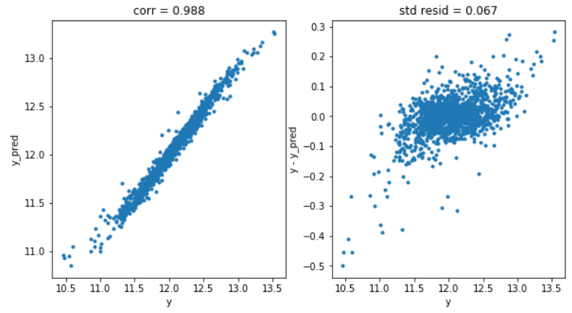
Random Forest

