Slide 1
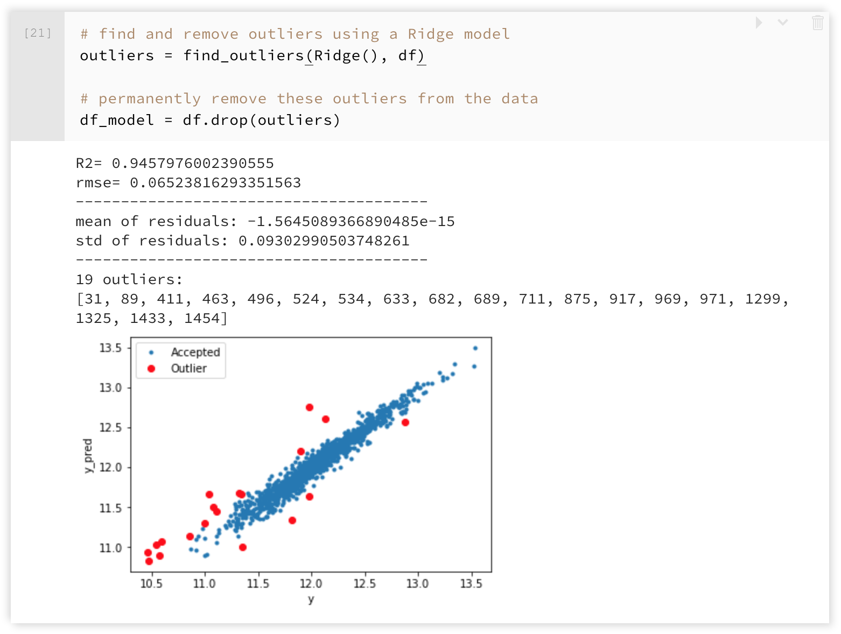
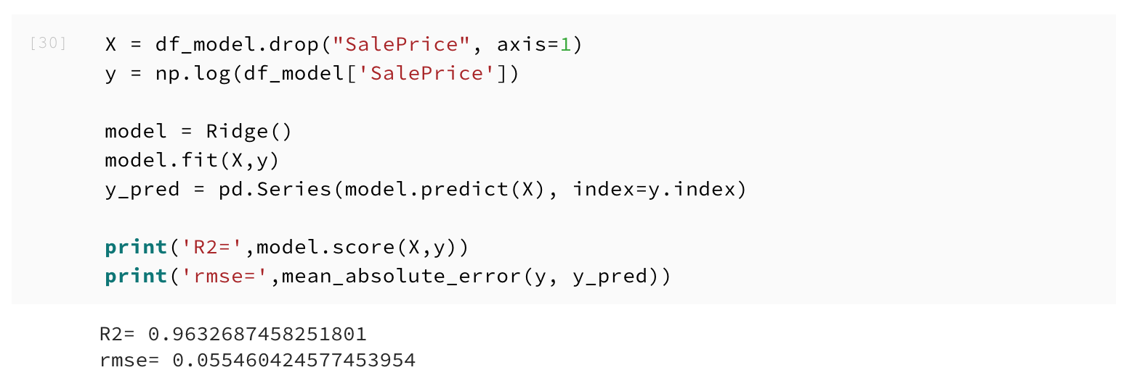
Identify and Remove Outliers

Slide 2
Fit Model
Linear Regression:
sklearn.linear_model.Ridge
sklearn.linear_model.Lasso
sklearn.linear_model.ElasticNet
Support Vector Machines:
sklearn.svm.LinearSVR
sklearn.svm.SVR
Nearest Neighbours:
sklearn.neighbors.KNearestNeighborsRegressor
Tree Based:
sklearn.ensemble.RandomForestRegressor
sklearn.ensemble.GradientBoostingRegressor
xgboost.XGBRegressor

Slide 3
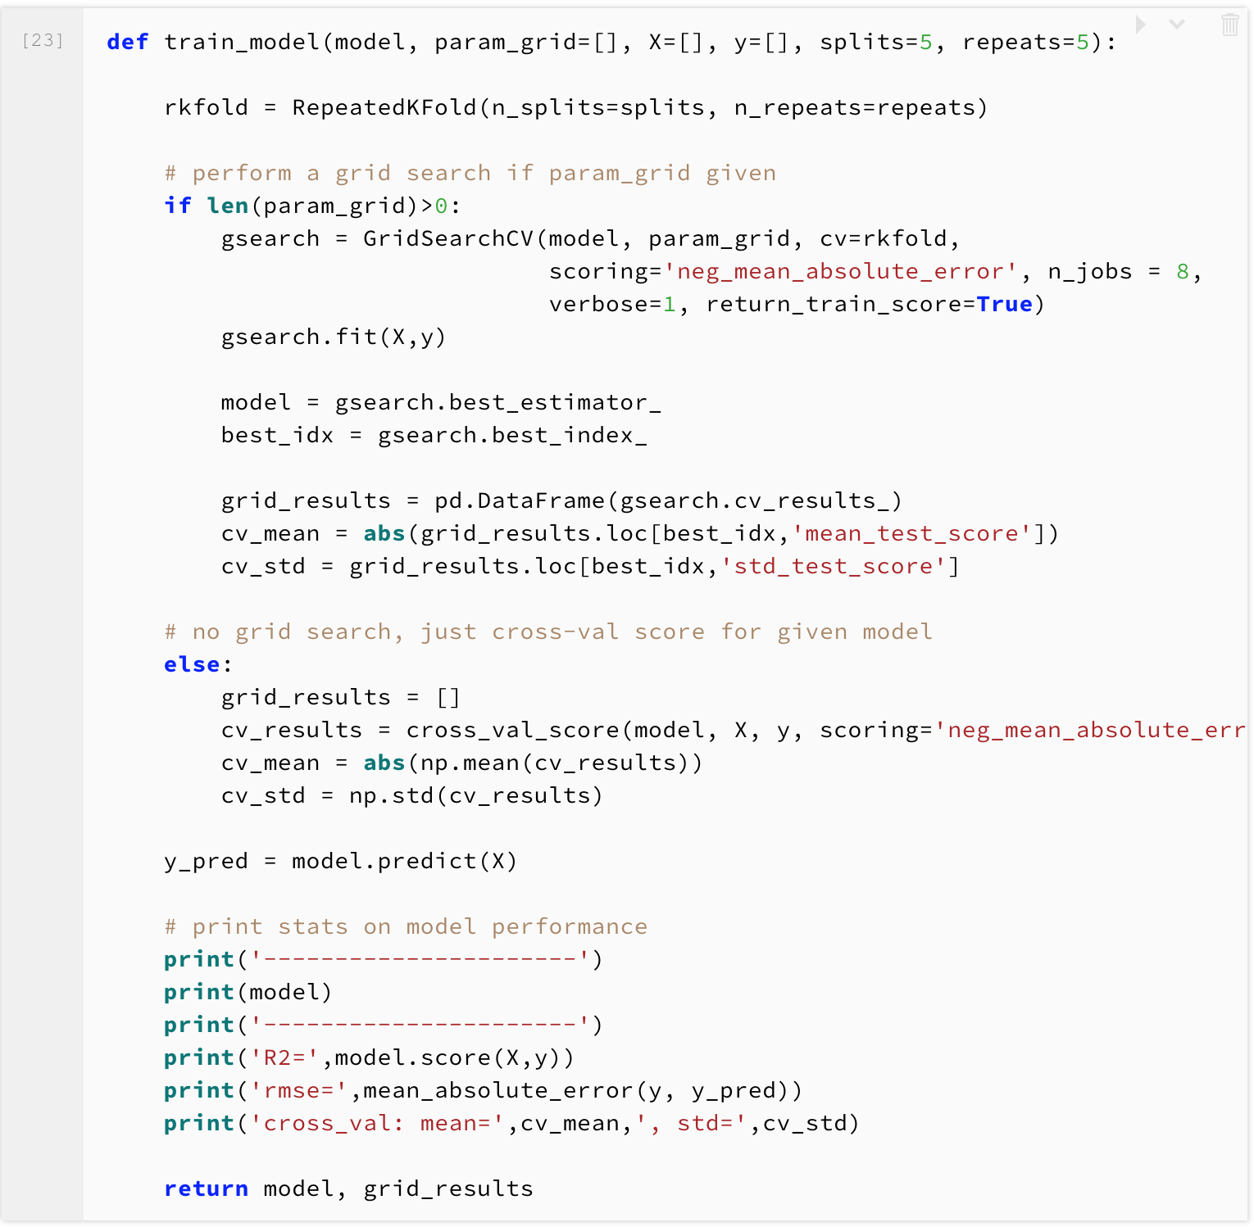
Train Model Function

Slide 4
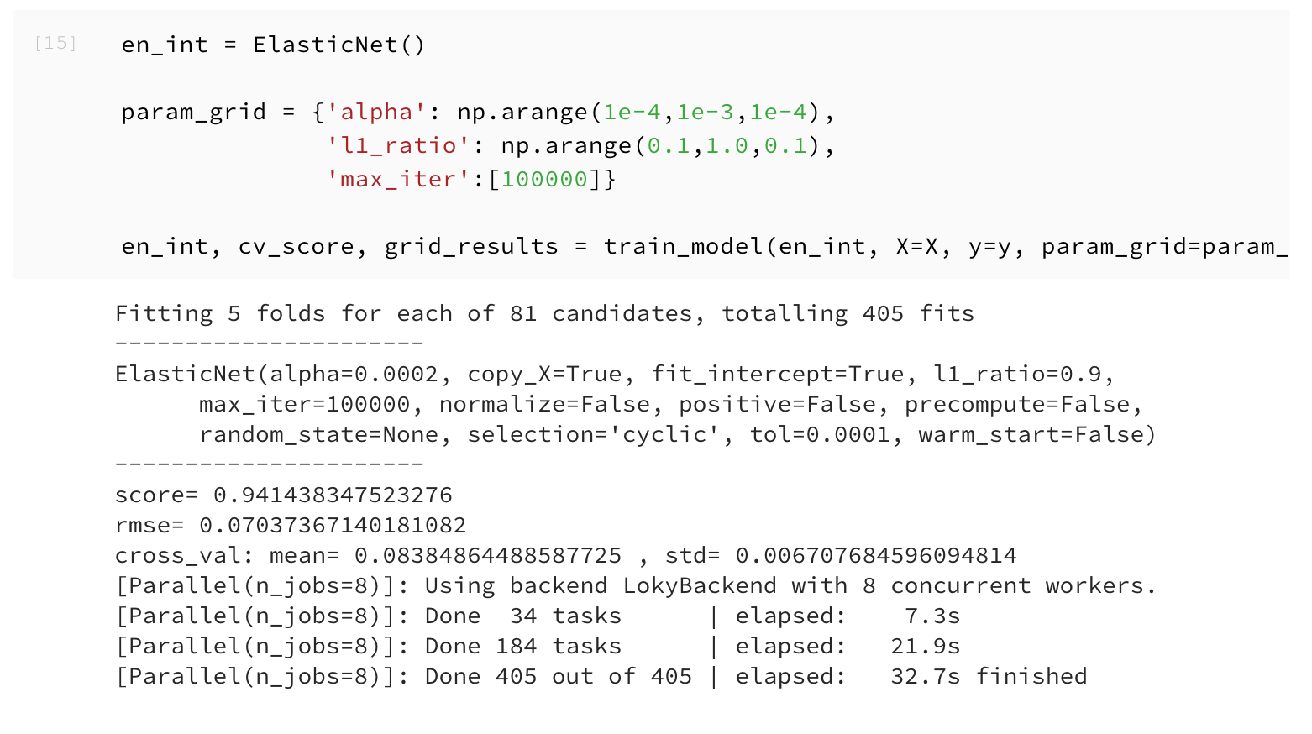
Elastic Net

Slide 5
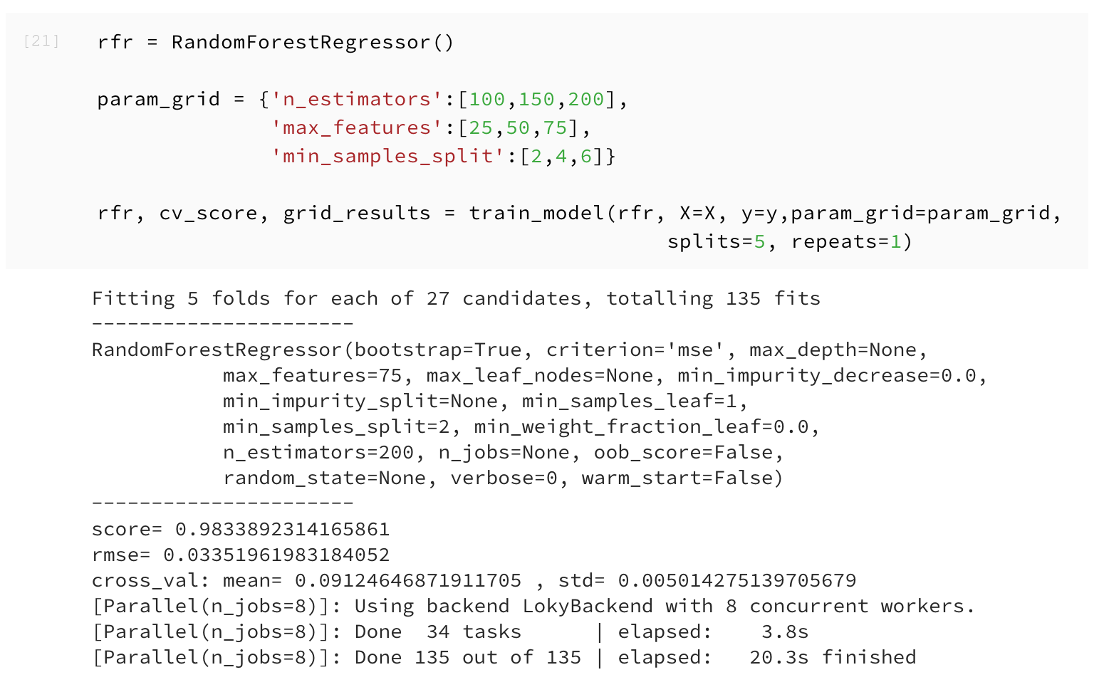
Random Forest

Slide 6
Compare Model with log(y)
 | R square (R2) | Root Mean Square Error (RMSE) | Mean | Standard Deviation (std)
Ridge | 0.9457976 | 0.0652382
Elastic Net | 0.9473058 | 0.07037367 | 0.08384865 | 0.00670768
Random Forest | 0.9877892 | 0.03351962 | 0.0912465 | 0.00501428

Slide 7
Compare Model without log(y)
 | R square (R2) | Root Mean Square Error (RMSE) | Mean | Standard Deviation (std)
Ridge | 0.95590900 | 11291.2240
Elastic Net | 0.91388614 | 15122.4778 | 16196.3887 | 829.09400
Random Forest | 0.98622979 | 5580.97214 | 15308.3902 | 999.77862

Slide 8
Compare Model with log(y)
We applied three algorithms in this part including Ridge, Elastic Net, Random Forest.
After removing outliers which identified by Ridge, the RMSE has slightly deceased.
Random Forest has better R2 and RMSE, but Elastic Net have better cross-validation scores.

