Slide 1
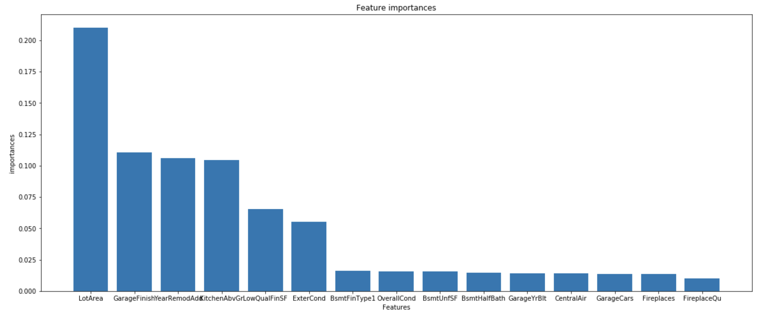
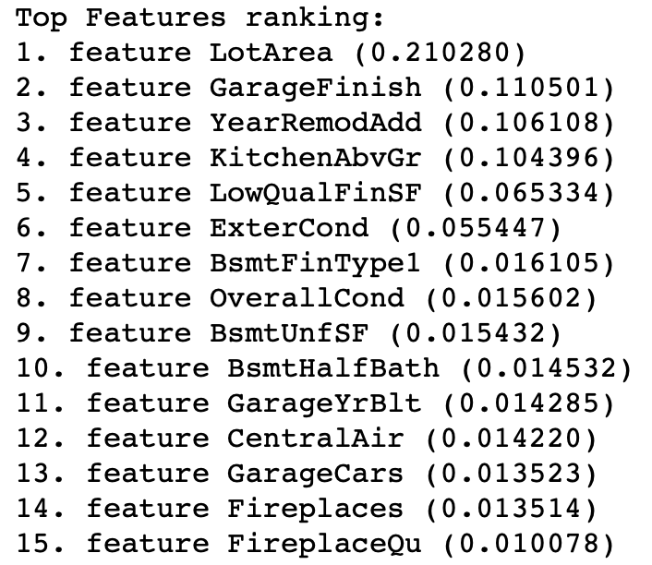
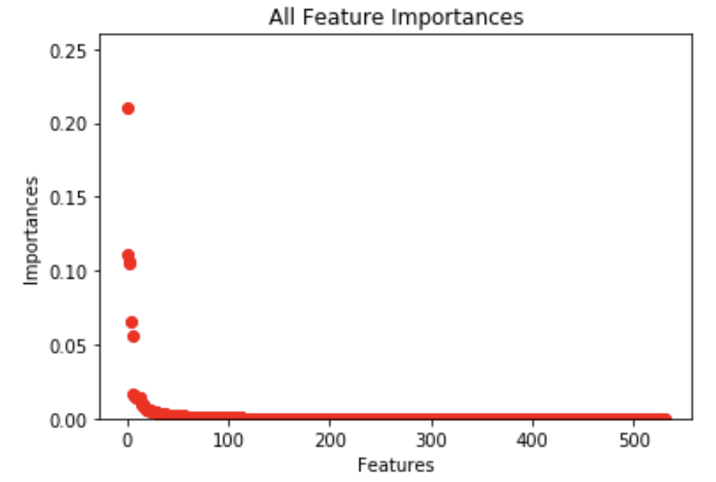
The most important feature is LotArea, Lot size in square feet.

Slide 2
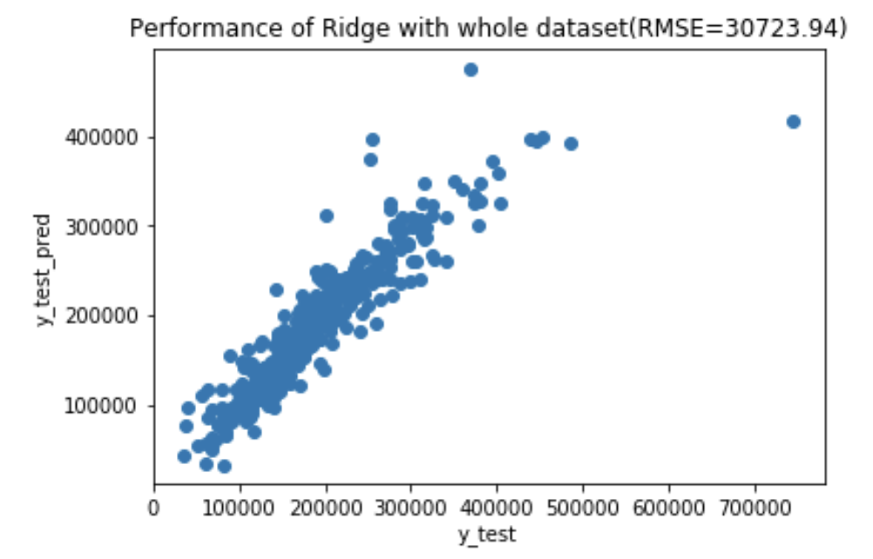
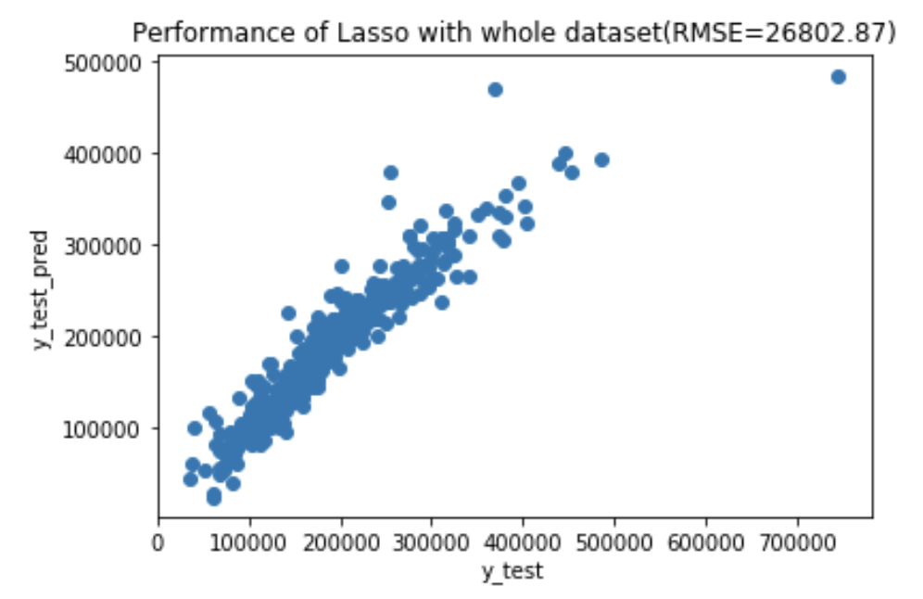
Fit into models

Slide 3
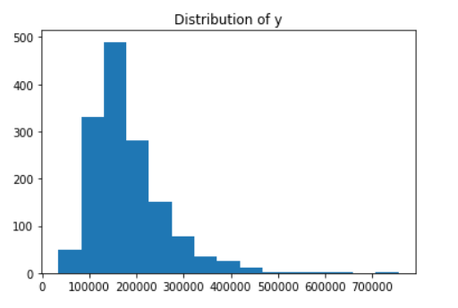
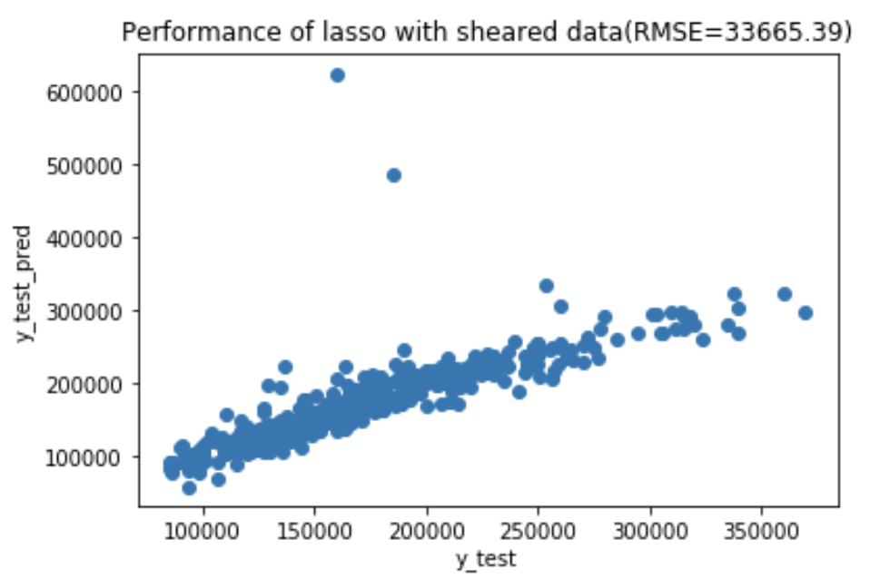
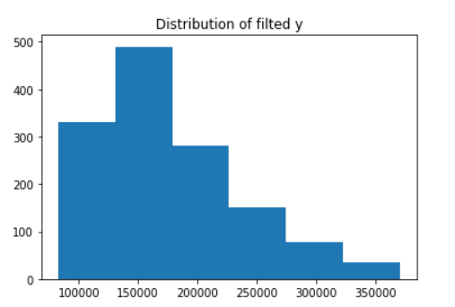
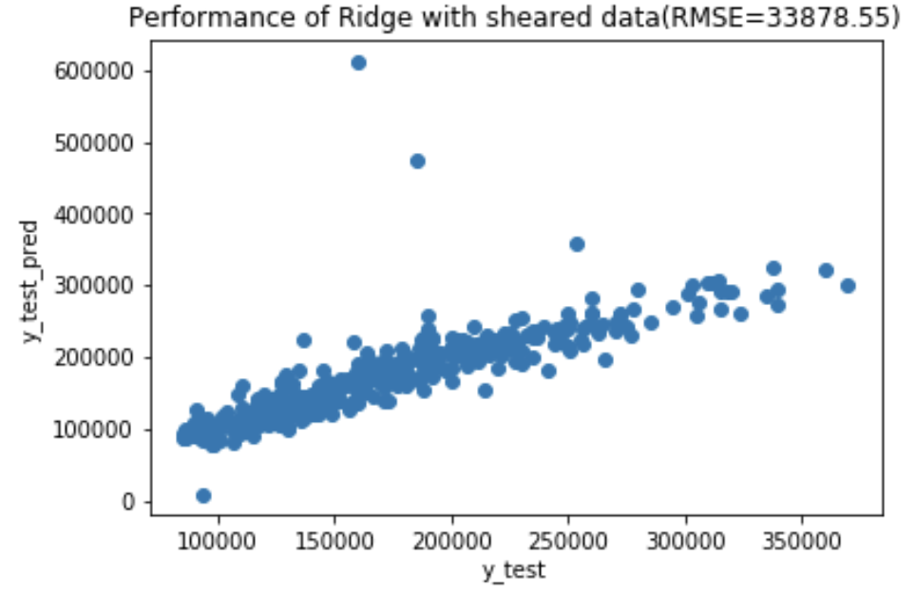
Remove outliers

Slide 4
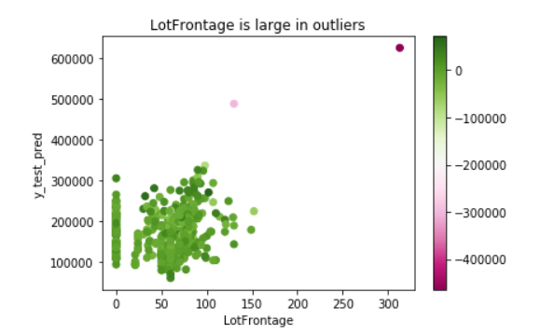
Remove outliers
LotFrontage: Linear feet of street connected to property

Slide 5
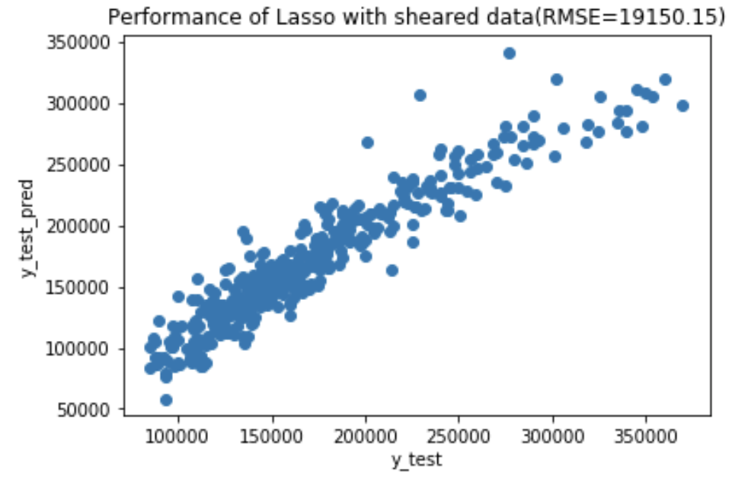
Remove outliers

Slide 6
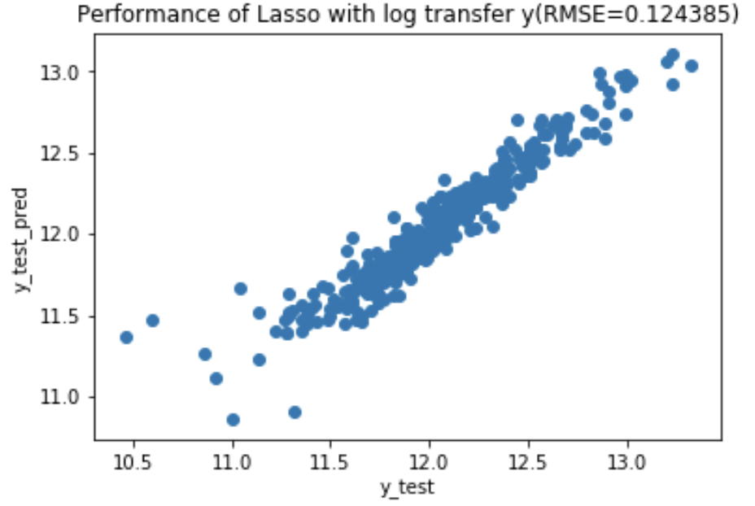
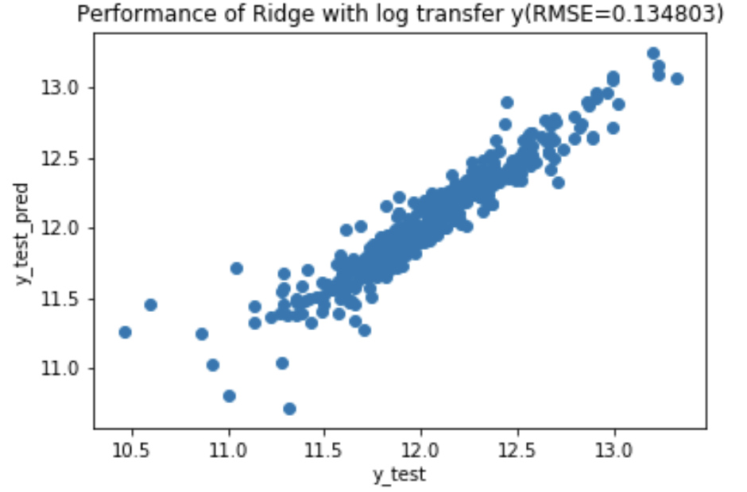
Log transform y

Slide 7
Conclusion
Conclusion
RMSE and R2:
ExtraTrees 27048.08 0.883939
Lasso 26802.87 0.803731
Ridge 30723.94 0.786243
Bagging Lasso 37058.150
Bagging Ridge 36500.47
Lasso with sheared data 19150.15 0.883223
Ridge with sheared data 21843.75 0.866617
Lasso with log transformed y 0.124385 0.902168
Ridge with log transformed y 0.134803. 0.897598

