Slide 1
House Prices: Advanced Regression Techniques
Team members:
Yaohua Chang
Wenyu Fan
Tamer Ibrahim
DSE I2100 Applied Machine Learning and Data Mining

Slide 2
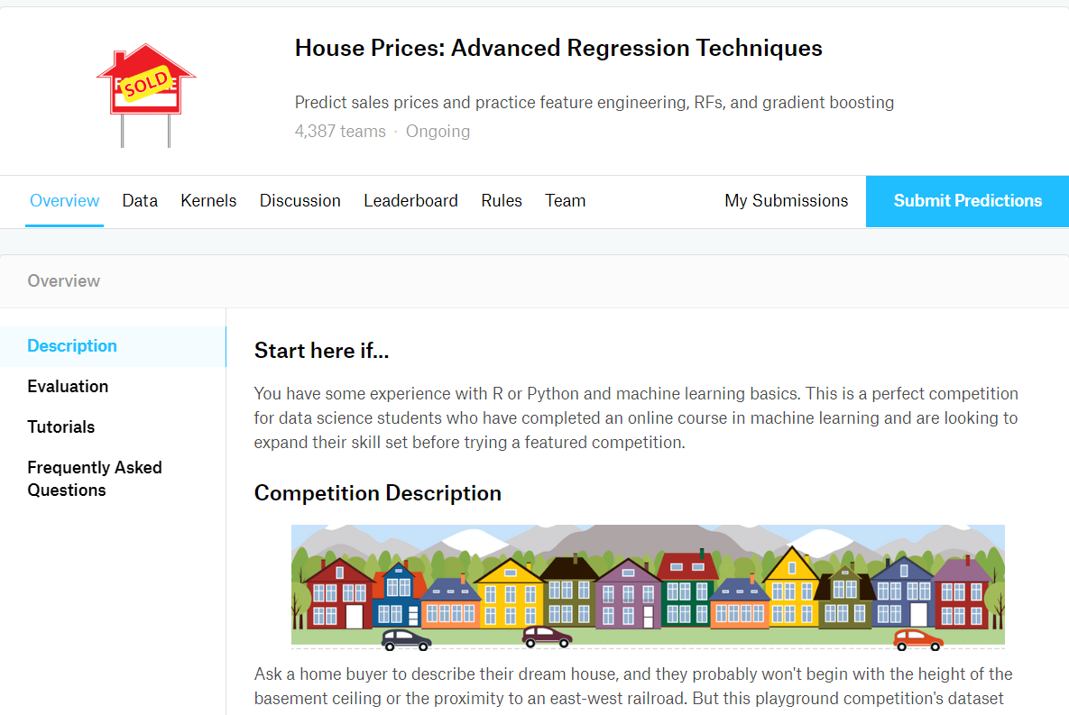
Kaggle Challenge

Slide 3
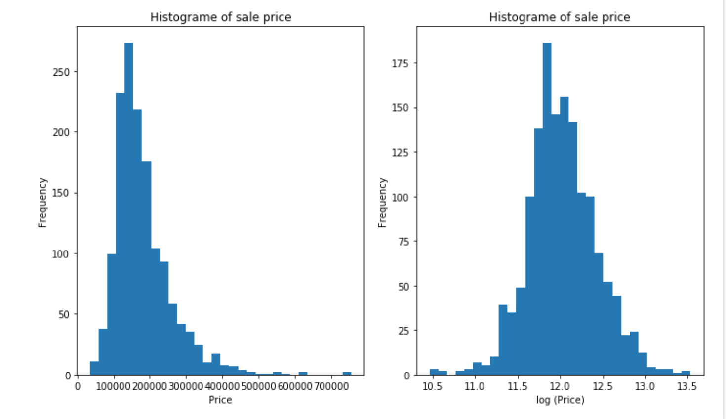
Transformation Target Value
y = np.log(df['SalePrice'])

Slide 4
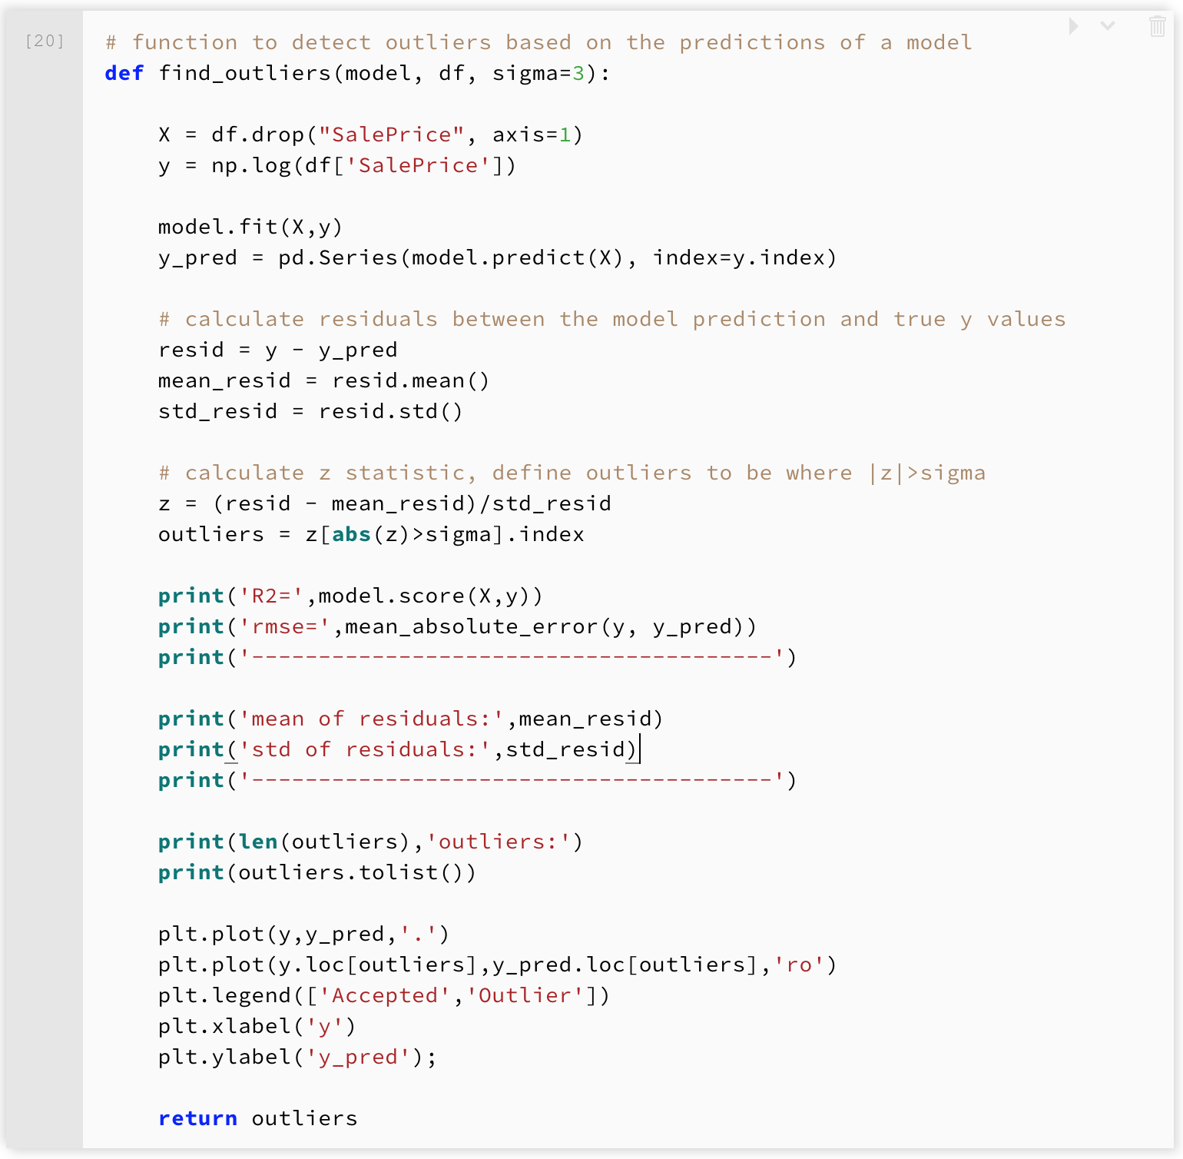
Identify and Remove Outliers

Slide 5
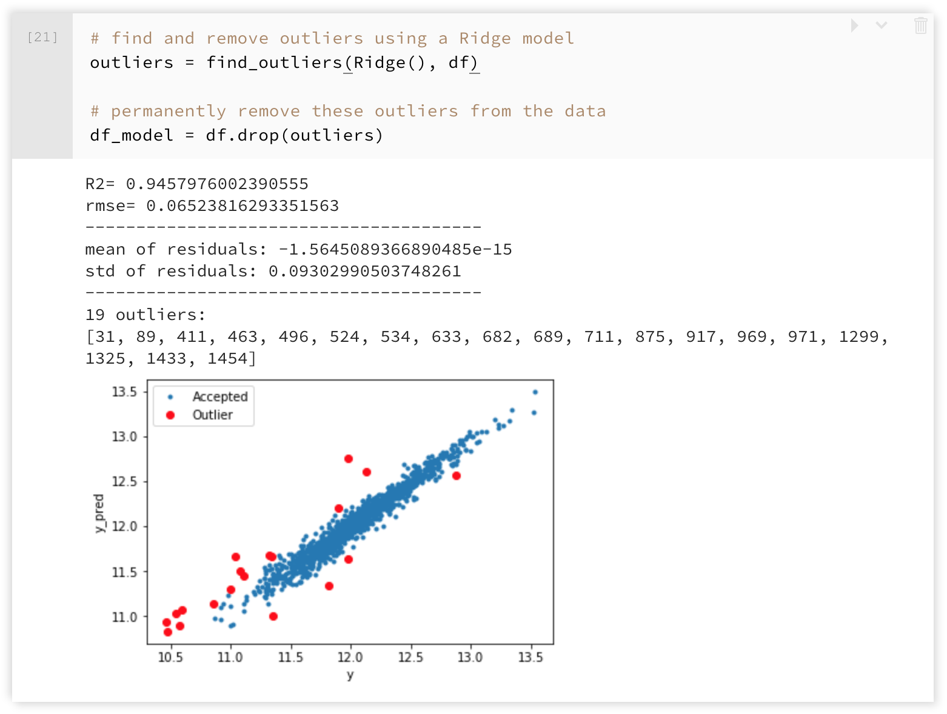
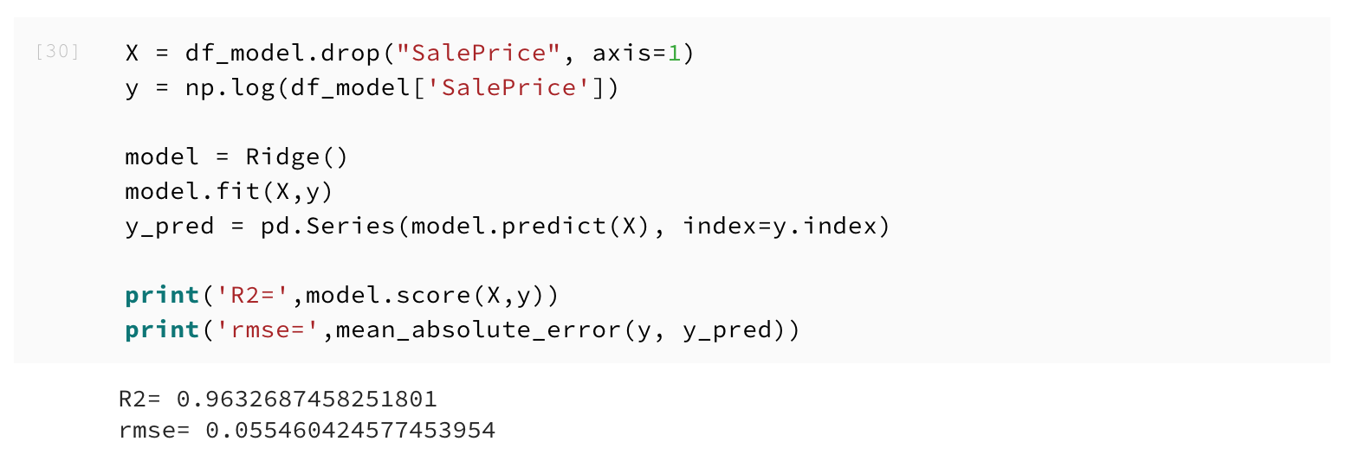
Identify and Remove Outliers

Slide 6
Fit Model
Linear Regression:
sklearn.linear_model.Ridge
sklearn.linear_model.Lasso
sklearn.linear_model.ElasticNet
Support Vector Machines:
sklearn.svm.LinearSVR
sklearn.svm.SVR
Nearest Neighbours:
sklearn.neighbors.KNearestNeighborsRegressor
Tree Based:
sklearn.ensemble.RandomForestRegressor
sklearn.ensemble.GradientBoostingRegressor
xgboost.XGBRegressor

Slide 7
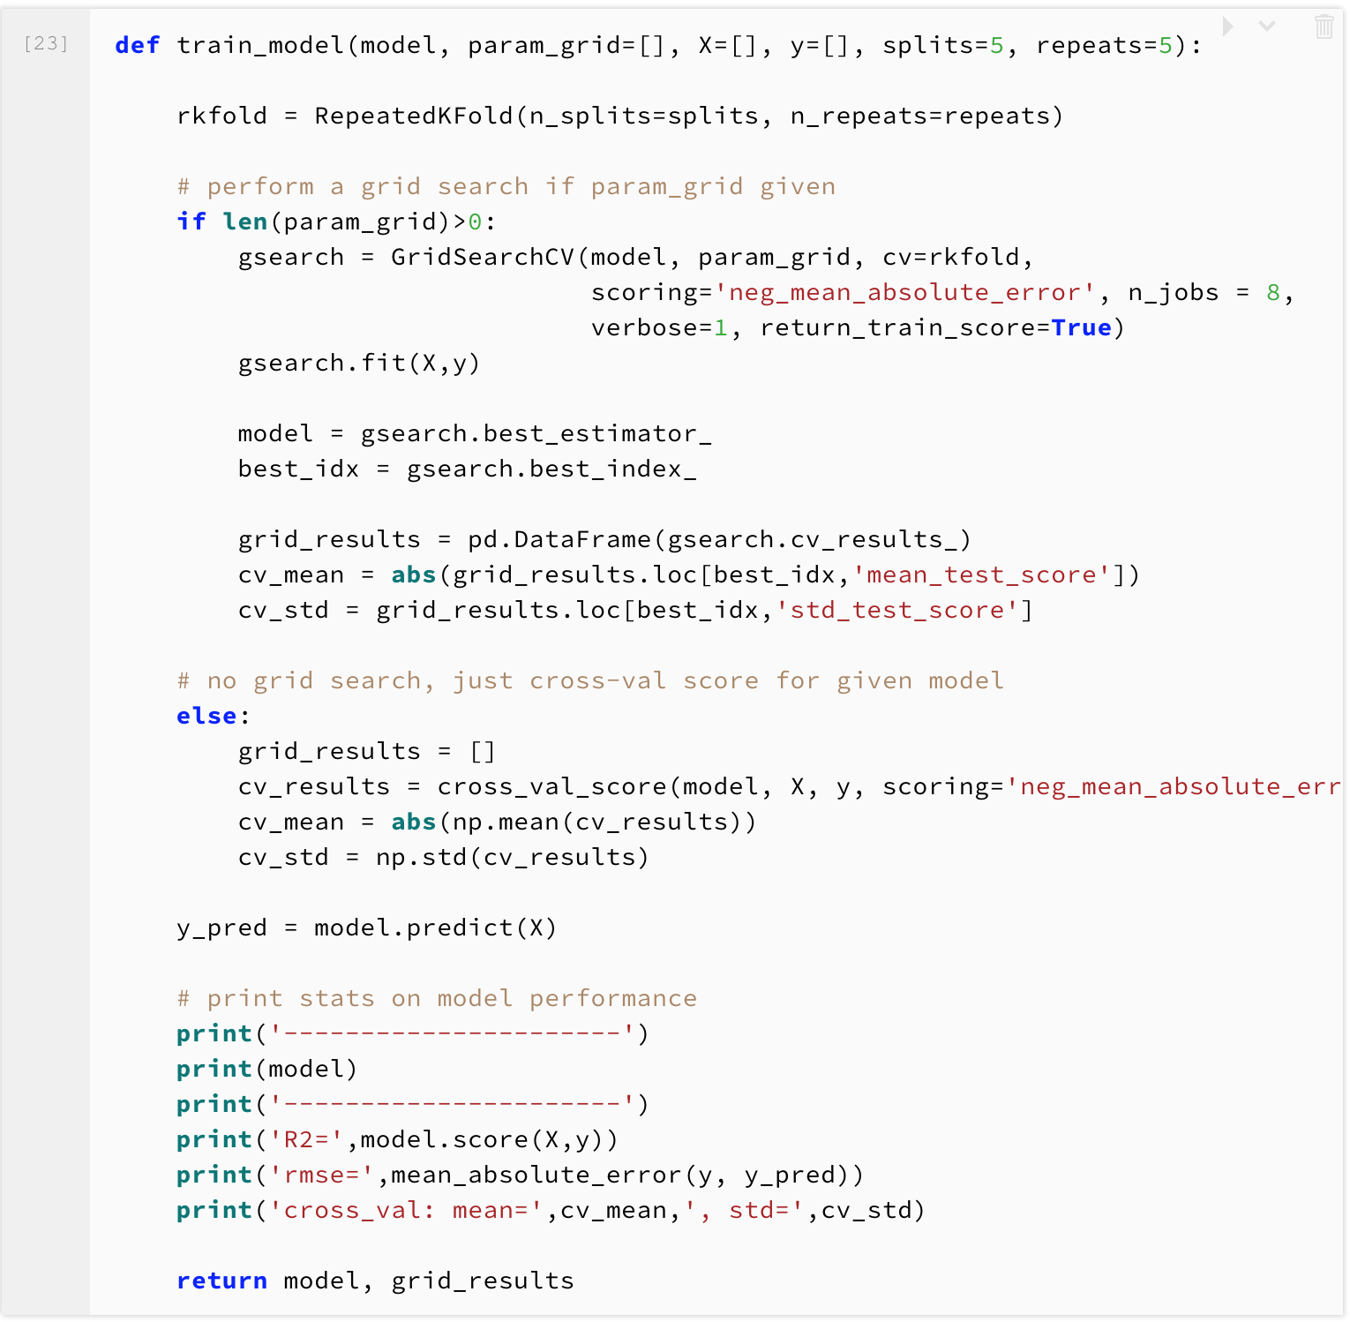
Train Model Function

Slide 8
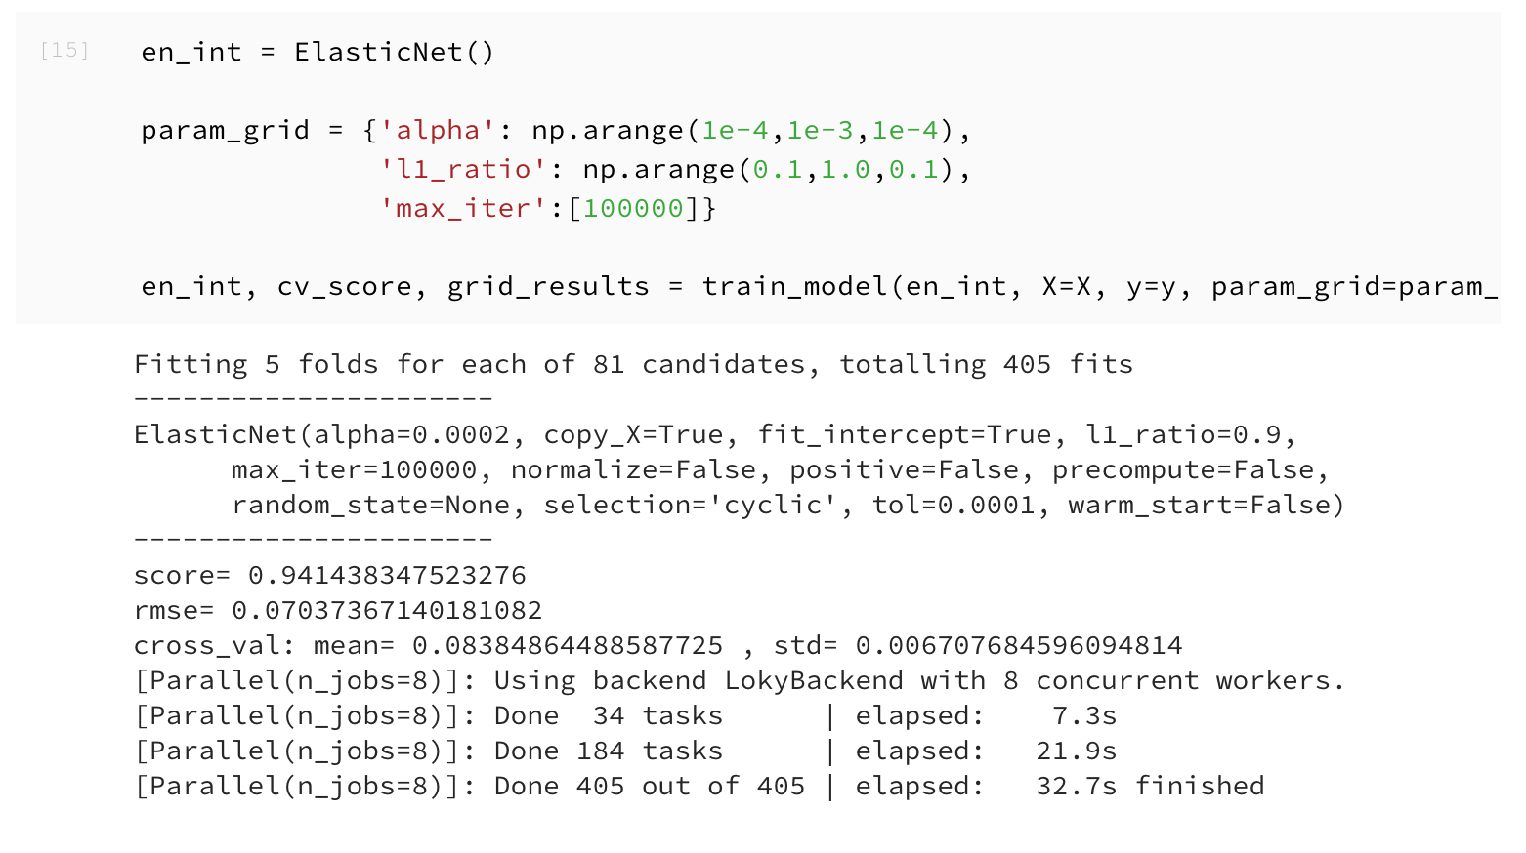
Elastic Net

Slide 9
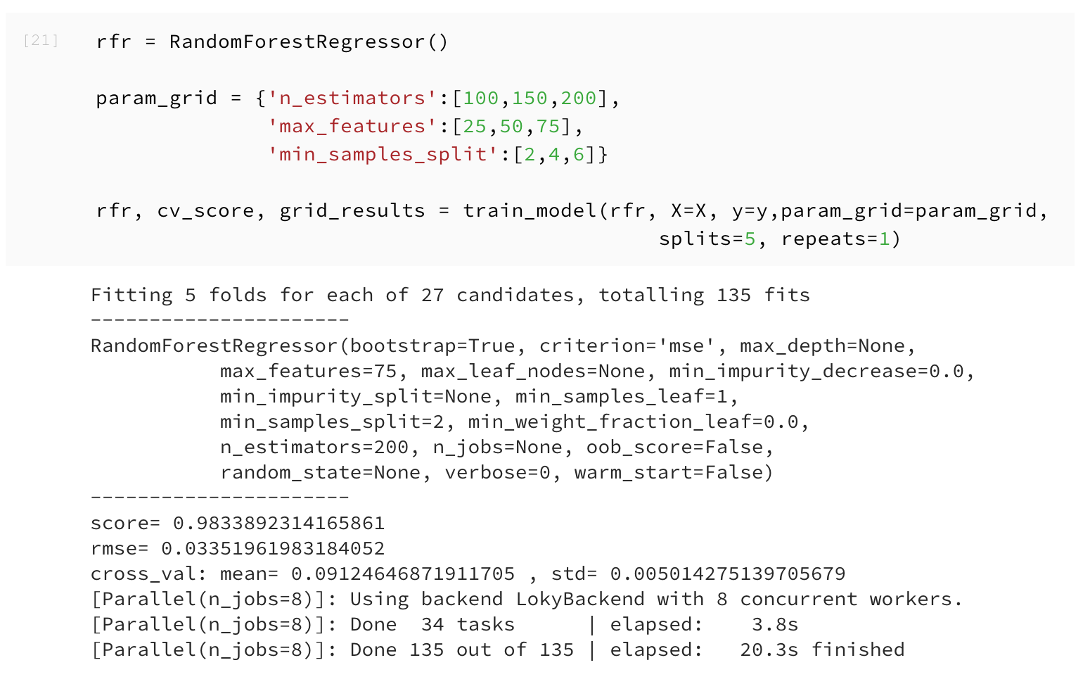
Random Forest

Slide 10
Compare Model with log(y)
 | Correlation | R square (R2) | Root Mean Square Error (RMSE)
Ridge | 0.98147165 | 0.96326875 | 0.05546042
Elastic Net | 0.97362819 | 0.9473058 | 0.07037367
Random Forest | 0.99492623 | 0.9877892 | 0.03351962

Slide 11
Compare Model without log(y)
 | Correlation | R square (R2) | Root Mean Square Error (RMSE)
Ridge | 0.9777374 | 0.95590900 | 11291.2240
Elastic Net | 0.9560788 | 0.91388614 | 15122.4778
Random Forest | 0.99465395 | 0.98622979 | 5580.97214

Slide 12
Compare Model with log(y)
We applied three algorithms in this part including Ridge, Elastic Net, Random Forest.
After removing outliers which identified by Ridge, the RMSE has slightly deceased.
Random Forest has better R2 and RMSE, but Elastic Net have better cross-validation scores.

