Slide 1
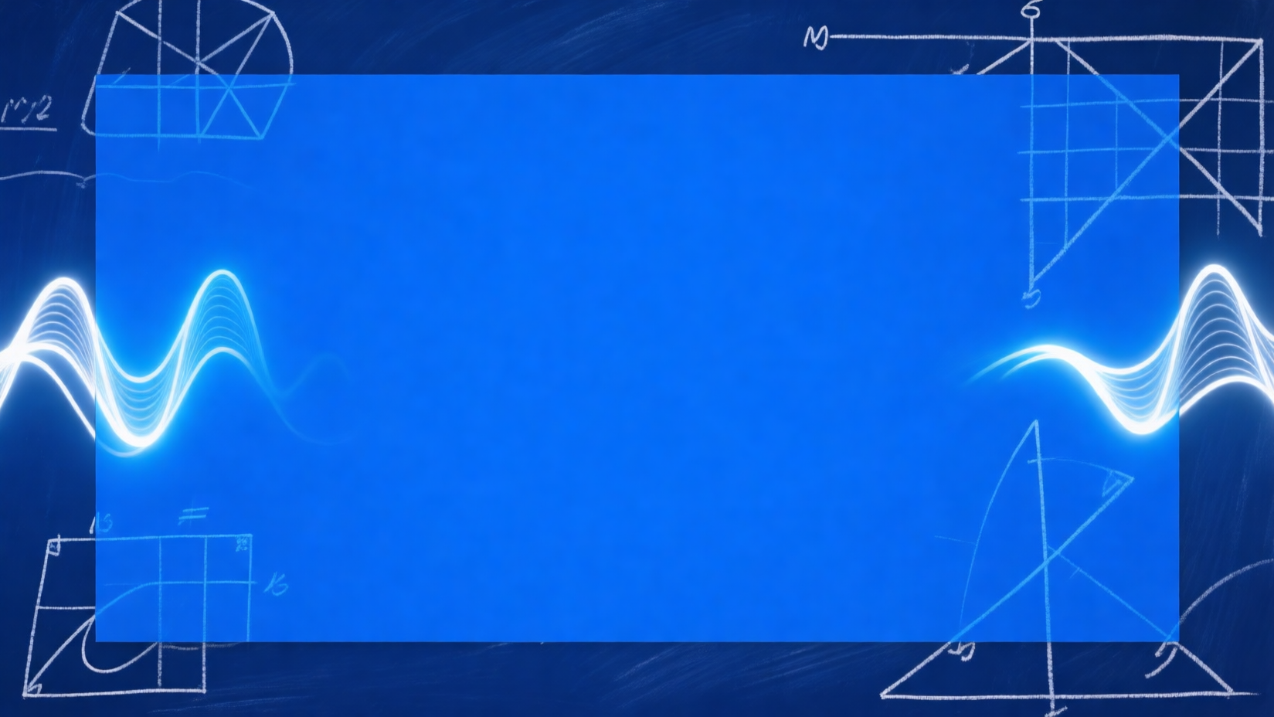
SUSTech Math
Jordan Algebras:
Origin, History,
Development, and
Modern Perspectives
From quantum mechanics to modern structure theory
LIU Yaohua
Department of Mathematics, Southern University of Science and Technology
SUSTech International Center for Mathematics
Academic English Presentation | April 2026
Notes:
Good morning everyone. Today I will give a brief introduction to Jordan algebras, focusing on their origin in quantum mechanics, their historical development, their main mathematical ideas, and a modern research direction. I will also place special emphasis on Efim Zelmanov, because his work gave one of the most decisive structural results in the subject.
Key points: 1. Jordan Algebras: Origin, History, Development, and Modern Perspectives 2. LIU Yaohua 3. Department of Mathematics, Southern University of Science and Technology
Duration: 1.0 min

Slide 2
02 Roadmap
SUSTech Math
Six guideposts for the 20-slide narrative
01
Physical origin
02
Definition and basic examples
03
Classification and the Albert algebra
04
Later development and applications
05
Zelmanov's breakthrough
06
Sources: Jordan, JvNW, Albert, McCrimmon, Kashuba
Part 1-4 overview
02
Notes:
[Transition] This brings us to roadmap.
My talk has six parts. First, I will explain why Jordan algebras were introduced in the first place. Second, I will give the basic definition and the standard examples. Third, I will discuss the early classification and the exceptional Albert algebra. Then I will describe how the subject grew into a broader mathematical theory, before turning to Zelmanov's theorem. I will end with a modern geometric direction connected with recent SUSTech-affiliated work.
Key points: 1. Physical origin 2. Definition and basic examples 3. Classification and the Albert algebra
Duration: 1.0 min

Slide 3

03 Why Jordan Algebras Appeared
SUSTech Math
The subject begins with the algebra of quantum observables.
Jordan algebras were born from
quantum mechanics.
Quantum mechanics in the
Copenhagen model
Observables = Hermitian matrices
or operators
Ordinary matrix operations are
not all observable
Jordan's 1932 program
Quantum-mechanical origin
Sources: Jordan, JvNW, Albert, McCrimmon, Kashuba
Jordan algebras presentation
03
Notes:
[Transition] This brings us to why jordan algebras appeared.
Jordan algebras were born from quantum mechanics. In the usual Copenhagen model, physical observables are represented by self-adjoint, or Hermitian, matrices or operators. But the ordinary matrix structure is not itself fully observable: for example, the product of two Hermitian operators is not necessarily Hermitian. Pascual Jordan therefore proposed a new algebraic setting that would depend only on observable operations, and not on the whole invisible matrix structure behind them.
Key points: 1. Quantum mechanics in the Copenhagen model 2. Observables = Hermitian matrices or operators 3. Ordinary matrix operations are not all observable
Duration: 1.0 min

Slide 4
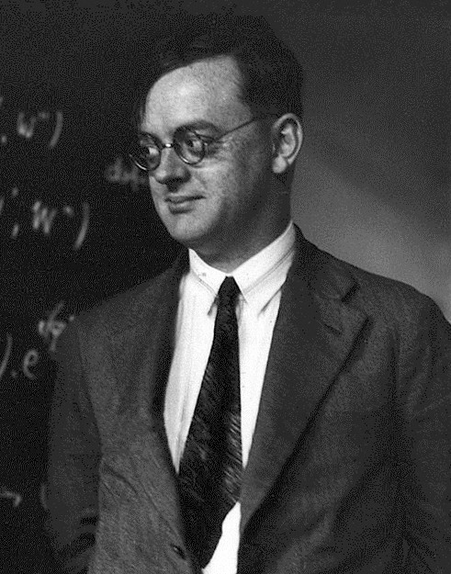
04 Jordan's New Product
SUSTech Math
Quasi-multiplication keeps the algebra inside the observable world.
Jordan's key move:
x o y = 1/2 (xy + yx)
Quasi-multiplication:
Commutative
Preserves Hermitian elements
Starting point of Jordan theory
Pascual Jordan
1902-1980
Sources: Jordan, JvNW, Albert, McCrimmon, Kashuba
Jordan algebras presentation
04
Notes:
[Transition] This brings us to jordan's new product.
Jordan's key idea was to replace ordinary multiplication with the symmetrized product x o y = 1/2 (xy + yx), sometimes called quasi-multiplication. This operation is commutative, and more importantly, it sends Hermitian elements to Hermitian elements. So it captures an observable product on the space of observables. This simple formula became the starting point of the whole theory of Jordan algebras.
Key points: 1. Quasi-multiplication: 2. x o y = 1/2 (xy + yx) 3. Commutative
Duration: 1.0 min

Slide 5
05 Basic Definition
SUSTech Math
Jordan algebras are commutative algebras satisfying a special associativity-like law.
Jordan identity
(x^2 o y) o x = x^2 o (y o x)
Definition
Physical intuition
Original emphasis
A Jordan algebra is a
Built to model
Originally also studied
commutative algebra
observables
with formal reality
It satisfies the Jordan
inside quantum mechanics
sum of squares behavior
identity
Sources: Jordan, JvNW, Albert, McCrimmon, Kashuba
Jordan algebras presentation
05
Notes:
[Transition] This brings us to basic definition.
Formally, a Jordan algebra is a commutative algebra satisfying the Jordan identity. In the original physical setting, Jordan and his collaborators were especially interested in formally real Jordan algebras, where a sum of squares can vanish only when each term is zero. The point was to isolate the algebraic behavior of observables in quantum mechanics and then ask what other systems satisfy the same laws.
Key points: 1. A Jordan algebra is a commutative algebra 2. It satisfies the Jordan identity 3. (x^2 o y) o x = x^2 o (y o x)
Duration: 1.0 min

Slide 6
06 The First Basic Examples
SUSTech Math
Three families already show the breadth of Jordan theory.
A+
H(A, *)
Spin factors
A+ : any associative
H(A, *) : Hermitian
Spin factors:
algebra with
elements under an
symmetrized product
involution
Sources: Jordan, JvNW, Albert, McCrimmon, Kashuba
Jordan algebras presentation
06
Notes:
[Transition] This brings us to the first basic examples.
The first examples are very natural. Any associative algebra gives a Jordan algebra if we symmetrize the product, and this is denoted by A+. If the associative algebra has an involution, then its Hermitian part H(A, *) is again a Jordan algebra. Another important family is given by spin factors, where vectors multiply through the inner product. These examples already show that Jordan theory is broader than just Hermitian matrices.
Key points: 1. A+ : any associative algebra with symmetrized product 2. H(A, *) : Hermitian elements under an involution 3. Spin factors:
Duration: 1.0 min

Slide 7
07 Special and Exceptional
SUSTech Math
The main historical divide asks whether a Jordan algebra comes from an associative source.
SPECIAL
EXCEPTIONAL
Embeds into a symmetrized
Cannot be realized as any A+.
associative algebra A+.
Represents genuinely new
Keeps a visible link to matrices
nonassociative behavior.
and operators.
Jordan hoped for infinite
Most standard examples belong
exceptional families.
here.
Would exceptional algebras yield a new quantum mechanics?
Sources: Jordan, JvNW, Albert, McCrimmon, Kashuba
Jordan algebras presentation
07
Notes:
[Transition] This brings us to special and exceptional.
A central distinction in the subject is the difference between special and exceptional Jordan algebras. A special Jordan algebra can be realized inside some symmetrized associative algebra A+. An exceptional Jordan algebra cannot. Jordan originally hoped that exceptional algebras would come in infinite families, and that such families might provide a new home for quantum mechanics beyond the usual matrix model.
Key points: 1. Special: comes from an associative algebra 2. Exceptional: does not come from any A+ 3. Jordan hoped for infinite families of exceptional algebras
Duration: 1.0 min

Slide 8
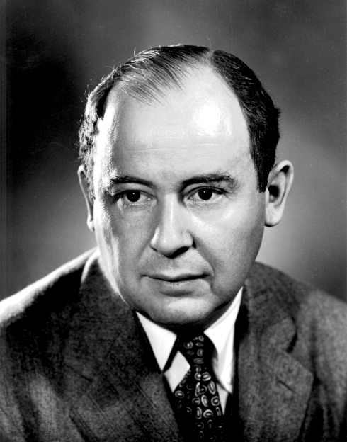
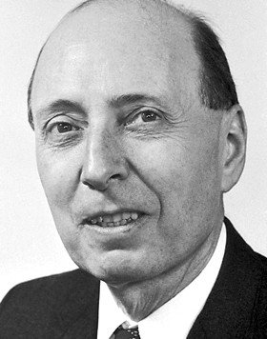
08 The 1934 Classification
SUSTech Math
Jordan, von Neumann, and Wigner sharply narrowed the possibilities.
Finite-dimensional formally real
Pascual Jordan
simple Jordan algebras
1934 classification
1
H_n(R)
2
H_n(C)
John von
Neumann
1934 classification
3
H_n(H)
4
H_3(O)
Eugene Wigner
5
Spin factors
1934 classification
Sources: Jordan, JvNW, Albert, McCrimmon, Kashuba
Jordan algebras presentation
08
Notes:
[Transition] This brings us to the 1934 classification.
In their fundamental 1934 paper, Jordan, von Neumann, and Wigner classified finite-dimensional formally real Jordan algebras. They showed that the simple building blocks are Hermitian matrix algebras over the real numbers, complex numbers, and quaternions, together with spin factors and one octonionic case, namely H_3(O). This result was a major milestone, because it sharply limited what exceptional examples could look like.
Key points: 1. Jordan-von Neumann-Wigner classification 2. Finite-dimensional formally real simple algebras: 3. H_n(R)
Duration: 1.0 min

Slide 9
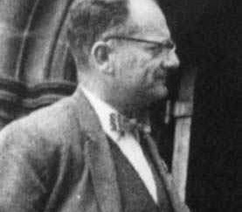

09 The Albert Algebra
SUSTech Math
The exceptional case becomes the symbolic centerpiece of the subject.
A. A. Albert
H_3(O)
Dimension 27
Exceptional
Unique classical case
3x3 Hermitian octonionic matrices
Sources: Jordan, JvNW, Albert, McCrimmon, Kashuba
Jordan algebras presentation
09
Notes:
[Transition] This brings us to the albert algebra.
The most famous exceptional Jordan algebra is H_3(O), the Jordan algebra of 3x3 Hermitian octonionic matrices. It has dimension 27, and Albert proved that it is genuinely exceptional. Today it is called the Albert algebra. Historically, this was both exciting and disappointing: exciting because it revealed a truly new structure, but disappointing because it seemed to be only one isolated example rather than a large family.
Key points: 1. H_3(O) has dimension 27 2. A. A. Albert proved it is exceptional 3. Now called the Albert algebra
Duration: 1.0 min

Slide 10
10 From Physics to Pure Algebra
SUSTech Math
After the 1930s, Jordan theory becomes a major branch of nonassociative algebra.
1930s
1960s-70s
1983
Quantum origin
Meyberg / Loos
Zelmanov
1
2
3
4
5
1940s-50s
1978
Albert & Jacobson
McCrimmon
Sources: Jordan, JvNW, Albert, McCrimmon, Kashuba
Jordan algebras presentation
10
Notes:
[Transition] This brings us to from physics to pure algebra.
After the initial physical motivation faded, Jordan theory was taken up by algebraists. The subject developed its own structure theory and its own methods, especially through work associated with Albert and Jacobson, and later through Meyberg, Loos, McCrimmon, and many others. McCrimmon's survey presents this development as a long historical arc from the origins in quantum mechanics to Zelmanov's decisive classification results.
Key points: 1. The subject moved beyond physics 2. Structure theory became central 3. Major names: Albert, Jacobson, Meyberg, Loos, McCrimmon
Duration: 1.0 min

Slide 11
11 Beyond the Real Case
SUSTech Math
The theory becomes richer over algebraically closed and arbitrary fields.
General fields
Three forms
Albert over fields
Study over
Split, reduced, and
Albert algebras over
algebraically closed
division forms
general fields
fields and general
fields
Sources: Jordan, JvNW, Albert, McCrimmon, Kashuba
Jordan algebras presentation
11
Notes:
[Transition] This brings us to beyond the real case.
A major step was the move from the real, formally real setting to Jordan algebras over algebraically closed fields and then over arbitrary fields. In this broader setting, one distinguishes split, reduced, and division forms. Albert algebras also appear in these different forms, not only in the classical real octonionic picture. This made the theory much richer and more algebraic.
Key points: 1. Study over algebraically closed fields and general fields 2. Split, reduced, and division forms 3. Albert algebras over general fields
Duration: 1.0 min

Slide 12
12 The Quadratic Viewpoint
SUSTech Math
U_x(y) packages structure more effectively than the raw product.
Bilinear product
Quadratic operator
x o y
U_x(y) = 2x o (x o y) - x^2 o y
The quadratic operator:
o y
xyx
U_x(y) = 2x o (x o y) - x^2
In special algebras: U_x(y) =
In spcial algebras: U_x(y)
= xyx
Fundamental Formula:
U_(U_x(y)) = U_x U_y U_x
Sources: Jordan, JvNW, Albert, McCrimmon, Kashuba
Jordan algebras presentation
12
Notes:
[Transition] This brings us to the quadratic viewpoint.
One of the deepest conceptual changes in the subject was the shift from the bilinear product x o y to the quadratic operator U_x(y). In special Jordan algebras, this operator corresponds to the familiar associative expression xyx. This quadratic viewpoint made inverses, isotopes, and structure theory much clearer, and it also helped extend Jordan theory beyond the older framework that depended strongly on dividing by 2.
Key points: 1. The quadratic operator: 2. U_x(y) = 2x o (x o y) - x^2 o y 3. In special algebras: U_x(y) = xyx
Duration: 1.0 min

Slide 13
13 The Wider Jordan Family
SUSTech Math
Jordan algebras become one node in a much larger family of structures.
Jordan
algebras
Jordan
Jordan
Jordan triples
superalgebras
structures
Jordan pairs
Sources: Jordan, JvNW, Albert, McCrimmon, Kashuba
Jordan algebras presentation
13
Notes:
[Transition] This brings us to the wider jordan family.
As the theory matured, it became clear that Jordan algebras are only one member of a larger family of Jordan structures. Jordan triples, Jordan pairs, and Jordan superalgebras all emerged as natural generalizations. This widening of the subject was closely related both to Lie theory and to geometry, and it showed that Jordan algebra was not an isolated construction but part of a much broader mathematical framework.
Key points: 1. Jordan algebras 2. Jordan triples 3. Jordan pairs
Duration: 1.0 min

Slide 14
14 Links with Lie Theory
SUSTech Math
Jordan systems feed directly into graded Lie-theoretic constructions.
Graded Lie
algebras
Symmetry
TKK bridge
Exceptional
groups
Structure
transfer
Sources: Jordan, JvNW, Albert, McCrimmon, Kashuba
Jordan algebras presentation
14
Notes:
[Transition] This brings us to links with lie theory.
Jordan theory is closely linked with Lie theory. Through the Tits-Kantor-Koecher construction, Jordan systems can be used as coordinates for certain graded Lie algebras. The exceptional Albert algebra is especially important here, because it is related to exceptional Lie groups and Lie algebras. So Jordan algebras became valuable not only in their own right, but also as a way to understand structures in Lie theory.
Key points: 1. Jordan systems as coordinates for graded Lie algebras 2. Tits-Kantor-Koecher construction 3. Exceptional Jordan algebra and exceptional Lie groups
Duration: 1.0 min

Slide 15
15 Links with Geometry and Analysis
SUSTech Math
Jordan theory continues into geometry, analysis, and projective structures.
Symmetric
cones
Octonion
Geometry &
Bounded
planes
analysis
domains
JB-algebras
Sources: Jordan, JvNW, Albert, McCrimmon, Kashuba
Jordan algebras presentation
15
Notes:
[Transition] This brings us to links with geometry and analysis.
Jordan algebras also have deep geometric and analytic applications. They appear in the study of symmetric cones and bounded symmetric domains, where the algebraic structure encodes geometric information. In infinite-dimensional settings, Jordan operator algebras and JB-algebras connect the subject with functional analysis. The Albert algebra also plays an important role in projective geometry, especially in the description of octonion planes.
Key points: 1. Symmetric cones 2. Bounded symmetric domains 3. JB-algebras and functional analysis
Duration: 1.0 min

Slide 16
16 The Long Open Problem
SUSTech Math
For decades, the subject revolved around the possibility of further exceptional algebras.
?
?
?
Was the Albert algebra
Could there be
This question remained
the only exceptional
infinite-dimensional
open for decades
simple example?
exceptional Jordan
algebras?
Sources: Jordan, JvNW, Albert, McCrimmon, Kashuba
Jordan algebras presentation
16
Notes:
[Transition] This brings us to the long open problem.
For a long time, the central open problem was whether there existed further simple exceptional Jordan algebras, especially in infinite dimensions. The Albert algebra was known, but it was only 27-dimensional and too small for the original physical hopes. So the big question was whether Jordan's dream might survive in a larger exceptional setting. This question remained open for roughly half a century.
Key points: 1. Was the Albert algebra the only exceptional simple example? 2. Could there be infinite-dimensional exceptional Jordan algebras? 3. This question remained open for decades
Duration: 1.0 min

Slide 17
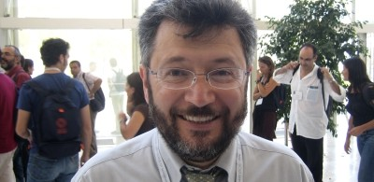
17 Zelmanov's Breakthrough
SUSTech Math
Zelmanov's 1983 theorem closes the classification problem in arbitrary dimension.
Theorem (Zelmanov, 1983)
1
Hermitian type
2
Spin / Clifford type
Albert type
Efim Zelmanov
3
families
4
No additional simple exceptional
Sources: Jordan, JvNW, Albert, McCrimmon, Kashuba
Jordan algebras presentation
17
Notes:
[Transition] This brings us to zelmanov's breakthrough.
This brings me to Efim Zelmanov. His theorem from 1983 says that every simple Jordan algebra, even in arbitrary dimension, falls into one of only three classes: Hermitian type, spin or Clifford type, or Albert type. In other words, no new simple exceptional Jordan algebras exist beyond the Albert case. This is the decisive structural theorem in the history of Jordan algebras.
Key points: 1. Theorem (Zelmanov, 1983): any simple Jordan algebra is: 2. 1. Hermitian type 3. 2. Spin / Clifford type
Duration: 1.3 min

Slide 18
18 Why Zelmanov Matters So Much
SUSTech Math
The theorem answers the founding historical question and clarifies the whole landscape.
Historical
Exceptional
Structural
closure
uniqueness
clarity
Sources: Jordan, JvNW, Albert, McCrimmon, Kashuba
Jordan algebras presentation
18
Notes:
[Transition] This brings us to why zelmanov matters so much.
Zelmanov's contribution matters for two reasons. First, it gave a final answer to the historical question that started the subject: there is no infinite-dimensional exceptional simple setting for quantum mechanics. Second, it provided a global structural picture of simple Jordan algebras. McCrimmon explicitly presents the historical survey of Jordan theory as leading up to this result, and also notes that Zelmanov's work here later played a role in the broader context of his Fields Medal achievements on the Burnside problem.
Key points: 1. Closed the original search for exceptional quantum mechanics 2. Showed Albert algebras are the only simple exceptional case 3. Gave a final large-scale structural picture
Duration: 1.4 min

Slide 19

19 A Modern Direction Connected with SUSTech
SUSTech Math
The historical narrative opens naturally onto varieties, deformations, and geometry.
Modern bridge
Iryna Kashuba (SICM-SUSTech):
varieties of Jordan algebras
Jor_n: the affine variety of
n-dimensional complex Jordan
algebras
GL(n, C)-orbits = isomorphism
Variety Jor_n
classes
Deformations, rigidity, moment
maps, solitons
Deformation theory
Rigidity
Moment maps
Jordan solitons
Sources: Jordan, JvNW, Albert, McCrimmon, Kashuba
Jordan algebras presentation
19
Notes:
[Transition] This brings us to a modern direction connected with sustech.
To end on a modern note, let me mention a direction represented in the SUSTech-affiliated talk by Iryna Kashuba. The idea is to study all n-dimensional complex Jordan algebras as points of an algebraic variety Jor_n, with change of basis given by the action of GL(n, C). In this setting one studies deformations, rigid algebras, and more recently moment maps and Jordan solitons. This is a beautiful example of how Jordan theory continues to develop through interactions with algebraic geometry and geometric invariant theory.
Key points: 1. Iryna Kashuba (SICM-SUSTech): varieties of Jordan algebras 2. Jor_n: the affine variety of n-dimensional complex Jordan algebras 3. GL(n, C)-orbits = isomorphism classes
Duration: 1.0 min

Slide 20
20 Conclusion and Selected References
SUSTech Math
Jordan algebras link quantum origins, structural classification, and modern geometry.
Takeaways
Selected references
Jordan algebras began in quantum
P. Jordan (1933)
mechanics
They evolved into a rich theory in
Jordan-von Neumann-Wigner (1934)
algebra, geometry, and analysis
The Albert algebra became the
A. A. Albert
exceptional symbol of the subject
Zelmanov delivered the decisive
K. McCrimmon, A Taste of Jordan
classification result
Algebras
I. Kashuba, Variety of Jordan
algebras and moment map
Thank you.
Sources: Jordan, JvNW, Albert, McCrimmon, Kashuba
Jordan algebras presentation
20
Notes:
[Transition] This brings us to conclusion and selected references.
So the story of Jordan algebras is a story that begins in physics, becomes a major chapter of nonassociative algebra, and then connects to Lie theory, geometry, and analysis. The Albert algebra is the exceptional centerpiece, and Zelmanov's theorem gives the final structural answer to the subject's original question. These are the main references behind my presentation. Thank you.
Key points: 1. Jordan algebras began in quantum mechanics 2. They evolved into a rich theory in algebra, geometry, and analysis 3. The Albert algebra became the exceptional symbol of the subject
Duration: 1.0 min

