Slide 1
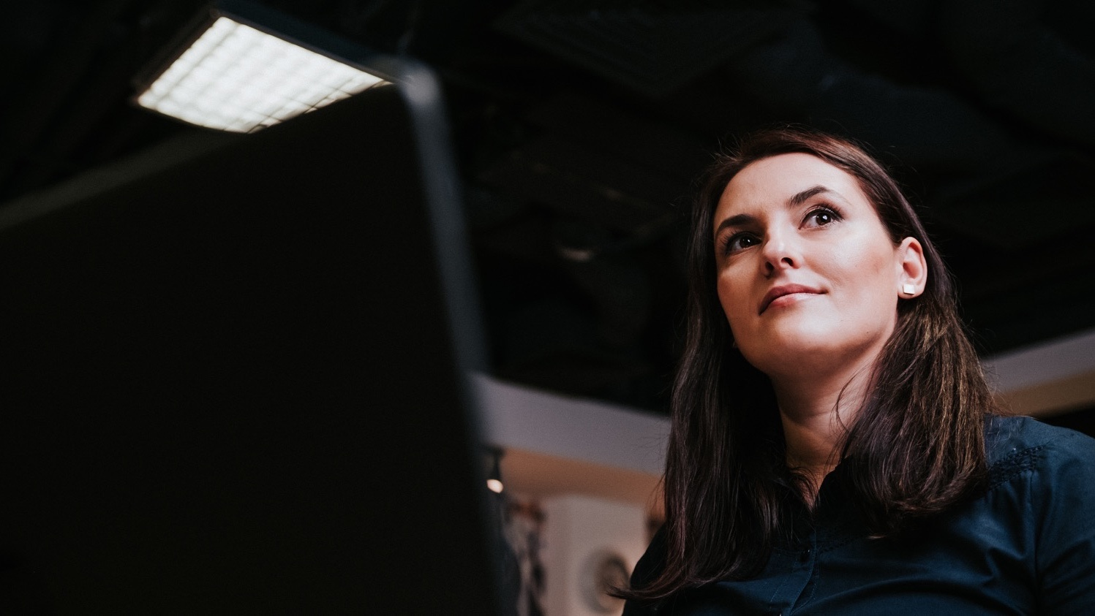
Intro2AI
Yaolin
2024-11-29, Trondheim

Slide 2
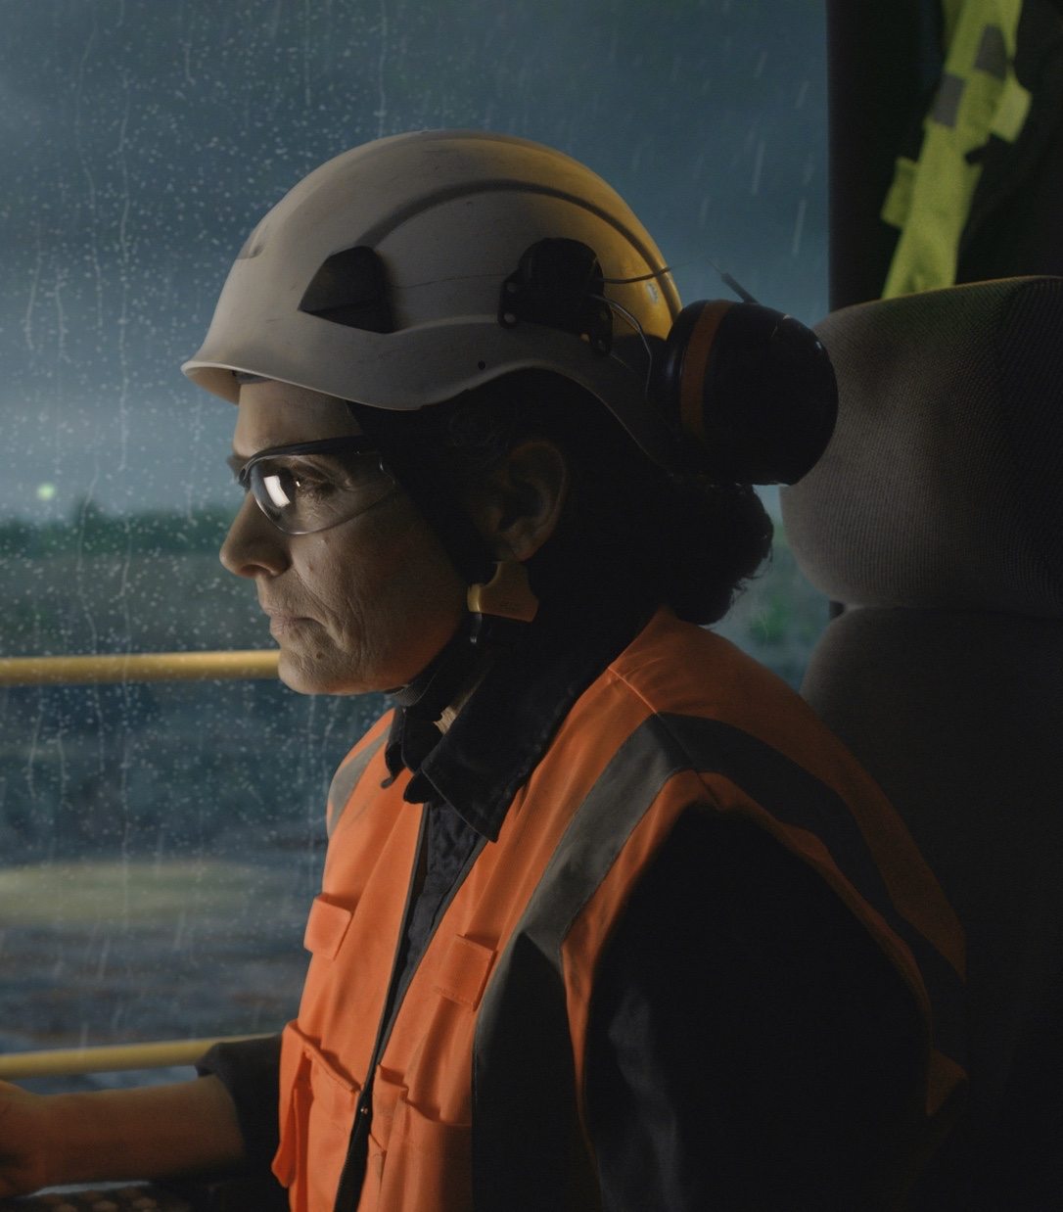
Notes:
”Safety is our number one priority”, so we need to remind ourselves of this regularly and promote it to our stakeholders as often as possible – the safety slide is one very good way of doing this. We know that creating a safety culture of a company is an on-going process – if we don’t talk about it ‘every day’, we can easily lose some of the great progress we’ve made.
What can help to make the use of the Safety slide effective?
A good use of the slide is to tell people attending a presentation of the emergency evacuation procedures for the room/facility you are at. So be sure to know this before putting the slide up on the screen.
Another good use is to prompt a short discussion about safety e.g. about our Zero Harm Vision. It could also be an opportunity to give a ‘safety share’ to the audience – a personal story that tells how you identified an unexpected hazard or experienced a “near miss”. If the audience appears ‘up for it’, you can ask them to contribute a safety share of their own – a very powerful approach if done well. While the content of the slide is important, the most important thing is to say whatever you say about safety with conviction.
What can undermine the effectiveness of the Safety slide?
The major thing that can do this is to ‘flash by’ the safety slide without making any, or any quality, comment about it. Doing the ‘flash by’ will give a negative message that “I’m showing the slide because I have to rather than I want to”. If you think there is no benefit from showing the slide on a particular occasion (e.g. the audience are all local Sandvik employees and are well aware of our safety journey and/or emergency procedures) then take the slide out altogether.
This general Safety first slide should be your first option to use. If a customized, or a more specific slide is needed, choose one from the example slides in the “Sandvik Assets” library, or contact your communications department for help.
Cybersecurity:
At Sandvik, cybersecurity is a key element in keeping our colleagues, customers and company protected. It is about technology, but even more about people. Cybersecurity is part of everything we do online and creating a cybersecure environment is something we all share. By being cautious and using methods and tools provided we help each other staying safe.
Psychological safety:
At Sandvik we need to be curious, interested in learning, and willing to share our thoughts and ideas. It is therefore our responsibility to create the best environment possible for us to succeed. Collaborative people who are satisfied in their job environment will attract engaged colleagues, and this will contribute to continued excellence.
Our ambition with diversity and inclusion, means that we value our employees’ different backgrounds, experiences and views so that all can realize their full potential. Psychological Safety means our way of including all, sharing knowledge and ideas, listening to others and confirming everyone’s contribution.
Health and well-being:
The term "Health and Wellbeing" commonly refers to the relationship between work, life and health. It is the combined efforts of employers, employees and society. At Sandvik, the term Health and Wellbeing refers to workplace wellness and health promotion programs designed to support healthy lifestyles.

Slide 3
Machine learning

Slide 4
Menu
Supervised Learning
Unsupervised Learning
Neural Networks
Generative AI

Slide 5
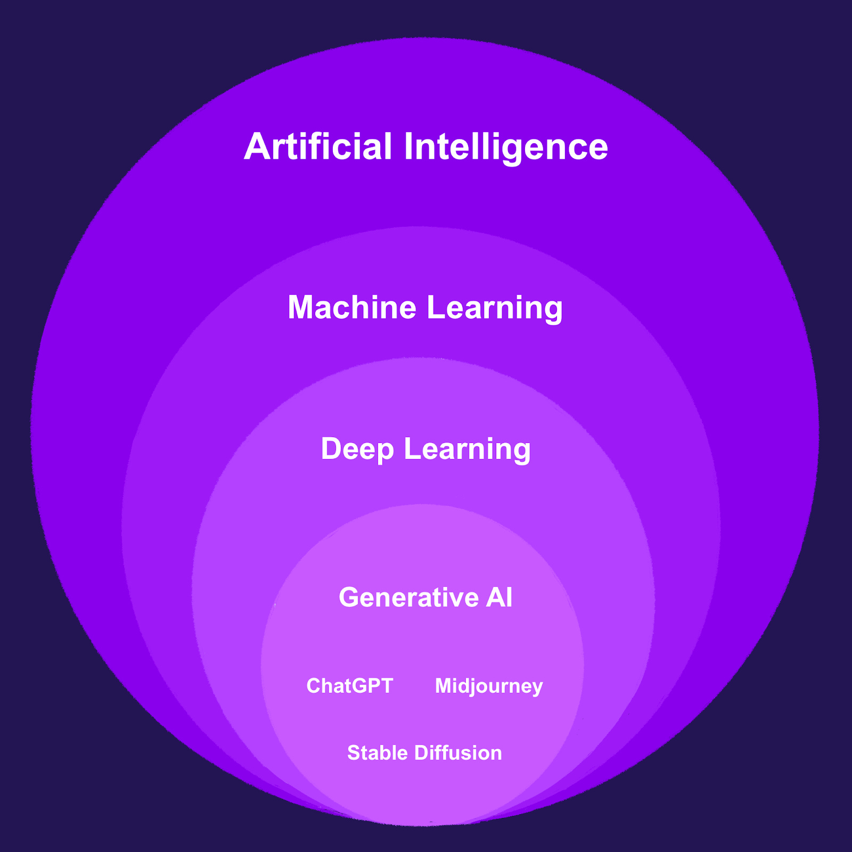

Slide 6
Glossary
Goal: Regression, Classification, etc
Objective Function
Gradient Descent
Validation

Slide 7
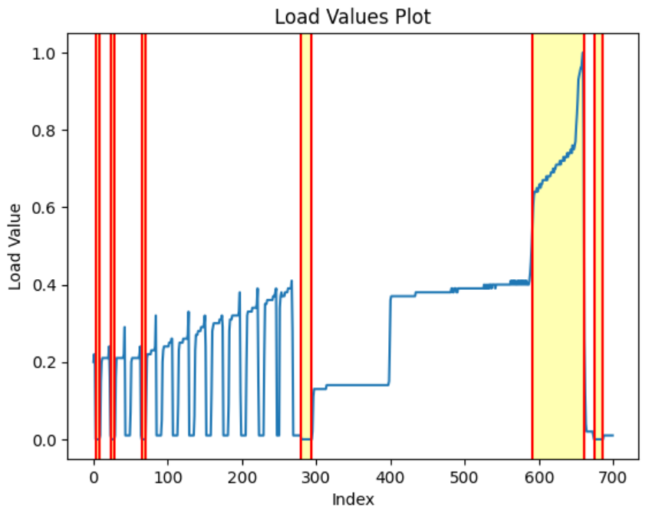
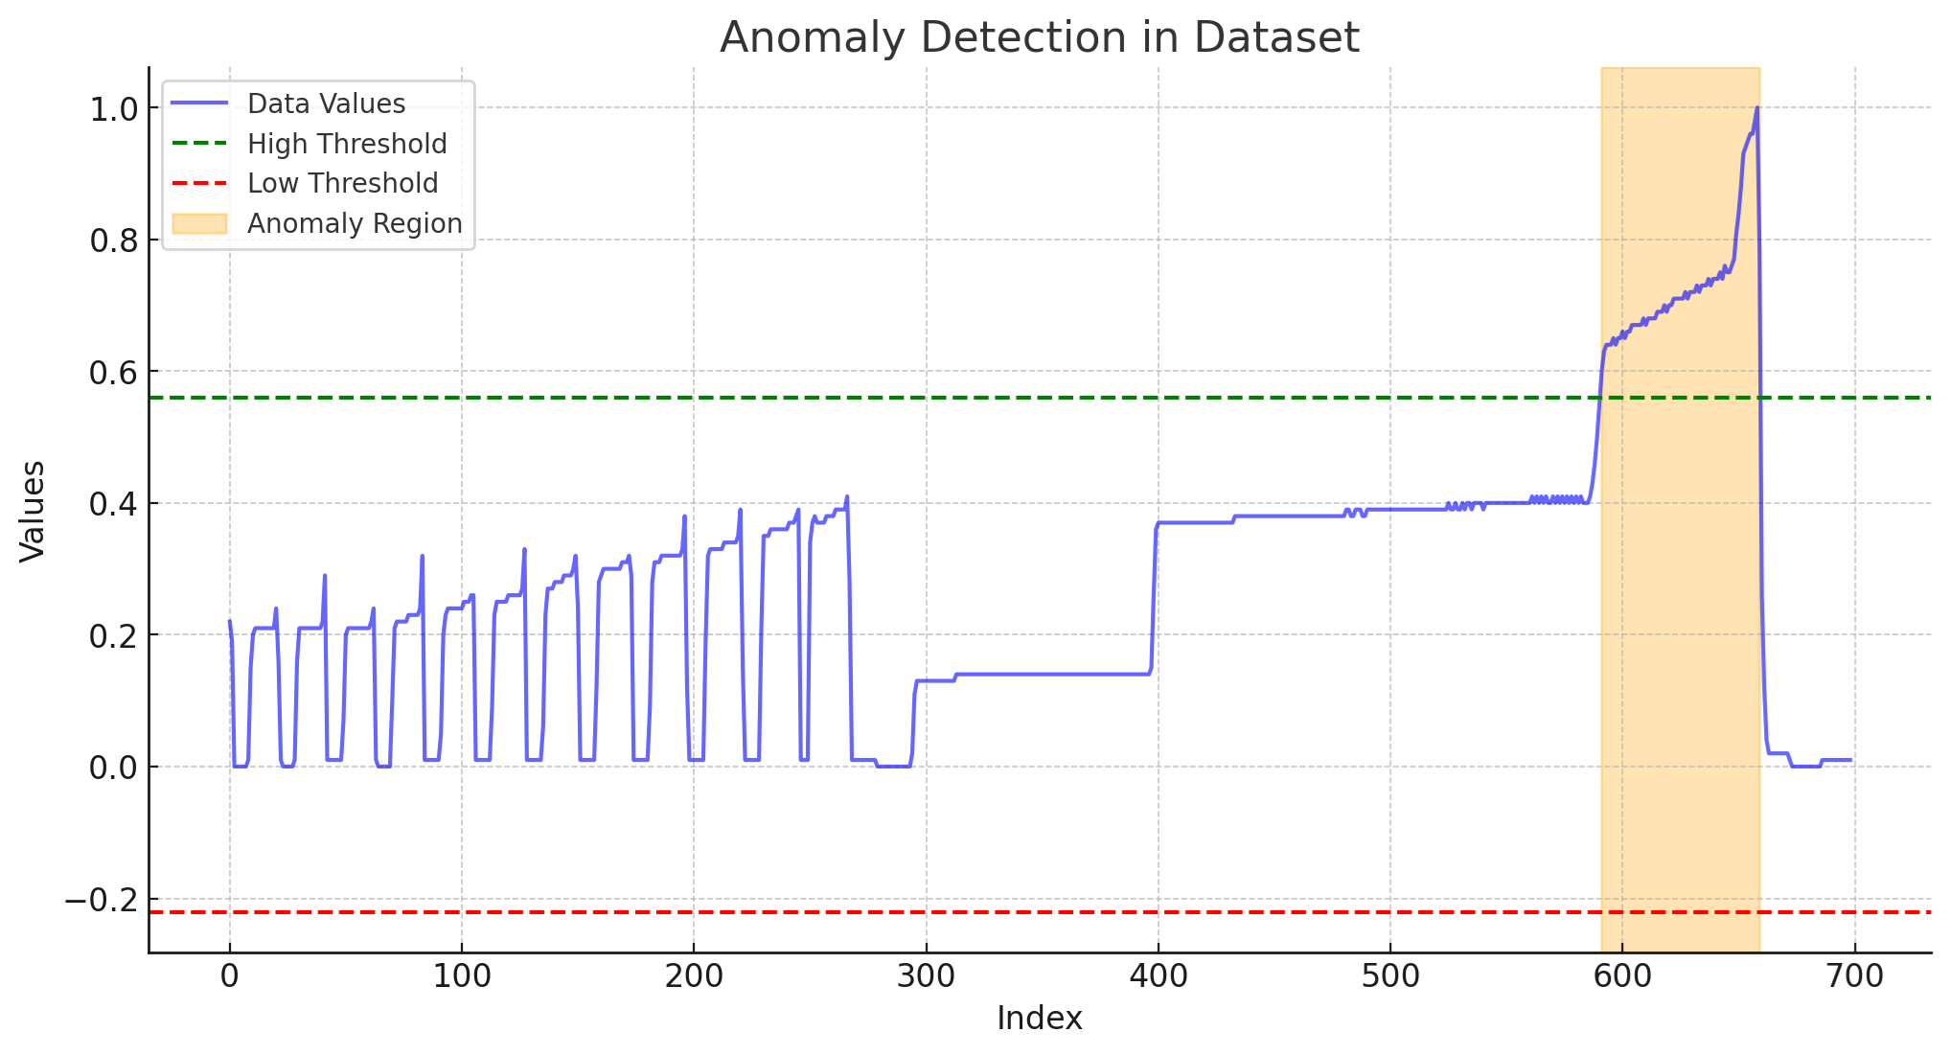
Zero-shot inference
GPT 4o
Claude Haiku

Slide 8
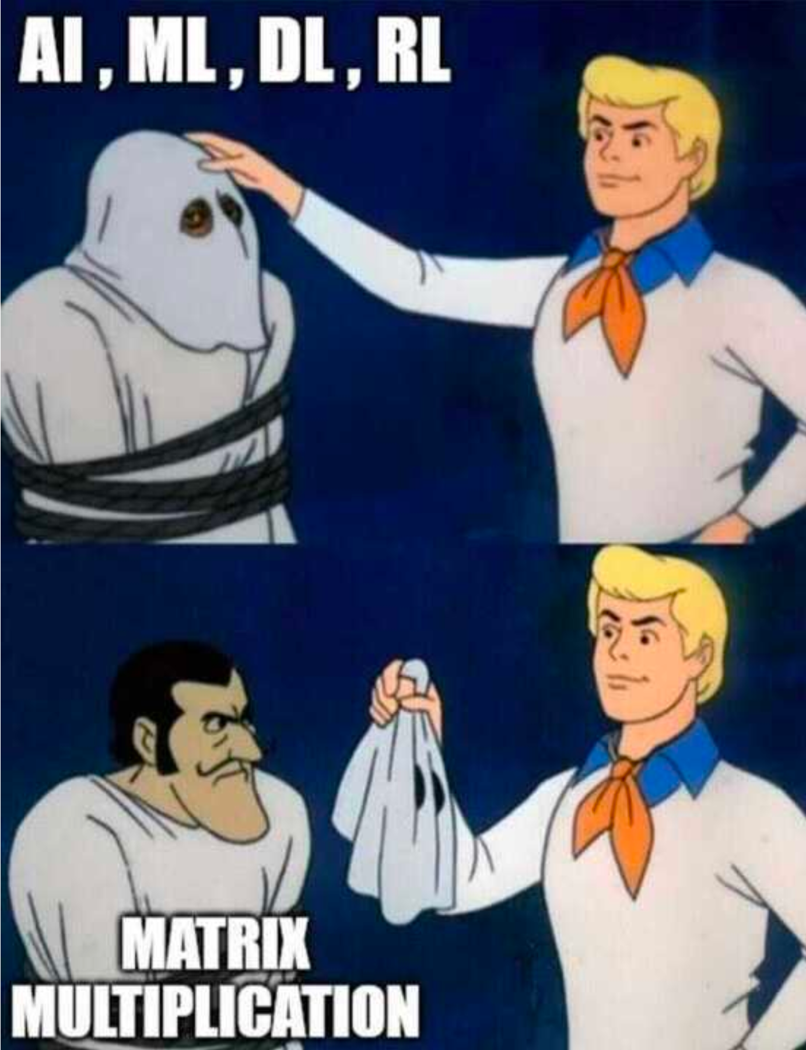
Remarks

