Slide 1
Adaptive sampling of ocean fronts with multiple AUVs
Trial lecture
Ph.D. Candidate: Yaolin Ge
Supervisors: Prof. Jo Eidsvik, Prof. Geir-Arne Fuglstad
Date of the trial lecture: 2024-05-08
Department of Mathematical Sciences
Faculty of Information Technology and Electrical Engineering

Slide 2
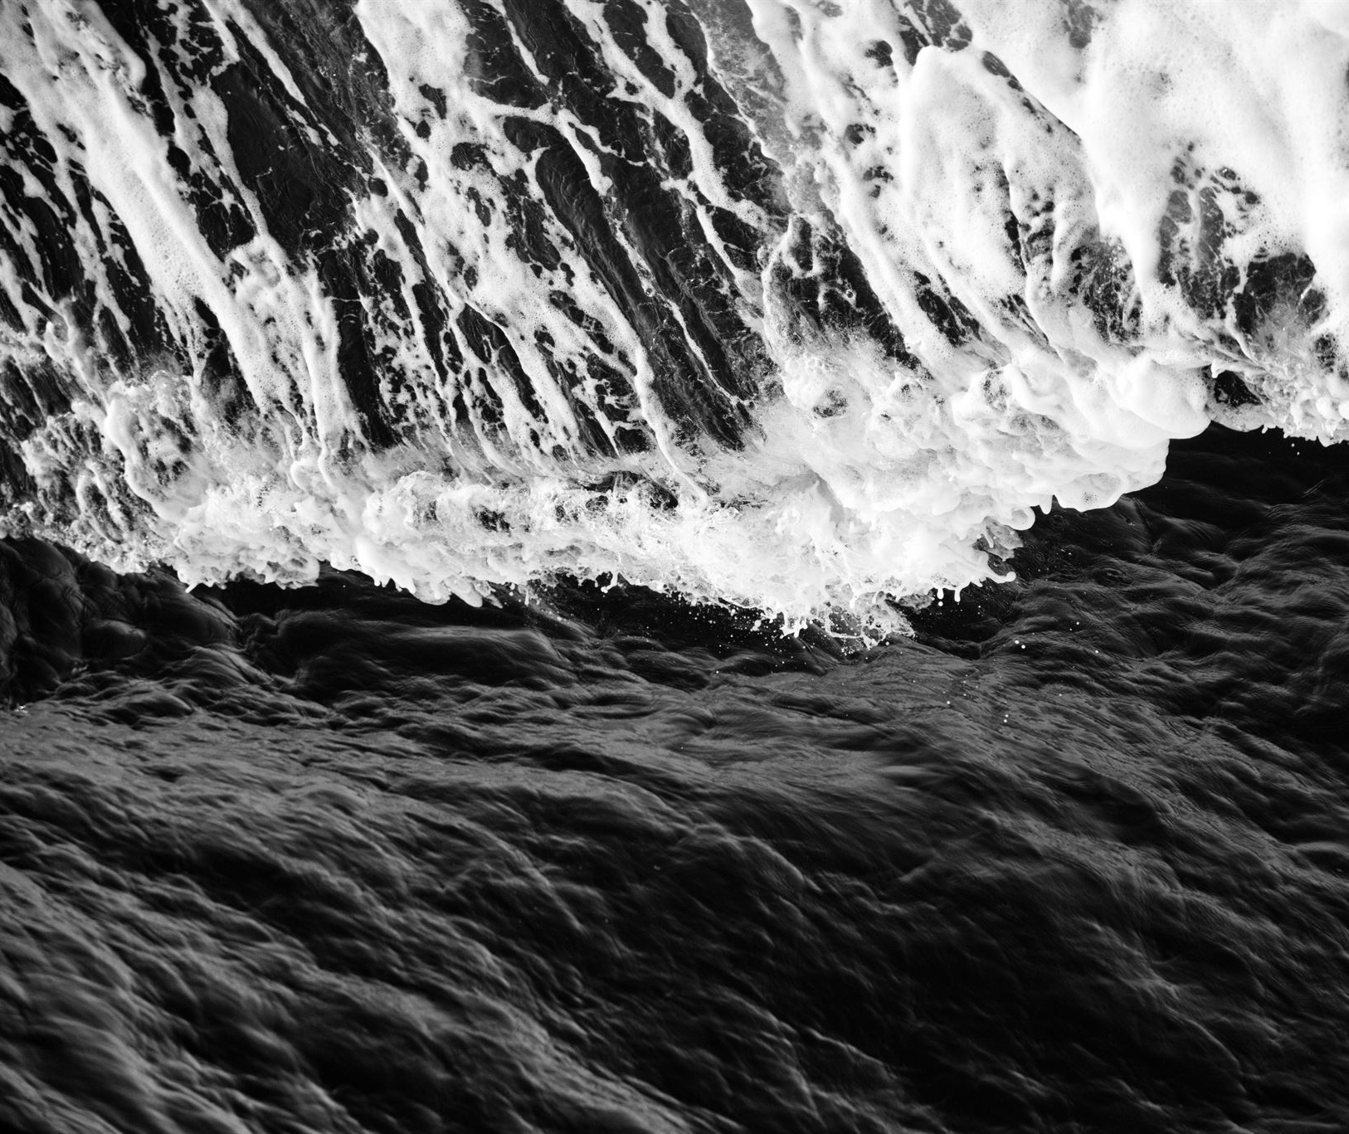
The Importance of Oceans in Our Daily Life
Oceans are a major heat reservoir and influence weather patterns, moderating temperature and making Earth habitable.
Oceans produce more than half of the oxygen we breathe and are home to countless species, many of which are yet to be discovered.
The fishing industry depends on oceans as a source of food and livelihood, making it critical for many coastal communities.
Oceans are also essential for global trade transportation, with around 80% of all trade goods transported by ships.
Notes:
Oceans are a vital part of our daily lives, with a major role to play in regulating the Earth's climate and supporting life on this planet. They provide us with food, energy, and transportation, and are also home to intricate ecosystems that are important for biodiversity. However, human activities are increasingly putting pressure on these ecosystems, with overfishing, pollution, and climate change all affecting the health of our oceans. It's important that we work to protect and conserve these important resources for future generations.

Slide 3
Agenda
Introduction
Adaptive sampling
Case studies
Remarks
Conclusion

Slide 4
Ocean Fronts
What is oceanfront?
Why is it important in the ecosystem and climate?

Slide 5
Autonomous Underwater Vehicles
What is an AUV?
What can AUV do?
Why AUV is important in ocean research?

Slide 6
Adaptive sampling
What is adaptive sampling?
Limitations associated with traditional methods such as satellite image etc.
Advantages of adaptive sampling using AUVs?

Slide 7
Challenges in oceanfront sampling
Environmental factors
Unpredictable currents and turbulence
Dynamic and complex environment
Technical challenges
Navigation and localization in underwater
Data transmission and coordination

Slide 8
Benefits of using multiple AUVs
Coordination and control strategies
Swarm intelligence and decentralized control
Pre-programmed routes vs. dynamic programming
Communication and Collaboration
Underwater communication
Real-time data sharing

Slide 9
Case studies
Different control strategies
Different communication strategies
Different targeting strategies

Slide 10
Future work
Improvements in AUV hardware and software
Enhanced communication and sensing capabilities
Machine learning for better adaptive sampling
Integrating big data sources such as AIS, satellite, buoys etc.

Slide 11
Conclusion
Oceanfronts are important for us
AUVs are flexibles to solve this problem
More AUV can help in certain ways, but its associated technical difficulty can be daunting to scale for now
AI can be a potential game changer

