Slide 1
Q & A

Slide 2
Station keeping plot

Slide 3
Cost effect

Slide 4
Why not MDP (Markov decision process)

Slide 5
Why matern kernel
Smoothness control: adapt to different types of data
Generalizations of kernels: flexible
Realistic modeling, geostatistics and spatial data modelling, reflects the physical properties of the processes
Parameter tunning
Computational efficiency

Slide 6

The ocean
The ocean covers 71% of the Earth's surface
The ocean contains 97% of the Earth's water supply
The ocean is important because it regulates the Earth's climate and weather patterns
Notes:
The ocean is a vast and mysterious place. It covers a huge percentage of our planet's surface, and contains a tremendous amount of water. It plays a critical role in regulating the Earth's climate and weather patterns. Here are some key facts about the ocean that you should know.

Slide 7
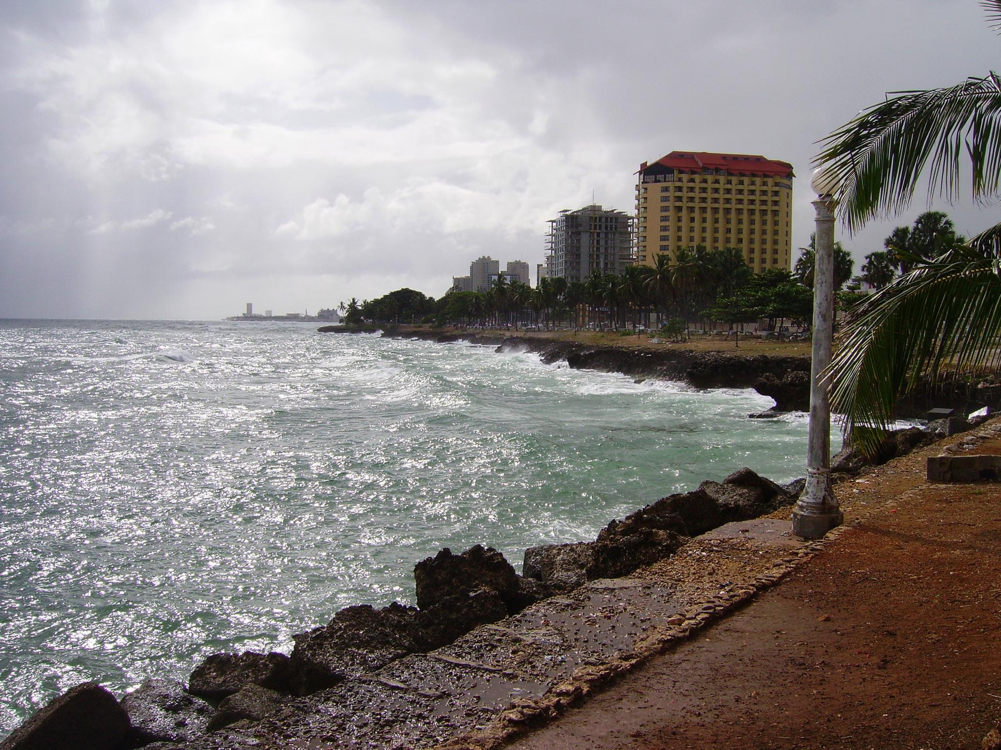
The Importance of Ocean Fronts
Ocean fronts are of critical importance to understanding weather and climate patterns.
Ocean fronts are areas where two bodies of water meet, which can often impact the local ecology.
Notes:
Ocean fronts are one of the most important features of the ocean, and are critical to understanding global weather and climate patterns. Ocean fronts occur where two bodies of water meet - often, this is where warmer and cooler water masses come into contact. This can have a major impact on local ecology, as ocean fronts can create eddies and other oceanographic features. Researchers study ocean fronts to understand how they develop and change, which is essential for many fields of study. Understanding the role of ocean fronts is critical both for predicting weather and climate patterns, as well as preserving ocean habitats.

