Slide 1
Adaptive Sampling of River Plume Fronts: Integrating Statistical Modeling and Autonomous Path Planning for Enhanced Oceanographic Exploration.
Doctoral Thesis Defense
Candidate: Yaolin Ge
Supervisors: Prof. Jo Eidsvik, Prof. Geir-Arne Fuglstad, Kanna Rajan
Date of the defense: 2024-05-08
Department of Mathematical Sciences, Faculty of Information Technology and Electrical Engineering

Slide 2
Agenda
Introduction
Research questions
Our approach
Validation and testing
Remarks
Conclusion

Slide 4
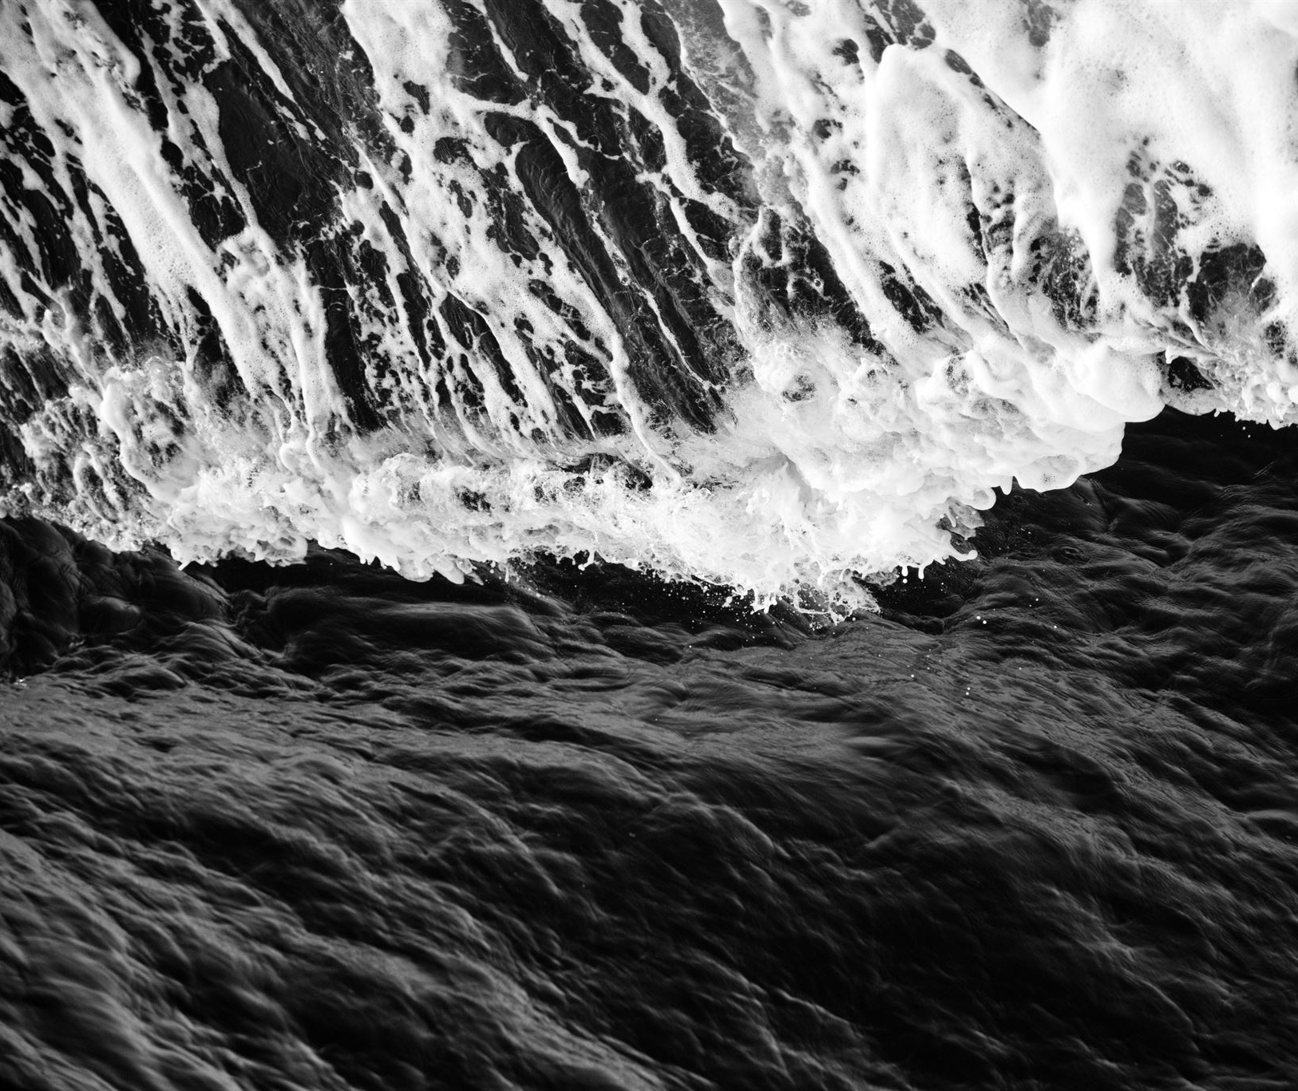
The Importance of Oceans in Our Daily Life
Oceans are a major heat reservoir and influence weather patterns, moderating temperature and making Earth habitable.
Oceans produce more than half of the oxygen we breathe and are home to countless species, many of which are yet to be discovered.
The fishing industry depends on oceans as a source of food and livelihood, making it critical for many coastal communities.
Oceans are also essential for global trade transportation, with around 80% of all trade goods transported by ships.
Notes:
Oceans are a vital part of our daily lives, with a major role to play in regulating the Earth's climate and supporting life on this planet. They provide us with food, energy, and transportation, and are also home to intricate ecosystems that are important for biodiversity. However, human activities are increasingly putting pressure on these ecosystems, with overfishing, pollution, and climate change all affecting the health of our oceans. It's important that we work to protect and conserve these important resources for future generations.

Slide 5
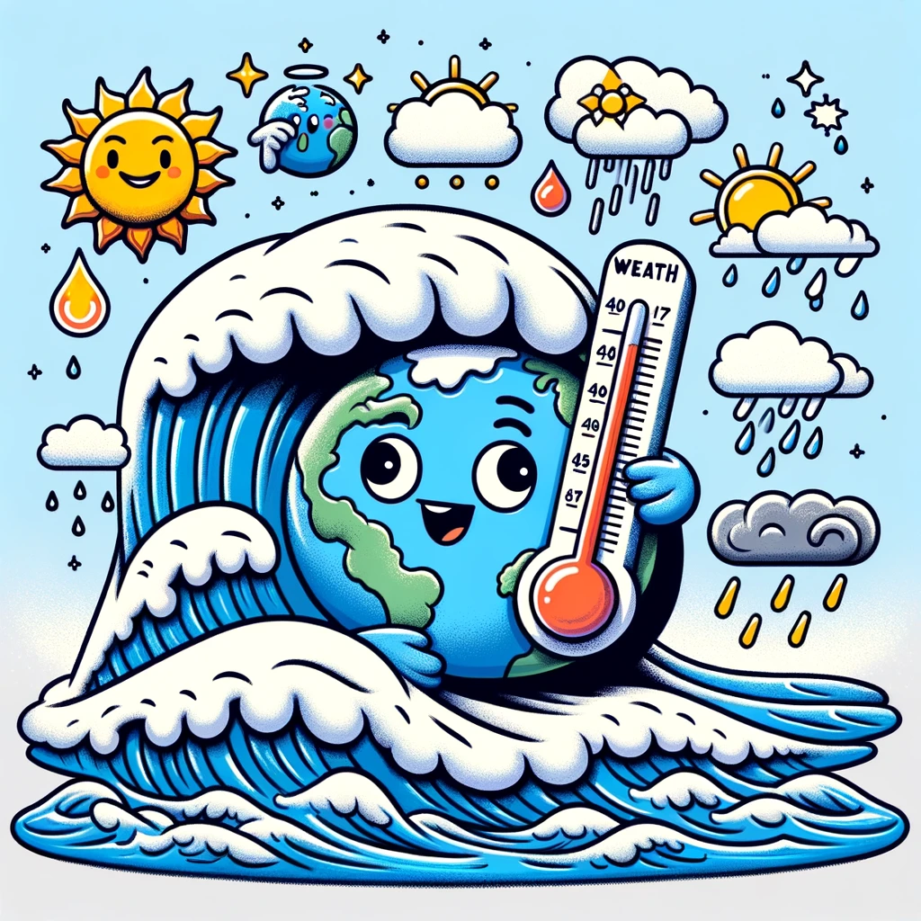
Ocean as a heat reservoir
It is a major heat reservoir, influencing weather patterns and moderating temperatures around the world (Rhein et al. 2013).

Slide 8
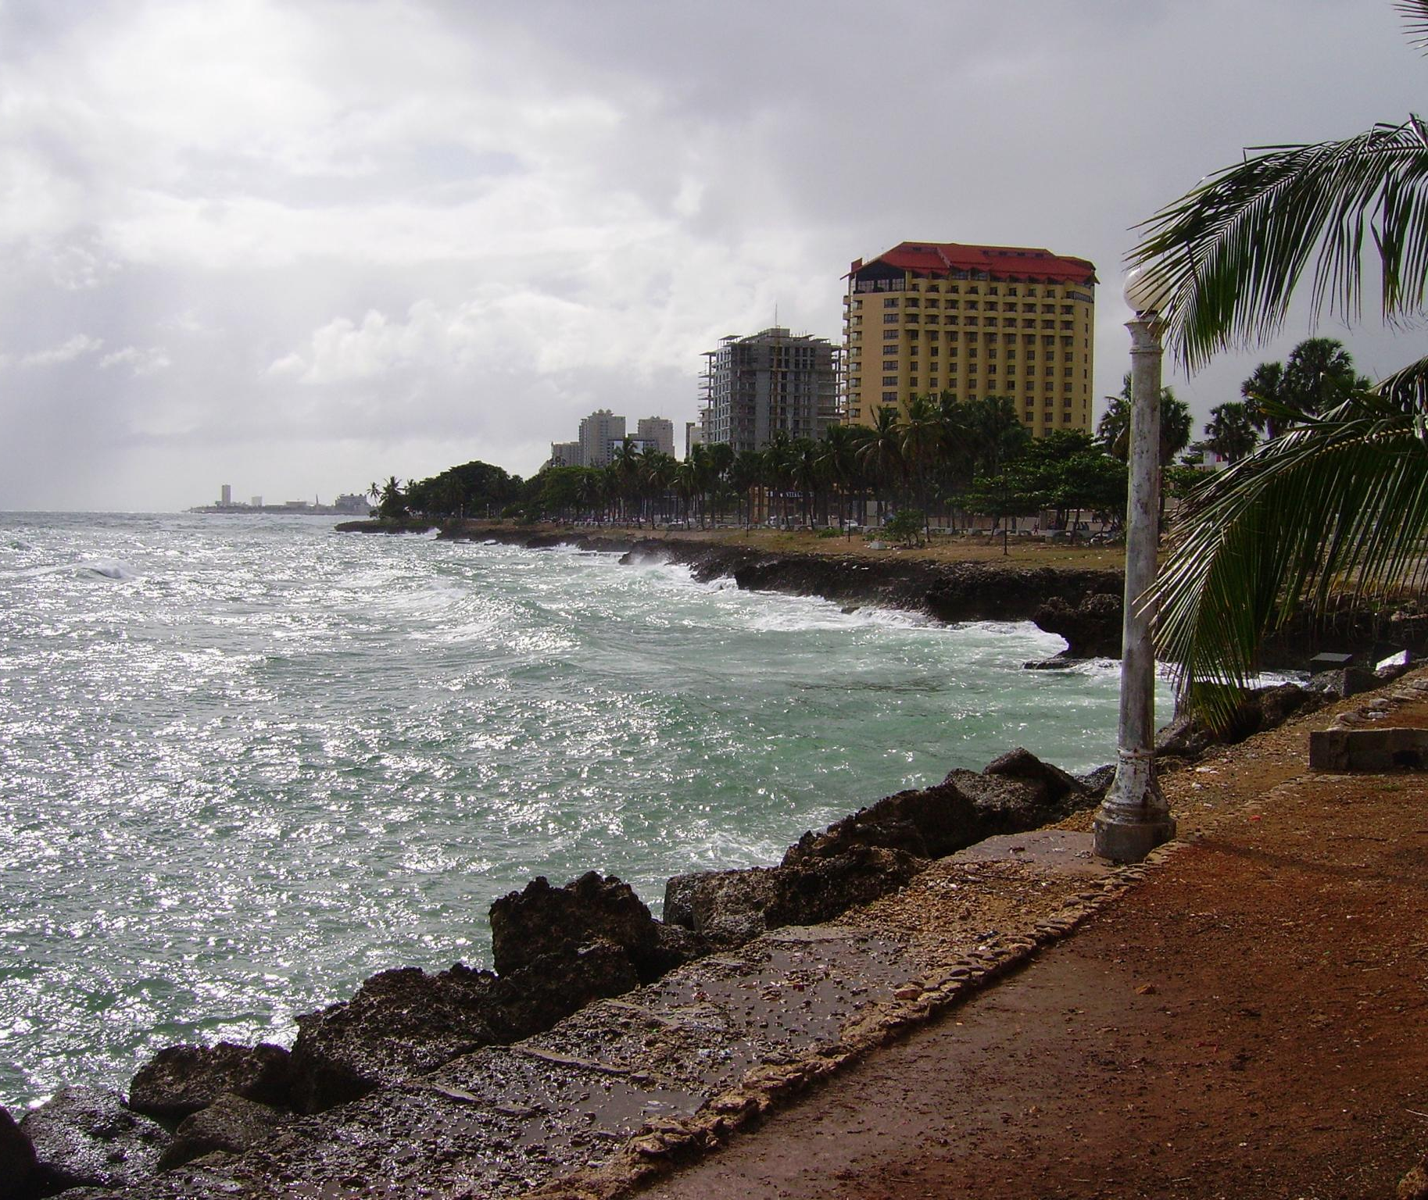
Adaptive Sampling of River Plume Fronts
River plume fronts can be studied through statistical modeling and autonomous path planning.
Adaptive sampling can enhance oceanographic exploration.
This slide shows an example of ocean fronts.
Notes:
An ocean front is the boundary between two different water masses, and typically has sharp gradients in temperature, salinity, and other properties. River plume fronts are important for many reasons, including for example, their impact on coastal ecosystems and the transport of pollutants. By using adaptive sampling and autonomous path planning, we can better study these important features of our oceans.

