Slide 1
SIMC – Physics Monte Carlo for Hall C and Hall A Dave Gaskell/John Arrington Hall A Analysis Meeting December 14, 2009
1. SIMC overview
2. Example reactions in depth
3. Neat plots
Available via CVS, see
https://hallcweb.jlab.org/wiki/index.php/Monte_Carlo

Slide 2
What is SIMC?
SIMC is the standard Hall C Monte Carlo for coincidence reactions (similar to MCEEP) → written in FORTRAN (now gfortran compatible …)
Features:
→ Optics (COSY) and “aperture checking” Monte Carlos of spectrometers
[HMS, SOS, SHMS, HRS’s, BigCal,…]
→ Includes radiative effects, multiple scattering, ionization energy loss, particle decay
→ Simple prescriptions available for FSIs, Coulomb Corrections, etc.
Reactions implemented:
Elastic and quasielastic → H(e,e’p), A(e,e’p)
Exclusive pion production
→ H(e,e’π⁺)n, A(e,e’π^{+/-}) [quasifree or coherent]
Kaon electroproduction → H(e,e’K⁺)Λ,Σ, A(e,e’K^{+/-})
H(e,e’π^{+/-})X, D(e,e’π^{+/-})X [semi-inclusive]
H(e,e’K^{+/-})X, D(e,e’K^{+/-})X [semi-inclusive]
H(e,e’ρ→π⁺π⁻)p, D(e,e’ρ→π⁺π⁻) [diffractive ρ]

Slide 3
What SIMC is NOT…
SIMC is NOT a full detector response simulation a la GEANT
SIMC does NOT simulate a large class of processes simultaneously to generate backgrounds (like Pythia for example)
SIMC is not a generic event generator → processes are generated over a limited phase space with the specific purpose of being “thrown” into a spectrometer
SIMC is not hard to modify → if you want it to do something else (different cross section model, add new spectrometer, etc.) it is pretty easy to update + I can help

Slide 4
A Brief History of SIMC
Quasielastic A(e,e’p) simulation code for SLAC
T.G. O’Neill, N.C. Makins: SLAC NE18
Modified for Hall C (SIMC-style HMS/SOS models)
R. Ent, R. Mohring, D.Dutta: E91-103, E94-139, E97-006
Inclusive event generators using HMS/SOS models
C. Bochna, J. Arrington, I. Niculescu: E89-008, E89-012, E96-003
Modified to simulate kaon electroproduction
D. Koltenuk, G. Niculescu: E91-016, E93-018
Modified to simulate pion electroproduction
D. Koltenuk, D. Gaskell: E91-003,E93-021
Combined version for QE scattering, pion, and kaon electroproduction
J. Arrington
SIMC-compatible HRS routines, 2001 release w/HRS
D. Meekins, R. Ent, M. Boswell, O. Okafor, E. Schulte E98-108
Modified to simulate semi-inclusive pion production, diffractive rho
D. Gaskell, H. Mkrtchyan, R. Ent (Meson Duality)

Slide 5
Overview
Initialization
Choose reaction, final state (if appropriate)
Disable/enable implementation of (or correction for) raster, eloss …
Event generation
Select vertex based on target size, position, raster size, beam spot size
Determine energy, angle generation that will populate 100% of the acceptance (accounting for radiation, energy loss, …)
Physics Processes
Event-by-event multiple scattering, radiative corrections, particle decay, coulomb corrections
Acceptance
Can apply geometric cuts or spectrometer model. Default spec. models include target/spec. offsets, model of magnetic elements, apertures at front, back, middle of magnets, collimators, detector active area
Event Reconstruction
Tracks are fitted in the focal plane and reconstructed to the target. Apply (average) energy loss, fast raster corrections. Calculate physics quantities for Ntuple.

Slide 6
Elastic and quasielastic ep
Initialize limits:
Set event generation limits to give full population of desired kinematics after taking into account resolution, energy loss, radiative corrections …
Generate vertex:
Generate position based on target geometry, bem width, raster. Generate beam energy.
Generate scattering kinematics
Hydrogen Elastic: Generate θ_{e}, φ_{e}
D(e,e’p): Generate θ_{e}, φ_{e,} θ_{p}, φ_{p}, p_{e} – calculate p_{m}
A(e,e’p): Generate θ_{e}, φ_{e,} θ_{p}, φ_{p}, p_{e,} p_{p} – calculate E_{m}, p_{m} → apply spectral function
Modifications to kinematics
Apply radiative corrections (generate photons)
Apply Coulomb corrections (Effective Momentum Approximation)
…….

Slide 7
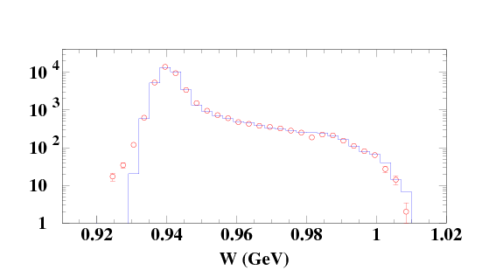
Elastic and quasielastic ep
….
Follow Particles
Apply energy loss, mult. scattering in target/detectors
Run particles through spectrometer models
Apply cross section weighting to good events
Save events to Ntuple
Calculate Normalization Factors
Luminosity
Event generation phase space
Proton elastic scattering – radiative tail

Slide 8
Pion and Kaon Electroproduction
Initialize limits:
Generate vertex:
Generate scattering kinematics:
H(e,e’π/K): Generate θ_{e}, φ_{e,} θ_{π}, φ_{π}, p_{e} – calculate p_{π}
A(e,e’π/K): Generate θ_{e}, φ_{e,} θ_{π}, φ_{π}, p_{e,} p_{m}, E_{m} → calculate p_{π}
Modifications to kinematics:
Follow particles:
Apply cross section weighting (use model for free proton in γ-N center of mass)
Simulate particle decay
1. Apply event-by-event weight equal to survival probability or
2. Decay the meson and follow the decay product
Calculate Normalization Factors:

Slide 9
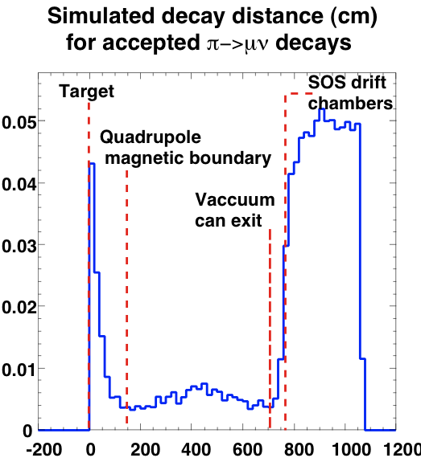
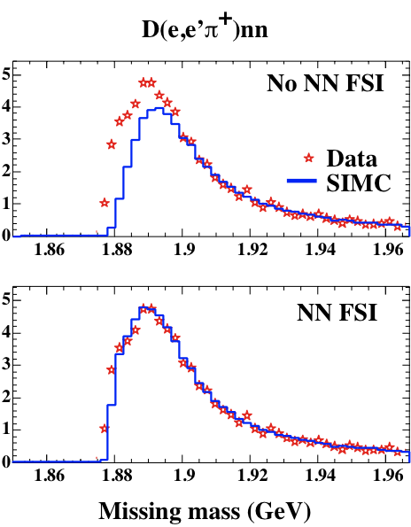
Fun plots from E91-003

Slide 10
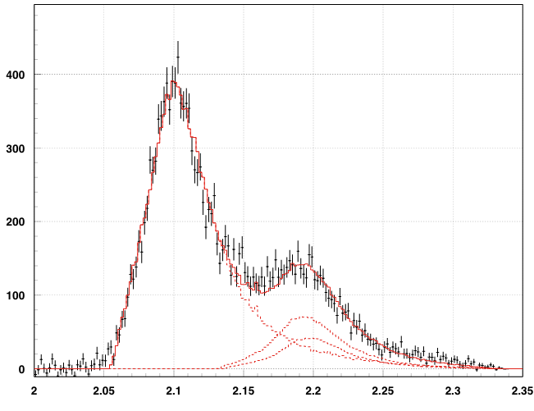
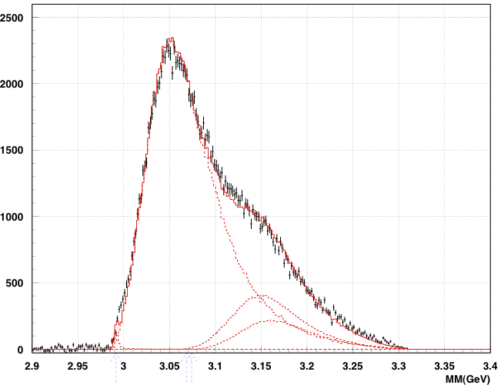
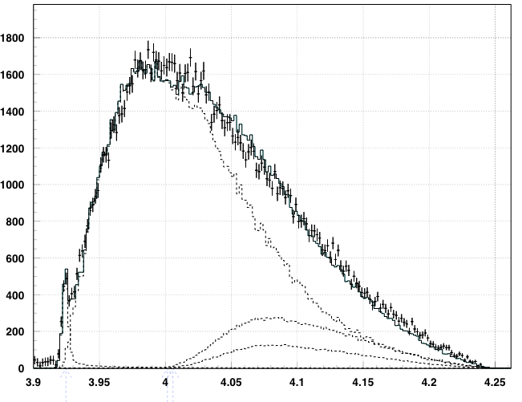
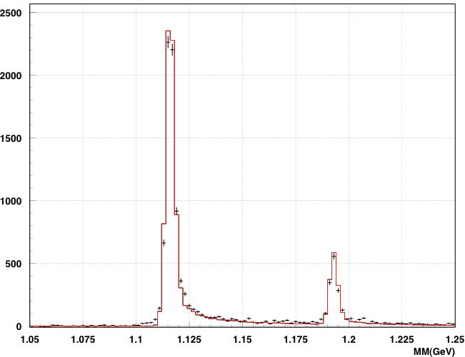
Kaon Electroproduction
Hydrogen
Deuterium
Includes:
Radiative corrections
Spectral function
FSI
Kaon decay
Only norm. of each peak fit to data
Helium-3
Helium-4

Slide 11
Spectrometer Models (HMS, SHMS, HRS ..)
Magnetic elements simulated using COSY
Real apertures
collimators, vacuum pipes
magnet apertures (front, middle, and back)
Fiducial cuts for detectors (depends on analysis, trigger)
Sequential transformations for magnetic elements, continuous drift for field free regions (important for decay)
Reconstruct track
Use smeared position at drift chamber
Reconstruct using (Hall C) track fitting algorithm
Can easily disable spectrometer, apply geometric cuts, add new spectrometer/detector (BigCal …)

Slide 12
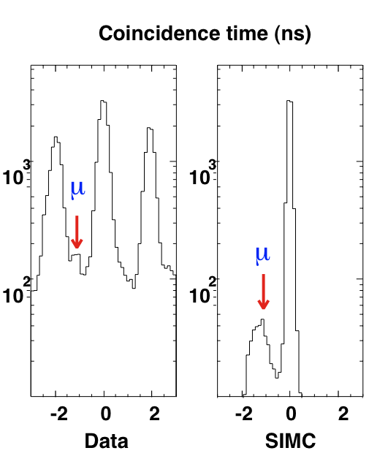
Pathlength using COSY
COSY model includes information on path length
Allows you to monitor total distance to focal plane to simulate differences in coincidence time
Example: pions decaying to muons (at 300 MeV/c) results in small difference (~1 ns) in coincidence time

Slide 13
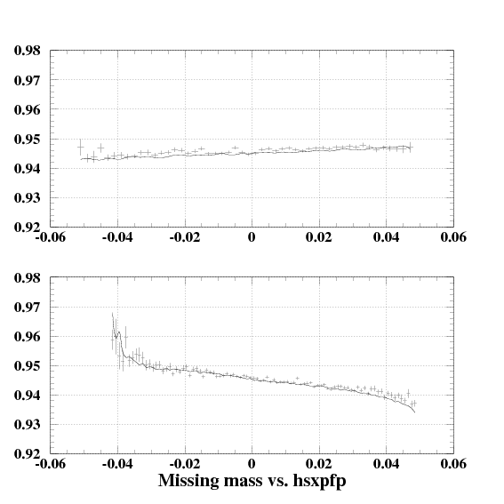
HMS Q3 P-dependent optics
Reliable COSY model of HMS allowed us (DHP) to diagnose small P-dependence in HMS optics
Missing mass showed correlation with x-prime in the focal plane (slope changing with P)
Source = small current offset in Q3 power supply
Plots show data (crosses) and simulation of offset (solid line)

Slide 14
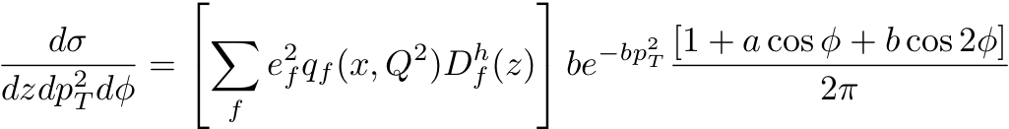
Semi-inclusive π^{+/-} Production
Event generation similar exclusive pion production, except final pion momentum must also be generated
Semi-inclusive cross section:
Spectrometers do not have complete p_{T} and φ acceptance, so cross section needs to include these degrees of freedom
→ PDFs = cteq5m
Fragmentation functions for π⁺+π⁻ from Binneweis et al (PRD 52, p. 4947, 1995)
Derive ratio of favored and unfavored fragmentation from HERMES data (my fit to data from P. Geiger PhD. thesis, Heidelberg University, 1998)
b parameter also taken from same HERMES analysis → 4.66 GeV⁻², same for π⁺ and π⁻
Analysis from Hall C E00-108 results in b=4.0 GeV⁻²
a and b parameters initially set to zero (i.e., no contribution from interference terms)

Slide 15
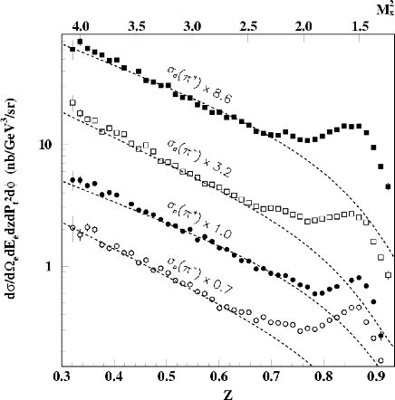
SIMC model vs. data
Cross sections from Hall C experiment E00-108
“Meson Duality”
Below z=0.7, we see good agreement with our simple model
At z>0.7 contributions from the Δ resonance become significant
Note that at larger x (Q²) we see larger differences – this may be from “simple” inclusive model

Slide 16
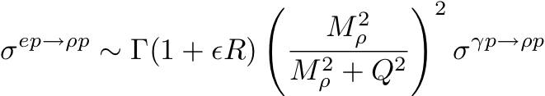
Diffractive ρ production
Important background for semi-inclusive process:
e+p → e’+ρ → e’ + π⁺ + π⁻
Event generation for diffractive ρ production handled slightly differently
→ Electron side handled as usual
→ ρ generated uniformly in cosθ_{cm}
This makes the simulation of diffractive ρ pretty slow
(compared to other processes)
Model for diffractive ρ production based on modifications to PYTHIA implemented to improved agreement with HERMES data
[P. Liebing, PhD thesis, University of Hamburg, 2004]
Model for H(e,e’ρ)p
= virtual photon flux
R=σ_{L}/σ_{T}
σ^{γp→ρp} = real photoproduction cross section

Slide 17
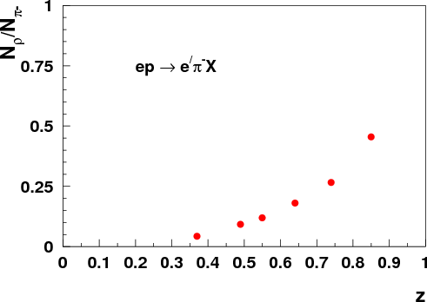
ρ Background Estimates
Studies done for Meson Duality
x=0.32, Q² = 2.30 GeV²
z dependence

Slide 18
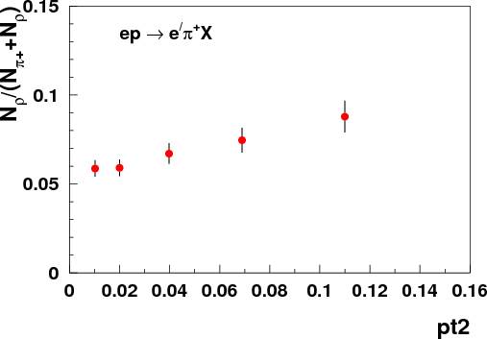
ρ Background Estimates
Studies done for Meson Duality
x=0.32, Q² = 2.30 GeV²
z dependence
p_{T} dependence

Slide 19
Parting thoughts
Mostly, I have focused on processes included in CVS version of SIMC
There are other modified versions floating around to simulate
H(e,e’p)π⁰, H(e,e’p)η → this is included in CVS version, but Mark Jones and Mark Dalton have improved versions
H(e,e’p)ω → Garth Huber and DG working on analysis of data taken parasitically during Fpi-2
SIMC can also handle UVa polarized target magnet (G. Warren, M. Jones …) → these mods. have been used for GEn, RSS, are being used (somewhat) for ongoing SANE analysis
HRS models likely slightly out of date → JRA working with Coulomb Sum Rule collaboration to update

