Slide 1
UVa11172
EE3 Hsu Yaoyuan 410487027

Slide 2
Relational Operator
Some operators checks about the relationship between two values and these operators are called relational operators.
Given two numerical values your job is just to find out the relationship between them that is
> ➔ First one is greater than the second < ➔ First one is less than the second or = ➔ First and second one is equal

Slide 3
Sample IO
Input
Output
First line of the input le is an integer t (t < 15) which denotes how many sets of inputs are there.
Each of the next t lines contain two integers a and b (|a|, |b| < 1000000001).
Ex. 3 10 20 20 10 10 10
For each line of input produce one line of output. This line contains any one of the relational operators
‘>’, ‘<‘ or ‘=‘, which indicates the relation that is appropriate for the given two numbers.
Ex. < > =

Slide 4
Program Structure
Start Point
Line Input
scanf(“%d”, &a)
Loop Structure
$1_{st}$ greater than $2_{nd}$
1_𝑠𝑡 greater than 2_𝑛𝑑
$1_{st}$ less than $2_{nd}$
1_𝑠𝑡 less than 2_𝑛𝑑
int main()
$1_{st}$ equal to $2_{nd}$
1_𝑠𝑡 equal to 2_𝑛𝑑

Slide 5
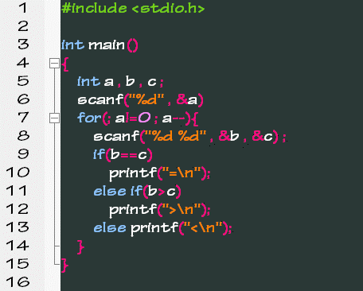
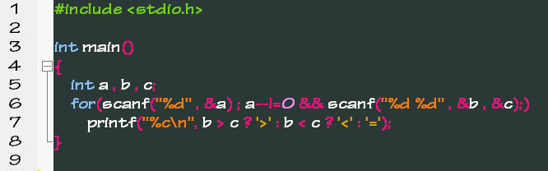
Source Code

